Slide 1
Architectural Support for High Speed Protection of Memory Integrity and Confidentiality in Multiprocessor Systems
Weidong Shi
Hsien-Hsin (Sean) Lee
Mrinmoy Ghosh
Chenghuai Lu
Georgia Institute of Technology
Atlanta, GA 30332

Slide 2
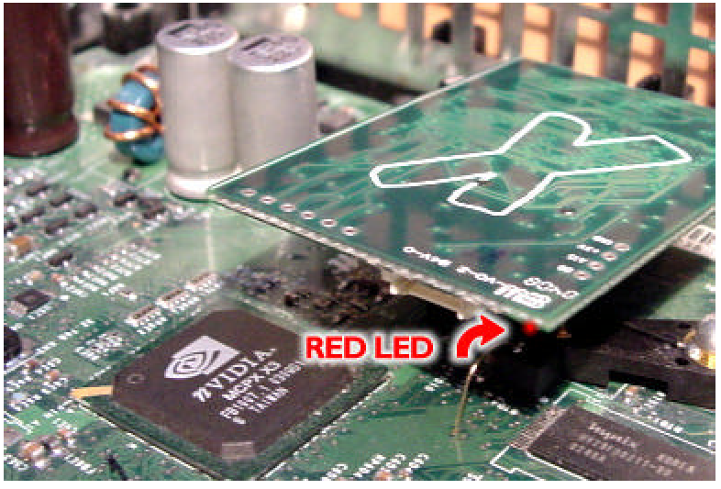
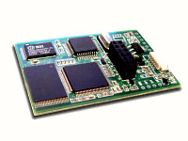
Types of Security Attacks
Software-based attacks
  Software reverse engineering, de-assembly
  Software patching
Hardware-based physical attacks
  Trace system from system bus, peripheral bus
  Differential power/timing analysis
  Build fake devices, device spoof (MOD chip)
  Modify RAM
  Replay bus signals, fake bus signal injection
  Trigger fake interrupts
XBOX with MOD-chip installed. MOD-chip is a low cost bus snoop and spoof device widely used to break XBOX security.

Slide 3
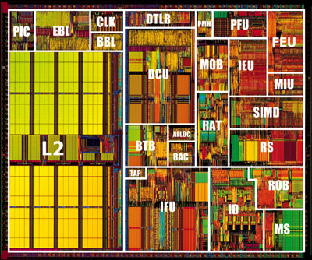
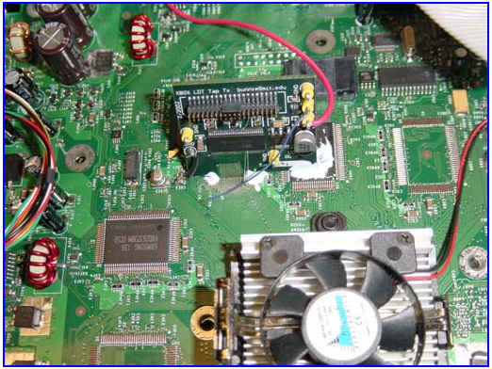
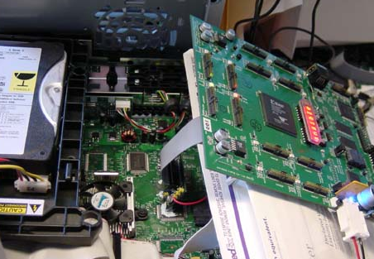
Cracking the XBOX
Nbridge + GPU
FPGA based
Bus Tracer
Hyper-Transport
P-III
South Bridge
Find out the key
Secret Key
BIOS Flash
(some BIOS codes
are encrypted)
socket over HT Bus soldered by hackers
MOD Chip
(PCB with μ-controller
and Flash memory)
BIOS hijacking
Low cost FPGA based bus snooping device

Slide 4
Motivation
Yet to be solved Issues of prior security measures
  Uni-processor based security model
  Protected memory cannot be shared
  Large space and performance overhead in security support
  Some compromise some security for performance improvement
Protect integrity and confidentiality in a Shared-memory Multiprocessor platform
Our Work

Slide 5
Agenda
Uni-processor Security Architecture
Platform-oriented Security Architecture
Architectural Support for Shared Memory Integrity and Confidentiality
Evaluation
Conclusions

Slide 6
Insecure Uni-Processor Architecture
Processor Core
Caches
Secure Processor
North Bridge
(Mem Controller)
RAM
South Bridge
Ethernet
Mouse
Keyboard
Disk

Slide 7
Secure Uni-Processor Architecture
Processor Core
Caches
Trusted Domain
Secure Processor
UnTrusted Domain
North Bridge
(Mem Controller)
RAM
South Bridge
Ethernet
Mouse
Keyboard
Disk

Slide 8
Secure Uni-Processor Architecture
Processor Core
Root
Signature
Caches
MAC hash tree
Trusted Domain
Crypto Engine
Secure Processor
UnTrusted Domain
North Bridge
(Mem Controller)
RAM
(encrypted data
& MAC code)
South Bridge
Ethernet
Mouse
Keyboard
Disk
Not directly applicable to a Shared-memory Multiprocessor system

Slide 9
Basics: Integrity Check (MAC Authentication)
Sender
Receiver
N-bit Plaintext
N-bit Plaintext
Secret Key
Secret Key
Hash/Encryption
Hash/Encryption
M bit MAC
M bit MAC
M bit MAC
≠ ?
Exception
Again, Sender and Receiver share the same secret key
Detect data tampering using Message Authentication Code (or MAC)
Any attempt for an adversary to modify data or forge a valid authentication code is guaranteed to be detected

Slide 10
Platform-oriented Security Architecture
Processor 1 (PE 1)
Processor n (PE n)
Processor Core
Processor Core
Cache-to-Cache
send encrypted data first then followed by encrypted MAC
receiver decrypts data and verifies integrity
Caches
Caches
Crypto Engine
Crypto Engine
encrypted data
encrypted MAC
Cache-to-Memory
send encrypted data and MAC to Nbridge
Nbridge decrypts the data, verifies its integrity, updates MAC tree, and store encrypted data to the RAM
Need to be
protected
RAM
Crypto Engine
MAC Tree
Cache
North Bridge (PE 0)

Slide 11
Protection on the RAM ⎯ MAC Tree
Root MAC
MAC
MAC
32B
RAM Block
32B
RAM Block
32B
RAM Block
M-ary MAC (message authentication code) tree to protect physical memory integrity dynamically (e.g. Replay attack).
The root MAC is a signature of the protected memory space.
Root MAC is kept inside the North Bridge.
Frequently accessed MAC tree nodes are cached inside NBridge

Slide 12
Platform-oriented Security Architecture
Processor 1 (PE 1)
Processor n (PE n)
Processor Core
Processor Core
Cache-to-Cache
send encrypted data first then followed by encrypted MAC
receiver decrypts data and verifies integrity
Caches
Caches
Crypto Engine
Crypto Engine
encrypted data
encrypted MAC
Cache-to-Memory
send encrypted data and MAC to Nbridge
Nbridge decrypts the data, verifies its integrity, updates MAC tree, and store encrypted data to the RAM
RAM
Crypto Engine
Memory-to-Cache
Nbrdige reads encrypted data and MAC from the RAM
Nbridge decrypts the data, verifies its MAC, re-encrypts the data and put encrypted data and MAC on the shared bus
receiver decrypts data and verifies integrity
MAC Tree
Cache
North Bridge (PE 0)

Slide 13

Platform-oriented Security Architecture
Physical memory (RAM) authentication ⎯ MAC Tree
Protected data sharing ⎯ Encryption using
  Bus sequence number
  Process key
Authentication speculative execution (ASE)

Slide 14
Basics: Counter Mode Encryption
Sender
Receiver
Init. Counter + 0
Init. Counter + 0
Secret Key
Secret Key
Block Cipher
or Cryptographic Hash
Block Cipher
or Cryptographic Hash
Pseudo-random pad
Pseudo-random pad
Plaintext A
XOR
XOR
Ciphertext A
Plaintext A
To send a data sequence securely
Sender and receiver share a secret key, and an initial counter value.
A pseudo-random pad is generated deterministically
Counter value does not need to be a secret.

Slide 15
Basics: Counter Mode Encryption
Sender
Receiver
Init. Counter + 1
Init. Counter + 1
Secret Key
Secret Key
Block Cipher
or Cryptographic Hash
Block Cipher
or Cryptographic Hash
Pseudo-random pad
Pseudo-random pad
Plaintext B
XOR
XOR
Ciphertext B
Plaintext B
Counter values increment coherently for both parties in a predetermined sequence

Slide 16
How to Encrypt each Transaction?
OTP generation
  Bus sequence number
  Process Key
Bus sequence number
  a 64-bit secret initialized after the system is booted
  shared by all the parties connected to the shared bus.
  incremented after each transaction
All PEs on the shared bus snoop each bus transaction
OTP can be pre-computed based on an approximate range of bus sequence numbers
256-bit Process Key
Bus sequence number
Cryptographic Hash
One-Time-Pad (OTP)
Cache Line
Encrypted Data

Slide 17
Generating
Process Key & Bus Sequence Number
Burned inside
each PE
By secure
kernel
Secret Constant
Process unique ID
Secret Constant
Session Key
Encryption (AES)
Session Key
Encryption (AES)
Initiated
every time
It boots
Process Key
Initial Bus
Sequence
Number
Bus Sequence Number works similar to counter mode encryption

Slide 18
Session Key Generation (Distribution)
Processor
PE0
Processor
PE1
Processor
PE n-1
broadcast
random num
receive
random num
from others
Secure Memory
Controller PE n
Random Number PE0
Random Number PE1
…
Random Number PEn
Secret Hash Key
Hash (SHA256)
Burned inside
each PE, same
for each PE
During System Boot
128 bit Session Key

Slide 19
Protected Data Sharing Operations
Processor A
Processor B
256-bit Process Key
Bus sequence number
256-bit Process Key
Bus sequence number
Cryptographic Hash
Cryptographic Hash
OTP (one-time-pad)
Data Block
Encrypted Data
OTP (one-time-pad)
Encrypted Data
Data Block

Slide 20
OTP Pre-computing
+1,+2, +3, …
Process Key
Latest
Bus sequence number
Data to be transmitted
OTP queue
OTP Generation
OTP(0x1234abcd0000)
OTP(0x1234abcd0001)
OTP(0x1234abcd0002)
Bus Arbitration Logic
…
OTP(0x1234abcd001e)
OTP(0x1234abcd001e)
request for bus ownership
OTP(0x1234abcd001f)
Shared Bus
Ownership granted,
current bus sequence number = 0x1234abcd001e
OTP Generation is on the critical path
We can pre-compute OTP needed in the neighborhood

Slide 21
OTP Pre-Computing
Processor A
Processor B
256-bit Process Key
Bus sequence number
256-bit Process Key
Bus sequence number
Cryptographic Hash
Cryptographic Hash
OTP (one-time-pad)
Data Block
Encrypted Data
OTP (one-time-pad)
Encrypted Data
Data Block

Slide 22
Split Transaction of Data and MAC
Sequence Authentication Buffer
ID
MAC
Valid
Verified
OTP
Processor A
Processor B
Processor C
Data(id, seq), Data(id+1, seq+1), MAC(id-3, seq-3), Data(id+2, seq+2), MAC(id, seq), …
Shared Bus

Slide 23
Authentication Speculative Execution (ASE)
Performance Side:
  allow execution to be continued using un-verified data
  allow execution to be continued using results derived from un-verified data
Security Side:
  under counter-mode, instructions and data may be altered by hackers. Authentication has to be performed in a timely fashion to prevent attacks that flip individual bits of encrypted data/instructions.
  memory state should not be altered using results of un-verified data
  instruction fetch should not be issued to the memory if determined by control flow using un-verified data

Slide 24

ASE
SAB Tag = 2
0: r3 = (addr1)
1: r4 = r3*const1
2: r5 = r4+const2
3: r6 = (addr2)
4: if (r5<r6) {
5: } else {
6: r7 = r6 + r1}
7: (addr3) = r7
r3
Load r3
SAB Tag =2
r4
SAB Tag =3
Load r6
r6
SAB Tag =2
r5
r5<r6
MAC
Verify?
N
Y
Fetched
Verified
Wait if Icache miss
Fetched
Verified
SAB Tag =1
r6
Fetched
Verified
r1
r1
SAB Tag =1
Sequential Authentication Buffer
r7
Wait until all the data
sources are verified
Save r7

Slide 25
Evaluation Methodology
RSIM MP simulator
  Benchmarks: Splash, Splash2
Modified Rsim simulator to support bus snoop based cache coherence
Added an accurate DRAM model
Added shared memory support
Implemented a North Bridge simulator with MAC tree authentication.
Extended processor model to support performance simulation of proposed protection including speculative authentication.

Slide 26


Non-Speculative (AIO) vs. ASE
ASE outperforms in-order execution by 80% for 2P- and 4P- processor systems.

Slide 27

Data Confidentiality
No cache
8KB seq# cache
32KB seq# cache
40 to 55% Performance loss compared to no security support
More cache-to-cache transactions, the faster execution due to OTP pre-computation
With a sequence number cache, memory-to-cache operations can be accelerated by ~30%

Slide 28
Conclusions
Proposed security scheme to protect confidentiality and integrity for shared memory in snoop bus multiprocessor system.
Proposed a number of techniques to minimize the overhead caused by security protection including,
  Physical memory (RAM) authentication
  Shared bus sequence number based encryption
  Split transmission of data and MAC
  Authentication Speculative Execution without violating rule of authentication safe
Lightweight secure processor design with novel security design features (offload to North Bridge).

Slide 29


Questions & Answers & Entertaining
That’s All Folks !

