Slide 1
A Low-Cost Memory Remapping Scheme for Address Bus Protection
Lan Gao*, Jun Yang§, Marek Chrobak*,
Youtao Zhang§, San Nguyen*, Hsien-Hsin S. Lee¶
*University of California, Riverside
§University of Pittsburgh
¶Georgia Institute of Technology

Slide 2

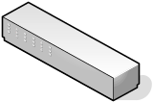
Security Breaches
--- from another way around
App₁
App₂
App_{n}
Steal Secret
Alter Execution

Slide 3
Outline
Background & Motivation
  Secure Processor Model
  Address Information Leakage
Previous Address Bus Protection Solutions
  The HIDE Scheme
  The Shuffle Scheme
Our Low-Cost Address Permutation Scheme
Performance Evaluation
Conclusion

Slide 4
Secure Processor Model
Processor Chip
Security Boundary
Bus
Off-Chip Memory
[D. Lie et al. ASPLOS 2000, G. Edward Suh et al. MICRO 36, J. Yang et al. MICRO 36]

Slide 5
Address Information Leakage
[X. Zhuang, ASPLOS 2004]
a
a
b
b
c
c
d
Address Sequence | abc abc abc … | abcd abd abcd abd …
CFG Hint
…
Loop
Conditional Branch

Slide 6






Oblivious Memory Access
The idea: [Oded Goldreich et al.]
  Replace each memory access by a sequence of redundant accesses
  Satisfactory from a theoretical perspective
Overhead:
 | “naive” | “square root” | “hierarchical”
Memory
Runtime

Slide 7
The HIDE Cache
The Idea: break the correlation between repeated addresses [Xiaotong Zhuang et al. ASPLOS 2004]
  Permute the address space at suitable intervals
  Permute blocks within a “chunk”
How: Lock and Permute
  Lock a block in the cache
    A new read from memory
    A dirty block since last permutation
  Permute a chunk when replacing a locked block

Slide 8
HIDE Cache: An Example
2 Way
Chunk 0
Chunk 1
Set 0
0
6
4
2
7
0
1
3
4
0
7
Most Recently Accessed
6
8
10
12
14
Set 1
1
4
6
3
5
2
3
1
5
2
5
7
9
11
13
15
CPU Sequence: Read 0, 1, 2, 3, 8, 0, Write 1, 3, Read 9
0
0
0
2
0
2
2
8
50% brought on-chip when C0 is permuted
1
1
1
3
1
3
Read 0 Lock 0
Read 1 Lock 1
Read 2 Lock 2
Read 3 Lock 3
Read 8 Perm C0 Lock 8
8
0
8
0
8
0
8
0
Block 1 relocated twice before it’s replaced
1
3
3
1
1
3
3
9
Read 0 Lock 0
Write 1 Lock 1
Write 3 Lock 3
Read 9 Perm C0 Lock 9

Slide 9
Increased Memory Accesses
2.5
perm
true
2.0
1.5
Normalized Memory Traffic
1.0
0.5
0.0
4K
8K
16K
32K
64K
Chunk Size (Bytes)
Breakdown of memory traffic for different chunk sizes

Slide 10
Increased Memory Accesses
18%
17%
14
12
10
8
6
Percentage of Total
4
2
65%
0
0
8
16
24
32
40
48
56
64
72
80
88
96
104
112
120
128
Number of Blocks
Histogram of pages with 0-128 blocks accessed between permutations

Slide 11
Redundant Permutations
33.63
10
9
8
7
6
5
Percentage of Total
4
3
2
1
0
0.001
0.01
ammp
art
bzip2
equake
gcc
gzip
mcf
mesa
parser
vortex
vpr
AVG
Write Lock Induced Permutations

Slide 12
The Shuffle Buffer
The Idea: dynamic control flow obfuscation [X. Zhuang et al., CASES 2004]
  Relocate a block if they appeared on the bus once
How: Random Swap
  Any newly read block is inserted into a shuffle buffer
  A buffered block is written back to the address of the newly read block
  Only read/write access pairs are observed on the address bus

Slide 13
Shuffle Buffer: An Example
Accesses
Shuffle Buffer
Memory
Page 0
Page 1
Start
0
1
2
3
4
5
6
7
8
9
15
0,1,2,3
0
1
2
3
4
5
6
7
8
9
15
8
0
1
2
3
4
5
6
7
8
9
15
1,3
0
1
8
3
4
5
6
7
2
9
15
9
0
1
8
3
4
5
6
7
2
9
15
Finish
0
9
8
3
4
5
6
7
2
1
15

Slide 14
Increased Page Faults
450000
base
Shuffle
400000
350000
300000
250000
200000
Number of Page Faults
150000
100000
50000
1658
0
50%
55%
60%
65%
70%
75%
80%
85%
90%
95%
100%
Resident Set Size (in % of Memory Footprint)
Page Fault Curve for gcc

Slide 15
Outline
Background & Motivation
  Secure Processor Model
  Address Information Leakage
Previous Address Bus Protection Solutions
  The HIDE Scheme
  The Shuffle Scheme
Our Low-Cost Address Permutation Scheme
Performance Evaluation
Conclusion

Slide 16
Our Scheme
Goals:
  Avoid wasteful memory traffic
    Eliminate wasteful permutations
    Avoid wasteful reads/writes in each permutation
  Preserve locality and keep the page fault rate low
How: RR Block Permutation
  Permute only on-chip blocks of the same chunk
  Permute only when an RR (Recently Read) block is to be replaced

Slide 17
RR Block Permutation Overview
Chunk 1
Remapping Function
Chunk 1

Slide 18
RR Block Permutation: An Example
(1)
(2)
(3)
(4)
(5)
(6)
Events | Initially
Cache
Mem | m[a₁]=x m[a₂]=y m[a₃]=z
load x,y,z from memory
read miss replace x
read miss replace y
permutation
write hit
x
x
x
z
y
z
y
z
y
z
y
z
y
m[b₁]=x
m[b₂]=y
m[b₃]=z
m[b₁]=x
m[b₂]=y
m[b₃]=z
Only x is written back
Only y is written back

Slide 19
Comparison of Number of Permutations
100
90
80
70
60
Percentage over HIDE Permutations
50
40
30
20
10
0
ammp
art
bzip2
equake
gcc
gzip
mcf
mesa
parser
vortex
vpr
AVG
Total number of permutations in percentage of the HIDE permutation number

Slide 20
The Search Algorithm
--- Permute Sufficient Number of Blocks
Replace block A
C
–
#
of accessed blocks in page P_{k}
in Page P_{k}
Σ
k
C
i
–
#
of accessed blocks in sector
YES
YES
Read
(
128
-
Σ
C
)
C
k
<
128
Σ
C
i
<
128
i
blocks on-chip
NO
NO
Search Page P_{k}’s neighbor
until 128 blocks are found
Permute the 128
selected blocks

Slide 21
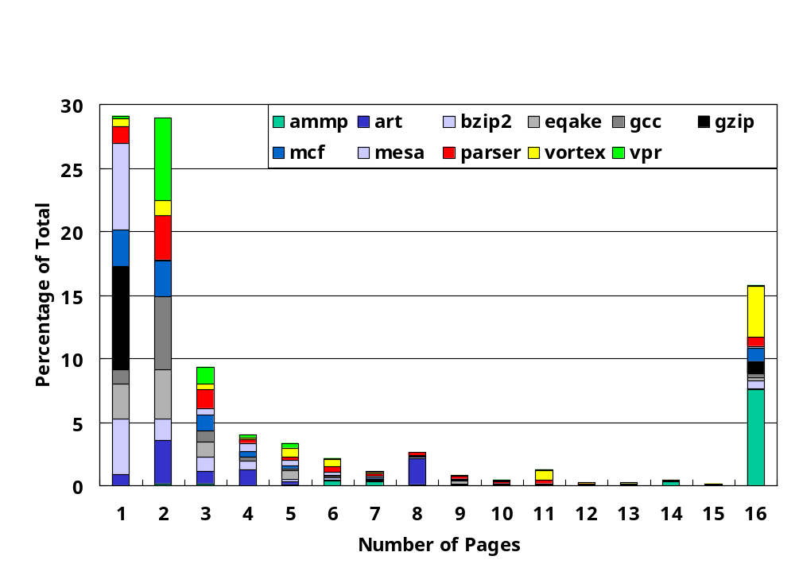
How Many Pages to be Searched?
Average number of pages that supply sufficient on-chip blocks per permutation

Slide 22
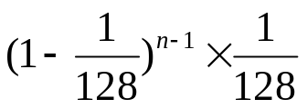
Security Strength
Between two permutations, all addresses on the bus are different
The easiest case: A block being mapped to the n^{th} writeback ->
It becomes more difficult to make a correct guess with these uncertainties:
  No clear indication when a permutation happens
  No fixed set of on-chip blocks that participate in a permutation

Slide 23
The Permutation Unit
Cache
Read
Eviction
RR
Yes
Relocate Engine
No
Address
2
Generation
Permutation
Unit
Unit
1
3
Chunk Info Table Cache
bit vectors
BAT
TLB
Memory

Slide 24
Outline
Background & Motivation
  Secure Processor Model
  Address Information Leakage
Previous Address Bus Protection Solutions
  The HIDE Scheme
  The Shuffle Scheme
Our Low-Cost Address Permutation Scheme
Performance Evaluation
Conclusion

Slide 25
Experiment Environment
Tools
  Simplescalar Toolset 3.0
  SPEC2K benchmarks
Configuration
  Cache
    Separate L1 I- and D-cache: 8K, 32B line
    Integrated L2 Cache: 1M, 32B line
    Chunk Size: 8K, 16K, 32K, 64K
  Other Settings
    Page Settings: 4KB, perfect LRU repl policy
    Perfect auxiliary on-chip storage for all schemes

Slide 26
Memory Traffic Comparison
68.85
35
Shuffle
chunk-16
chunk-8
chunk-4
chunk-2
HIDE
30
25
20
Normalized Memory Traffic
15
10
5
0
ammp
art
bzip2
equake
gcc
gzip
mcf
mesa
parser
vortex
vpr
AVG

Slide 27
Page Faults Comparison
3500
HIDE
chunk-16
chunk-8
3000
chunk-4
chunk-2
Shuffle
2500
2000
Normalized Page Fault Increase
1500
1000
500
0
50%
55%
60%
65%
70%
75%
80%
85%
90%
95%
100%
Resident Set Size

Slide 28
Conclusion
Proposed an efficient address permutation scheme to combat the information leakage on the address bus
Tackled two main problems of the previous schemes:
  The excessive memory traffic in the HIDE scheme
  The increased page faults in the Shuffle scheme
Preliminary experiments:
  Reduce the memory traffic in HIDE from 12X to 1.88X
  Keep the page fault rate as low as the base settings

Slide 29


Questions ?

