Slide 1
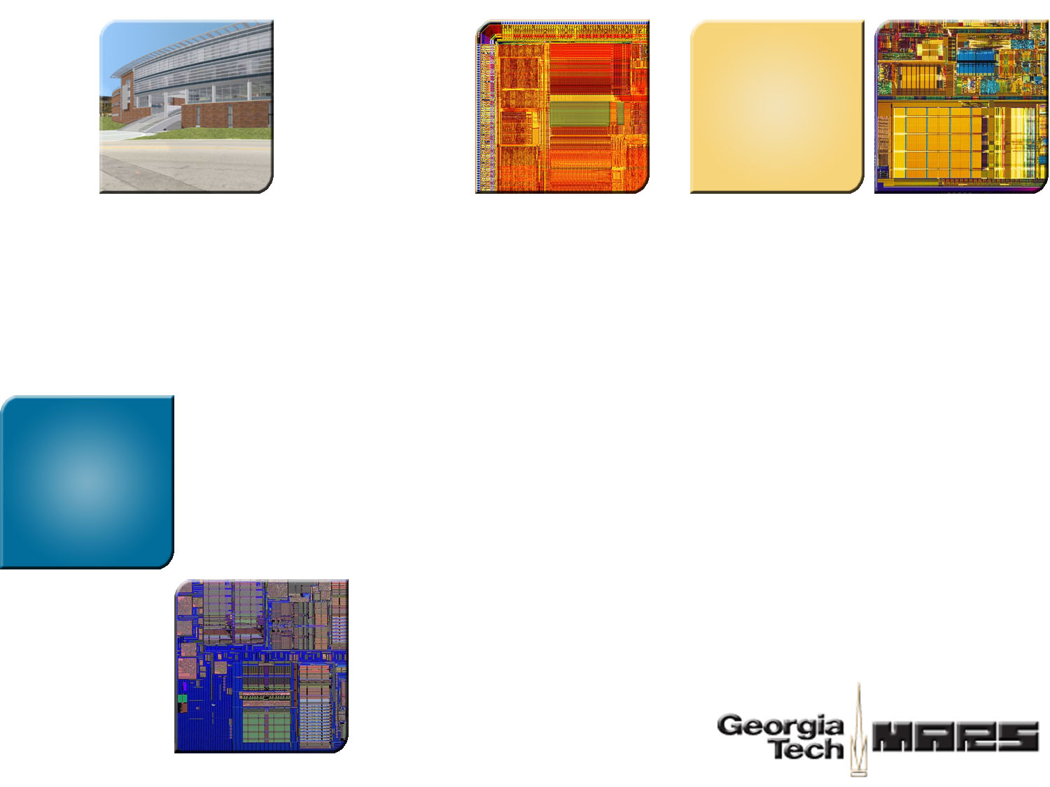
Enabling Thread Level Speculation via A Transactional Memory System
Helper Transactions
Richard M. Yoo Georgia Tech
Hsien-Hsin Sean Lee Georgia Tech
In Workshop on Parallel Execution of Sequential Programs on Multi-core (PESPMA-08)

Slide 2

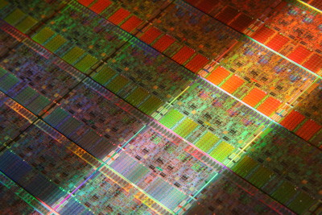


Exploiting Multi-Core Performance
Thread Level Speculation (TLS)
  Extract new threads from single-threaded applications
Transactional Memory (TM)
  Help the existing threads perform better
Where are ILP
Techniques ?

Slide 3

TLS versus TM
TLS
TM
Task
Spawning
Result
Buffering
Contention
Management
Context
Passing
Dependency
Violation
Detection
Replay
Sequential
Ordering
Checkpointing
Transaction
Scheduling
TLS and TM share multiple hardware components

Slide 4

Helper Transactions
Goal: Enable TLS with a TM-ready system
Support “out-of-order procedure fall-thru speculation” on TM
Amortize TLS implementation cost on a TM-ready system

Slide 5
Agenda
Thread-Level Speculation (TLS)
Mapping TLS onto A Transactional Memory System
Extending TM System

Slide 6
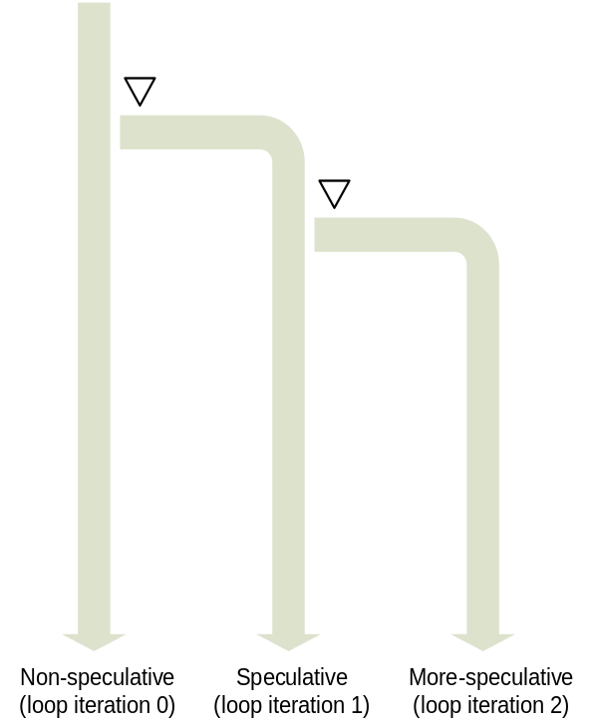
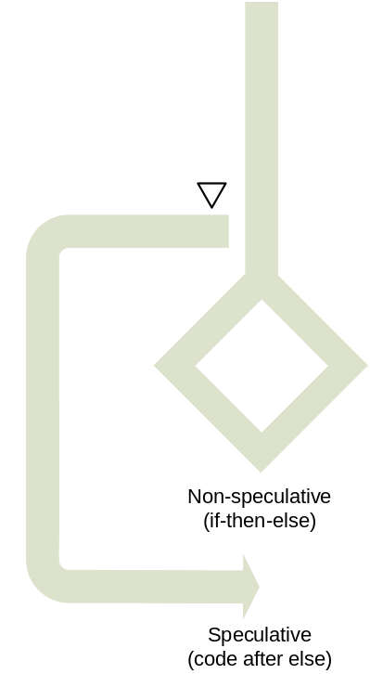
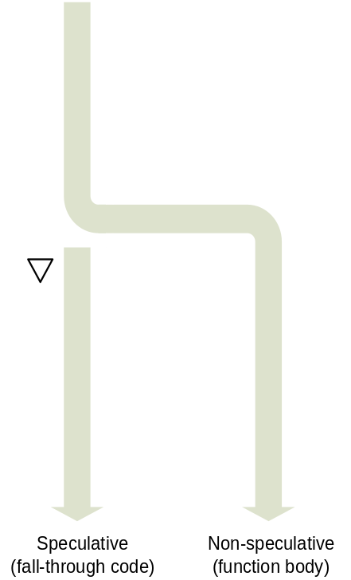
Spawning Points of Thread Level Speculation
Loop Speculation
If-then-else Speculation
Procedure Fall-Thru Speculation

Slide 7
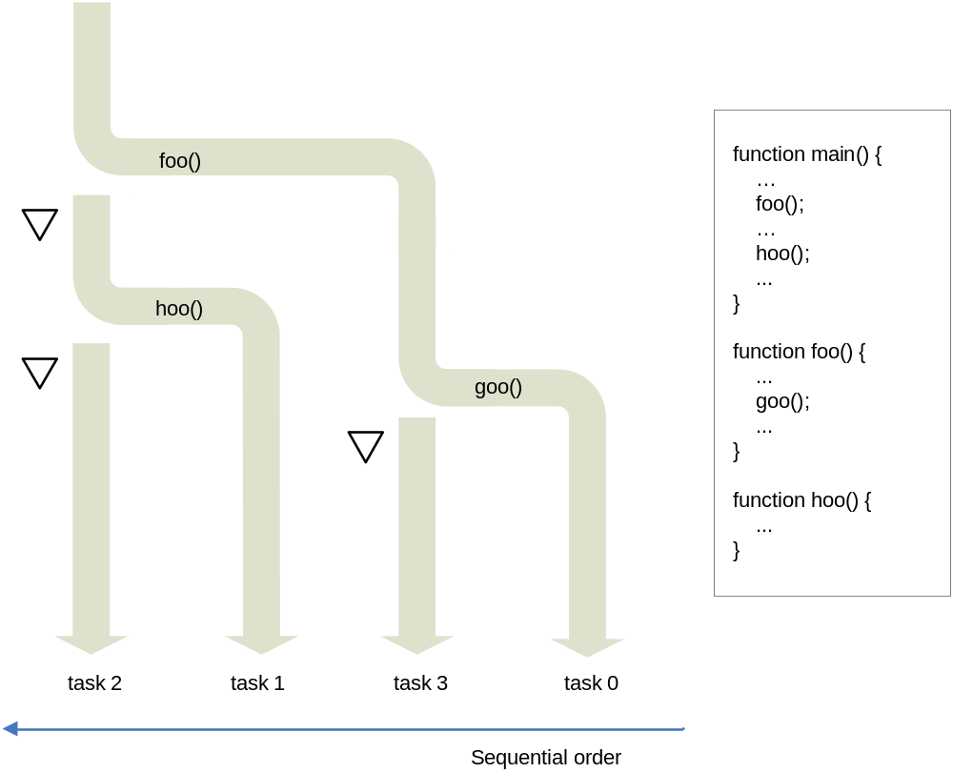
Out-of-order Spawn
The spawn order of tasks (0-1-2-3) disagrees with the sequential order (0-3-1-2)
Complicate sequential ordering maintenance
Helper Transactions focus on
out-of-order procedure fall-through speculation
Out-of-Order Procedure Fall-Thru Speculation
Spawning

Slide 8
Agenda
Thread-Level Speculation (TLS)
Mapping TLS onto A Transactional Memory System
Extending TM System

Slide 9
TLS||TM Basics
main()
{
Differ from conventional TM
  transactions execute different code
  Sequential order among transactions
Execution timeline
foo()
depth=1
depth=1
fallthru code
foo() code
foo2()
depth=2
foo2() code
depth=0
depth=1
depth=2
Green light to commit
buffer
Green light to commit
fallthru code

Slide 10
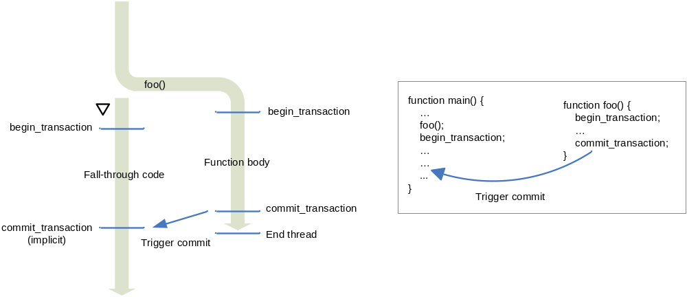
Procedure Fall-Thru Speculation on TM
Each task in TLS = a transaction
  Function body is guarded with begin_transaction and commit_transaction
  Spawned thread starts a transaction itself upon start
  TM detects memory dependency violation

Slide 11
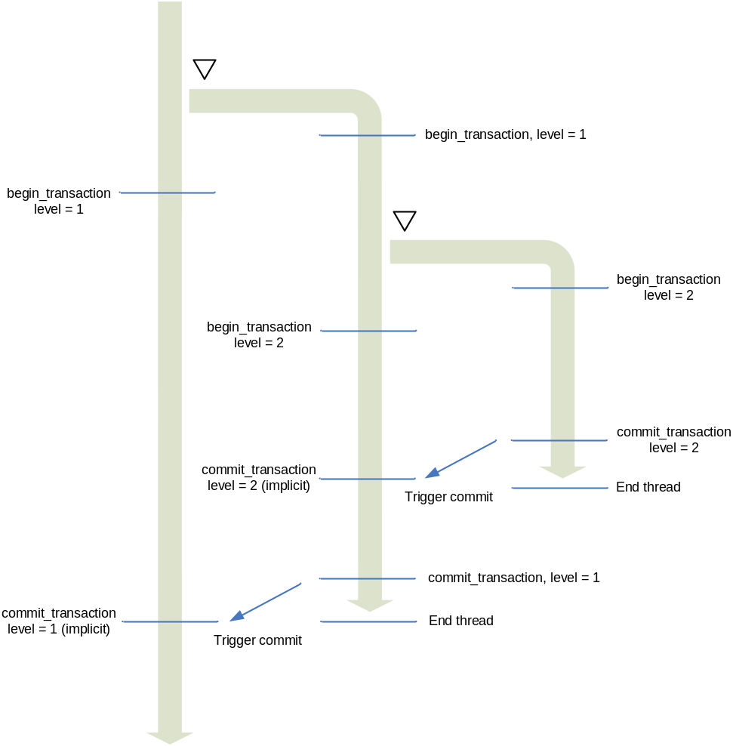
Alternative Approach to Out-of-Order Spawn
Spawn a new thread with function body
  Reduces traffic used to convert register dependencies into memory dependencies
  Simplifies compiler implementation
Requires partial abort support from the TM system
Out-of-Order Procedure Fall-Through Speculation on TM (Revised)

Slide 12
Agenda
Thread-Level Speculation (TLS)
Mapping TLS onto A Transactional Memory (TM) System
Extending TM System

Slide 13
Required Support
Compared to TLS, TM lacks
  Thread spawning mechanism
  Context passing mechanism
  Sequential ordering mechanism
Compiler support
  Thread spawning mechanism
  Context passing mechanism
Hardware extension
  Sequential ordering mechanism

Slide 14
Compiler Support
Store the function call arguments in memory…
Volatile int in_memory_a, in_memory_b, in_memory_c;
int main ( int argc, char* argv[])
{
int a, b, c;
…
in_memory_a = a;
in_memory_b = b;
in_memory_c = c;
create_thread( _tls_foo);
begin_transaction;
…
}
void* _tls_foo ( void* arg)
{
int arg0, arg1, arg2;
arg0 = in_memory_a;
arg1 = in_memory_b;
arg2 = in_memory_c;
begin_transaction;
foo( arg0, arg1, arg2);
commit_transaction;
}
int foo ( int arg0, int arg1, int arg2)
{
… // function foo body
}
Function call is replaced with a thread spawn to the clone function
Register dependencies should be changed into memory dependencies
Encountering a function call
Fall-through thread is also guarded with a transaction
int main ( int argc, char* argv[])
{
int a, b, c;
…
foo( a, b, c);
…
}
int foo ( int arg0, int arg1, int arg2)
{
… // function foo body
}
…and retrieve them back
Guard the function body with transaction
Create a clone function whose body is the function call
Sample Code Before TLS Transformation
Sample Code After TLS Transformation

Slide 15
Hardware Extension 1:
Binary Tree to Encode the Sequential Ordering
Sequential order determines
  Which transaction to abort upon conflict
  Which transaction should stall on commit
Use binary tree to represent sequential ordering
  Child_X executing “function body” appends 1 to its parent’s encoding
  Child_X executing “fall-thru code” appends 0
root
main()
main() FT
foo()
foo()
0
1
hoo()
goo()
main() FT
hoo()
foo() FT
goo()
00
01
10
11
X2
X0
X1
X3
X0
X2
X1
X3
Sequential ordering

Slide 16
Hardware Extension 1:
Binary Tree to Encode the Sequential Ordering
Sequential order determines
  Which transaction to abort upon conflict
  Which transaction should stall on commit
Use binary tree to represent sequential ordering
  Child_X executing “function body” appends 1 to its parent’s encoding
  Child_X executing “fall-thru code” appends 0
root
main()
main() FT
foo()
foo()
0
1
hoo()
goo()
main() FT
hoo()
foo() FT
goo()
00
01
10
11
X2
X0
X1
X3
X0
X2
X1
X3

Slide 17
Hardware Extension 2:
Aborting a Subtree of Transactions
Upon a transaction abort
  More speculative transactions are all aborted
  Conservatively abort a subtree of transactions
More Speculative,
Abort the entire subtree of transactions
root
0
1
conflict
00
01

Slide 18
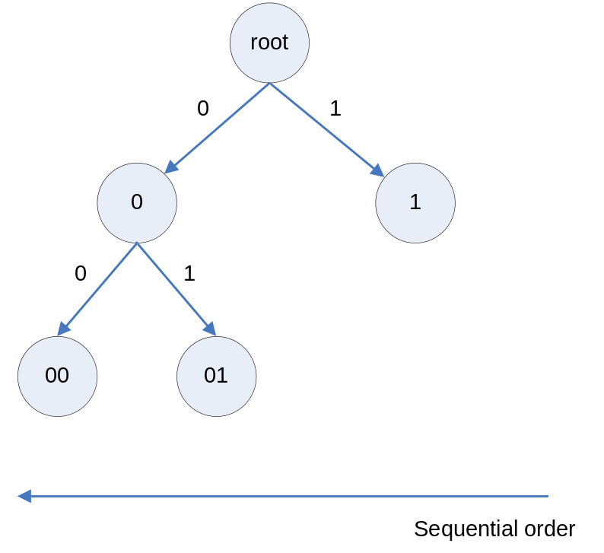
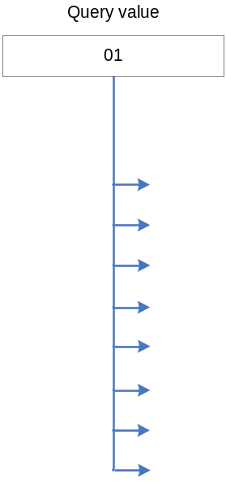
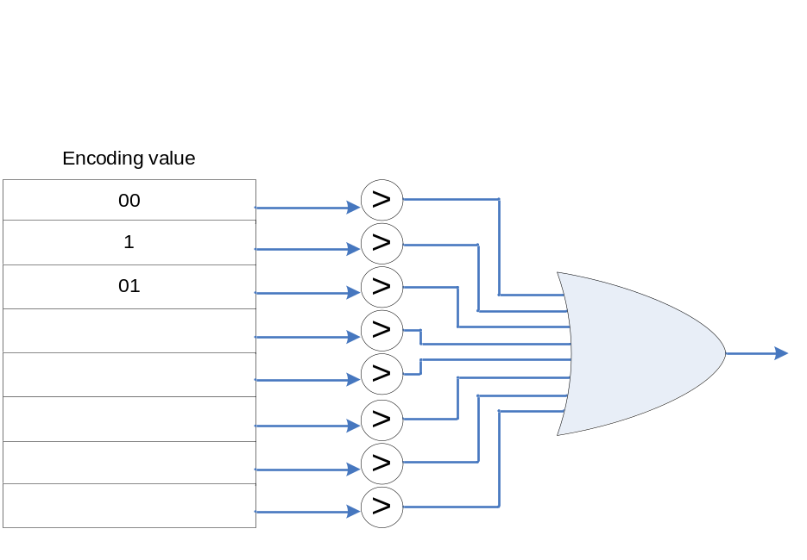
Hardware Extension 3:
Ordering the Commits
A central module to serialize the commits
  Similar to ROB
  Transaction consults it to determine commit or stall
1
1
Can I commit?
1
Module Generating Stall Signal

Slide 19
Summary
TM can be extended to support out-of-order TLS
Two-fold approach
  Compiler support for thread spawning and context passing
  Hardware support for sequential ordering
Extend the usage scope of a TM system
Amortize TLS implementation cost onto a TM-ready system

Slide 20



Thank You!
Georgia Tech ECE
MARS Labs
http://arch.ece.gatech.edu

Slide 21
TLS versus TM
Thread-Level Speculation
  Divide a program into possibly non-conflicting tasks
  Hardware speculate tasks to execute in parallel
  Inter-task dependency maintained by detecting, squashing and rolling back conflicting tasks
Transactional Memory
  Transaction
    A sequence of instructions that executes in atomic fashion
    These instructions either commit or abort as a single large operation
  Speculatively execute transactions within a critical section
  Underlying TM system detects and aborts transactions that violate memory dependency

Slide 22
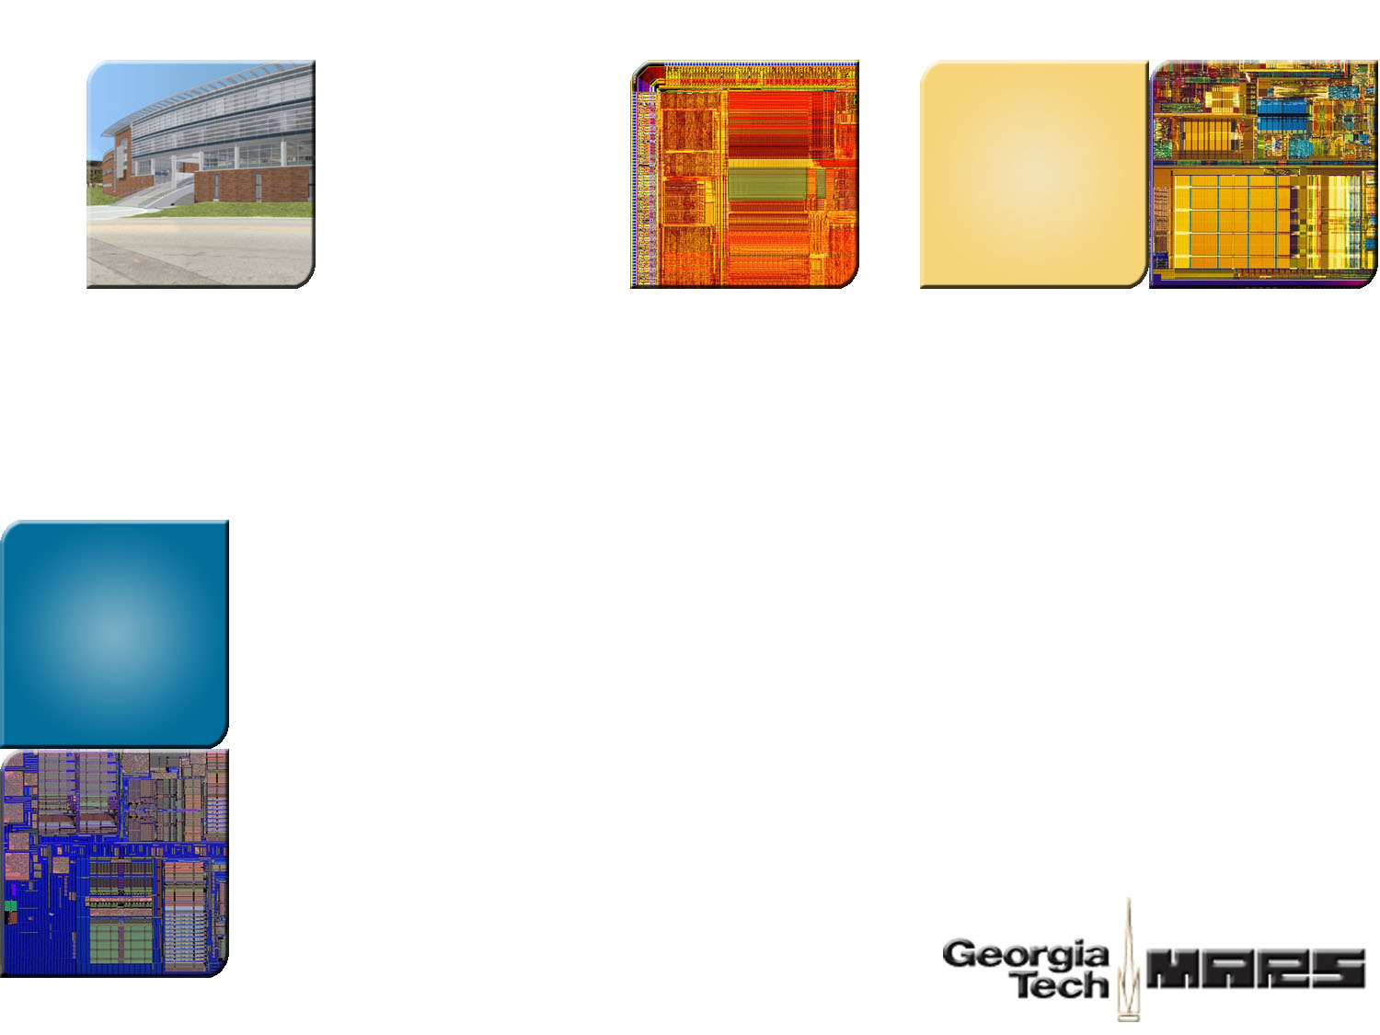
BACKUP FOILS

Slide 23
Helper Transactions
Goal: Enable TLS with a TM-ready system
  Support “out-of-order procedure fall-through speculation” on TM
  Amortize TLS implementation cost on a TM-ready system
Implementation | Category | Architecture | Operand Passing Network | Out-of-order Spawn | Lock Parallelization
Multiscalar | TLS | Dedicated | Y
SVC | TLS | SMP | Y
Hydra | TLS | CMP |  | Y
PolyFlow | TLS | SMT |  | Y
TLS4OutOrder | TLS | CMP |  | Y
Voltron | TLS | CMP | Y | Y | ?
Helper Transactions | TM + TLS | CMP |  | Y | Y
TCC | TM | CMP |  |  | Y
UTM | TM | CMP |  |  | Y
LogTM | TM | CMP |  |  | Y
Comparison of Various Parallelization Techniques

Slide 24
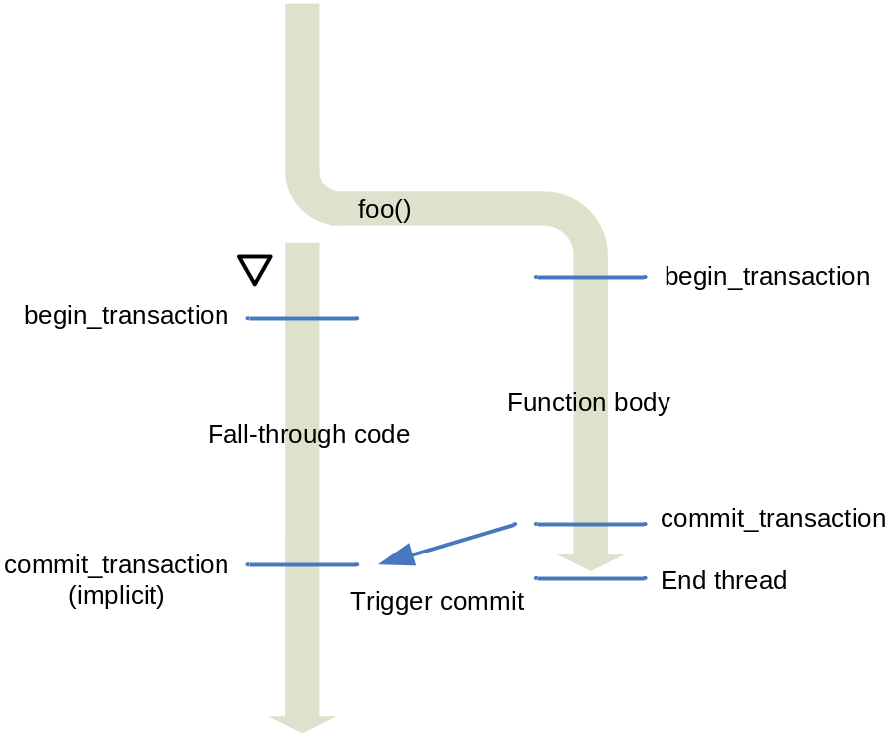
The Basics (Cont’d)
Differ from conventional TM
  transactions execute different code
  Sequential order among transactions
In this example, function_X sequentially precedes fallthru_X
  When conflict, TM should abort fall-thru_X in favor of function_X
  Upon commit_transaction, fallthru_X should be stalled until function_X commits.
  OR
  Commit of function_X implicitly triggers the commit of the fallthru_X (implicit commit)
fallthru_X
function_X
Procedure Fall-Thru Speculation on TM
Aborted transaction may improve
performance due to cache warm-up

Slide 25
Spawning Points of Thread Level Speculation
Task boundaries
Determined by high level programming language
  E.g., Loops, if-then-else statements, procedure fall-throughs, etc.
Loop Speculation
If-then-else Speculation
Procedure Fall-Thru Speculation

Slide 26
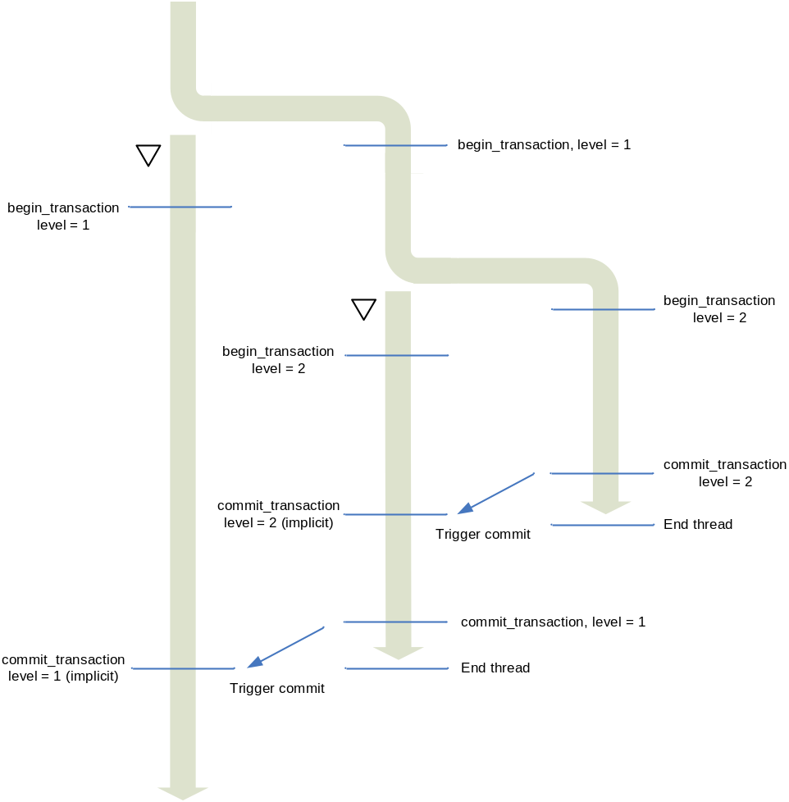
Supporting Out-of-Order Spawn
Map out-of-order spawning to nested transactions
  A transaction may have multiple concurrent transactions
  At spawn point, the spawning thread increments its nesting level
  The spawned thread starts a transaction at the same level
Maintain sequential order by
  Upon conflict, abort more speculative transaction
  Stall the explicit commit of the more speculative transaction until the less speculative transaction commits
Out-of-Order Procedure Fall-Thru Speculation on TM

