Slide 1



Improving TLB Energy for Java Applications on JVM
Chinnakrishnan S. Ballapuram
Hsien-Hsin S. Lee
SAMOS VIII

Slide 2





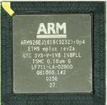
How to Execute Java Applications
Java Virtual Machine (JVM)
  Interpreter mode
  JIT mode
  Dynamic compilation mode
Native Java processor
  picoJava
  ARM926EJ-S
  aj100 from Systronix
animated

Slide 3

JVM in Interpreter Mode
Java app
JVM
SW
HW
Core
Bytecode Fetch
Go through data side
Fill up dTLB and dL1
iTLB
dTLB
iL1
dL1
Processor
unified L2
Memory
inst
data
JVM stack
App data
App code
JVM heap

Slide 4
JIT and Dynamic Compilation Mode
Java app
JVM
SW
HW
Core
JIT-ed code is written to the heap through the dTLB and dCache
iTLB
dTLB
iL1
dL1
Processor
unified L2
Memory
inst
data
JVM stack
App data
App code
JVM heap

Slide 5
JIT and Dynamic Compilation Mode
Java app
JVM
SW
HW
Core
JITed native binary on the heap will be executed through the iTLB and iCache
So does the JVM itself
Snooping may be required
iTLB
dTLB
iL1
dL1
Processor
unified L2
Memory
inst
data
JVM stack
App data
App code
JVM heap

Slide 6
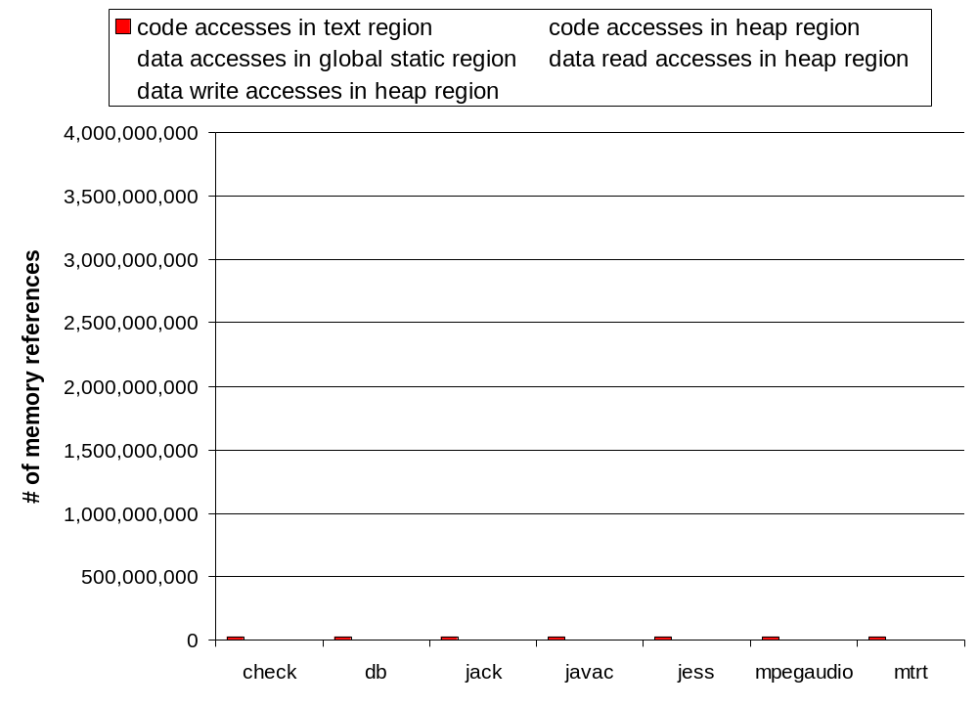
JVM’s Instruction and Data Distribution
JVM code accesses themselves in code region

Slide 7
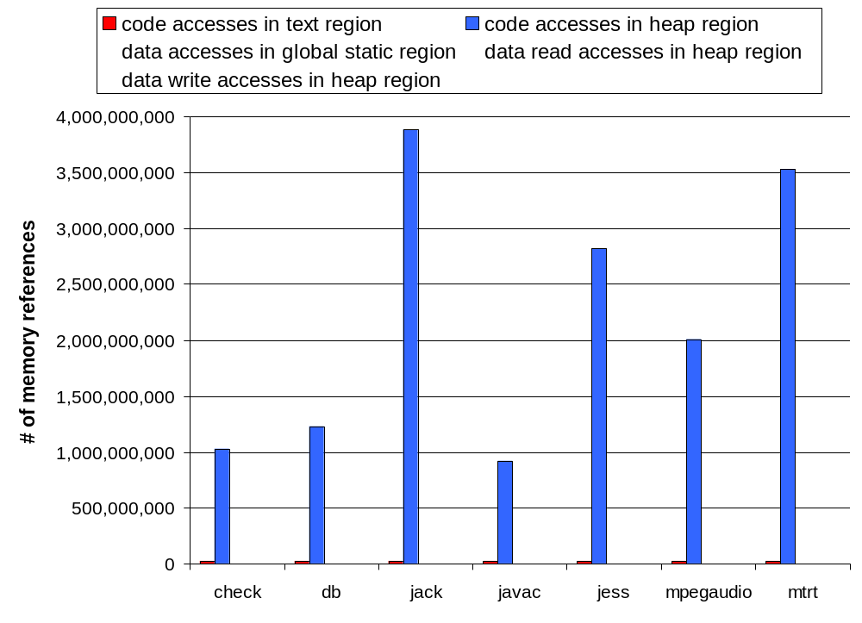
JVM’s Instruction and Data Distribution
JIT-ed codes are placed in heap region of the JVM
Code accesses in the heap dominates memory references

Slide 8

JVM’s Instruction and Data Distribution
Almost no global access in JVM

Slide 9
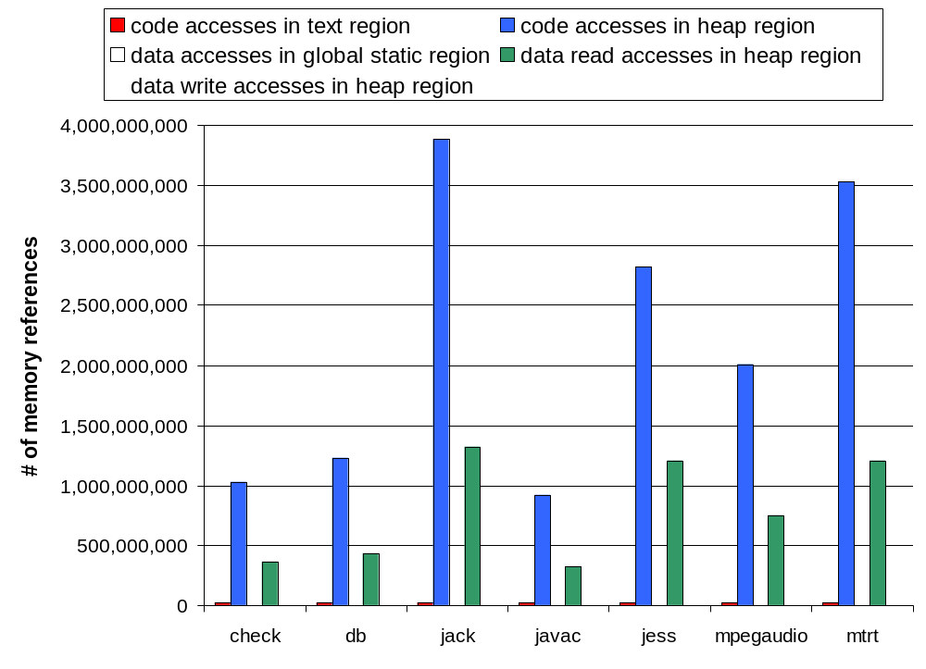
JVM’s Instruction and Data Distribution
JIT reads from heap

Slide 10
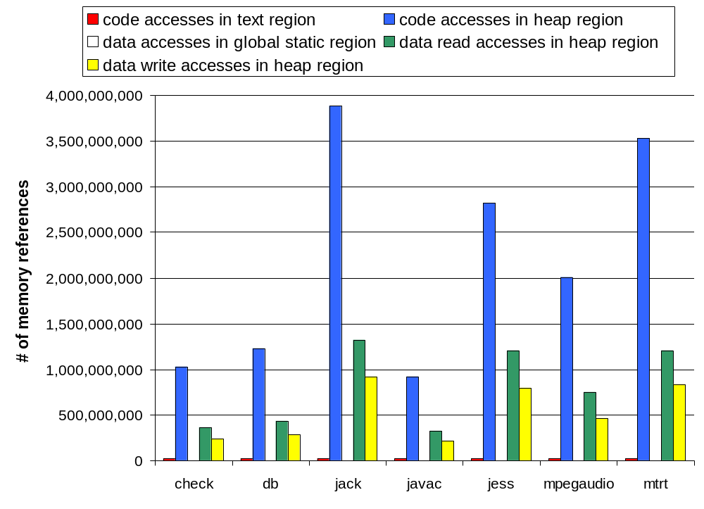
JVM’s Instruction and Data Distribution
JIT writes to the heap (a majority is writing translated native instructions)

Slide 11
JVM and Java iTLB (J-iTLB)
Virtual Address
ld_code_start
Instruction Address Router
ld_code_end
(IAR)
JVM code iTLB
0
0
1
1
Java application iTLB
31
iCache
Using two distinct iTLBs to eliminate the interference between the JVM code and the JIT-ed code.

Slide 12
JVM and J-iTLB with Object iTLB
Virtual Address
ld_code_start
Instruction Address Router
ld_code_end
(IAR)
JVM code iTLB
0
0
1
Object iTLB
7
0
1
Java application
2nd Level iTLB
The first level, a smaller object iTLB supports the dynamic object code accesses in the Java application code.
31
iCache

Slide 13
JVM and Java dTLB
Load/Store Virtual Address
JVM or Java app data read
Load
Buffer
Store
Buffer
0
0
read TLB (rTLB)
1
1
write TLB (wTLB)
7
31
JIT-ed writes
dCache
The characteristics of read and write data accesses are exploited to reduce power.

Slide 14
iTLB and dTLB Complete Organization
Virtual Address
Load/Store
Virtual Address
Instruction Address Router
(IAR)
Load
Buffer
Store
Buffer
JVM code iTLB
0
Object iTLB
0
1
1
7
0
0
0
read TLB (rTLB)
1
write TLB (wTLB)
1
1
Java app 2nd Level iTLB
7
31
31
iCache
dCache
Unified L2 Cache

Slide 15
Simulation Parameters
Baseline i- and d-TLB | 32 entries
JVM iTLB | 2 entries
Object iTLB | 8 entries
2nd level iTLB | 32 entries
Read dTLB | 32 entries
Write dTLB | 8 entries
L1/L2 hit latency | 1/6 cycles
TLB hit latency | 1 cycle
iL1 and dL1 cache | 32KB, 4-way, 32-byte line
L2 cache | 512KB, 4-way, 32-byte line
Memory latency | 150 cycles
Page size | 4KB
IAR | 300μW
Dynamic Simplescalar (DSS)
PowerPC ISA
Wattch power model

Slide 16
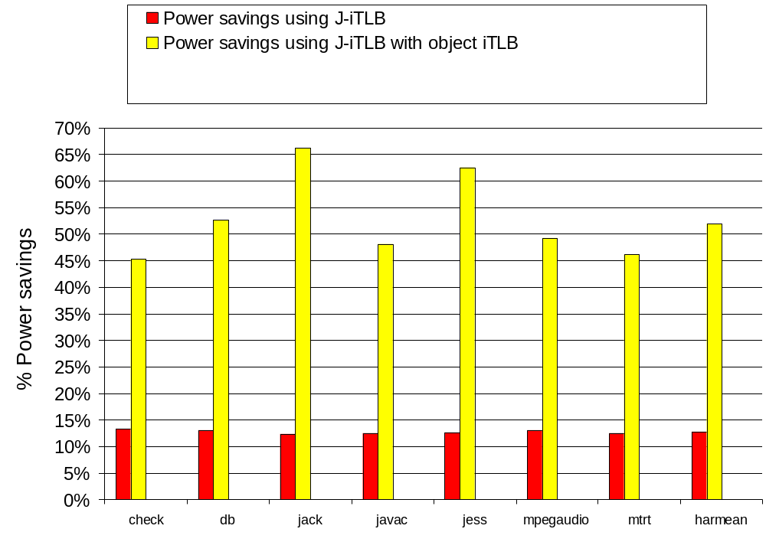
Power Savings for iTLB

Slide 17
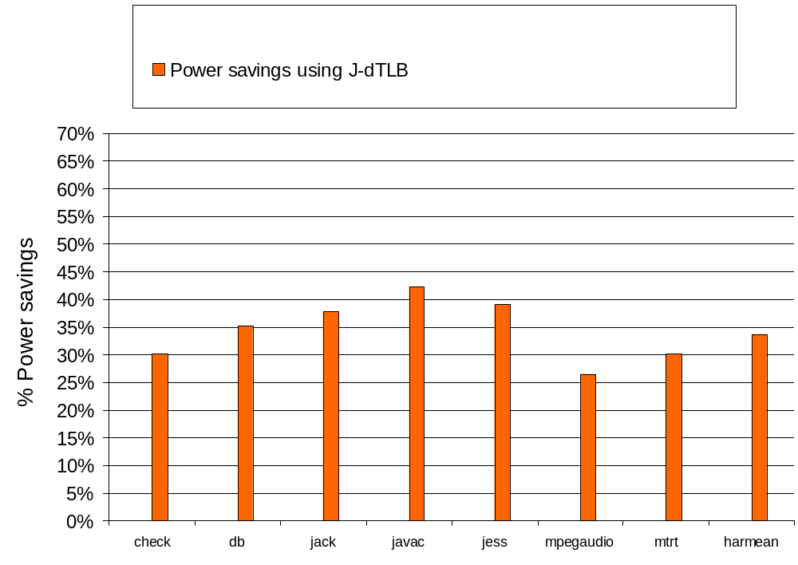
Power Savings for dTLB

Slide 18
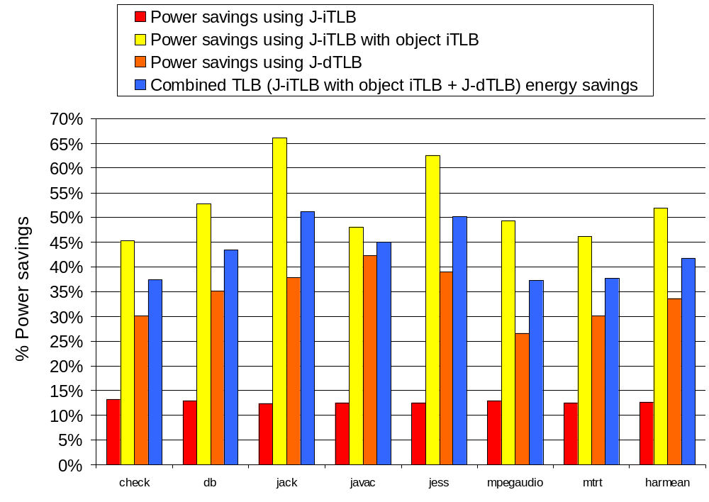
Overall Power Savings

Slide 19
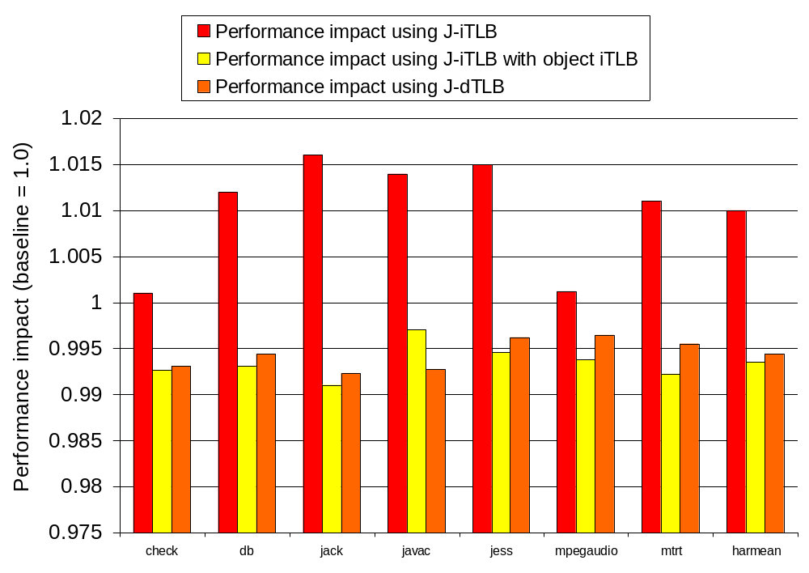
Performance Impact

Slide 20
Conclusion
Conflicts exist in the memory reference characteristics and distribution between the JVM and the Java applications.
These characteristics can be exploited for an energy-efficient TLB design.
We studied
  Horizontal partitioning of iTLB, J-iTLB
  Horizontal and vertical partitioning of iTLB
    J-iTLB with Object iTLB and second level Java application iTLB
  Split dTLB with read and write TLB-lets
Energy Reduction Results
  J-iTLB - 12.7% power savings, 1% perf improvement
  J-iTLB with Object iTLB - 51% power savings, 1% perf impact
  J-dTLB - 34% power savings, 1% perf impact
  Overall 42% power savings, 1% perf impact

Slide 21


Thank You !
Georgia Tech
Electrical and Computer Engineering
MARS Labs
http://arch.ece.gatech.edu
SAMOS VIII

