Slide 1
CoolPression: A Hybrid Significance Compression Technique for Reducing Energy in Caches
Mrinmoy Ghosh
Weidong Shi
Hsien-Hsin (Sean) Lee
School of Electrical and Computer Engineering
Georgia Institute of Technology
September 15, 2004

Slide 2
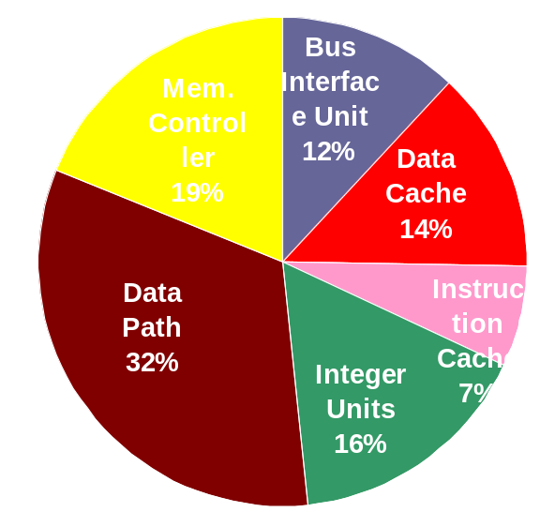
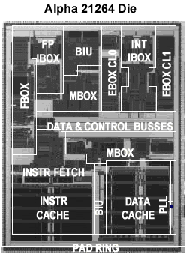
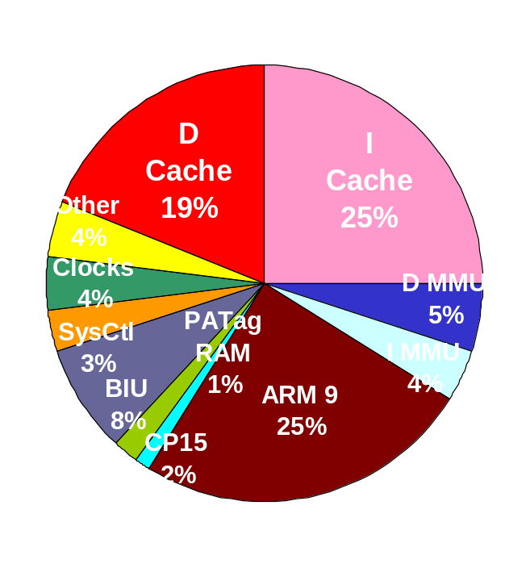
Hot Caches
Alpha 21264
ARM 920T

Slide 3
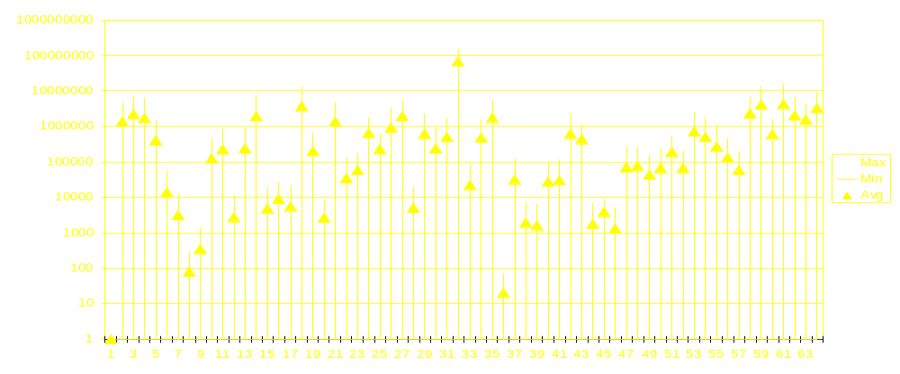
Motivation
Occurrences of Leading Zeroes for SPECint2000
8
16
24
32
40
48
56
64
# of Instances
# of Leading Zeroes
Uniform distribution of occurrences of leading zeroes across the 64 bit space

Slide 4
Salient Features of CoolPression
Energy-saving based on “bits” granularity
Compress both leading 1’s and leading 0’s
Reuse most significant byte, minimizing overhead
CoolPression is a hybrid of two schemes
    Dynamic Zero Compression
    CoolCount Scheme
    Choose the better scheme dynamically

Slide 5
CoolPression Cache
32 bits
SRAM Cell Array
Sense Amps

Slide 6
CoolPression Cache ⎯ DZC
Dynamic Zero Compression Technique [Villa et al 2000]
ZIBs
36 bits
1
1
1
1
1
1
1
1
0
0
0
0
0
0
0
0
1
1
1
1
1
1
1
1
0
0
0
0
0
0
0
0
SRAM Cell Array
Sense Amps

Slide 7
CoolPression Cache
CoolCount Technique
ZIBs
36 bits
0
0
0
0
0
0
0
0
0
0
0
0
0
1
1
1
1
1
1
0
0
0
1
1
1
1
1
1
1
1
1
1
SRAM Cell Array
Sense Amps

Slide 8
CoolPression Cache
CoolCount Technique
ZIBs
CE Bit
32 - count
6 bits
36 bits
0
0
0
0
0
0
0
0
0
0
0
0
0
1
1
1
1
1
1
0
0
0
1
1
1
1
1
1
1
1
1
1
SRAM Cell Array
Sense Amps
37
Data from Cache
CoolCount
Circuit
33
CoolCount
Circuit
Data Out
32
Bitline
Enable Lines
Step 1: Read In First 7 bits and the ZIBs
Step 2a: Read only 32 –count bits and
append with leading zeroes or ones

Slide 9
Counting Leading 0’s And 1’s
0
0
0
0
1
1
0
1
0
0
0
0
0
0
0
1
1
1
1
0
0
1
Priority Encoder
“# of Leading Zeroes or Ones ”

Slide 10
Counting Leading 0’s And 1’s
0
0
0
0
1
1
0
1
0
0
0
0
0
0
0
1
1
1
1
0
0
1
0
0
0
1
0
1
1
Priority Encoder
“# of Leading Zeroes or Ones”

Slide 11
Counting Leading 0’s And 1’s
0
0
0
0
1
1
0
1
0
0
0
1
0
1
1
Priority Encoder
0
1
1
“# of Leading Zeroes or Ones”

Slide 12
Counting Leading 0’s And 1’s
0
0
0
0
1
1
0
1
Priority Encoder
0
1
1
1
0
0
“# of Leading Zeroes or Ones”

Slide 13
Bitline Precharge Enabling Circuit
Bitline Precharge
C2
Precharge Control Transistor
C1
Y7
Precharge Enable from Coolcount Decoder Circuit
C0
Y6
VDD
VDD
Y5
Y4
Y3
SRAM Cell
Y2
wl
Y1
SRAM Cell
wl
VDD
Y0
b
b

Slide 14
Read Data From CoolPression Cache
Read in Count Enable (CE) Bit and First 6 bits of data
Yes
CE ==1
Enable Least Significant 64-count bit lines
No
Read Data From Least Significant 64-count bit lines and append with count leading zeroes or ones
Read Data for bytes where ZIB is not enabled and make the other bytes zero

Slide 15
Write Data To CoolPression Cache
Count Number of Leading Zeroes or Ones
Check for Bytes which are zero
Set CE bit to one and Enable Most Significant 6 bits lines and Least Significant 64-count bit lines
Yes
Count > Zero Bytes
No
Set CE bit to 0 and Write Data to Cache setting ZIBs where necessary
Write Encoded Data to Cache

Slide 16
Simulation Methodology
Simulator: Simplescalar with Wattch
Benchmarks: SPEC INT 2000
Power Numbers for Cache Structures: CACTI
Power Numbers for Priority Encoder:
  J.S Wang, C.H. Huang. “High Speed and low power CMOS priority encoders”. Journal of Scientific Computing, 35(10) 2000
  For a 64 KB Cache Priority Encoder consumes around .1% of the Cache Power

Slide 17
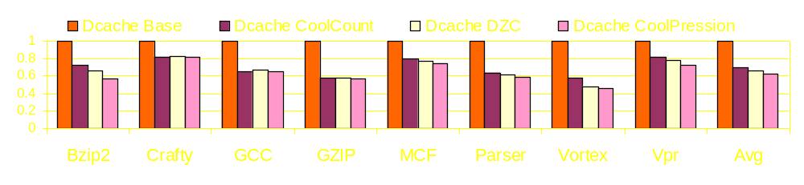
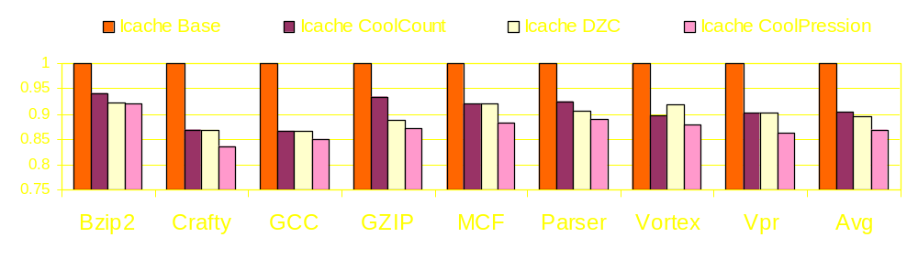
Results
16K Data Cache
Norm Total Power
16K Instruction Cache
Norm Total Power

Slide 18
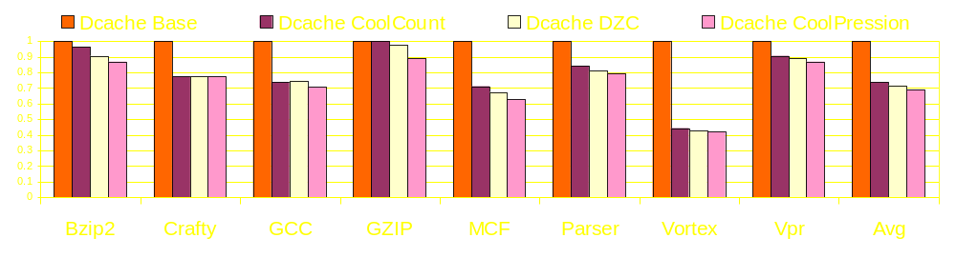
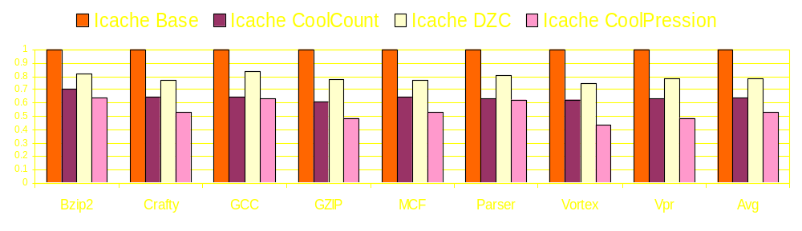
Results
32K Data Cache
Norm Total Power
32K Instruction Cache
Norm Total Power

Slide 19
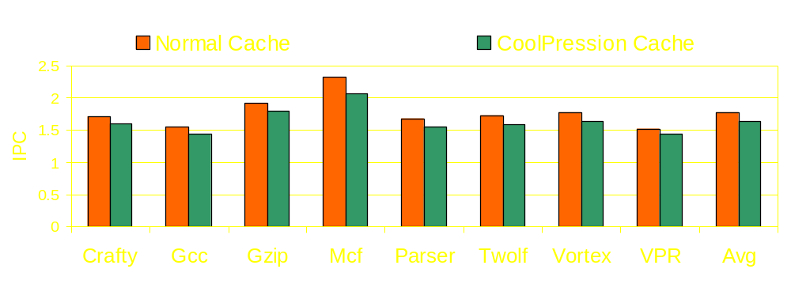
Potential Performance Impact

Slide 20
Conclusions
System Transparent Hybrid Zero Compression Scheme
Bit level and Byte level compressibility used to save power
Energy Savings of over 35% over baseline cache
Potential Use at other places where data transfer takes place

Slide 21
Thank You

