Slide 1
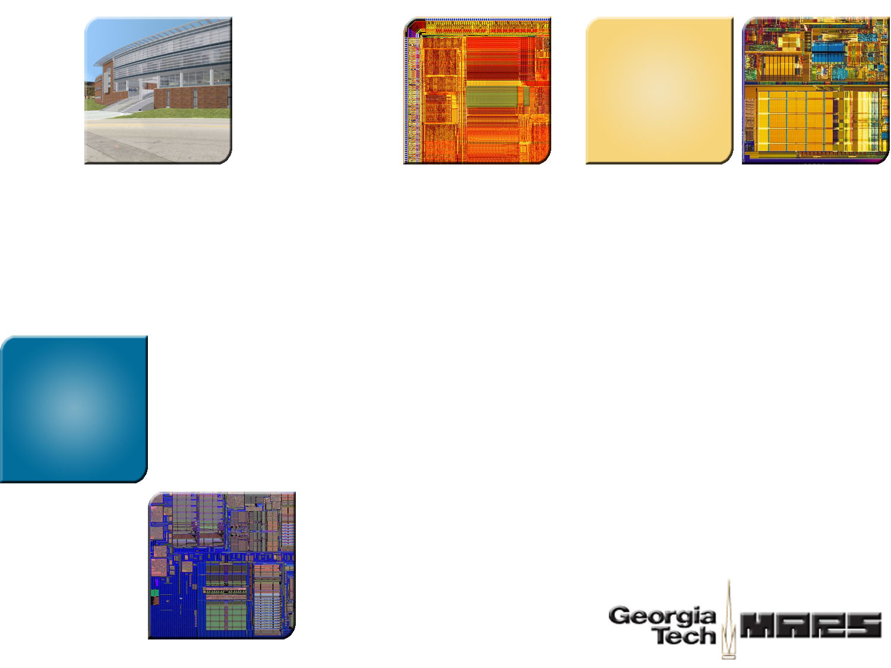
Adaptive Transaction Scheduling for Transactional Memory Systems
Richard M. Yoo
Hsien-Hsin S. Lee
Georgia Tech
Georgia Tech

Slide 2

Agenda
Introduction
Adaptive Transaction Scheduling
Experimental Results
Conclusion

Slide 3




Analogy for Lock
Threads
Send 1 car at a time to avoid collision
Assuming collision would happen most of the time
  Pessimistic concurrency control
A critical section
Analogy adopted from “Transactional Memory Conceptual Overview,” Intel

Slide 4
Analogy for Transactional Memory
Send all the cars at the same time
  Take care of collision if it happens
Assuming collision would not happen too often
  Optimistic concurrency control

Slide 5
Necessity for Transaction Scheduling
Being too optimistic
  What if the road itself inherently lacks parallelism?
  What if we know beforehand that there will be a collision?
Should we still send all the cars at the same time?
  Better perform some scheduling

Slide 6
Necessity for Adaptive Transaction Scheduling
Drawbacks of static scheduling
  What if the road width changes dynamically?
To maximally exploit the inherent parallelism, scheduling should be adaptive
4 cars
2 cars
3 cars

Slide 7
Back to Science
A program exhibits varying degrees of data parallelism along the execution
  Launching a fixed # of concurrent transactions all the time would not be sufficient
    Excessive concurrent transactions would create unnecessary conflicts
    Too little concurrent transactions would reduce the performance
Ideally, the performance would be maximized when
  The # of concurrent transactions = the # of maximum data parallel transactions
Questions
  How to measure the # of maximum data parallel transactions?
  How to utilize that information in transaction scheduling?
Adaptive Transaction Scheduling (ATS)

Slide 8
Agenda
Introduction
Adaptive Transaction Scheduling
Experimental Results
Conclusion

Slide 9

Contention Intensity
The intensity of the contention a transaction faces during its execution
  The higher the contention intensity, the lower the effectiveness of a transaction
  Can be controlled dynamically by adjusting the number of concurrently executing transactions
Each thread maintains its Contention Intensity (CI) as:
  Initially, CI = 0
  Current Contention (CC) = 0 when a transaction commits, = 1 when a transaction aborts
  Evaluate this equation whenever a transaction commits or aborts
Define contention intensity as a dynamic average
of current contention information

Slide 10

Transaction Scheduler
Implement a transaction scheduler directly inside a transactional memory system
  Maintain a queue of transactions
Each thread maintains its own contention intensity
When a thread begins / resumes a transaction,
  Compare its contention intensity with a designated threshold
  If the contention intensity is below threshold, begin a transaction normally
  If the contention intensity is above threshold, stall and report to the scheduler
CI = 0.7, threshold = 0.5
CI = 0.3, threshold = 0.5
CI
Queue of transactions
begin transaction normally
report to scheduler
Thread
Scheduler
When the contention is low,
transaction scheduling has little / no effect

Slide 11
Transaction Scheduler (contd.)
Once scheduled, the scheduler dispatches only one transaction at a time
  To be dispatched
    A transaction should be at the head of the queue
    No other transactions dispatched from the scheduler should be running
When the exclusivity is met, the scheduler signals back the thread to proceed
The thread then starts its transaction
begin transaction
signal the thread
Thread
Scheduler

Slide 12
Transaction Scheduler (contd.)
Upon its commit / abort, the transaction dispatched from the scheduler should notify the scheduler
  Triggers the dispatch of the next transaction
Re-evaulate contention intensity
  If the contention intensity has subsided below threshold, the thread would not resort to the scheduler next time it begins a transaction
CI = 0.7
CI = 0.3, threshold = 0.5
begin transaction normally
commit / abort transaction
report to scheduler
Thread
Scheduler

Slide 13
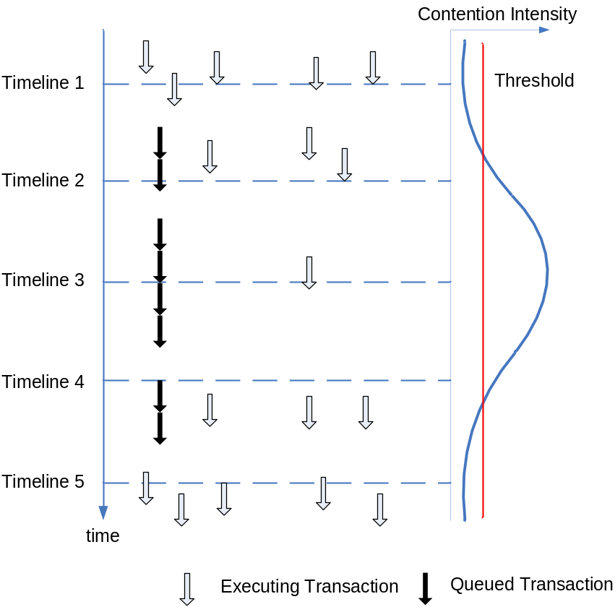
The Whole Picture
An average of all the
CIs from running threads
Timeline flows from
top to bottom
Transactions begin execution
without resorting to the scheduler
As contention starts to increase,
some transactions report to the scheduler
As more transactions get serialized,
contention intensity starts to decrease
Contention intensity subsides
below threshold
More transactions start without the
scheduler to exploit more parallelism
Behavior of a Queue-Based Scheduler
ATS adaptively varies the number of concurrent transactions
according to the dynamic parallelism feedback

Slide 14
Summary of Adaptive Transaction Scheduling
Adaptively exploits the maximum parallelism at any given phase
  Dynamically changes the number of concurrent transactions
  Contention intensity acts as a dynamic parallelism feedback
Under low contention
  Little / no net effect
  Selectively serializes only the high-contention transactions
Under extreme contention
  Most of the transactions would be serialized due to its queue-based nature
  Gracefully degenerating transactions into a lock
    Avoidance of livelock under extreme contention
    Performance lower bound guarantee

Slide 15
Agenda
Introduction
Adaptive Transaction Scheduling
Experimental Results
Conclusion

Slide 16
Experimental Settings
Implemented ATS on both the
  LogTM (hardware transactional memory)
  RSTM (software transactional memory)
Simulated System Settings
  Wisconsin GEMS simulator
CPU | Sixteen 1GHz SPARCv9 single-issue, in-order non-memory IPC=1
L1 Cache | 4-way split, 64 KB 5-cycle latency
L2 Cache | 4-way unified, 16 MB 10-cycle latency
Memory | 4 GB
Directory | centralized, 6-cycle latency
Interconnection Network | hierarchical switch topology 40-cycle link latency
Simulated System Settings

Slide 17
Experimental Settings (contd.)
LogTM Settings
  Supports only one active transaction per CPU
    The scheduler queue depth amounts to the total number of CPUs
  Default contention management scheme is stalling
    NACKed transaction keeps retrying the access with a fixed interval (unless it detects a possible deadlock situation)
    Implemented transaction scheduling on top of this contention manager
Scheduler Settings
  Assume that the hardware queue resides in a central location
  16-cycle fixed, bi-directional delay for CPU and scheduler communication

Slide 18
Experimental Settings (contd.)
Benchmark Suite
  Selected applications from SPLASH-2 suite
    Other workloads did not exhibit significant critical sections
    Transactionized by replacing the locks with transactions
  Deque microbenchmark
    Concurrent queue / dequeue operations on a shared deque
    The length of a transaction can be adjusted with a parameter
    Examine the scheduler’s behavior over a wide spectrum of potential parallelism
Throughout the experiments, α was fixed to 0.7,
and the threshold was fixed to 0.5

Slide 19
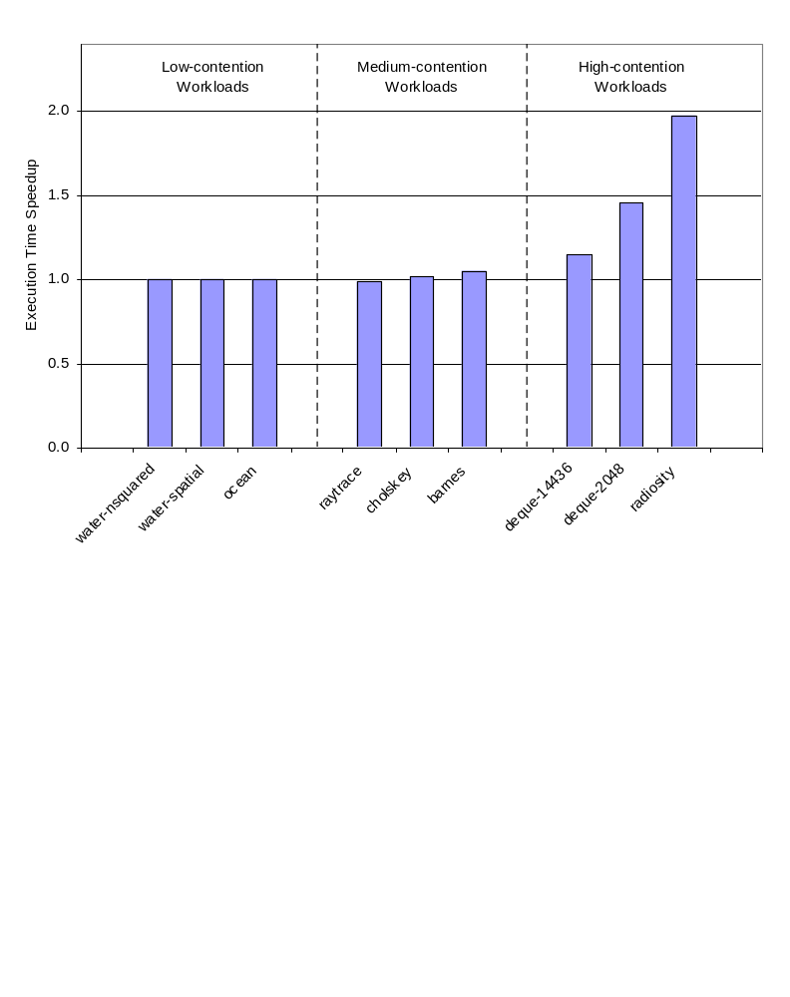
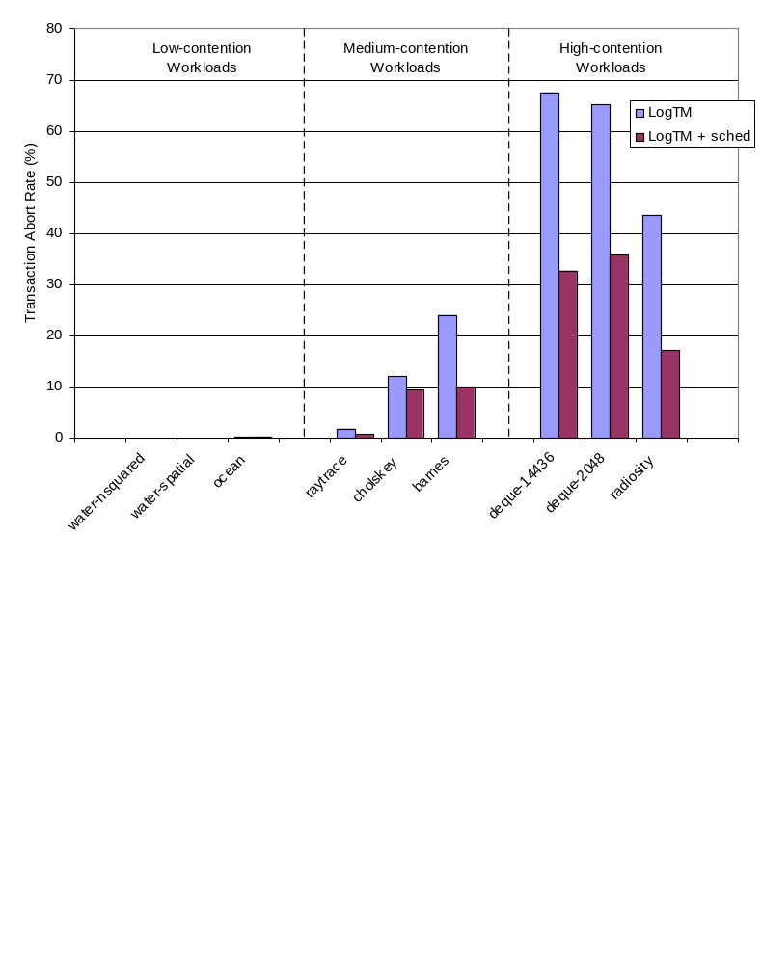
Execution Time Characteristics
Baseline: LogTM without transaction scheduling
97%
46%
-1%
2%
5%
15%
Execution Time Speedup
Transaction Abort Rate
Medium-contention workloads
- Start to exhibit significant transaction abort rates
- Marginal performance improvement
- The scheduler significantly reduces transaction abort rate
Baseline starts transactions in excess but commits the same amount of transactions
- ATS enabled LogTM can accomplish the same task with smaller number of transactions
High-contention workloads
- Huge performance improvement
- The scheduler more than halves transaction abort rate
- Baseline issues 50% ~ 100% more transactions than the scheduling enabled LogTM
Low-contention workloads
- Exhibit negligible abort rates
- Neither positive nor negative effect

Slide 20
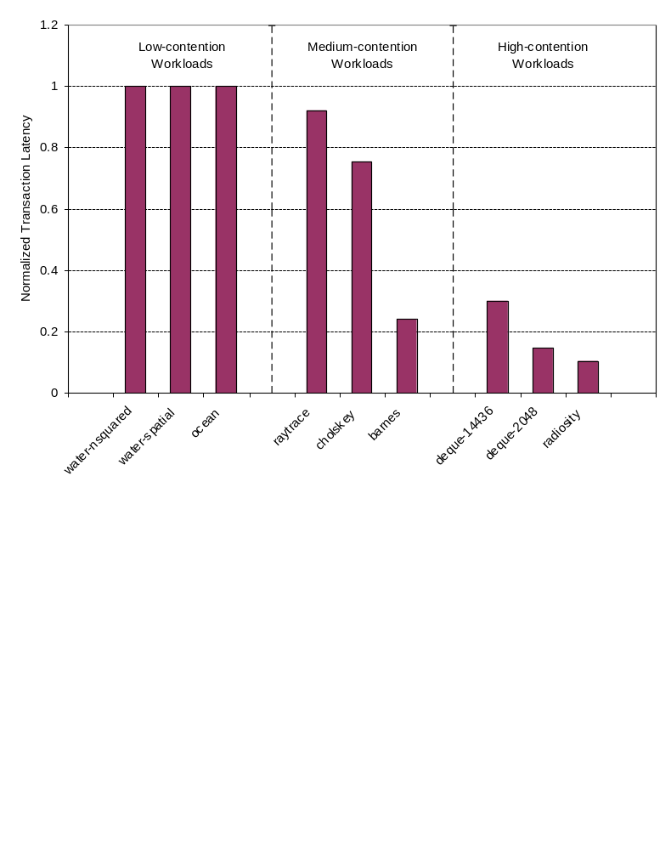
Improving the Quality of Transactions 1
Transaction latency
  The number of cycles of a committed transaction’s lifetime
Baseline stalls the offending transaction upon conflict
  Higher contention typically leads to longer transaction latency
  Squandered CPU cycles and energy
The scheduler not only reduces the average of transaction latency, but also the standard deviation of transaction latency
Normalized Transaction Latency
ATS renders transactions faster
and more deterministic

Slide 21
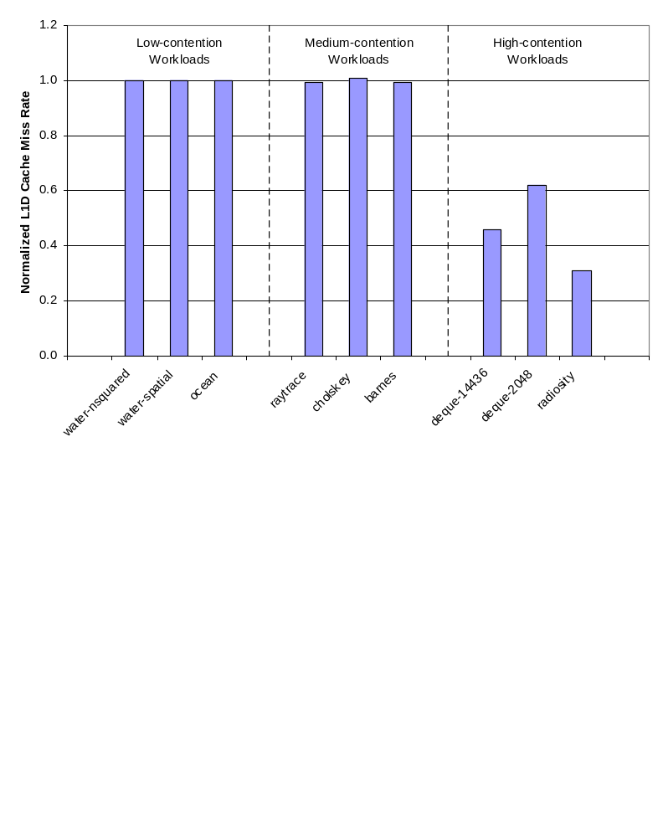
Improving the Quality of Transactions 2
Cache miss rate
  Frequent aborts amount to more cache line invalidations
  Leads to a higher cache miss rate when a transaction resumes
Normalized L1D Cache Miss Rate
Under ATS, high-contention workloads exhibit
significantly reduced cache miss rate

Slide 22
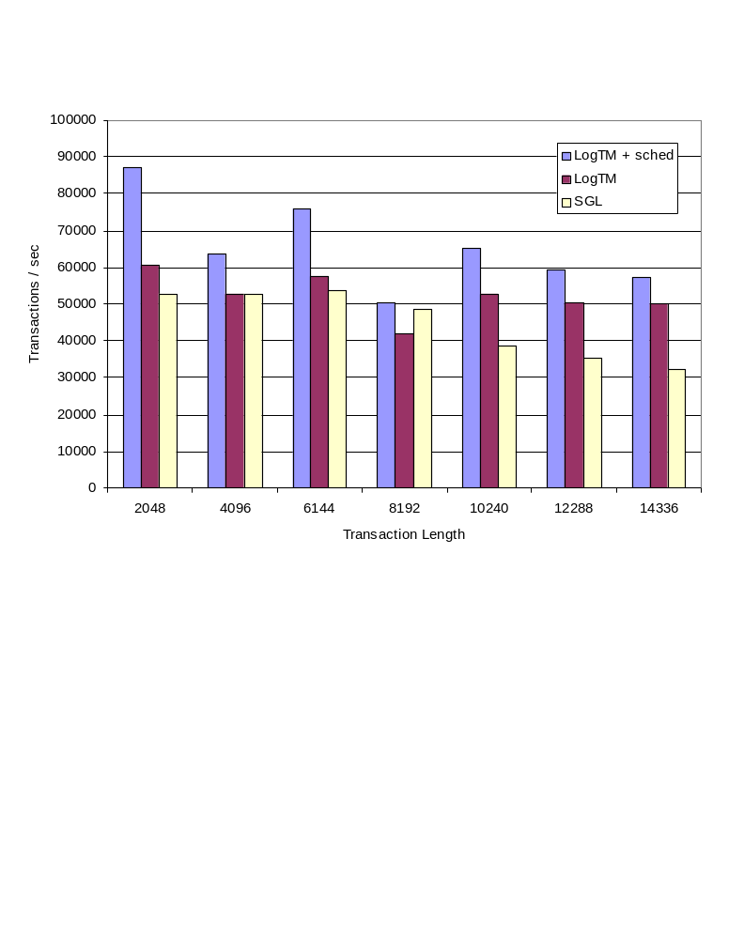
Guaranteeing Performance Lower Bound
Due to its queue-based nature
  Under extreme contention, most transactions would be serialized
  This contention scope is similar to a single global lock
ATS can guarantee that the performance would not be worse than a single global lock under extreme contention
Throughput on Deque Microbenchmark

Slide 23
Conclusion
Adaptive transaction scheduling exploits the maximum inherent parallelism at any given phase
  No negative effect on low-contention workloads
  Significant performance improvement for medium ~ high-contention workloads
Also improves the quality of transactions
Performance lower bound guarantee

Slide 24
Questions?
Georgia Tech MARS lab
http://arch.ece.gatech.edu

Slide 25
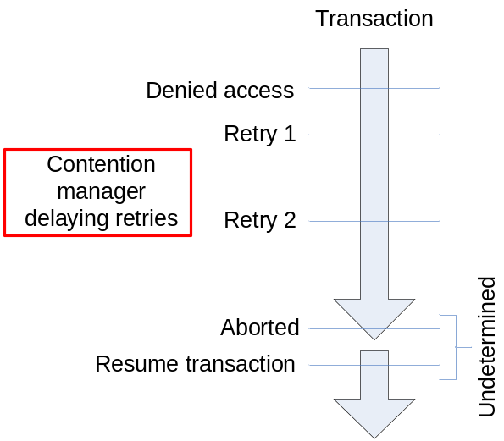
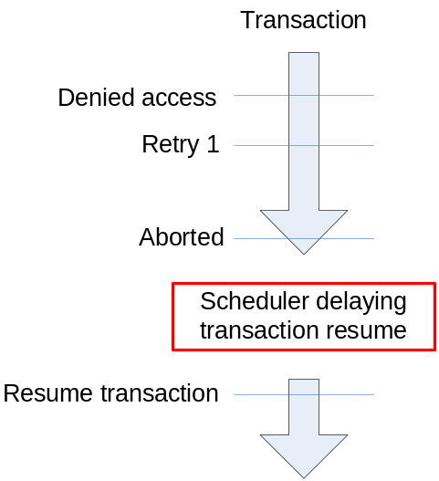
Comparison with Contention Manager
Contention Manager
Adaptive Transaction Scheduling
Contention manager
  Focuses on ‘when to retry the denied object access’
  Takes effect after a conflict has materialized (reactive)
Adaptive transaction scheduling
  Focuses on ‘when to resume the aborted transaction’
  Takes effect before a conflict occurs (proactive)

Slide 26
Comparison with Contention Manager (contd.)
Contention manager
  Frequent module access:
    When a transaction starts, aborts, or commits
    When a transaction acquires an object
    When a transaction reads /writes an object
    When there is a conflict
  Module should be distributed
    No global view of contention
    Resolve conflict on a peer-to-peer basis
  Difficult to implement in hardware
Adaptive transaction scheduling
  Infrequent module access:
    When a transaction starts, aborts, or commits
  Module can be centralized
    Can maintain the global view of contention
    Enables advanced, coherent scheduling policies
  Relatively simple to implement in hardware
ATS performs macro scheduling,
while the contention manager performs micro scheduling

Slide 27
Queue Coverage
Maintaining a single queue for all the critical sections
  The scheduler controls the number of concurrent transactions in any of the critical sections
Maintaining a dedicated queue for each critical section
  The scheduler controls the number of concurrent transactions in each of the critical sections
Phased behavior of multi-threaded programs
  The case of different threads executing different critical sections was rather rare
  A single global queue for all the critical sections would suffice

Slide 28
Serialization Effect from the Queue
Due to its adaptive nature, the serialization effect from the queue was minimal
  Under HTM, no serialization effect was observed ~16 CPUs
Under many-core scenario, the queue might become a serialization point
Form clusters of cores, and assign one dedicated queue to each cluster
  Scheduling quality might be inferior to the case of one global queue
  The information scope is still greater than the peer-to-peer contention resolution

