Slide 1
Evaluating System-wide Monitoring Capsule Design
Using Xilinx Virtex-II Pro FPGA
Taeweon Suh §, Hsien-Hsin S. Lee §, Sally A. Mckee †,
and Martin Schulz ♀
§ Georgia Institute of Technology, † Cornell University,
and ♀ Lawrence Livermore National Laboratory

Slide 2
Owl: System-wide Monitoring
Overcome traditional sampling, counter-based performance monitoring
Proposed general framework for system-wide monitoring called Owl
Monitoring capsule can be deployed anywhere in a system
Each monitoring capsule consists of FPGA cells to hold monitoring modules as well as standardized hardware interfaces
Pre-built monitoring modules are dynamically deployed in monitoring capsule’s FPGA fabric
CPU
M
CPU
M
M
M
L1 Cache
L1 Cache
M
L2 Cache
M
L2 Cache
M
M
M
M
Memory
M
I/O
Bridge
M
M

Slide 3
Example: Multi-level Memory Monitoring
CPU
Monitor
L1 Cache
Monitor
L2 Cache
Monitor
Main Memory
Cross Capsule
Analysis

Slide 4
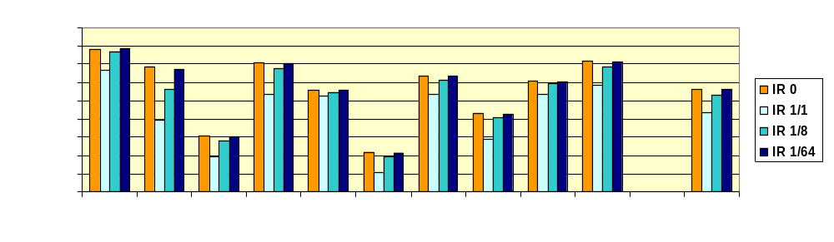
Feasibility Study
IPC perturbation according to different injection rates (IR) of all L1 traffic
  Simplescalar-4.0 alpha with bus and SDRAM models
In this work, we conduct a feasibility study with a rapid prototyping environment using FPGA platform

Slide 5
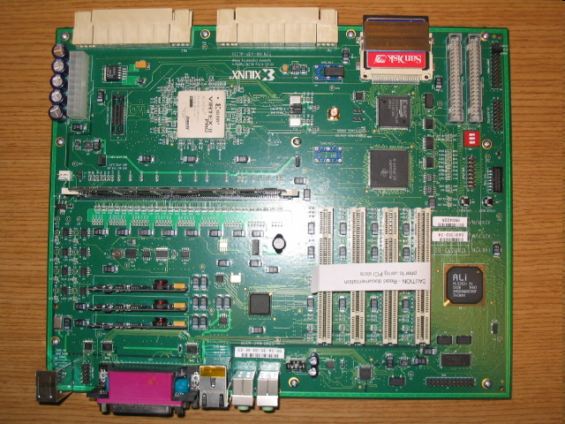
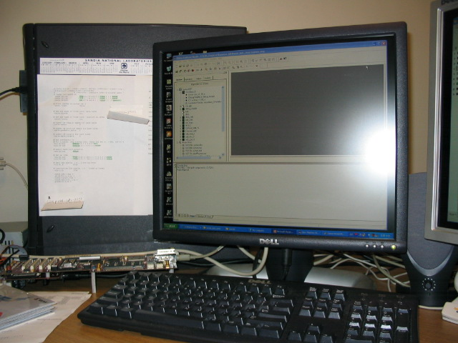
Microblaze-based Evaluation Platform
D-Cache behavior monitoring
Xilinx ML310 board
Virtex-II Pro
Microblaze
Monitoring Capsule
for D-Cache
Serial
JTAG
Ethernet
OPB
DDR SDRAM
controller
Ethernet
controller
UART

Slide 6
PowerPC-based Evaluation Platform
D-Cache behavior monitoring
Xilinx ML310 board
PowerPC 405
Virtex-II Pro
Monitoring Capsule
for D-Cache
Ethernet
controller
PLB
OPB
Serial
JTAG
Ethernet
Bridge
DDR SDRAM
controller
UART

Slide 7
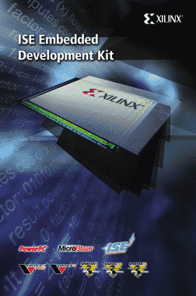


Evaluation Hardware Design Flow
Xilinx EDK 6.3
Xilinx ISE 6.3
Base System Builder
Add CPU,
DDR controller
Ethernet controller,
UART,
Interrupt Controller
Add
Monitoring
Capsule
Deploy
a Monitoring
Module
Synthesize & Place & Route
Debugging with

Slide 8
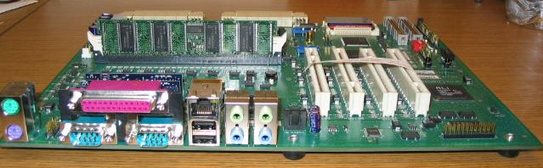
Owl Evaluation Stack
SPEC2000
uClinux running
on Microblaze
Measure system perturbation adopting monitoring modules with different injection rates, by comparing execution times of SPEC2000 with/without monitoring

Slide 9

Owl Evaluation Challenges on FPGA platform
Memory on board is too fast, compared to processors in FPGAs
  DDR SDRAM: 100MHz
  Microblaze: 100MHz
  => This can be solved by inserting wait cycles for memory transactions in monitoring capsule
Available processors (Microblaze, PowerPC405) in FPGAs are too simple to mimic the state-of-the-art superscalar processors
=> However, Owl concept covers any complexity system,
which includes a rapid prototyped simple system like
Microblaze-based platform

Slide 10


Questions & Answers
That’s All Folks !

