Slide 1

Initial Observations of Hardware/Software Co-simulation using FPGA in Architecture Research
Taeweon Suh § Hsien-Hsin S. Lee §
Shih-Lien Lu † John Shen †
February 12, 2006
§ Georgia Institute of Technology, † Intel Corporation

Slide 2
Hardware/Software Co-simulation
Software simulation
  Advantages: Flexible, observable, easy-to-implement
  Disadvantage: Intolerable simulation time
Hardware emulation
  Advantage: Significant speedup, concurrent execution
  Disadvantages: Much less flexible and observable, low-level design taking longer time to implement and validate
Hardware/Software Co-simulation
  Try to retain advantages of both approaches
  Basic idea
    Implement time-consuming software functions into FPGA
    The remaining simulator interacts with FPGA

Slide 3
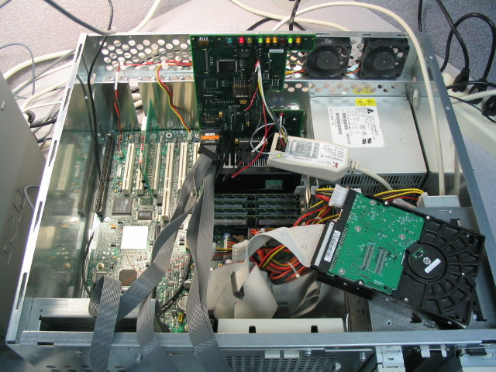
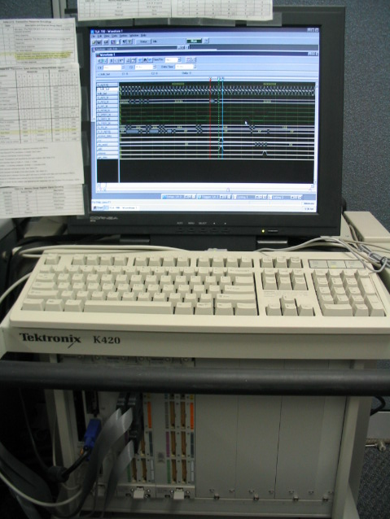
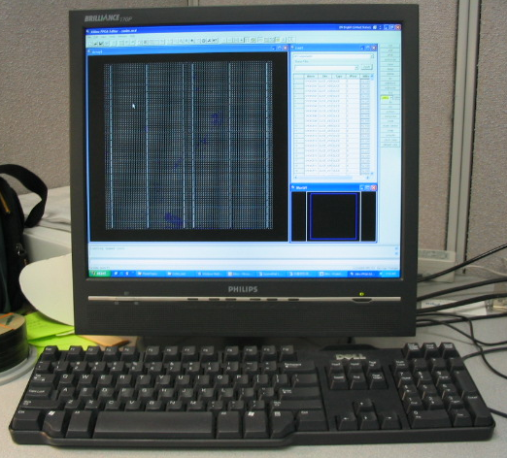
Experiment Equipment
Intel server system
ACE FPGA board
UART
Pentium-III
Host PC
Logic analyzer

Slide 4
Communication Method
Communication between Pentium-III and FPGA
  Use FSB as communication medium
  Allocate one page of memory for communication
  Send data to FPGA: write-through cache mode
  Receive data from FPGA: cache-to-cache transfer
Pentium-III
(MESI)
cache line
“FLUSH”
FPGA
(Virtex-II)
Front-side bus (FSB)
“read” bus
transaction
“write” bus
transaction
“cache-to-cache transfer”
Memory
controller
2GB SDRAM

Slide 5
Hardware/Software Implementation
Hardware (FPGA) implementation
  State machines
    Monitoring bus transactions on FSB
    Checking bus transaction types, i.e., read or write
    Managing cache-to-cache transfer
  Implementation of software functions to FPGA
  Debugging logic and statistics counters
Software implementation
  Linux device driver
    FPGA needs to know when to respond to FSB transactions
    Specific physical address is needed for communication
    Allocate one page of memory for FPGA access via Linux device driver
  Simulator modification for accessing FPGA

Slide 6
Example: Simplescalar Co-simulation
Preliminary experiment for correctness checkup
  Implement a simple function (mem_access_latency) into FPGA
Co-simulation results
Baseline (h:m:s)
Co-simulation (h:m:s)
difference (h:m:s)
mcf
2:18:38
2:20:50
+ 0:02:12
bzip2
3:03:58
3:06:50
+ 0:02:52
crafty
2:56:38
2:59:28
+ 0:02:50
eon-cook
2:43:52
2:45:45
+ 0:01:53
gcc-166
3:45:30
3:48:56
+ 0:03:26
parser
3:34:57
3:37:27
+ 0:02:30
perl
2:42:30
2:45:50
+ 0:03:20
twolf
2:43:30
2:45:28
+ 0:01:58

Slide 7
Co-simulation Results Analysis
FSB access is expensive
  ~ 20 FSB cycles (≈ 160 CPU cycles) for each transfer
    One cache line (32 bytes) needs to be transferred for cache-to-cache transfer
    P-III MESI requires to update main memory upon cache-to-cache transfer
“mem_access_latency” function is too simple
  Even software simulation takes at most a few dozen CPU cycles
Device driver overhead
  System overhead due to device driver
  It requires one TLB entry, which would be used in the simulation otherwise
Time-consuming software routines and reasonable FPGA access frequency are needed to benefit from hardware implementation

Slide 8
On-going Work
SoftSDV co-simulation for multi-core research
  Implement distributed lowest level caches, and interconnection network such as ring or mesh in FPGA
CPU0
CPU1
CPU2
CPU3
L1,L2
L1,L2
L1,L2
L1,L2
L3
L3
L3
L3
FPGA
Ring I/F
Ring I/F
Ring I/F
Ring I/F
Ring I/F
Ring I/F
Ring I/F
Ring I/F
L3
L3
L3
L3
CPU4
CPU5
CPU6
CPU7
L1,L2
L1,L2
L1,L2
L1,L2

Slide 9
Conclusions
Proposed a new co-simulation methodology
Preliminary co-simulation using Simplescalar proves the correctness of the methodology
  Hardware/software implementation
  Communication between P-III and FPGA via FSB
  Linux driver
Co-simulation results indicate
  Bus access (FSB) is expensive
  Linux driver overhead also needs to be overcome
  Time-consuming blocks need to be emulated
Multi-core co-simulation would benefit from FPGA
  Implement distributed low-level caches and interconnection network, which would be complex enough to benefit from hardware modeling

Slide 10

Questions, Comments?
Thanks for your attention!

Slide 11
Backup Slides

Slide 12
Communication Details
All FSB signals are mapped to FPGA pins
Encoding software function arguments in the FSB address for Simplescalar example
  For 4KB page,
    Set its attribute as write-through mode
    Lower 12 bits in FSB address bus are free to use
    High 24 bits are used for TLB translation
Pentium-III (MESI)
Xilinx
Virtex-II
Front-side bus (FSB)

