Slide 1
智慧型系統概論HW2
通訊4A 鄭筱筠

Slide 2
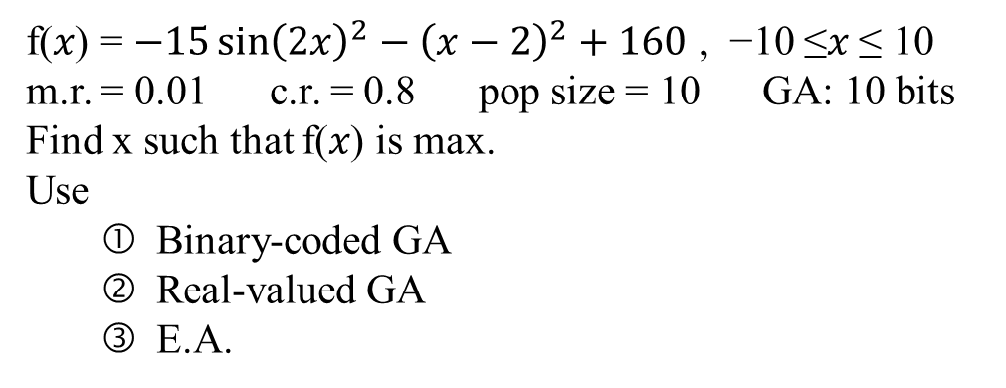
Object
f(𝑥) = $−15{\sin\left(2x\right)}^{2}−{\left(x−2\right)}^{2}+160$ , −10 ≤𝑥 ≤ 10
m.r. = 0.01 c.r. = 0.8 pop size = 10 GA: 10 bits
Find x such that f(𝑥) is max.
Use
Binary-coded GA
Real-valued GA
E.A.

Slide 3
Procedure
Genetic Algorithm
Binary-coded GA
Real-valued GA
E.A.

Slide 4
Procedure
Binary-coded GA
Reproduction
Crossover
Mutation
RWS
TS
one-point
two-point
mask
bit
string
mask

Slide 5
Procedure
Real-valued GA
Reproduction
Crossover
Mutation
RWS
TS
x₁′ = x₁ + 𝜎(x₁ − x₂) x₂ ′ = x₁− 𝜎(x₁ − x₂) −1≤ 𝜎 ≤1
x′ = x+𝑠∗𝑟𝑎𝑛𝑑𝑜𝑚𝑛𝑜𝑖𝑠𝑒
𝑛𝑜𝑖𝑠𝑒 ∈ [−1 1]

Slide 6
Procedure
E.A.
Reproduction
Crossover
Mutation
RWS
TS
average crossover operator
𝑥 = 1/2[x_{j}+ x_{k}]
convex combination operator 𝑥 = 𝑟 x_{j} +(1−𝑟) x_{k}，𝑟 ∈ (0,1)
x′ = x + rd r ∈ (0, 1) d:randomly generated vector

Slide 7
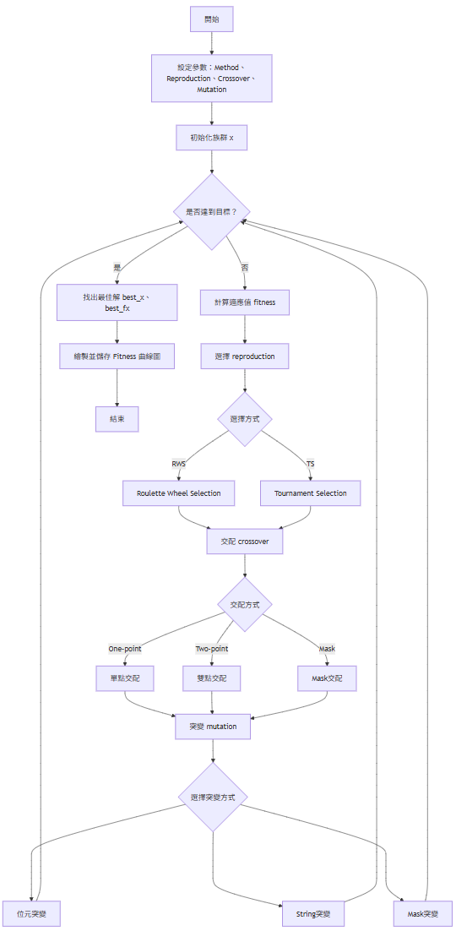
Program Flow Chart

Slide 8
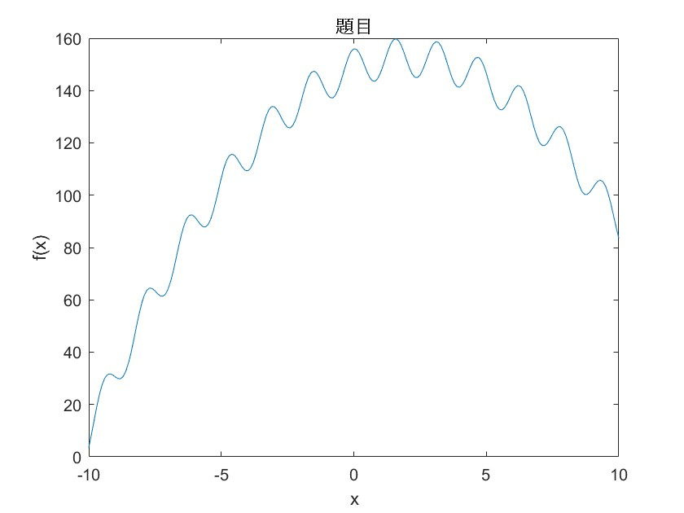
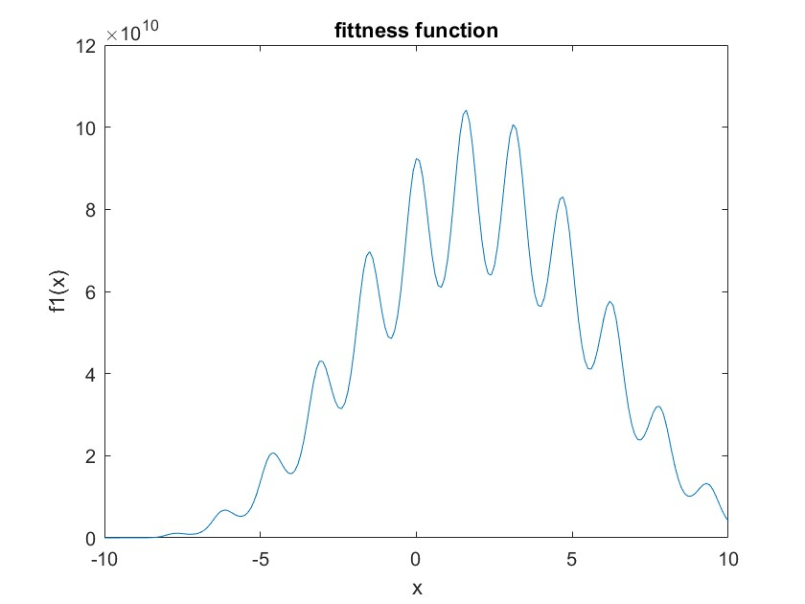
Simulation Results

Slide 9
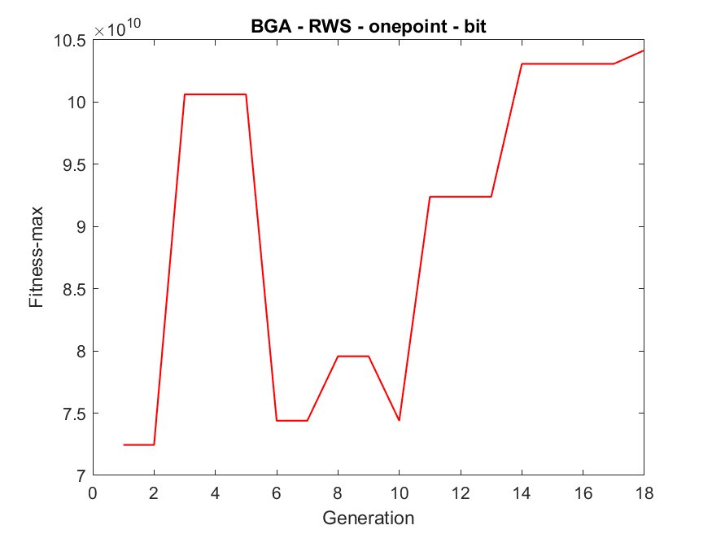
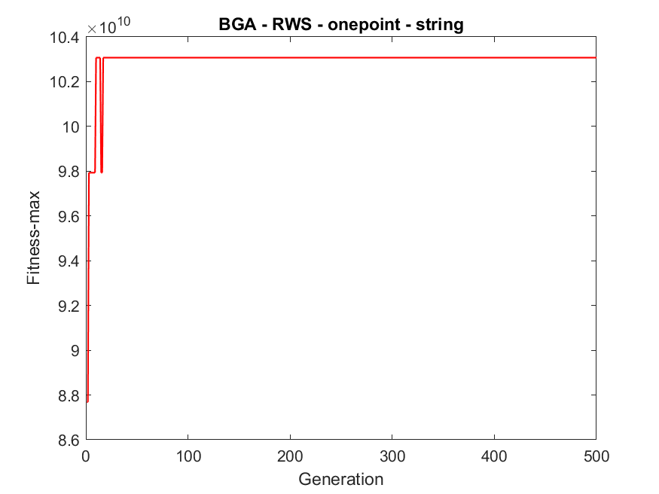
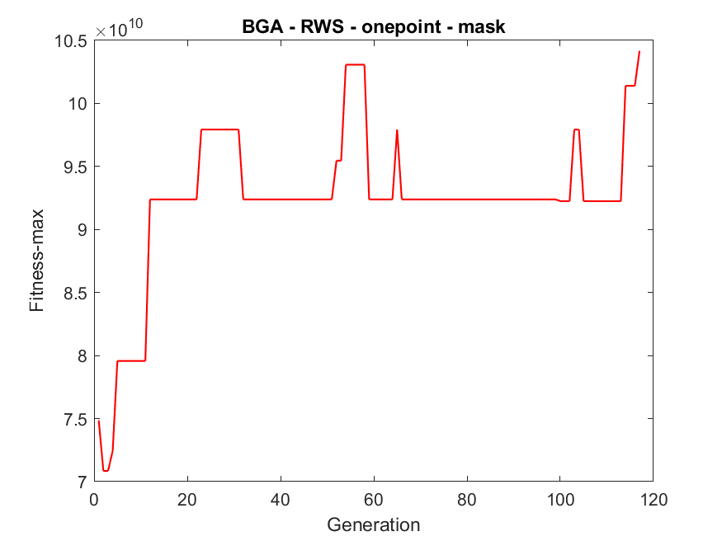
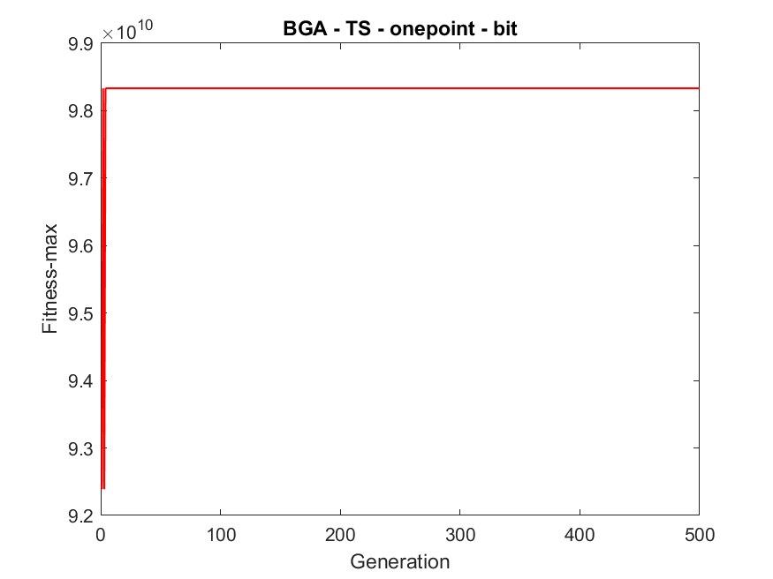
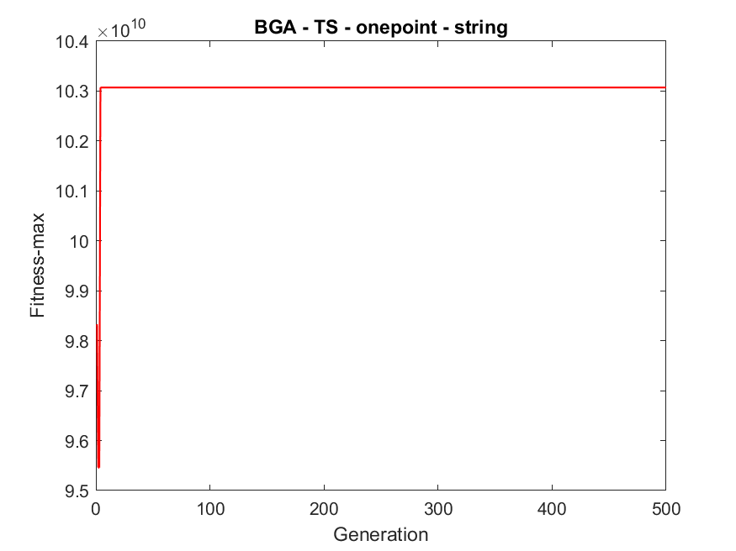
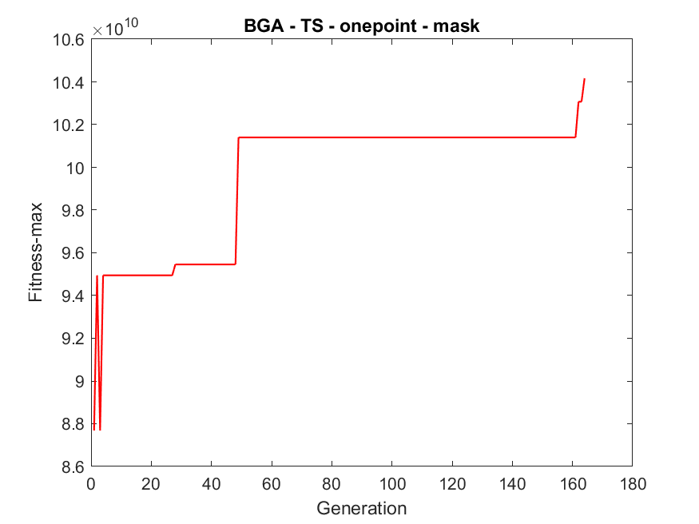
Simulation Results - BGA

Slide 10
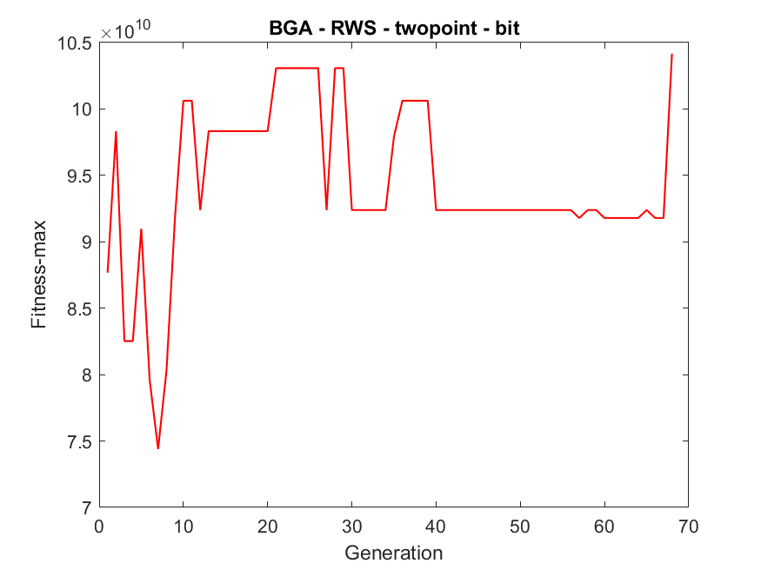
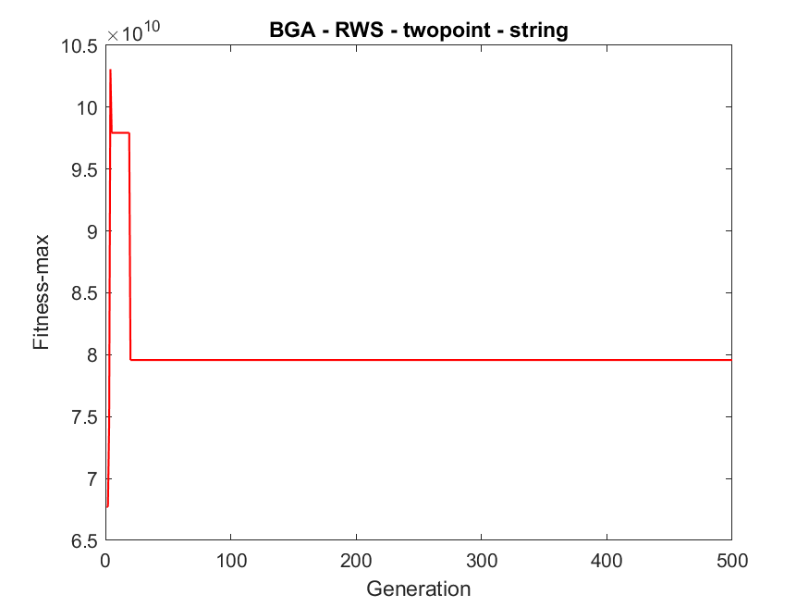
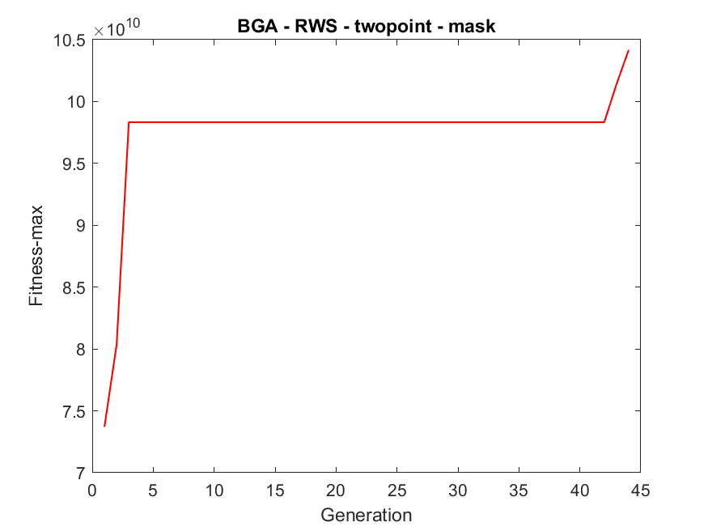
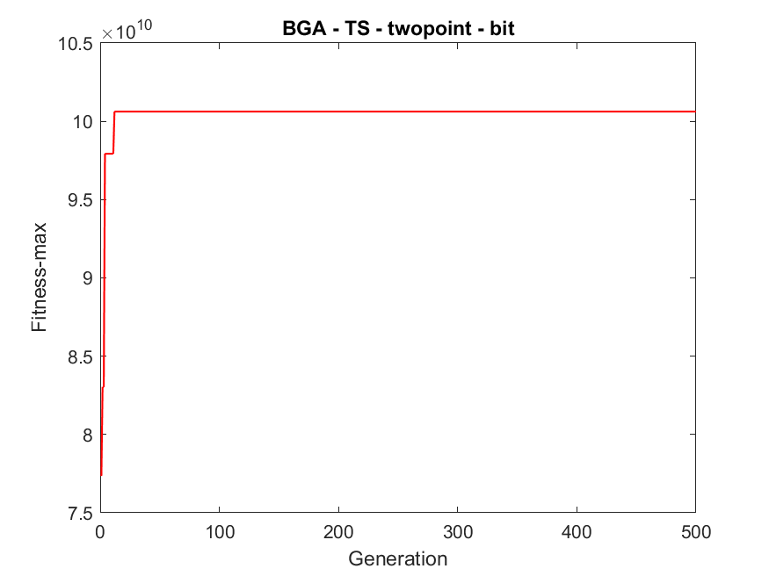
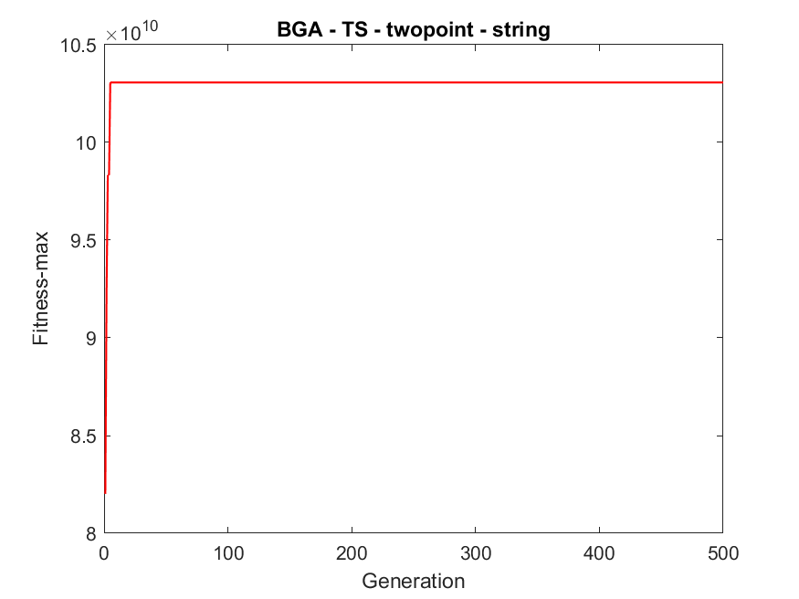
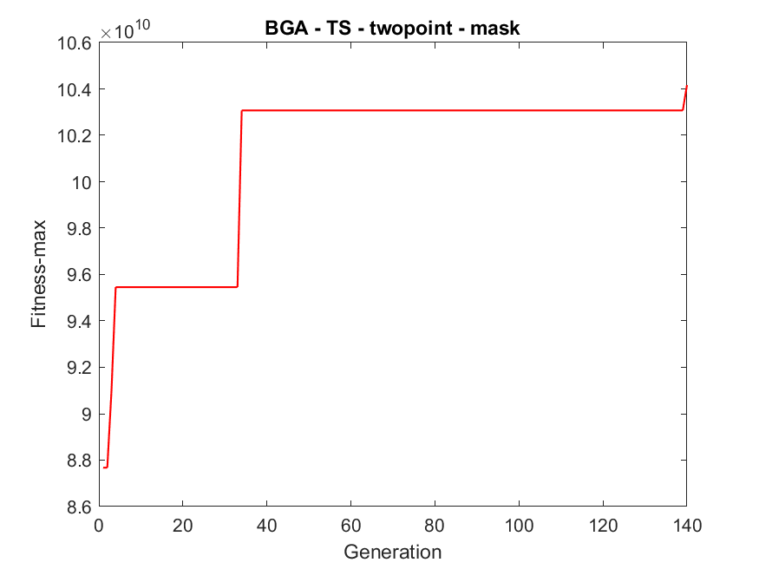
Simulation Results - BGA

Slide 11
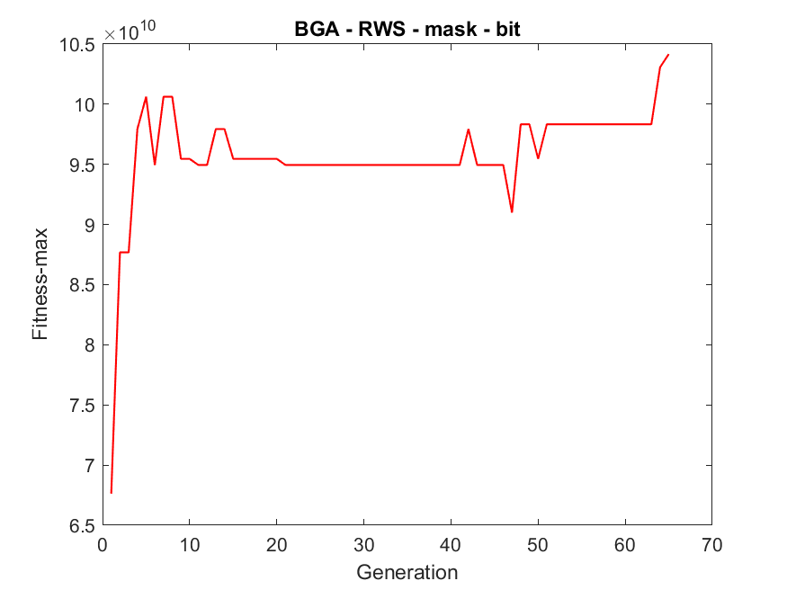
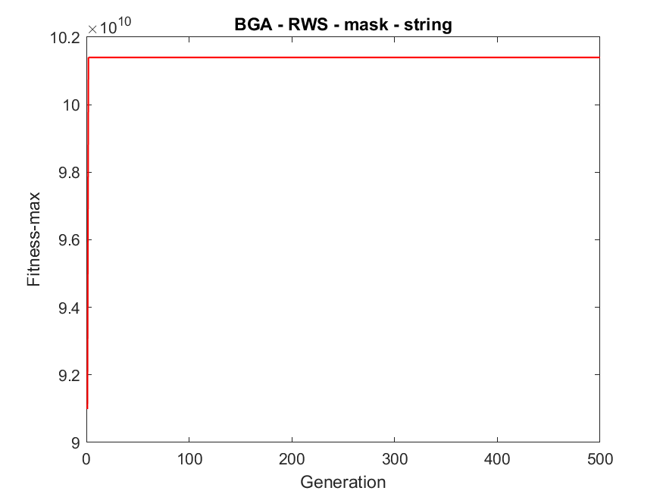
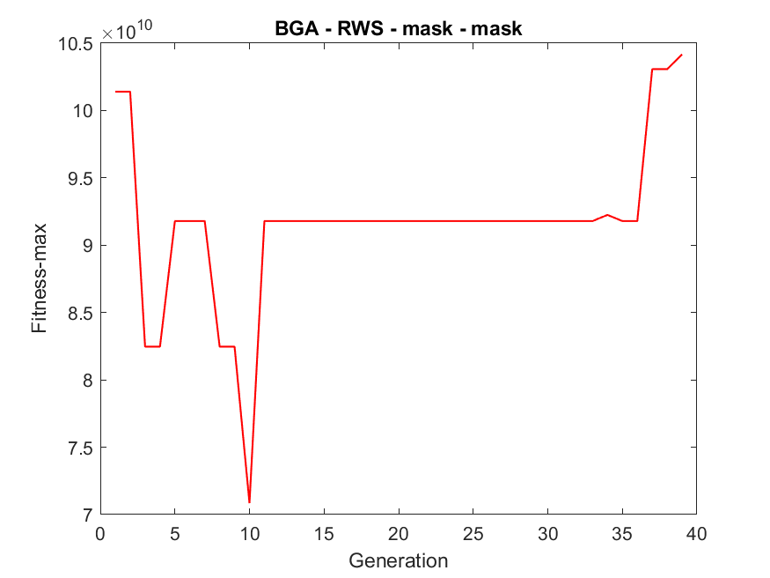
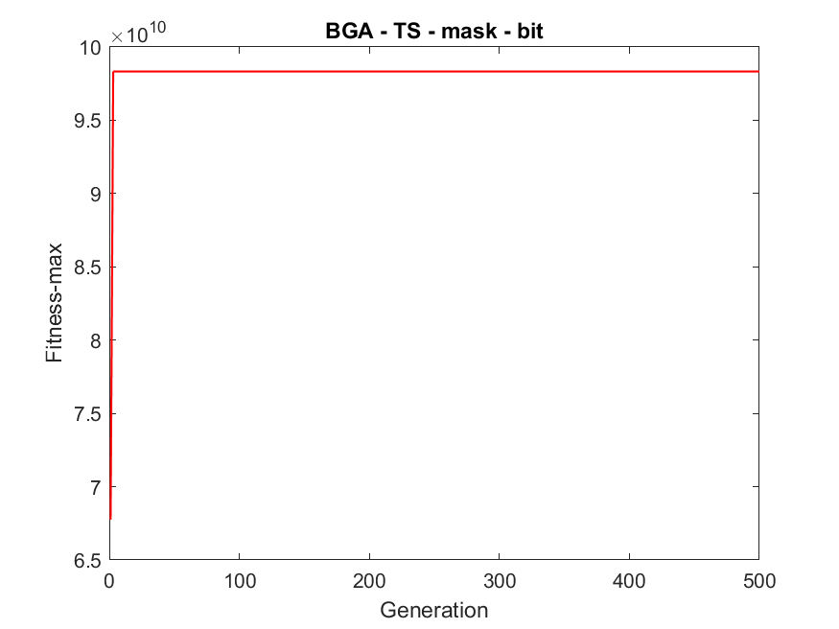
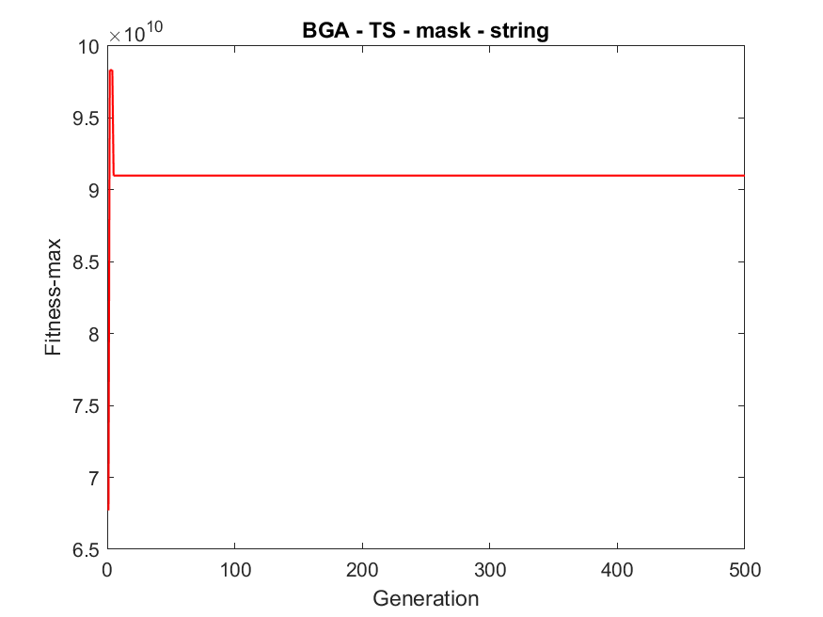
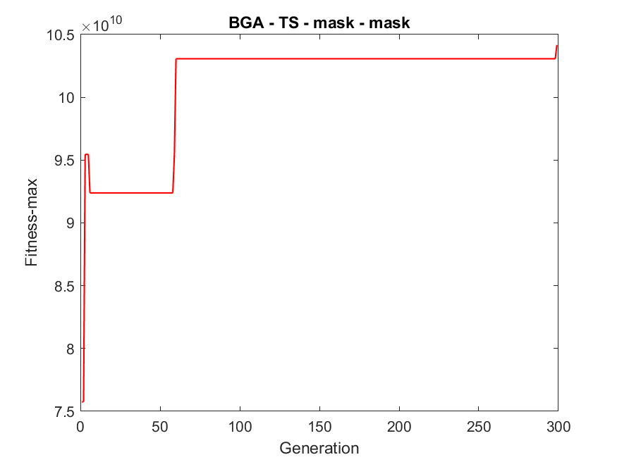
Simulation Results - BGA

Slide 12
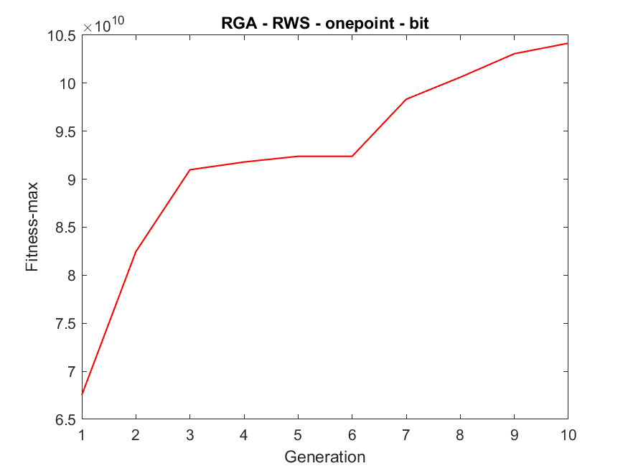
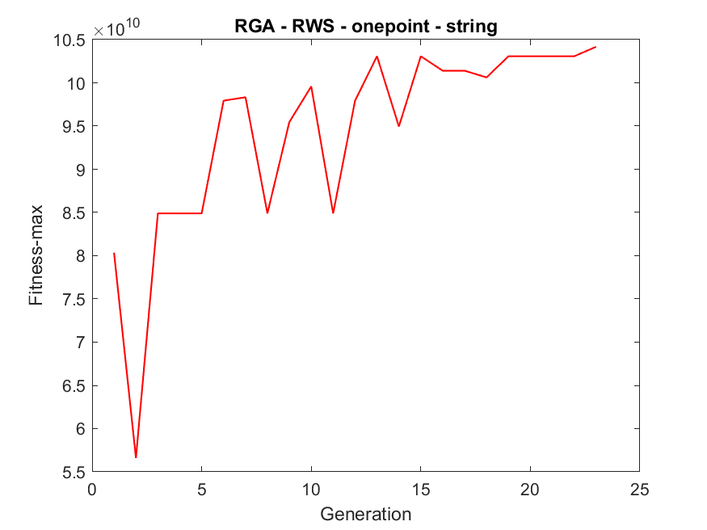
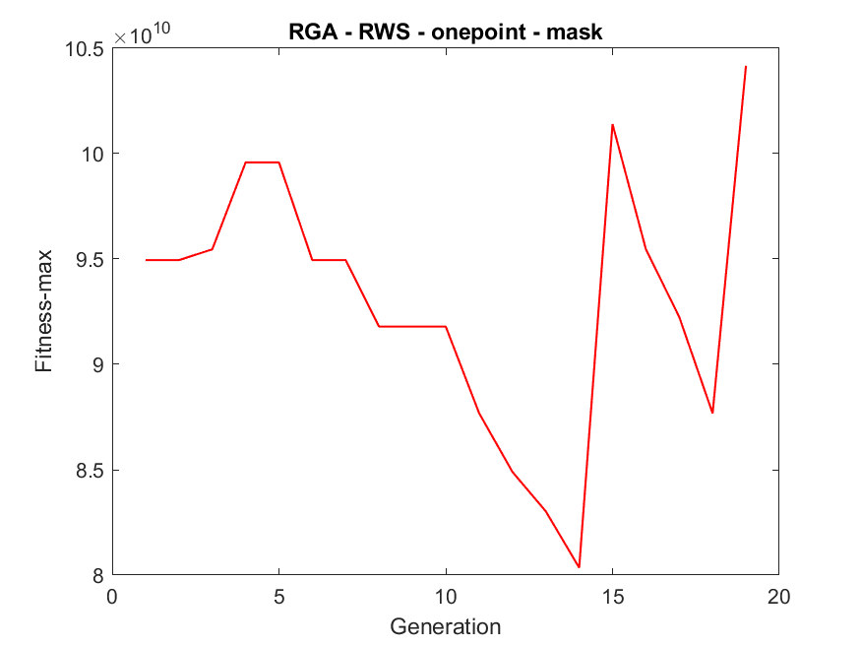
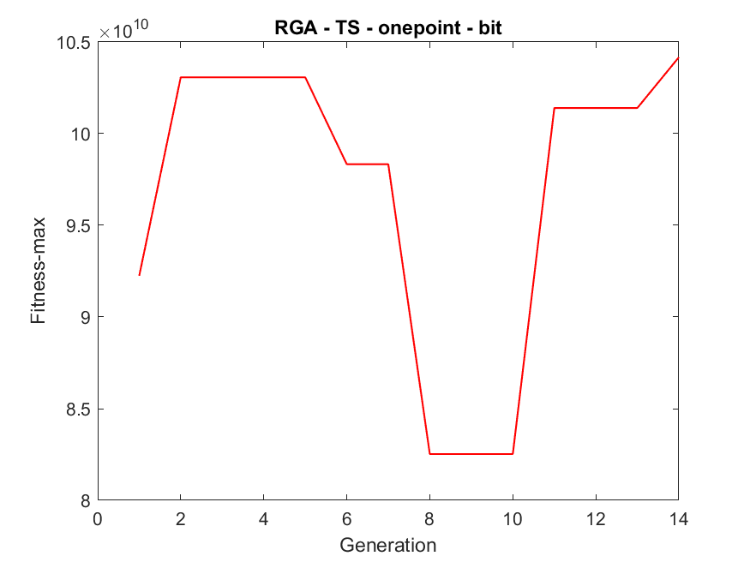
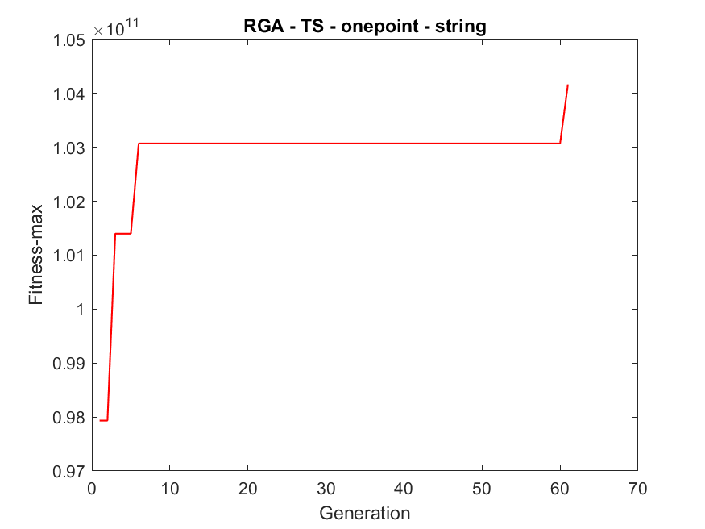
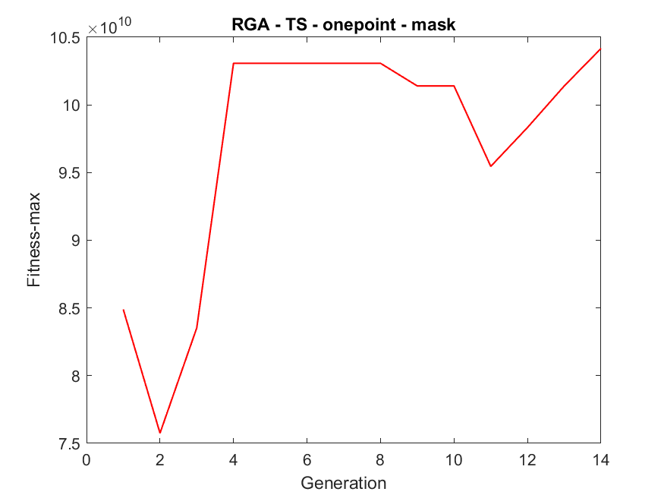
Simulation Results - RGA

Slide 13
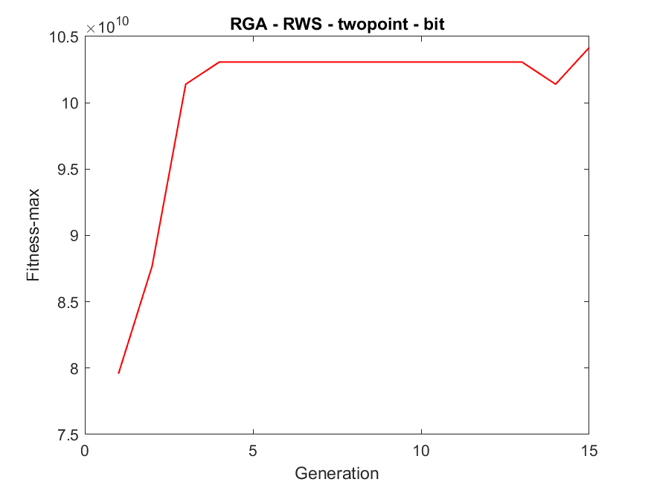
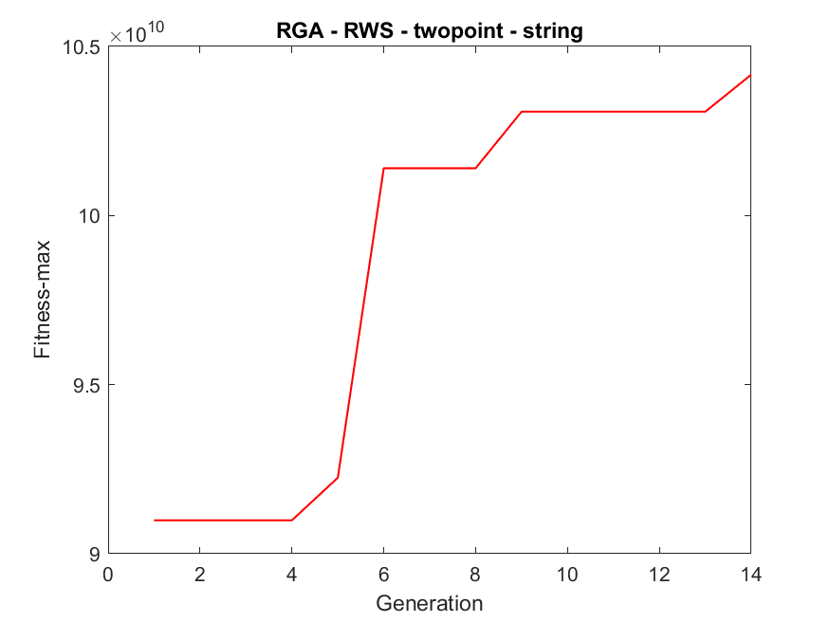
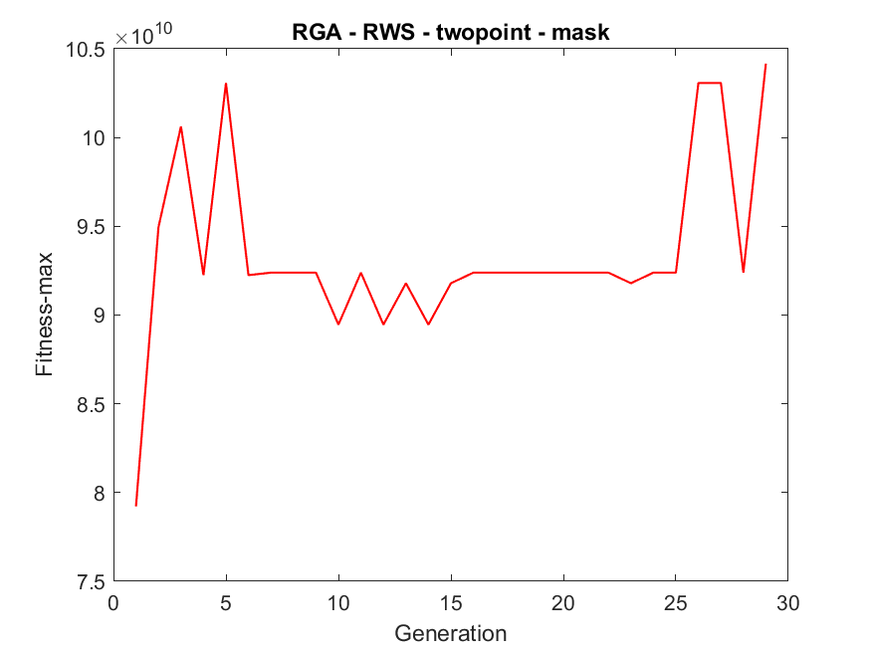
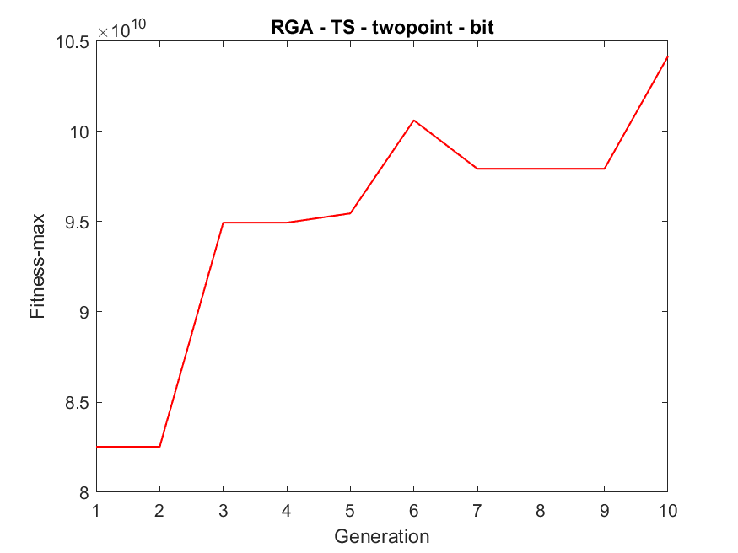
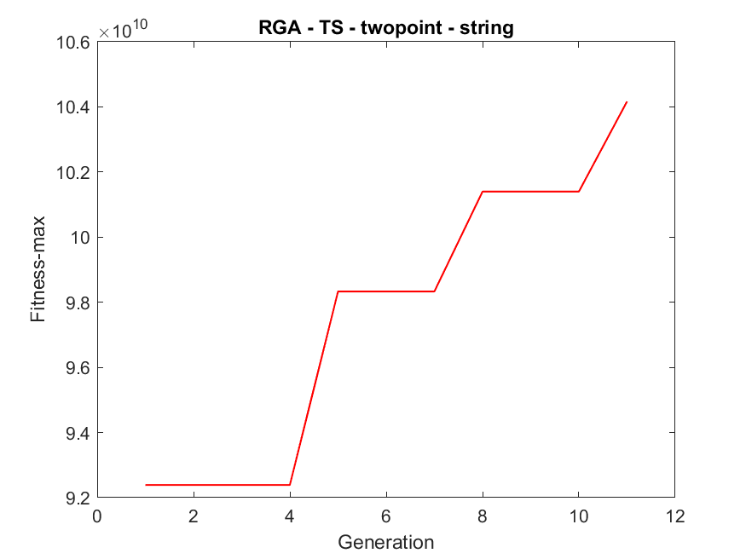
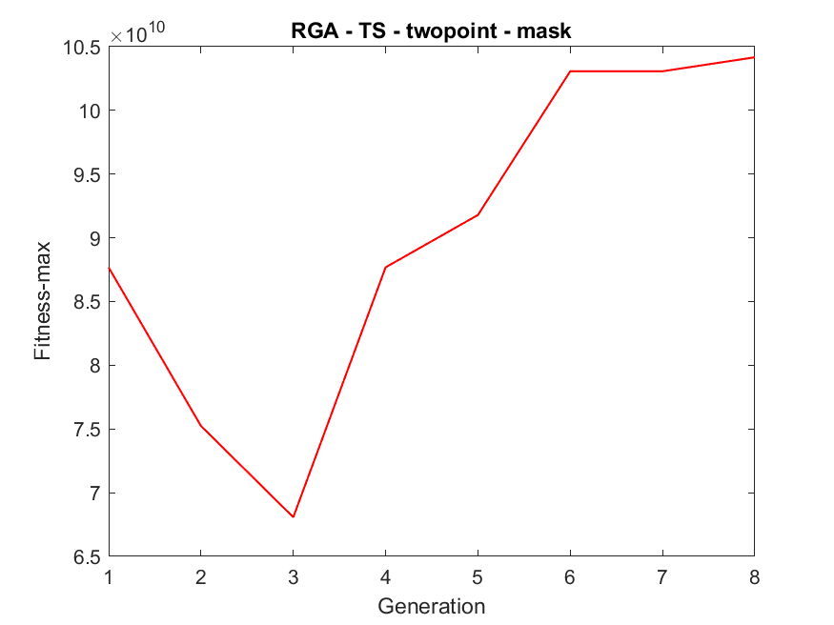
Simulation Results - RGA

Slide 14
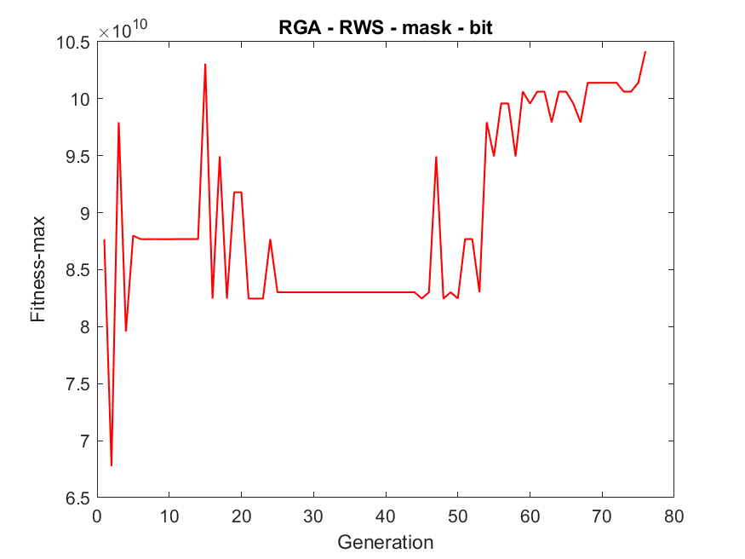
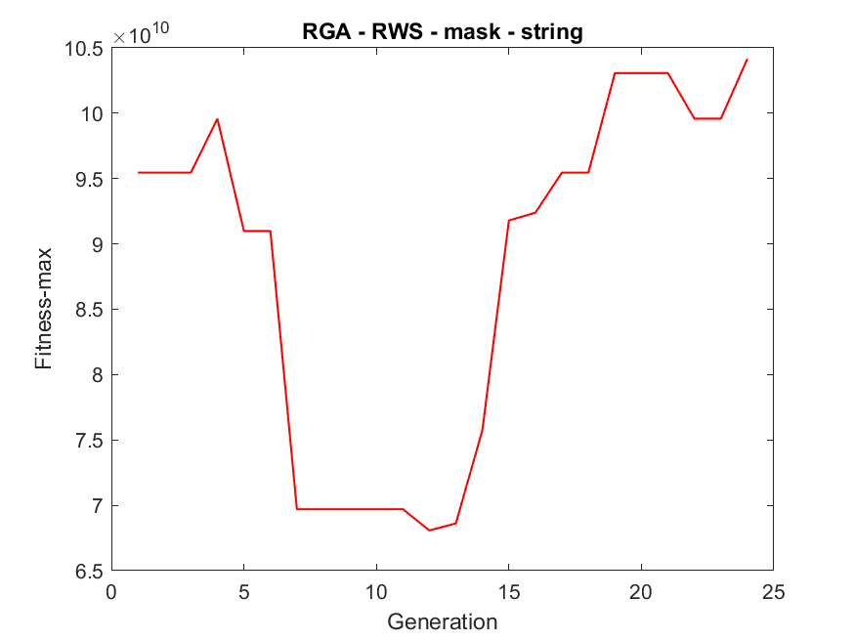
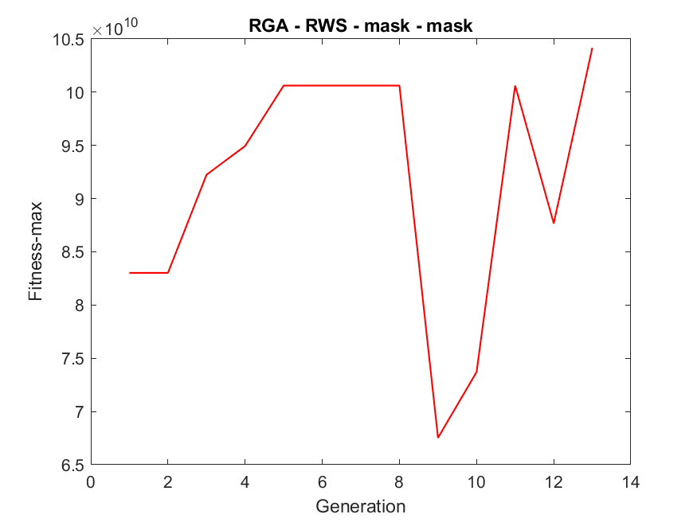
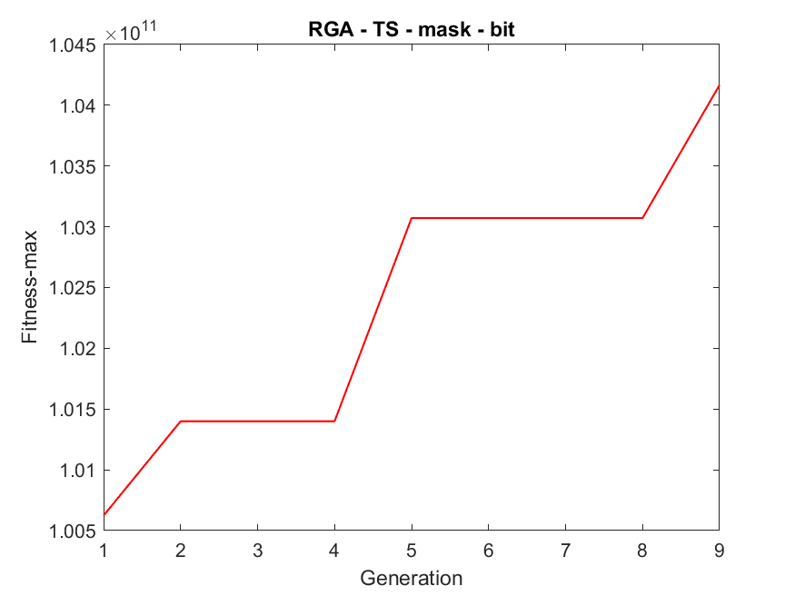
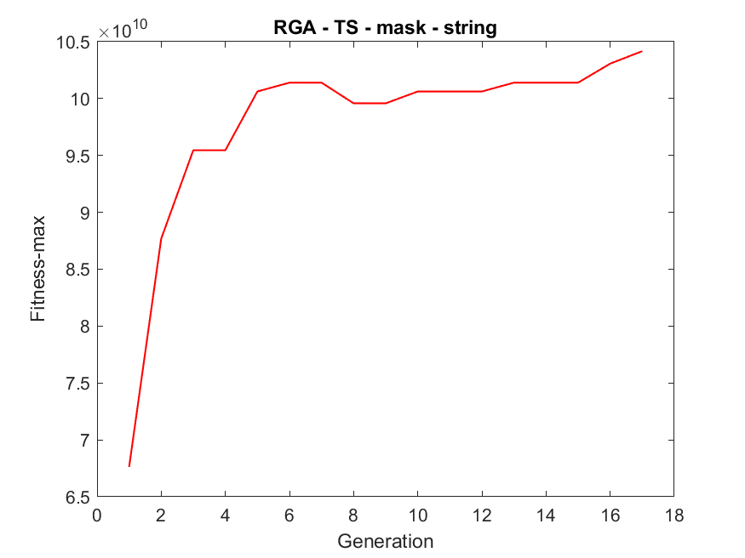
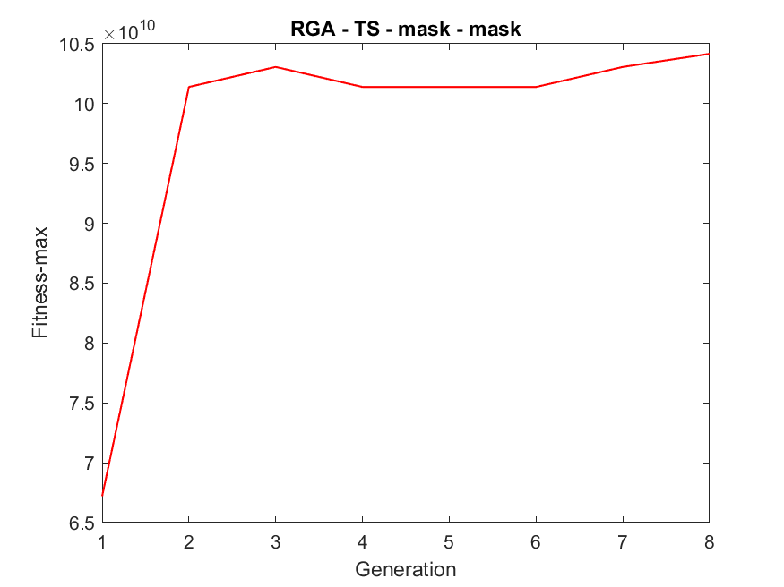
Simulation Results - RGA

Slide 15
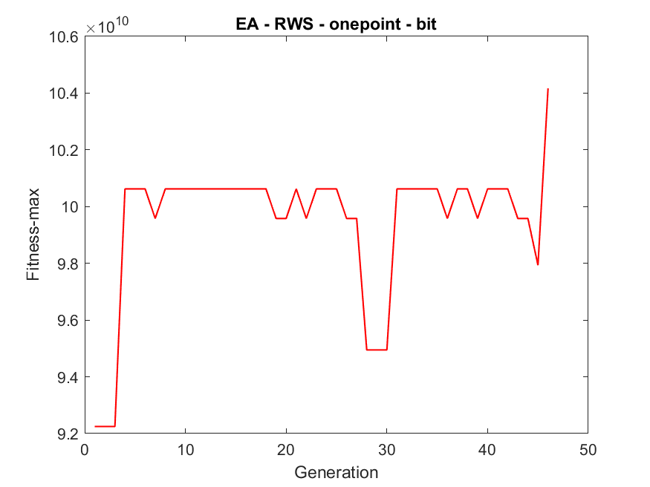
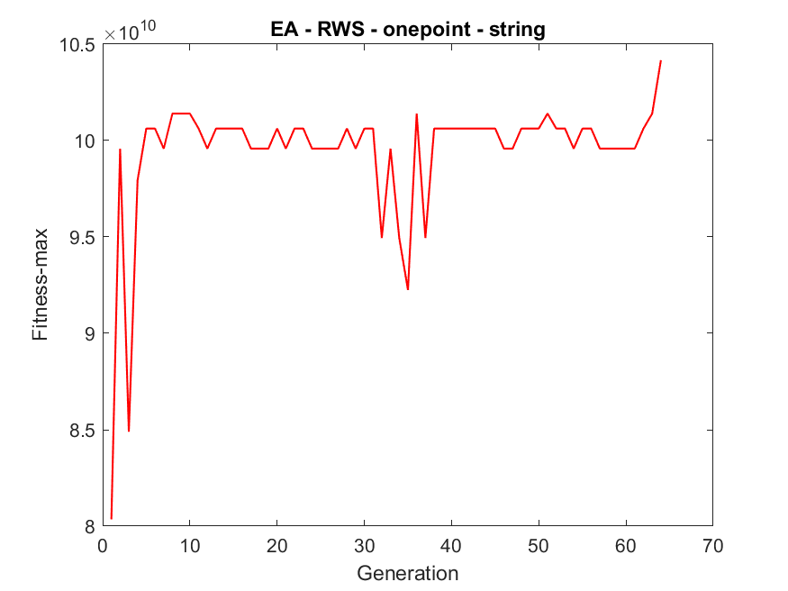
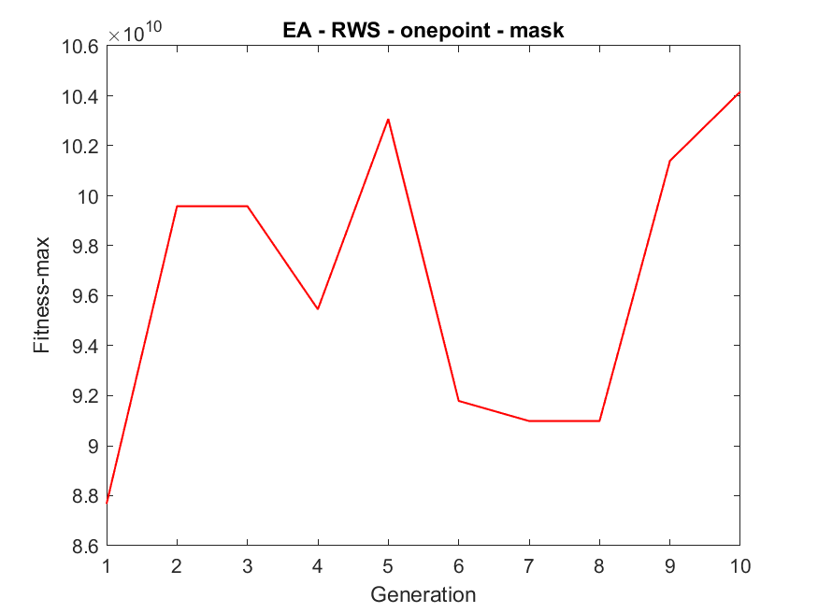
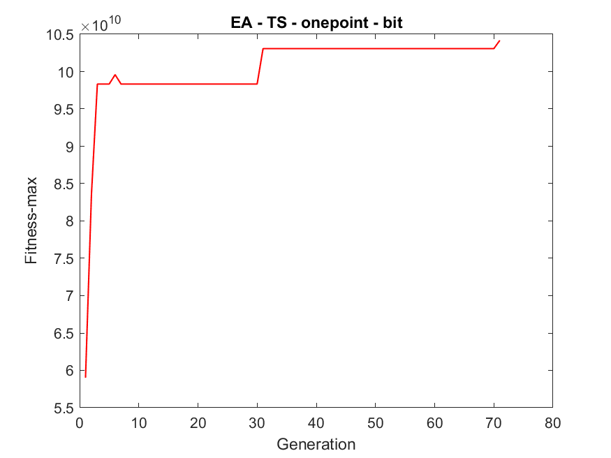
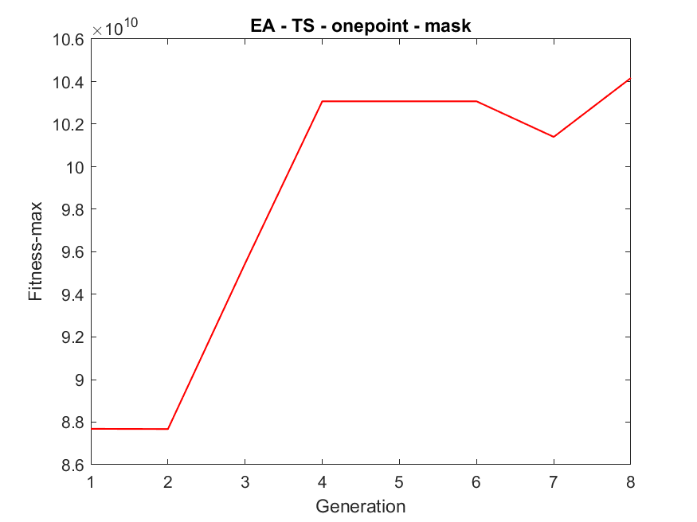
Simulation Results - EA

Slide 16
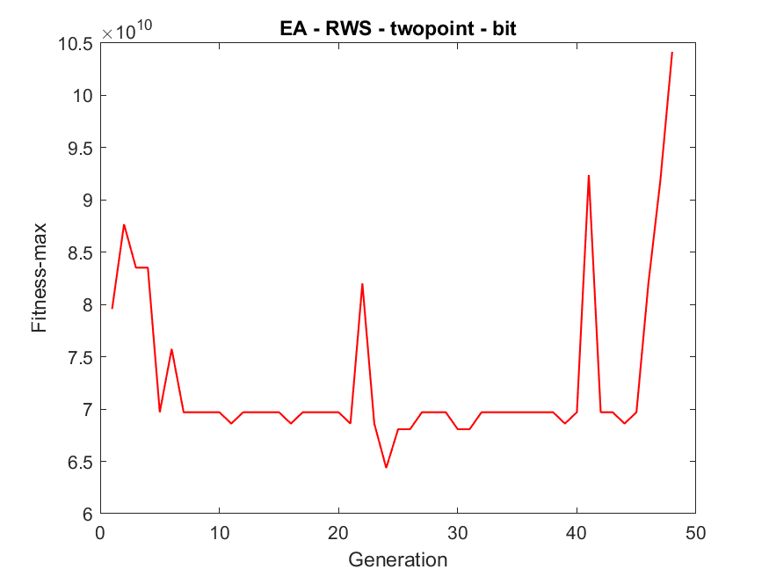
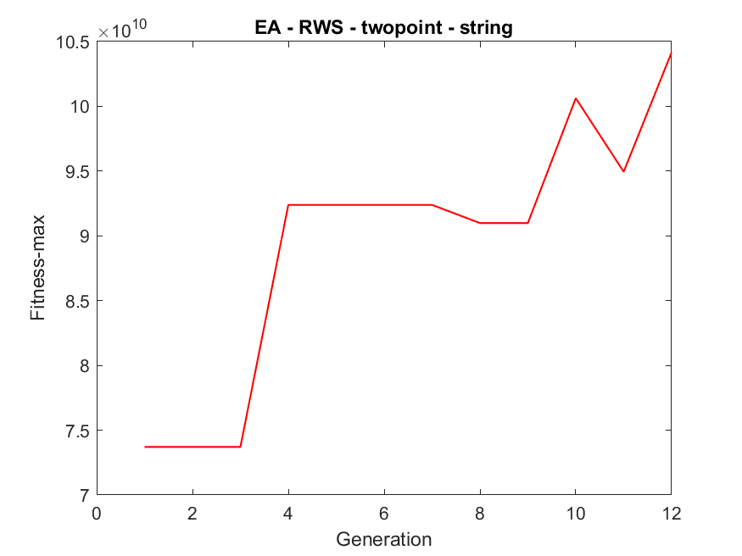
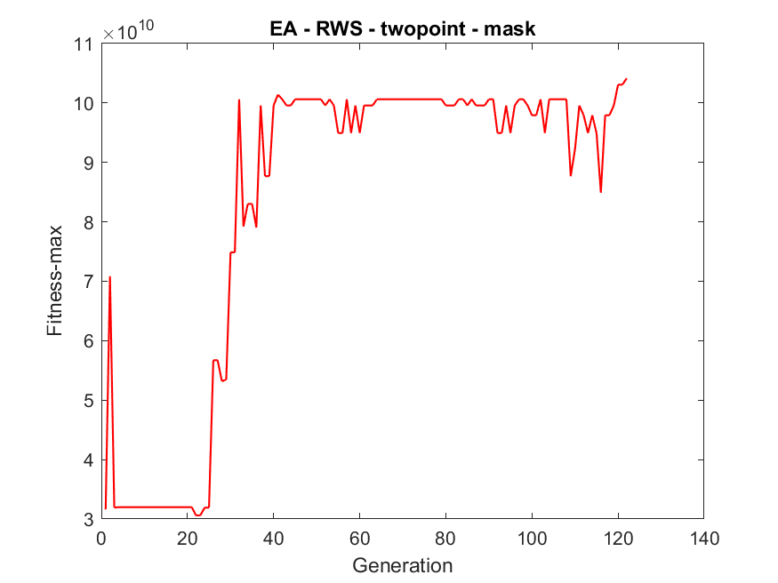
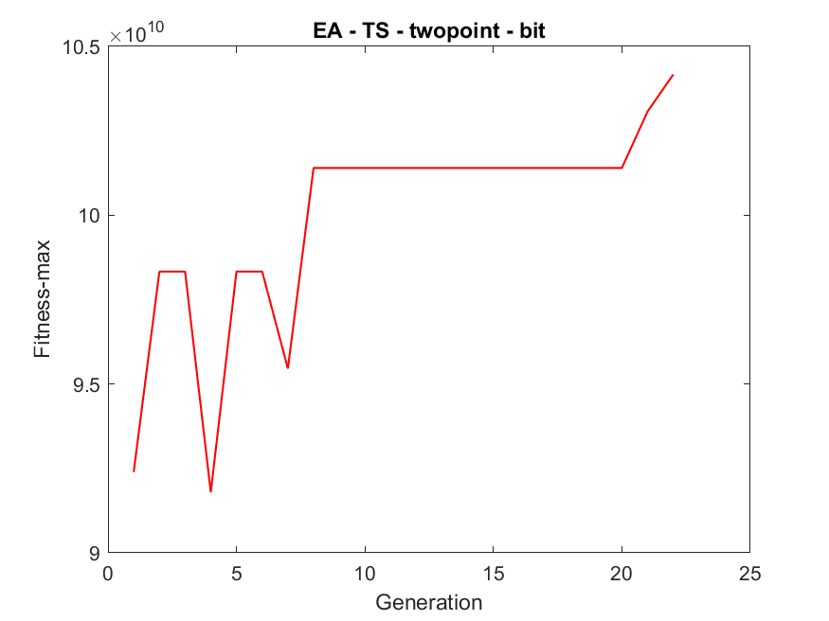
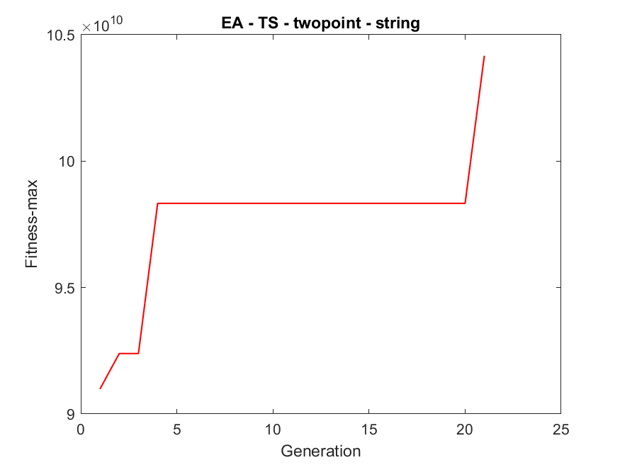

Simulation Results - EA

Slide 17






Simulation Results - EA

Slide 18
Conclusion - Analysis
x = 1.6000，f(x) = 159.7889 為最大。
在本次模擬實作中，透過三種基因演算法與兩種選擇機制進行比較與分析，首先就三種基因演算法來看，EA整體表現最為穩定且具彈性。EA能夠更細緻地在連續空間中探索目標函數的極值位置，在我實作的EA版本中，不論選用 average 或 convex 交配方法，收斂速度與最終適應度表現都相當不錯，尤其搭配Tournament Selection時效果更為明顯。相比之下，BGA雖然結構簡單、實作容易，但在變異性與解析精度上稍顯不足，特別是當使用mask交配法與mask突變法時。而RGA則在穩定性方面表現最差，可能是因為RGA在crossover時易導致解空間劇烈跳動，若無適當控制，會使族群陷入震盪，進而影響整體效能。

