Slide 1


A Knowledge Graph and LLM Based Framework
for Personalized Reading Assessment
and Management for Children
Supervisor: Prof. CHEN Ching-Han
Prof. Frank GECHTER
Student : WU Hsin-Jou
Date: 9th July 2025
Notes:
This topic is co-supervised by Prof. CHEN from NCU and Prof. GECHTER from UTBM, France.

Slide 2
Outline
Abstract
Problematic & Research Objectives
Knowledge Graph and LLM-Based Management System Design
Experimentation
Conclusion

Slide 3
Abstract
This study proposes a personalized reading assessment framework for children, combining knowledge graphs and large language models (LLMs) to overcome the limitations of traditional standardized tests. The system integrates OCR, LLM-based semantic parsing, and multi-level knowledge graph construction to track reading activities in real time and model knowledge structures dynamically. Key assessment metrics include Knowledge Quantity, Relationship Density, Cognitive Level Distribution, and Knowledge Association Density, visualized through an interactive dashboard. Evaluated on 2,600+ children’s books and a longitudinal case study, the system demonstrates its ability to monitor knowledge growth and diversity, providing a scalable, data-driven approach for personalized education. This framework highlights the potential of AI to enhance learning analytics and child literacy development.
Notes:
For the problematic,
In the age of AI, we all know that AI can read and understand the articles much more faster than human beings.
However, reading is still an important part in our life. It is essential for accumulating the vocabulary amount a person has, know how to comprehend a pieces of text.
Also, it helps develop creativity.
Reading is a lifelong learning ability.
The habit of reading should be cultivated from childhood. Therefore, how to manage the knowledge a child has is a key point.

Slide 4
Problematic
Reading Necessity and Efficiency in the Age of AI
Reading remains fundamental for children’s cognitive and language development in an AI-driven world
Reading builds critical skills:
Vocabulary growth
Comprehension
Creativity
Lifelong learning ability
Notes:
For the problematic,
In the age of AI, we all know that AI can read and understand the articles much more faster than human beings.
However, reading is still an important part in our life. It is essential for accumulating the vocabulary amount a person has, know how to comprehend a pieces of text.
Also, it helps develop creativity.
Reading is a lifelong learning ability.
The habit of reading should be cultivated from childhood. Therefore, how to manage the knowledge a child has is a key point.

Slide 5
Problematic of Children’s Reading Management
Standardized Tests
Subjective Judgment
Lack of Objective, Continuous Monitoring
Limited Visualization of Knowledge Structure
Limited Personalized Guidance
Notes:
There are some problems about the existing children’s reading management.
Standardized Tests: Over-reliance on fixed formats, lacks flexibility. → Cannot fit to the individuals.
Subjective Judgment: Teacher-based evaluation may lead to inconsistencies.
Lack of Objective, Continuous Monitoring: Difficult to track knowledge acquisition(獲得) over time.
Limited Visualization of Knowledge Structure: Unable to reflect conceptual connections between the knowledge.
Limited Personalized Guidance: The assessments do not adapt to individual learning needs.

Slide 6
Research Objectives
Knowledge extraction (crawler + LLM)
Real-time OCR
+
Reading log
Knowledge graph tracking
Evaluation framework (KG-based)
Novel framework
integrating AI and KG
in EdTech
Notes:
With the above 3 technologies,
this research proposes a framework combining OCR, LLM, and KG
to enhance personalized reading assessment.
The following are the research objectives.
Develop a mobile OCR system for real-time book identification and reading log creation.
Integrate knowledge extraction mechanisms using web crawlers and LLMs for content analysis.
Construct dynamic, visualized knowledge graphs to track children's knowledge acquisition.
Implement a multidimensional evaluation framework based on the knowledge graph.
This research propose a novel framework integrating AI and KG in EdTech.
To do the tasks including knowledge management and analysis.

Slide 7
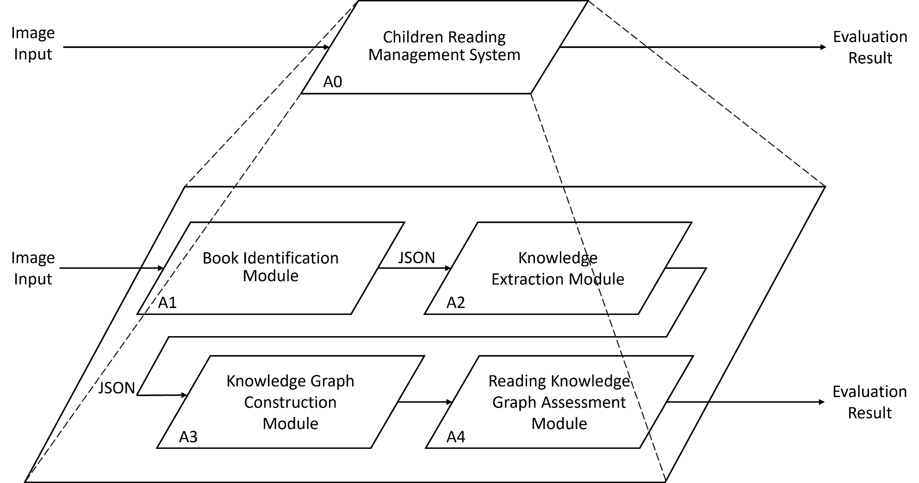
Reading Management System A0
Notes:
High-Level Architecture Diagram (Ref. Fig. 7):
A1: Book Identification Module – OCR book metadata.
---- 跳過 ----
A2: Knowledge Extraction Module – Web scraping and LLM content processing.
A3: Knowledge Graph Construction Module – Converts extracted data into structured KG.
A4: Reading Knowledge Graph Assessment Module – Evaluates reading behavior via KG.

Slide 8
Reading Management System UI Design
User
Upload image
Search condition
Result
Time Limitation
Result
Book Upload
Analysis Result
Query Knowledge Graph
Web UI
Image Recognition
Cypher query
Result
Result
Web Crawl
Cypher query
Knowledge Point Extraction
import
Neo4j Database

Slide 9
Core Assessment Metrics
Knowledge Point Quantity
Association Density
Cognitive Level Distribution
Domain Coverage
Reading breadth
Concept integration ability
Depth of cognitive engagement
Thematic diversity
Notes:
In A4, there are 4 core assessment metrices.
Knowledge Point Count representing the breadth of knowledge acquired.
Association Density: measures the number of relationships among knowledge points, representing the structural integration and interconnectedness of concepts that the reader has engaged with.
Cognitive Level Distribution measuring the depth of cognitive engagement
Domain Coverage: evaluating the variety of domains covered in the user’s reading history

Slide 10
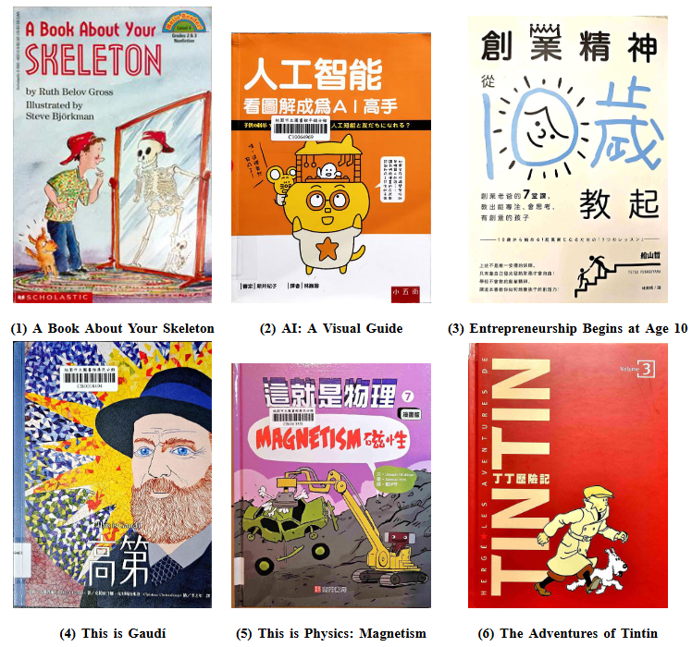
Dataset Description
Comprises over 4,000 real children’s book images
Single child’s reading history between 2022 and 2024
Wide range of domains
Science
Literature
Entrepreneurship
Art
And so on
Notes:
Mother tongue: Chinese
Books read are mainly in Chinese with English books less than 10%.

Slide 11
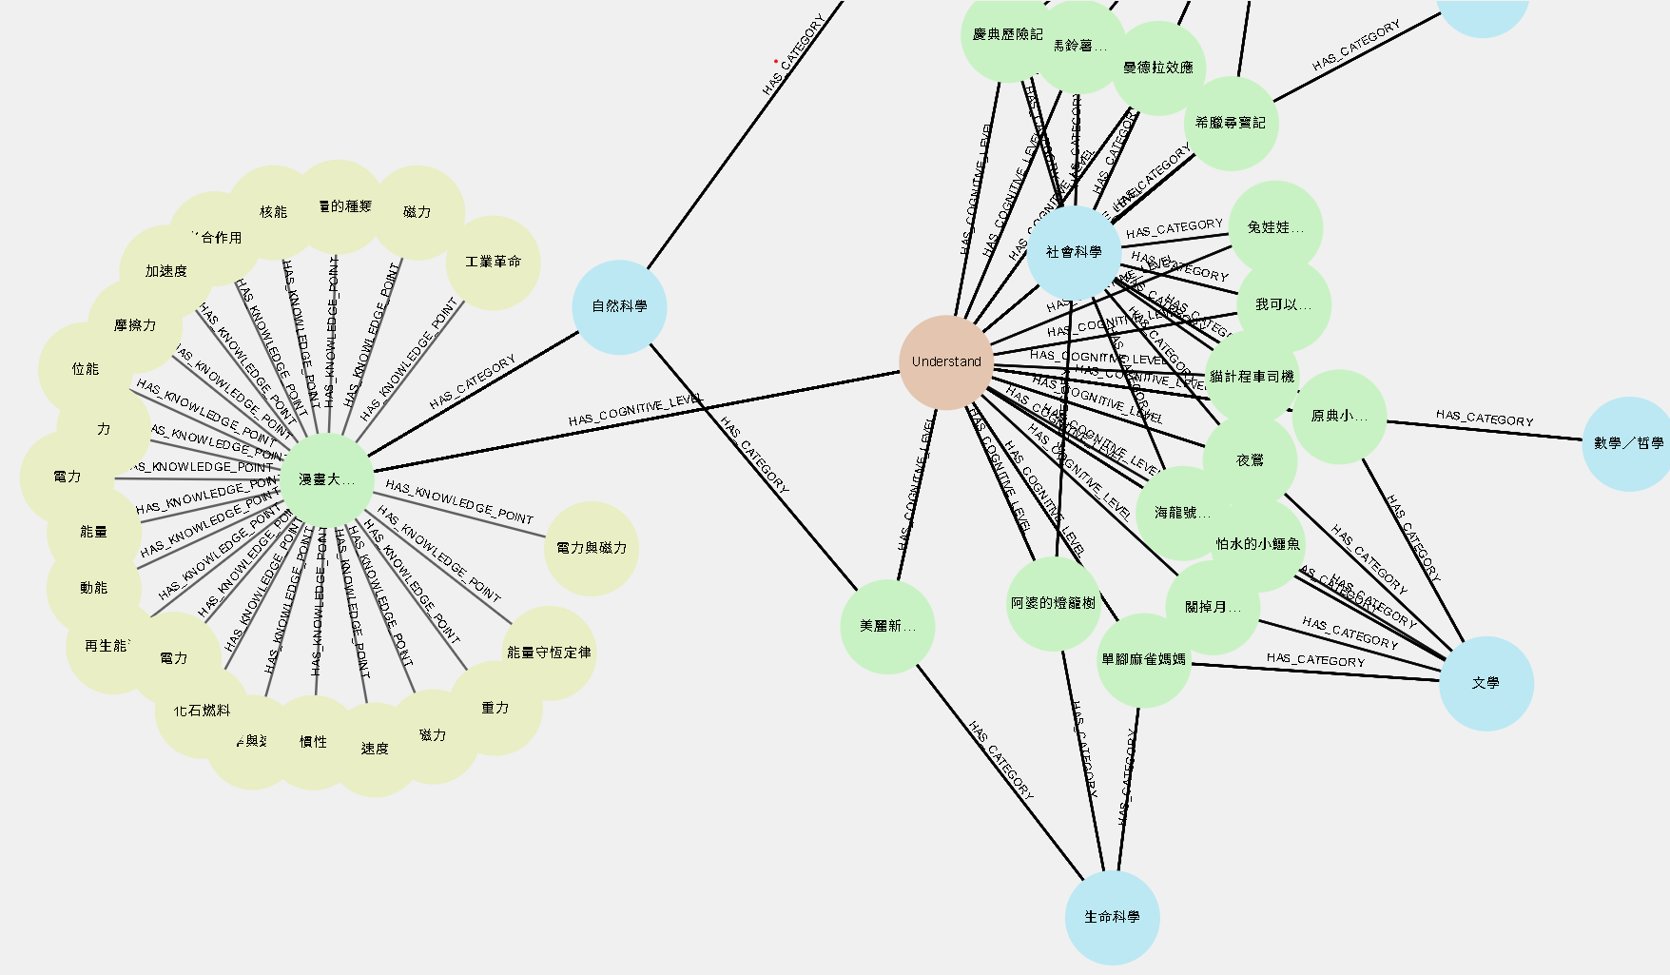
Visual Evaluation Interface Enables Multi-Dimensional Insights
Color-coded nodes stand for different type of data nodes:
Pink → Cognitive Level
Blue → Category
Green → Book
Yellow → Entity (Knowledge)
Color-coded by title, domain, cognitive level → Reflects knowledge structure
Notes:
The nodes are Color-coded according to title, domain, cognitive level
→ Reflects knowledge structure
(color codes)

Slide 12
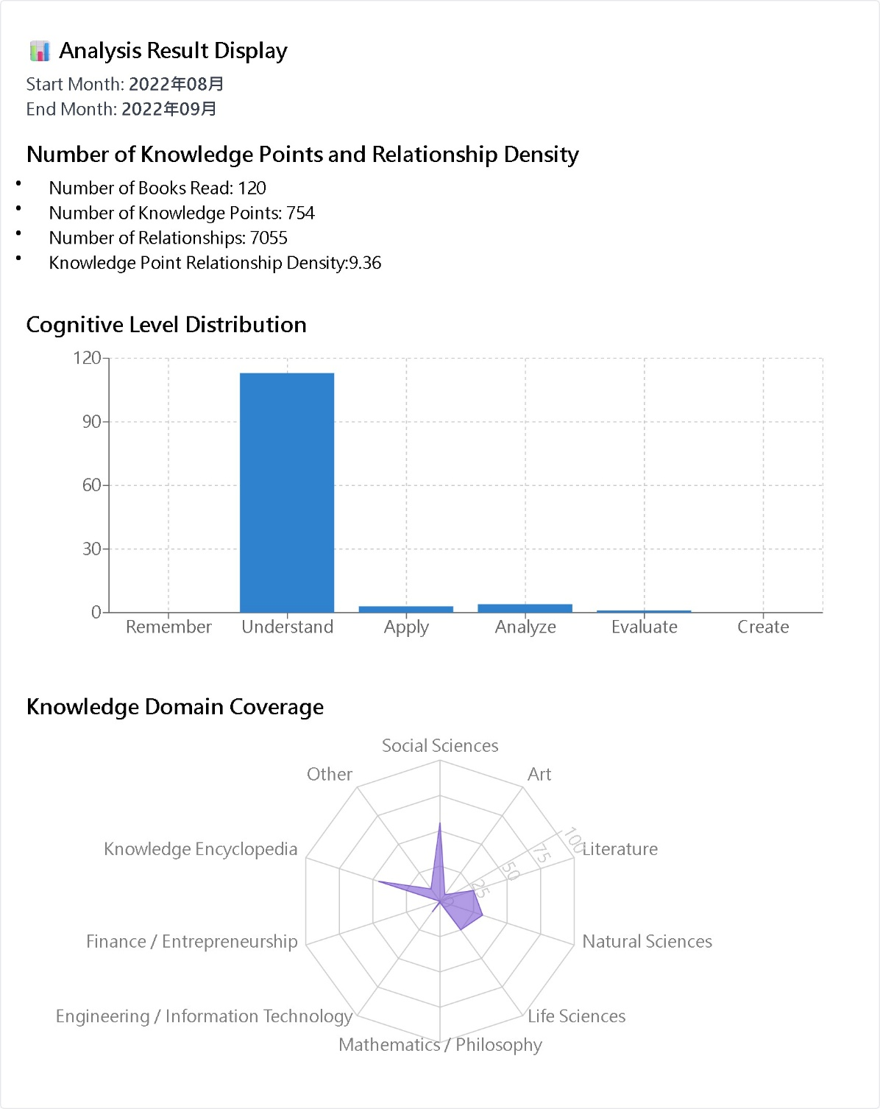
Visual Evaluation Interface Enables Multi-Dimensional Insights
Multi-dimensional insights from the visualized evaluation interface, enabling parents and teachers to track a child’s reading progress.
Notes:
It is how an analysis result is presented.
Not only number, but the bar chart and radar chart.

Slide 13
Quantitative Growth of Knowledge Acquisition Over Time (Statics)
Time | Jan-Feb 2023 | Jan-Apr 2023 | Jan-Jun 2023 | Jan-Aug 2023 | Jan-Oct 2023 | Jan-Dec 2023
Number of Books Read | 57 | 287 | 630 | 759 | 827 | 899
Number of Knowledge Points | 378 | 1541 | 2818 | 3333 | 3519 | 3784
Number of Relationships | 3318 | 16681 | 33857 | 41140 | 45113 | 49085
Knowledge Point Relationship Density | 8.78 | 10.82 | 12.01 | 12.34 | 12.82 | 12.97
Knowledge Accumulation
Notes:
This is a example analysis from 2023. The time slot is every two months.
From the records, we can see how the knowledge is accumulated.
This Demonstrates effective and scalable knowledge tracking.
Validates system’s capacity to reflect the knowledge growth.

Slide 14
Conclusion
Combine OCR, LLM, and web crawling to extract and structure knowledge from physical book covers, stored and visualized using Neo4j.
Multi-Metric Assessment using four indicators—knowledge count, relation density, cognitive depth, and domain coverage—presented through an interactive dashboard.
Longitudinal Insights: Tracks reading growth over time, enabling dynamic monitoring and personalized learning insights.
OCR
LLM
Knowledge Graph
Notes:
This study presents a novel GenAI-based Children Reading Knowledge Management System that integrates OCR, LLM, and Knowledge Graphs to address key limitations in knowledge management and traditional reading assessment methods.
By shifting from standardized tests and subjective evaluations to a data-driven, automated framework, the system enhances the visibility and analyzability of children's knowledge acquisition during reading.
The major contributions include:
Innovative Technical Integration, combining OCR, LLM, and web crawling technologies for the automated extraction of textual and semantic information from physical book covers.
The information is structured and visualized using Neo4j-based knowledge graphs, demonstrating the feasibility and effectiveness of this AI-enhanced educational framework.
Multi-Dimensional Reading Assessment using four key indicators—Knowledge Quantity, Relation Density, Cognitive Level Distribution, and Domain Coverage—offer a comprehensive evaluation of reading depth and breadth, all visualized through an intuitive interface for educators and parents.
Dynamic Tracking and Analysis allows Users to perform longitudinal analysis of reading trends. Capable for monitoring knowledge development and reading preferences over time. Also, provide an personalized learning insight for each individuals.
In summary, this research validates a scalable, GenAI-powered approach to children’s reading knowledge management and evaluation, creating new tool for personalized, intelligent educational tools.

