Slide 1
Relay Pin Control
2024/07/09
Author : Raymond

Slide 2
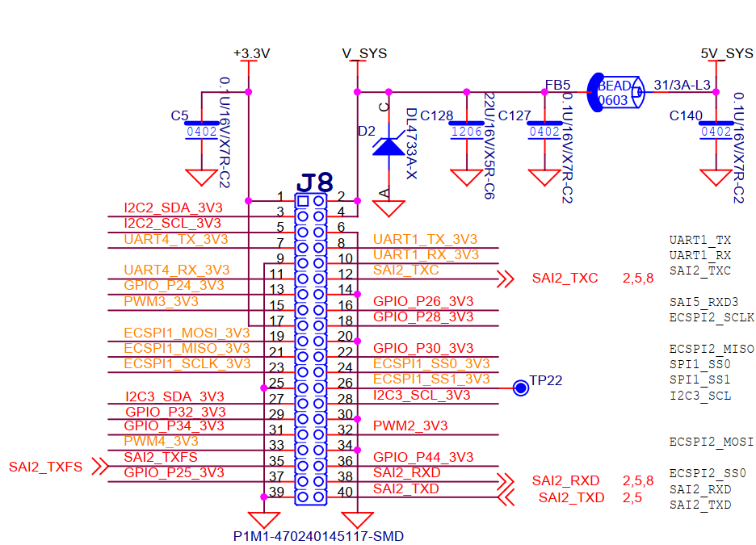
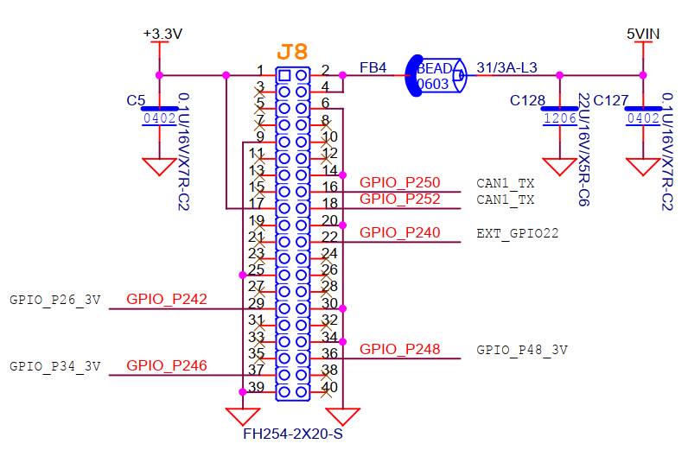
HW Schematic: GPIO usage
PICO-PI-8M
TN254 Relay
Find out the GPIO mapping between two platform

Slide 3
Pin mapping
PICO-Pi-8M | Pin Match | TN254_REBOOT-TEST-RELAY | Relay port Label | Command Chip/line
GPIO_P26 | 16 | P250 | DCOUT1 | gpioset gpiochip2 16=1 (ON) gpioset gpiochip2 16=0 (OFF)
GPIO_P28 | 18 | P252 | DCOUT2 | gpioset gpiochip2 6=1 (ON) gpioset gpiochip2 6=0 (OFF)
GPIO_P30 | 22 | P240 | DCOUT3 | gpioset gpiochip2 7=1 (ON) gpioset gpiochip2 7=0 (OFF)
GPIO_P44 | 36 | P248 | DCOUT4 | gpioset gpiochip4 20=1 (ON) gpioset gpiochip4 20=0 (OFF)
GPIO_P25 | 37 | P246 for 3.3V/5V LED1/2 control | N/A | gpioset gpiochip2 0=1 (ON) gpioset gpiochip2 0=0 (OFF)
GPIO_P32 | 29 | P242 | DCOUT5 | gpioset gpiochip2 8=1 (ON) gpioset gpiochip2 8=0 (OFF)

Slide 4
Concept
Check the LED when power ON OFF
Command
Relay
gpioset gpiochip2 16=0 (OFF)
DCOUT1
LED
gpioset gpiochip2 6=1 (ON)
DCOUT2
DUT2
gpioset gpiochip2 7=0 (OFF)
DCOUT3
gpioset gpiochip4 20=1 (ON)
DCOUT4
DUT1
gpioset gpiochip2 8=1 (ON)
DCOUT5
Power Supply
DC IN
Control power to ON /OFF for DUT

