Slide 1
MindSetAlarmClock
Harsimranjeet Singh , Eliezer Ruiz , Thuy Tien Nguyen (Penelope)

Slide 2
Objective
To encourage students to wake up on time and practice concepts learned in the class through an interactive android application
Audience
This application is Marketed toward college students and lifelong learners who aspire to learn Computer Science and its applications.

Slide 3
Problems and Its Solution
Most of us in college tend to sleep late and wake late in the mornings which causes us to miss class or important meetings that may impact us negatively.
The app is designed to help all students to reinforce habits of waking up on time through interactive learning and build good habits

Slide 4
Functionality
This application is fairly easy to use and self explanatory.
Application tracks time and use alarm to indicate time selected by the user.
The key functionality of the alarm clock is that it cannot be turned off until the user solve a mathematic problem.

Slide 5
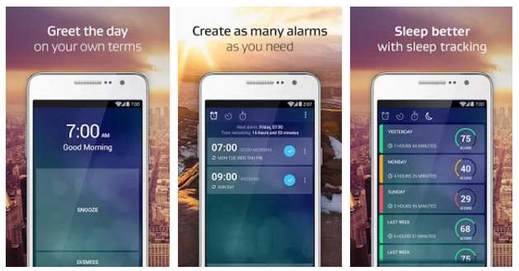
Related Work Alarm Clock Xtreme Free +Timer
Alarm Clock Xtreme Free +Timer

Slide 6
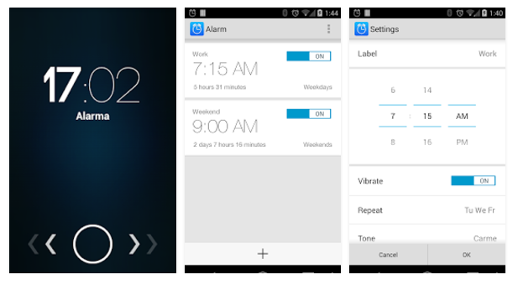
Alarm by Angel Arias

