Slide 1
Cloud Based Parking System
By
Harmeet Singh-16233090
Rajarshi Tarafdar-16232740

Slide 2
Why?
In today’s era every thing is becoming online. Why to waste time finding a parking spot for your vehicle on the destination ? When you can reserve the spot in one touch from anywhere.

Slide 3
Features of the application
There will be O-Auth signing in for the app.
Map and list view will be provided for the locations.
Users can book the slots with priority timing.
Available parking slots will be found out.
Email Confirmation on booking with details and link for payment.
Cloud based payment gateway with paypal.
Secured as it is fully controlled by paypal where they can link there debit and credit card..
User can get the reservation details, cancel it at any time or delete its account.

Slide 4
Technologies used
Google Api”s
Paypals Sdk
Boot Strap for designing
Mean Stack
Android
Node js
Express js
Angular js
Cloud based Mongo DB

Slide 5
Parkwhiz api
Free API
Add pricing Location
Add Pricing
Add Availability

Slide 6
Rest Service Call
Fetching the parking details
Shown in list and map view.
Reserve respective slots
Use gmail as a service in node js to send email confirmation

Slide 7
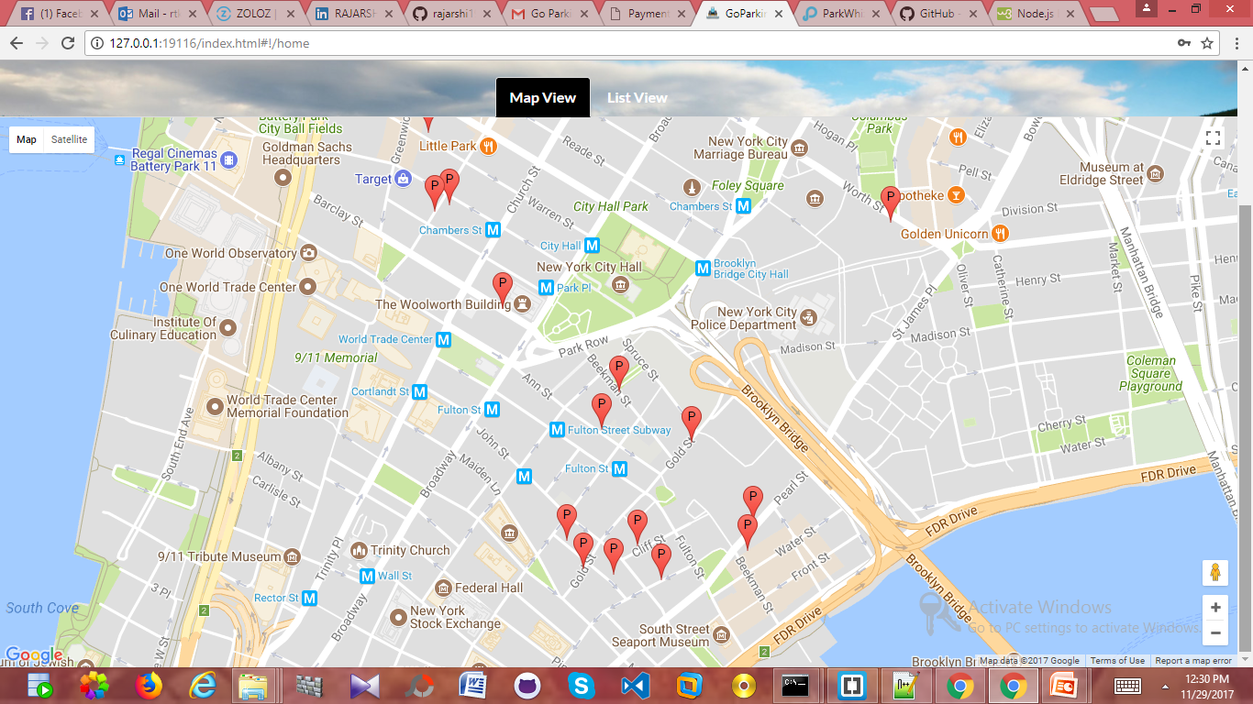

Slide 8
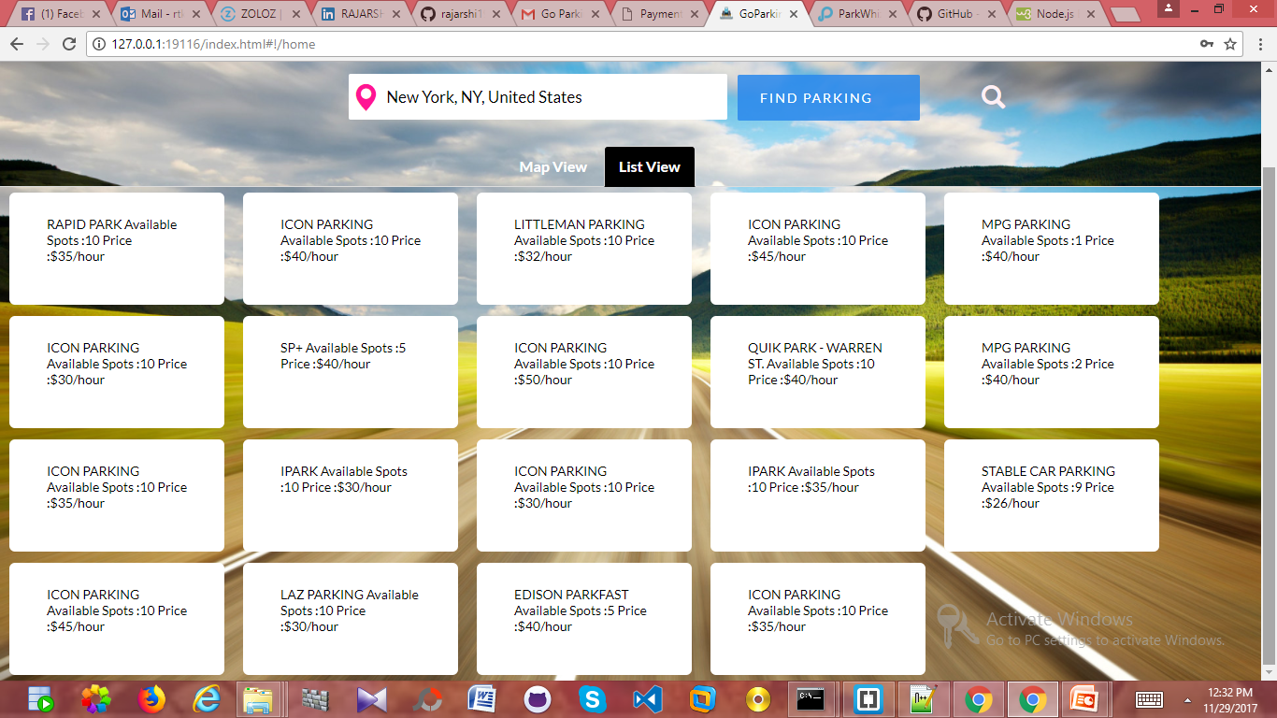

Slide 9
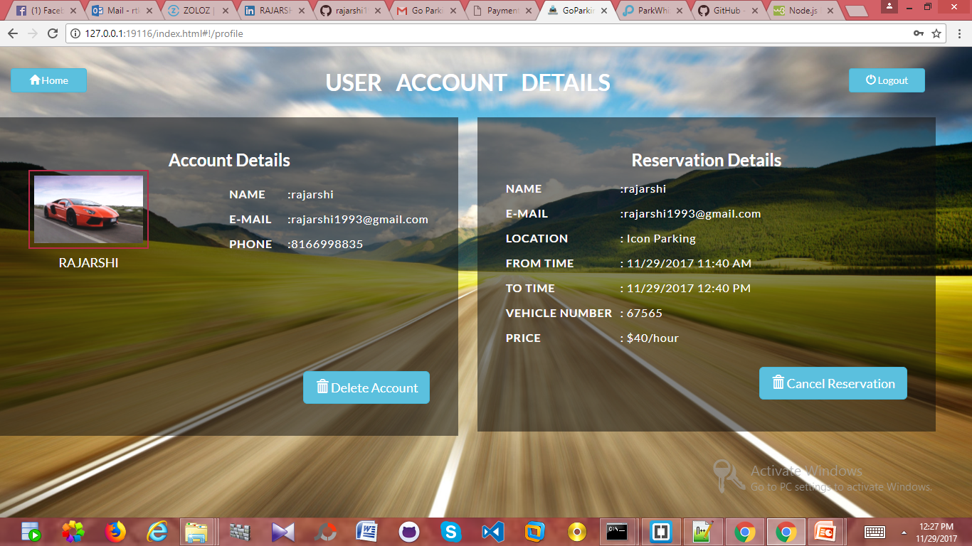

Slide 10
Integration of Payment Gateway
Email Confirmation is sent.
It can be modified for multiple users.
Payment Link is sent.
Paypal SDK
Use of Local tunnel.
Sandbox accounts in paypal for creating virtual testing environment.

Slide 11
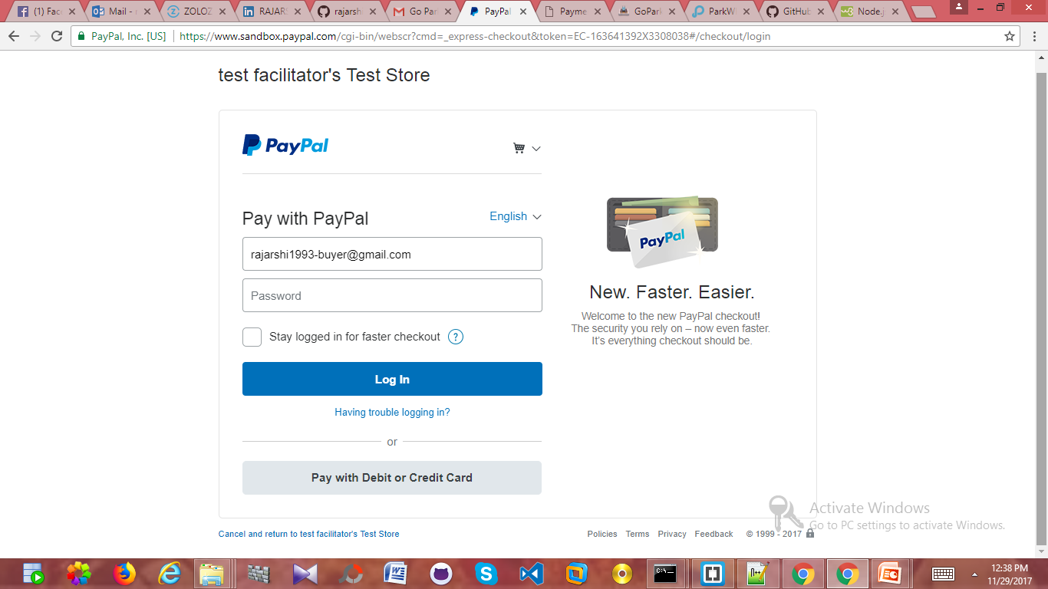

Slide 12
FUTURE SCOPES
Can be implemented in UMKC Parking system for the ease to access.
Effective and Cheaper environment

Slide 13
REFERENCES
http://www.go-parking.com/
https://www.parkwhiz.com/developers/
https://nodejs.org/en/get-involved/development/
https://developer.paypal.com/
https://www.npmjs.com/package/node-local-tunnel

Slide 14
Links
Github Link-https://github.com/hsingh08/Cloud-Computing-Project
Video-https://www.youtube.com/watch?v=U0bYSbOry0g&feature=youtu.be

Slide 15
Thankyou

