Slide 1

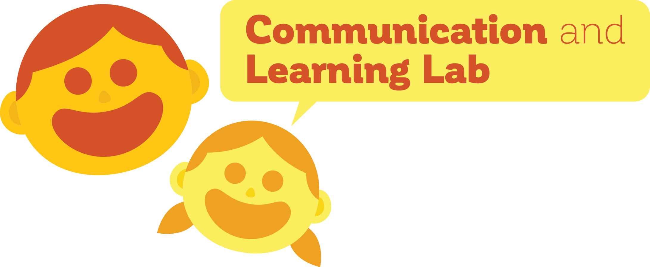
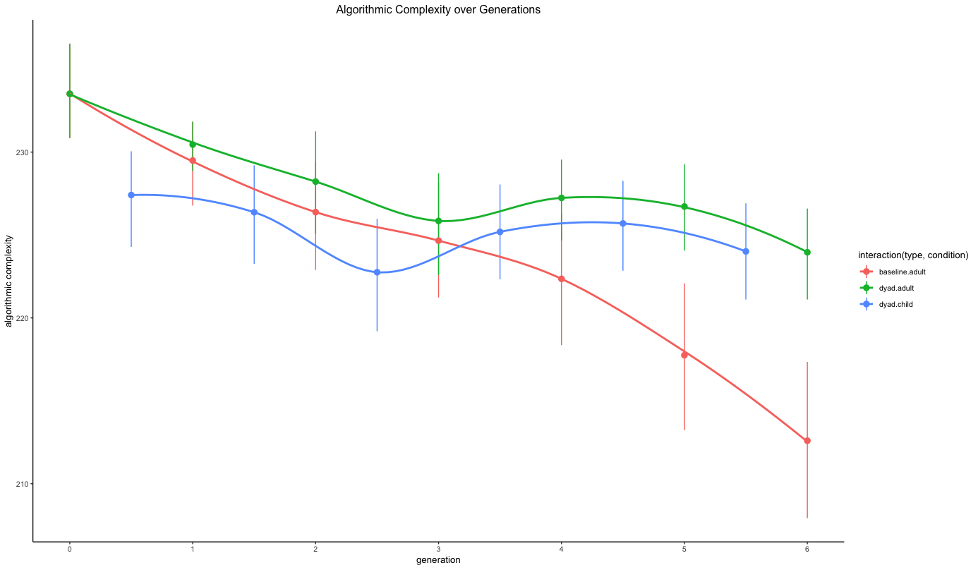
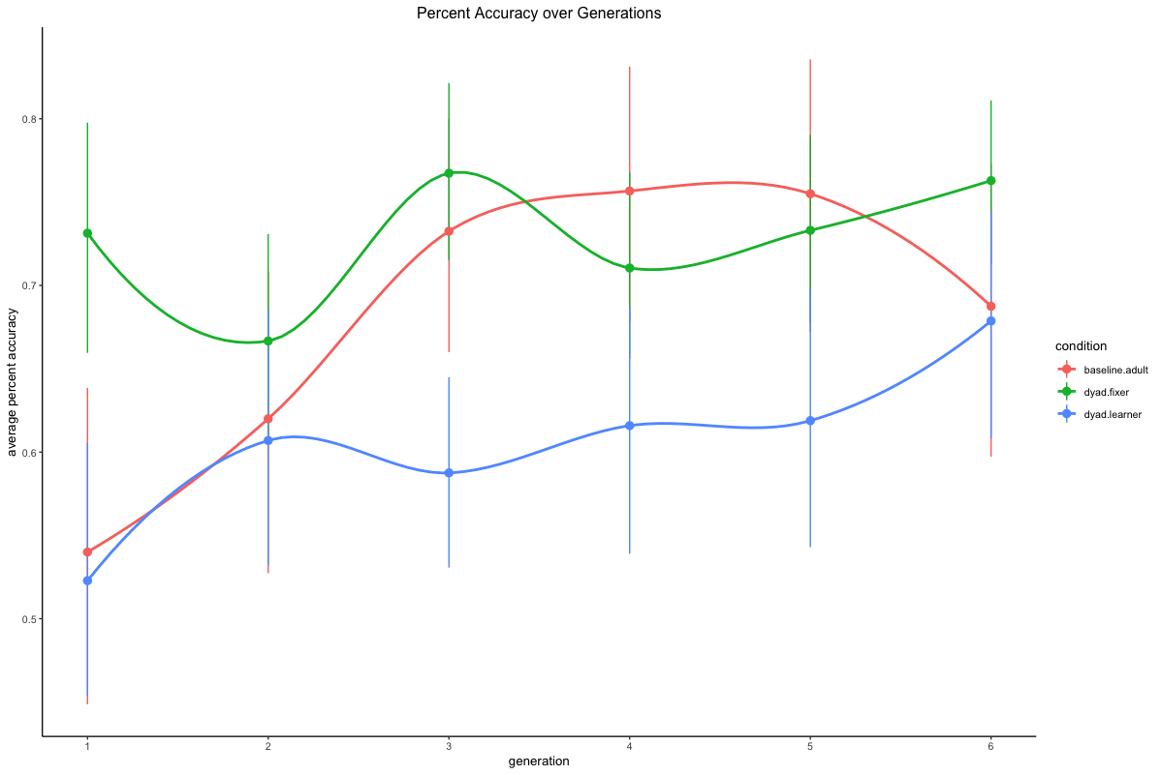
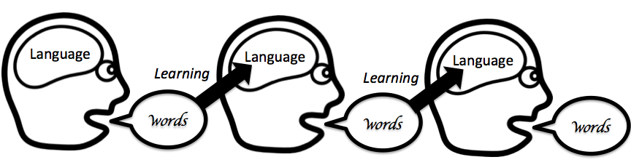
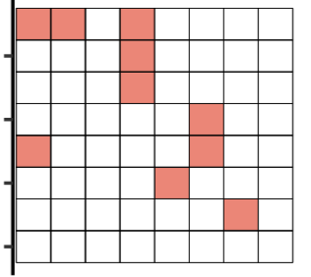
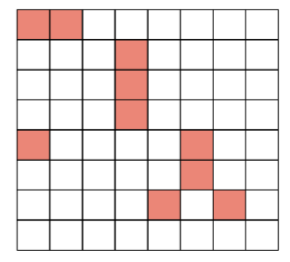
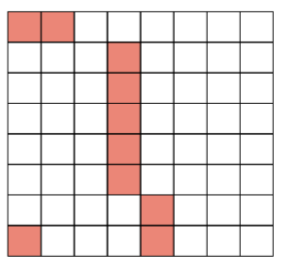
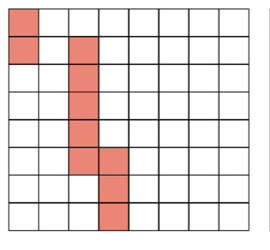
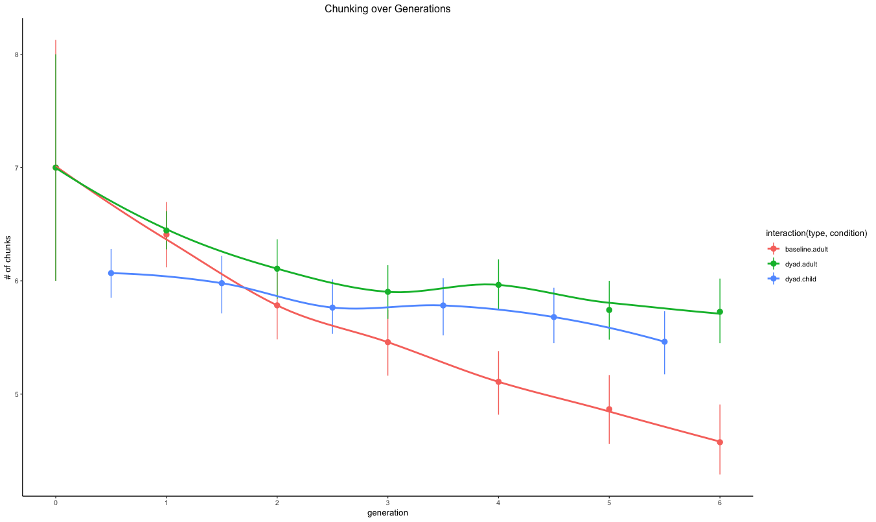
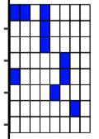
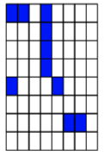
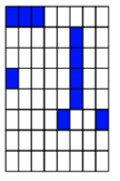
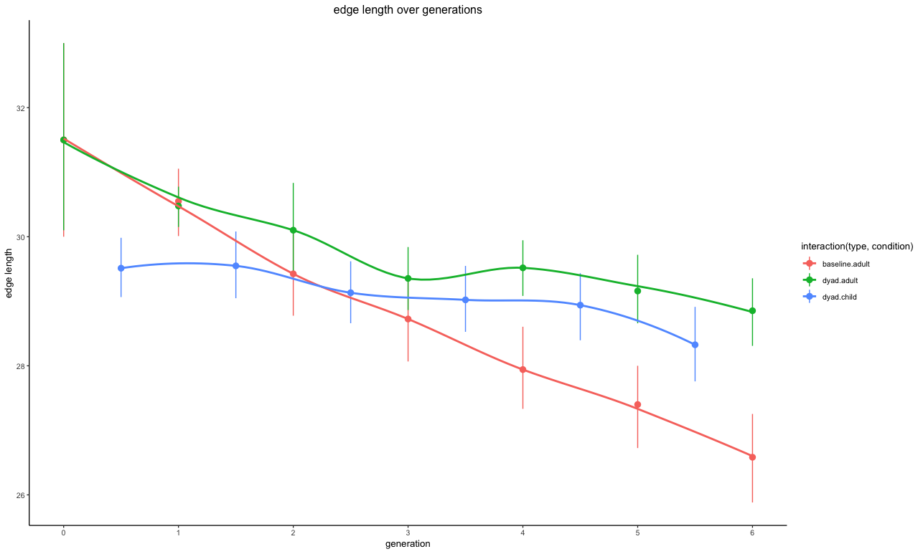
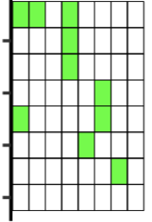
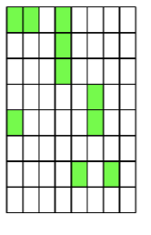
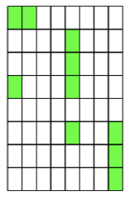
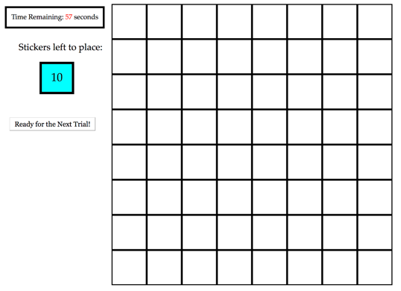
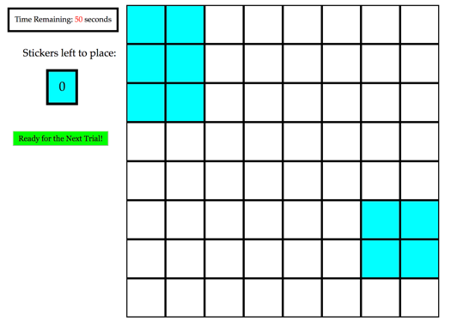
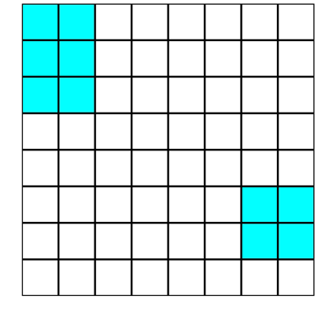

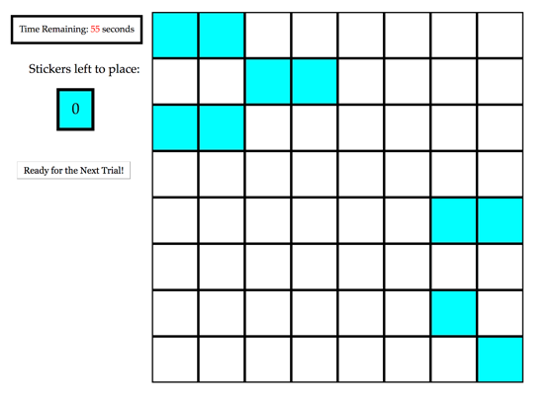
The preservation of structure in language:
the importance of having an editor
Madeline Meyers, Dan Yurovsky
The Department of Psychology, University of Chicago
Background
Results
Why do languages change and evolve, aside from acquiring new vocabulary?
Transmissibility pressure: the language needs to be learnable, and therefore simple.
Descriptiveness pressure: the language needs to be useful, and therefore more complex.
Early language learners have potentially greater pressures towards transmissibility – what keeps descriptiveness around?
Language learning is an active, social process: involving feedback from those who are more knowledgeable in the language (e.g. teachers).
We predict that the influence of teachers through correction is a mechanism by which descriptiveness is retained in language systems.
The addition of a corrective element in the novel language-learning task allows a higher degree of complexity to be retained while still achieving a similar level of percent accuracy as the baseline task.
Diffusion Chain Paradigm
1. Adult Baseline Condition
Randomly-generated language
Resultant language
Generation 1
Generation 2
Generation 3
2. Learner-Fixer Dyad Condition
Learner
“Fix the errors”
“Fix the errors”
Fixer
Randomly-generated language
Resultant language
Method
Conclusions & Future Work
1. Adult Baseline Condition & Learners in Dyad Condition
Adding a corrective element into the language learning process—like feedback from a teacher—allows a higher degree of descriptiveness to be retained in language
Vertical language transmission may be the mechanism by which languages are protected from degeneration
Three measures of pattern complexity had strikingly similar results
Results replicated original work by Kempe et al. (2015)
Data collection is ongoing with children ages 6-8 at the Museum of Science and Industry in Child Baseline and Child-Adult Dyad conditions to investigate how child and adult learners may differentially change an evolving language, as children and adults may possess different pressures affecting the language-learning process
Adult Baseline Condition:
120 U.S. adults on Amazon Mechanical Turk
20 chains of 6 generations each
Input Grid:
Max 60 seconds
2. Fixers in Dyad Condition
Target Grid:
10 seconds
Visual Mask:
3 seconds
Learner-Fixer Dyad Condition:
240 U.S. adults on Amazon Mechanical Turk (120 Learners & 120 Fixers)
20 chains of 6 generations each
Input Grid:
Max 60 seconds

