Slide 1
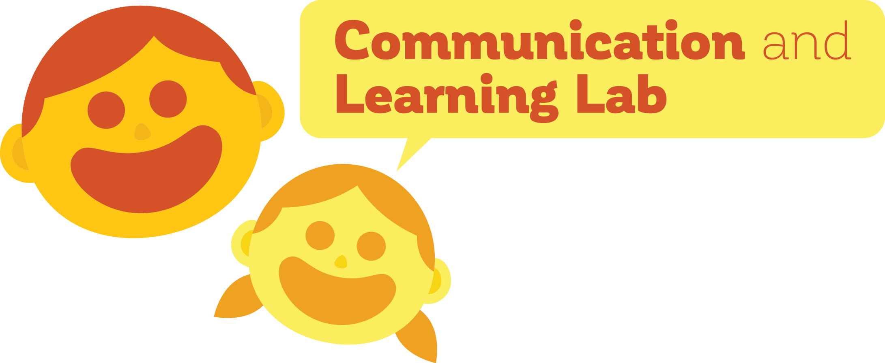
Caregiver reconstruction of children’s errors: the preservation of COMPLEXITY in language
MADDIE MEYERS
DAN YUROVSKY, PH.D.

Slide 2
Put in beginning example here
OKAY?

Slide 3
2 competing pressures on language
Transmissibility/simplicity

Slide 4
Put in beginning example here
Descriptiveness/Complexity

Slide 5
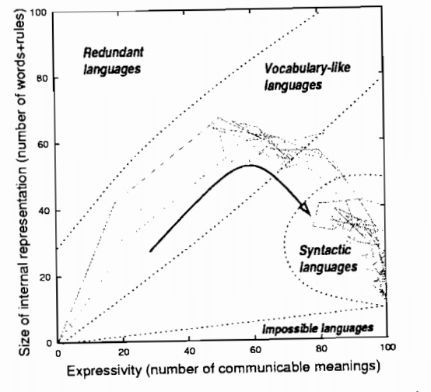
Languages show the effects of these pressures
Kirby, S., & Hurford, J. R. (2002). The emergence of linguistic structure: An overview of the iterated learning model. In Simulating the evolution of language (pp. 121-147). Springer, London.

Slide 6
Children might respond differently to these pressures
Children
Often make simplifying errors
Speak in the presence of competent speakers of the language

Slide 7
Using iterated learning to study evolution
Iterated learning paradigm

Slide 8
Using iterated learning to study evolution
But….
Horizontal transmission vs. vertical transmission vs. speaking in isolation

Slide 9
Using iterated learning to study evolution
But….
Horizontal transmission vs. vertical transmission vs. speaking in isolation
People make inferences about what you said based on their prior knowledge& knowledge of what you know
bidirectionality

Slide 10
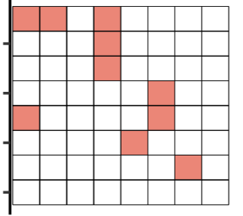
Experiment 1 paradigm

Slide 11
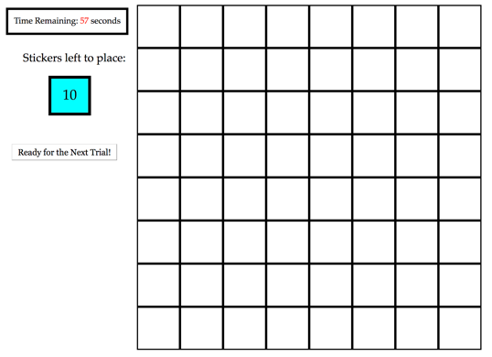
Experiment 1 paradigm

Slide 12
Experiment 1: adult baseline
480 adults on Amazon Mechanical Turk
40 separate chains of 12 generations (participants)
Measured
Complexity (****)
Percent Accuracy

Slide 13
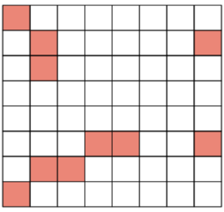
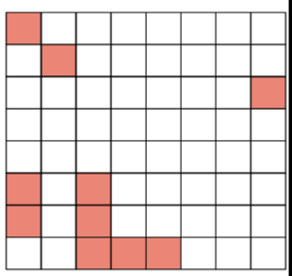
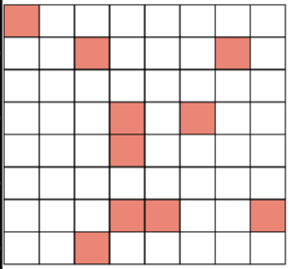
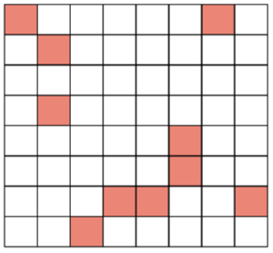
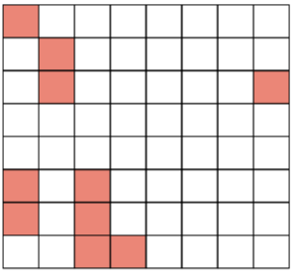
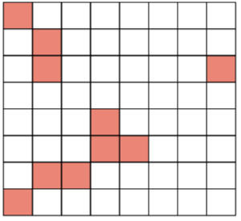
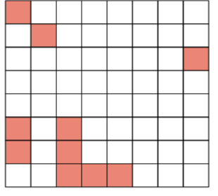
Experiment 1 results

