Slide 1
Project 1 Global Warming – Fact or Fiction?
Danielle Dejean, Kaidon Kennedy, Carolyn Scheese, Harpreet ‘Monty’ Singh
Notes:
Carolyn
Global Warming – Fact or Fiction??
Global warming: a phrase we've all heard and perhaps grown accustomed to, but today, let's unpack some data.
This session will unveil how artificial intelligence helps us understand the intricate dance between CO2 emissions and rising global temperatures—see what the data really tells us.
I’m Carolyn Scheese, and my team mates are: Danielle Dejean, Kaidon Kennedy, & Harpreet ‘Monty’ Singh
And we are excited to present our project to you.
We had a lot of fun and learned a lot!
We hope you will enjoy our presentation.

Slide 2
Project Overview & Goals
Find and examine various environmental data to see the impact of CO2 for evidence of global warming and possible correlations by countries and continents throughout the world.
Explore the temperature and CO2 changes of different countries and different continents over a 25-year span (1995 – 2020)
Average temp over time by country and continent
Examine CO2 emissions as it relates to increases in surface temperature
Explore possible predication models for increases in average global temperature over various timelines; monthly, yearly, etc.
Notes:
Carolyn

Slide 3
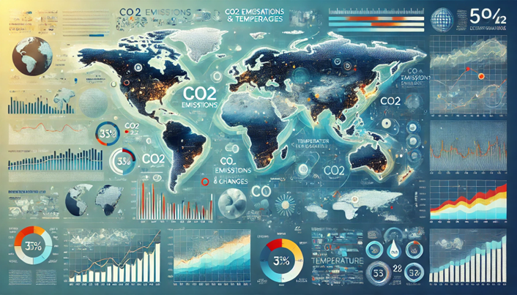
Data Sets
Global Warming Trends (1961-2022)
https://www.kaggle.com/datasets/jawadawan/global-warming-trends-1961-2022
Country, ISO code, Year and Temperature
Country wise surface temperature from 1961 to 2022
Countries and their Continents
https://www.kaggle.com/datasets/hserdaraltan/countries-by-continent
Temperature (1960) to Temperature (2022): annual surface temp (C) from1960 to 2022
Daily temperature of different cities with country and Region
https://www.kaggle.com/datasets/subhamjain/temperature-of-all-countries-19952020
Contains data of various major cities of different countries in the world.
data.worldbank.org
World Bank Open Data
https://data.worldbank.org/indicator/EN.ATM.CO2E.PC?most_recent_year_desc=false
Free and open access to global development data
An image that represents an exploration of data from countries and continents across the world on CO2 and Temperatures across the world that can be used as a background in a PPT presentation; modern and professional style – Dall-E
Kaggle – High Quality
Examined 4 data sets
Used 3 data sets
*excluded worldbank
No copywrite issues with this data
Notes:
Carolyn
We looked at several data sets beginning with Kaggle. We also explored other data sets from NASA and many others that we found by searching the internet.
We initially started with 2 data sets then decided that the data set from World Bank did not contain the information we were looking for, so we excluded it. We added additional 2 data sets from Kaggle.
We finally settled on 3 data sets from Kaggle
Global Warming Trends (1961-2022)
Country wise surface temperature from 1961 to 2022
2. Countries and their Continents
196 countries matched to their continent
3. Temperature of all countries from (1995-2020)

Slide 4
Data Collection, Cleanup & Exploration
Extract
Download & import .csv files & libraries
Explore
Columns, data types, null values, units of measure
Transform
Reshape dfs, drop un-useful data, merge, sort & relabel
Load
Export usable df to .csv file
Notes:
Danielle

Slide 5
Approach
Challenges
Reading in a file with a header
co2_df = pd.read_csv('co2_data.csv', header=2)
Converting from long to wide format
temp_df = temp2_df.pivot(index='Country', columns='Year', values=‘YearlyAvgTemperature’)
The first temperature file had suspect temperature units. Even though it had values, and the documentation indicated it was usable, we couldn’t make sense of them. We had to disregard that data, and find another data source with known/usable units. In doing this we lost 5 years of data, and several countries, but were able to make sense of the results.
Extract & Explore
Import pandas (matplotlib, datetime & prophet for charts & forecasting)
Read in the .csv files
Ensure data had usable values, overlapping column/years
Check columns/data types
Notes:
Danielle

Slide 6
Approach
Challenges
Set ‘Country’ column to index to isolate and drop rows with NaN values
co2_df.set_index('Country', inplace=True)
co2_df.dropna(axis=0, how='all', inplace=True)
Reset the index to make ‘Country’ a mergable column
temp_df = temp_df.reset_index()
Loop through renaming temp/CO2 columns to differentiate year
for col in temp_df.columns:
new_col = lambda x, col=col: 'Temp_' + str(col)
temp_df.rename(columns={col: new_col(col)}, \
inplace=True)
for cols in co2_df.columns:
if cols.isdigit():
new_col = 'CO2_' + cols
co2_df.rename(columns={cols: new_col}, inplace=True)
Transform & Load
Drop unneeded data
Rename columns
Merge (inner)
Output to .csv
Notes:
Danielle

Slide 7
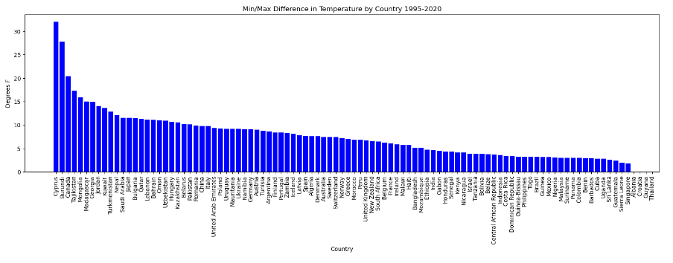
Min/ Max Difference in Temperature by Country 1995 – 2020
Cyprus
Thailand
# Which country had the highest change in Temperature
# Plot a bar chart
plt.figure(figsize=(20,5))
plt.bar(x_axis, df_sorted["Temp_difference"], color='b', align="edge")
plt.xticks(tick_locations, df_sorted["Country"], rotation="vertical")
plt.title("Min/Max Difference in Temperature by Country 1995-2020")
plt.xlabel("Country")
plt.ylabel("Degrees F")
plt.show()
Based on the temp data from 1995-2020 and chart above, we can see that Cyprus had the highest difference in Temp while Thailand remained consistent in temperatures changes over the years.
Notes:
Harpreet-Based on the temp data from 1995-2020 and chart above, we can see that Cyprus had the highest difference in Temp while Thailand remained consistent in temperatures changes over the years. Below are some reasons why these 2 countries might at the top and bottom of this data chart.
Cyprus is located in the Eastern region of the Mediterranean where it can see significant temperature variations between seasons. This can cause climate changes which often lead to hot, dry summers and mild, wet winters, contributing to noticeable seasonal temperature swings.
Thailand has a tropical climate characterized by relatively stable temperatures throughout the year. Having a consistent Monsoon every year helps as well.

Slide 8
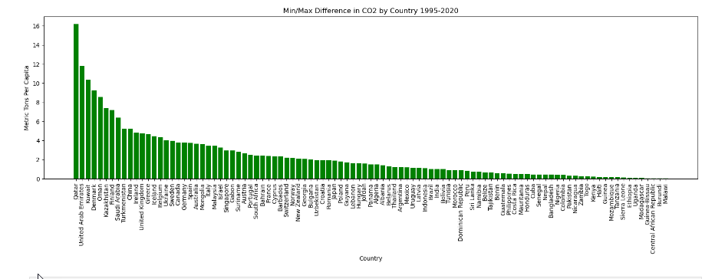
Min/ Max Difference in CO2 by Country 1995 – 2020
Qatar
Malawi
# Which country had the highest change in CO2
# Plot a bar chart
plt.figure(figsize=(20,5))
plt.bar(x_axis, df_sorted2["CO2_difference"], color='g', align="edge")
plt.xticks(tick_locations, df_sorted2["Country"], rotation="vertical")
plt.title("Min/Max Difference in CO2 by Country 1995-2020")
plt.xlabel("Country")
plt.ylabel("Metric Tons Per Capita")
plt.show()
According to the data, the county with the highest CO2 difference over the years is Qatar while the African country of Malawi had the lowest difference of C02 over the same time frame.
Notes:
Harpreet-According to the data, The county with the highest CO2 difference over the years is Qatar while the African country of Malawi had the lowest difference of C02 over the same time frame.
I believe some factors that might have caused these countries to be the top and bottom of the chart are:
Qatar is a small country that has an open desert landscape and their biggest resource is oil and natural gases.
Malawi is a small country with mostly rain forests and greenery landscape and their major resource is minerals such as uranium, phosphates, coal, and limestones.

Slide 9
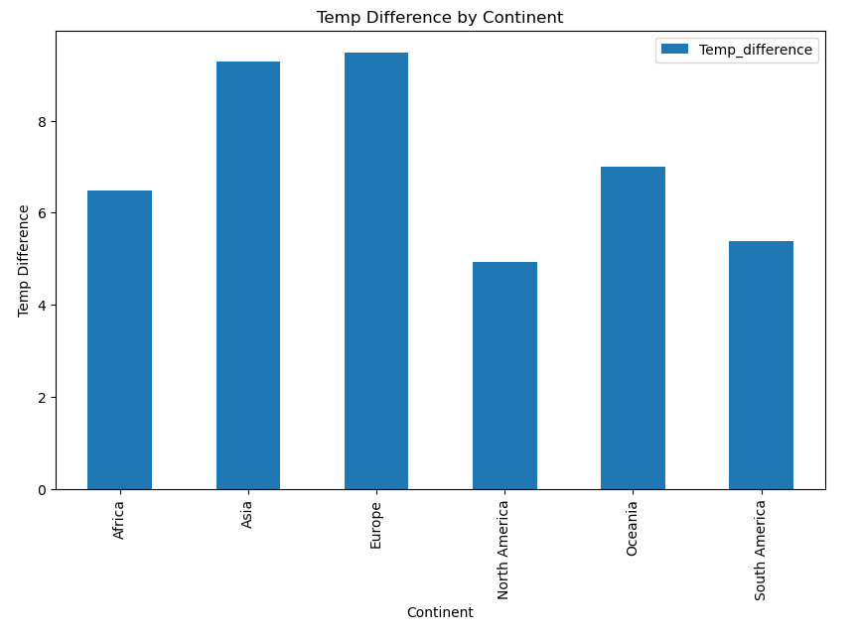
Max & Min Temp (1995-2020) Difference by Continent
Based on the data and chart, we can see that from 1995 to 2020 Europe saw the biggest difference temp difference while North America saw the lowest difference in temp over the same period.
# plt.figure(figsize=(20,5))
# plt.bar(x_axis, avg_temp_per_continent["Temp_difference"], color='b', align="edge")
# plt.xticks(tick_locations, avg_temp_per_continent["Continent"], rotation="vertical")
# avg_temp_per_continent.plot(kind = 'bar', y=‘)
bar_chart = avg_temp_per_continent.plot(kind='bar', x='Continent', figsize=(10, 6))
# Set the title and labels
bar_chart.set_title("Temp Difference by Continent")
bar_chart.set_xlabel("Continent")
bar_chart.set_ylabel("Temp Difference")
# Show the bar chart
bar_chart
Notes:
Harpreet- Based on the data and chart, we can see that from 1995 to 2020 Europe saw the biggest difference temp difference while North America saw the lowest difference in temp over the same period.
Based on my research, below are some reasons for Europe to have the highest difference in temp from 1995-2020.
Europe has seen more frequent and severe heatwaves leading for faster climate changes compared to other Continents. Europe's size and geography, including both coastal and inland areas, results in different temperature patterns.
North Americas’ coastal areas benefit from oceanic moderation, with the Pacific and Atlantic Oceans stabilizing temperatures. North America also has large bodies of water, such as the Great Lakes, which absorb and release heat slowly, reducing temperature variability.

Slide 10
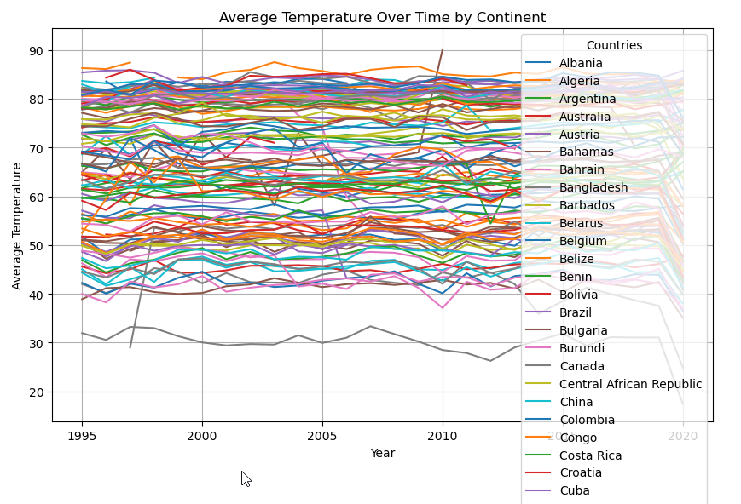
Average Temp over time by Country
Based on this data and chart, we can see that there is not really a general trend of all temperatures going up like we think there is.
This might be caused by our data not being as accurate as we originally thought. If we had more time, we would look for another dataset that might provide a more clear distinction of Temperature change over time.
# plotting the change in avg temp in countries over time
pivot_df = avg_temp_continent_country.pivot(index='Year', columns='Country', values='YearlyAvgTemperature')
# Plot
pivot_df.plot(kind='line', figsize=(10, 6))
plt.title('Average Temperature Over Time by Country')
plt.xlabel('Year')
plt.ylabel('Average Temperature')
plt.legend(title='Countries')
plt.grid(True)
plt.show()
Notes:
Harpreet-Based on this data and chart, we can see that there is not really a general trend of all temperatures going up like we think there is. This might be caused by our data not being as accurate as we originally thought. If we had more time we would look for another dataset that might provide a more clear distinction of Temperature change over time.

Slide 11
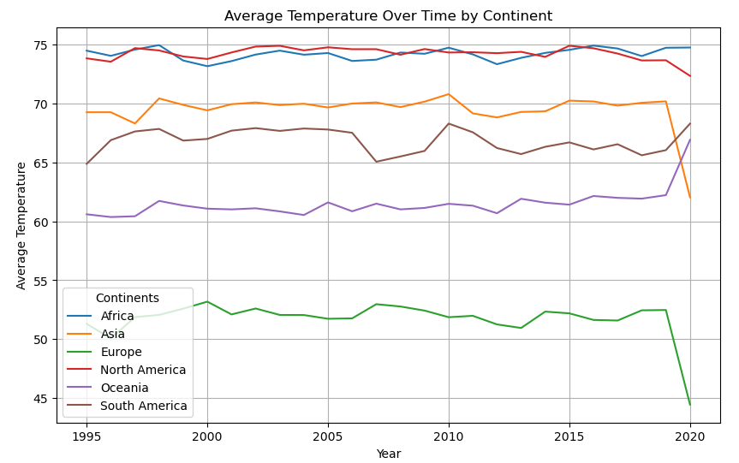
Average Temp over time by Continent
As a group we wanted to see the trends with temperatures around the globe. So to do so we grouped all country data to their respective continent. After that we just plotted each continent and its yearly average temperature over 25 years. The biggest struggle was just grouping every country to their respective continent.
df_pivot = continent_avg_temps.pivot(index='Year', columns='Continent', values='YearlyAvgTemperature')
df_pivot.plot(kind='line', figsize=(10, 6))
plt.title('Average Temperature Over Time by Continent')
plt.xlabel('Year')
plt.ylabel('Average Temperature')
plt.legend(title='Continents')
plt.grid(True)
plt.show()
Notes:
Kaidon

Slide 12
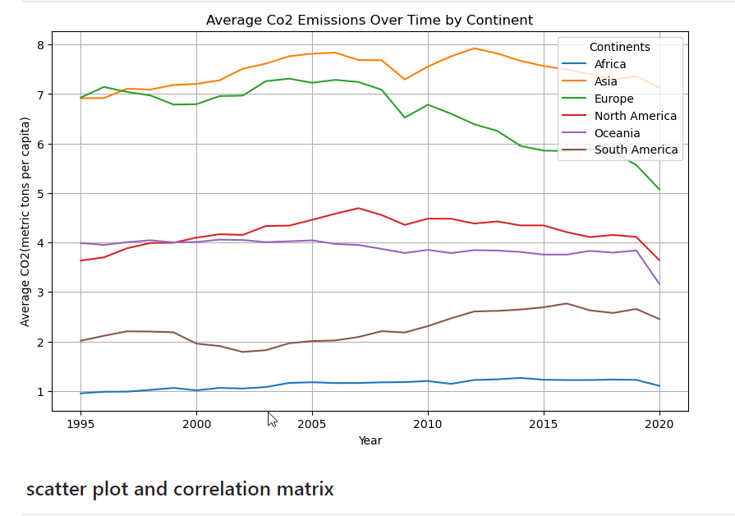
Average cO2 Emissions over time by Continent
The goal was to also see the CO2 emissions per continent to compare the higher emissions and how the trend of those temperatures have changed. Which visually we didn’t see as much correlation as we would think, which was confirmed with a correlation coeficiant of -0.090863 as well as to see the difference between larger continents and smaller continents and their emissions. It was cool to see that Europe which is substantially smaller than Asia is closest continent in emissions. The hardest part was this was just comparing it to the average temperature plot.
# Plot
df_pivot_co2.plot(kind='line', figsize=(10, 6))
plt.title('Average Co2 Emissions Over Time by Continent')
plt.xlabel('Year')
plt.ylabel('Average CO2(metric tons per capita)')
plt.legend(title='Continents')
plt.grid(True)
plt.show()
Notes:
Kaidon

Slide 13
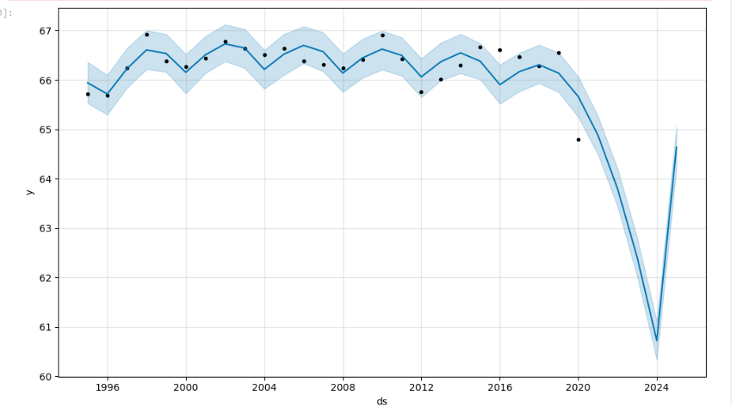
Forecasting
Forecasted World Temperature
To achieve the goal of potentially forecasting the average temperature of the world we needed to get an average world temp for each year. Then we just needed to make it datetime. Which to do so I had to spend sometime figuring out how to do so with the format being right. Below is the code that I had to do to specify the format. world_avg_temperature['Year'] = pd.to_datetime(world_avg_temperature['Year'], format='%Y’).
After that it was straightforward just had to change the column names and create and fit the model. Then just plot our prediction model.
Notes:
Kaidon

Slide 14
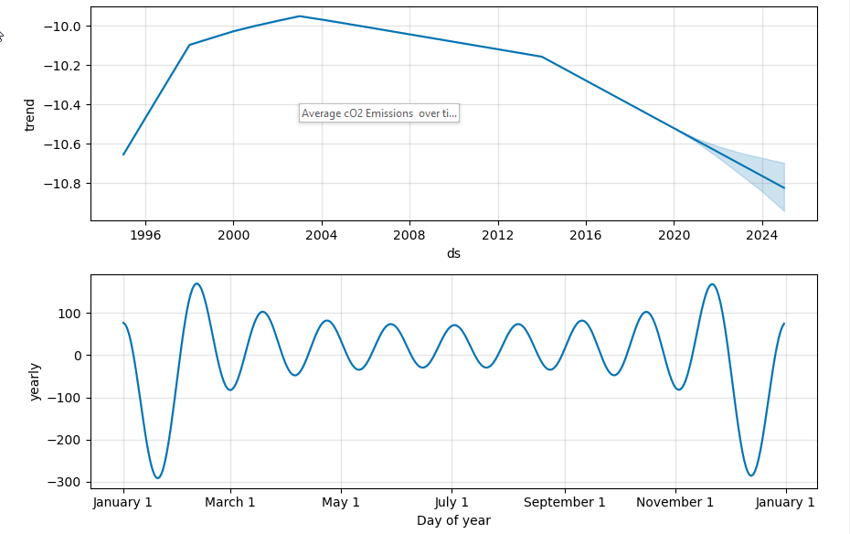
Forecasting
Visual Results of Predictions
After the first plot we wanted to visualize the results. With the results it only confirmed that the predictions were predicting that it would be a downward trend with the average temperature of the world. There wasn’t much challenge after doing the work for the first plot.
figures = model.plot_components(forecast_trends)
Notes:
Kaidon

Slide 15
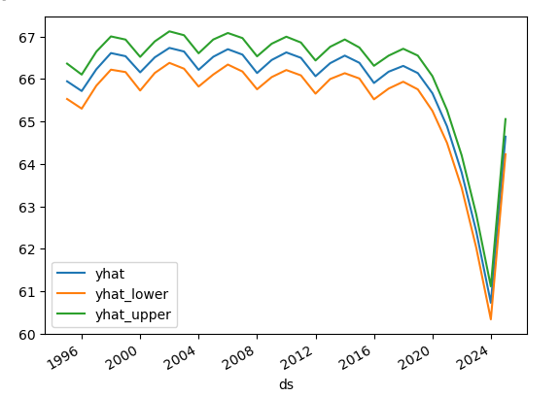
Forecasting
Yhat Prediction Plot
After that we wanted to plot the yhat, yhat lower and upper over the last 2 years. Which just put out the same results just showing the lowest and highest prediction. This was pretty straight forward just needed to set it to go off the last 730 days(2 years)
forecast_trends[["yhat", "yhat_lower", "yhat_upper"]].iloc[-730:, :].plot()
Notes:
Kaidon

Slide 16
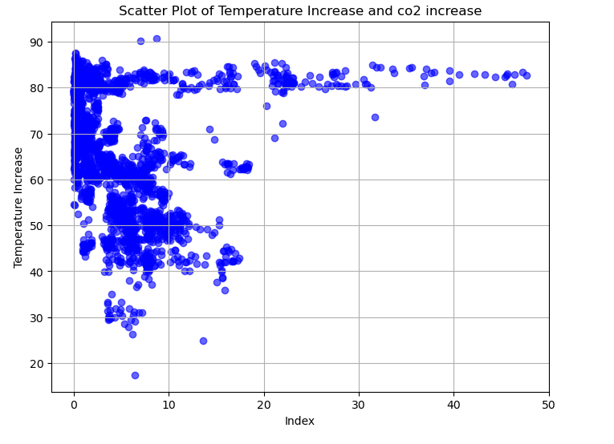
Scatter plot of temp & CO2 increase
Findings:
- Not a direct 1:1 correlation, however…
- As CO2 increases, there is less variability / more predictability in temp
To create this chart:
- Merged temp, country datasets
- Used plt.scatter
Further exploration:
- Attempt to fit a regression line
Code:
# Create a scatter plot
plt.figure(figsize=(8, 6))
plt.scatter(avg_co2_temp_continent_country['CO2 emissions (metric tons per capita)'], avg_co2_temp_continent_country['YearlyAvgTemperature'], color='blue', alpha=0.6)
# Scatter plot with index on x-axis and Temp increase on y-axis
plt.xlabel('Index')
plt.ylabel('Temperature Increase')
plt.title('Scatter Plot of Temperature Increase and co2 increase')
plt.grid(True)
plt.show()
Notes:
Harpreet-
CO2 Levels and Temperature Variability: There's no direct 1:1 correlation, but higher CO2 levels generally lead to less temperature variability and more predictability.
Chart Creation: Merged temperature and country datasets, and used plt.scatter for visualization.
Further Exploration: Plan to fit a regression line to better illustrate the relationship and provide clearer results.

Slide 17
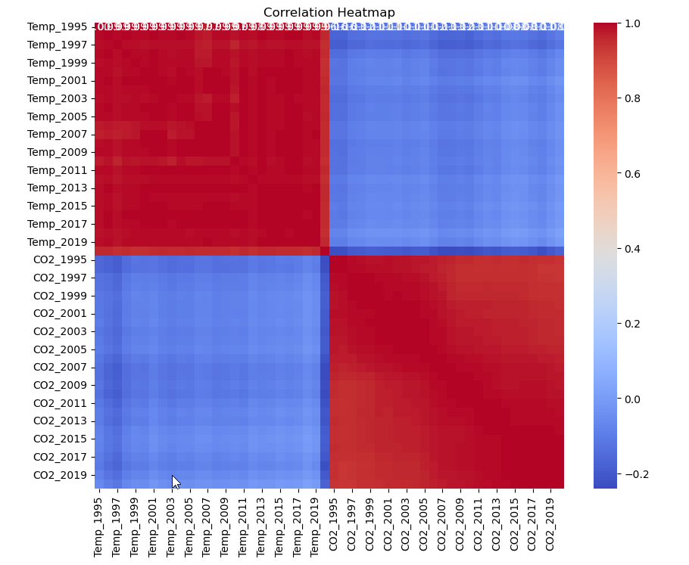
Correlation Heatmap
# see if there is a temp/CO2 correlation
Temp_CO2_Merged.drop(['Continent', 'Country', 'Temp_min', 'Temp_max', 'Temp_difference', 'CO2_min', 'CO2_max', 'CO2_difference'], axis=1, inplace=True)
display(Temp_CO2_Merged)
correlation_matrix = Temp_CO2_Merged.corr()
# Create a heatmap of the correlation matrix using Seaborn:
plt.figure(figsize=(10, 8))
sns.heatmap(correlation_matrix, annot=True, cmap='coolwarm', fmt=".2f")
plt.title('Correlation Heatmap')
plt.show()
Notes:
Danielle

Slide 18

If we had more time
Get additional and better data to forecast temperature & CO2
Explore CO2 vs Methane
Explore change in water temperature
Fit a linear regression line on the scatter plot correlation chart
Investigate the lag between the drastic change in CO2 levels and Temp
Impact of COVID-19 on CO2 over time by continent
Explore the temp data for inconsistencies/ errors – 2 continents dropped dramatically
Explore inequity for which countries are most affected and which have the biggest discrepancies. GDP Explore impact of population density/per capita.
Explore effect of electric car policies on production & CO2 levels; e.g., country that manufactured vs country that purchased. Did this impact 2020?
Notes:
Carolyn

Slide 19

Questions?
an image or symbol to represent asking questions - Dalle
Notes:
All

