Slide 1
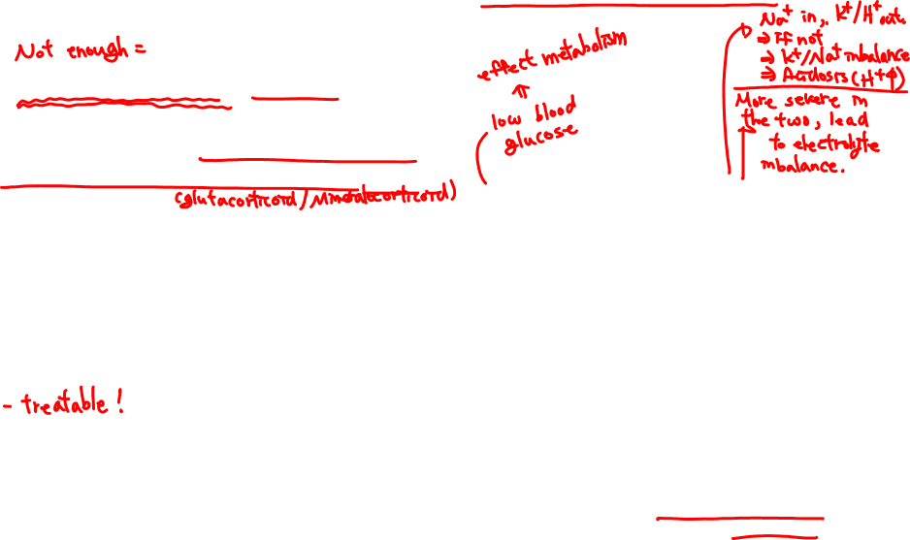
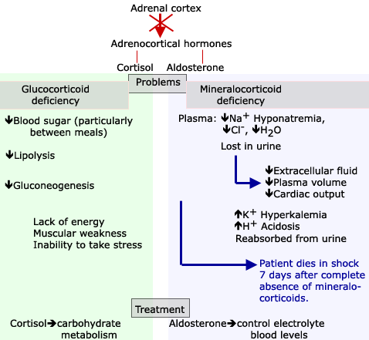
PATHOPHYSIOLOGY OF ADRENAL CORTEX
Addison’s Disease: hypofunction.
-characterized by failure of the adrenal cortex to produce adrenocortical hormones.
-may involve total destruction of the gland.
-mostly due to atrophy of the adrenal glands due to tuberculosis and involves medulla as well as the cortex.
Figure 4.1

Slide 2
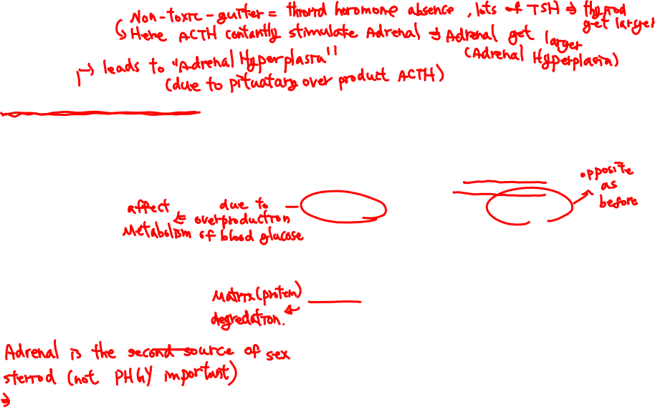
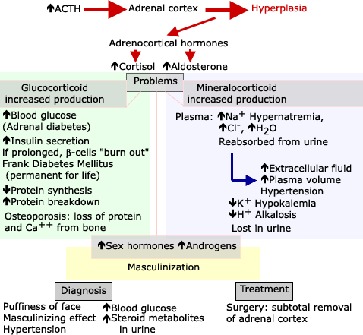
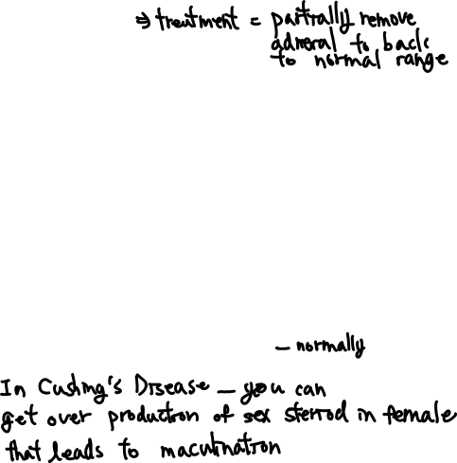
Cushing’s Disease hyperfunction
-Characterized by hyperplasia of the adrenal cortex due to increased circulating levels of ACTH.
-excessive production of glucocorticoids as well as increased production of mineralocorticoids.
Figure 4.2

Slide 3
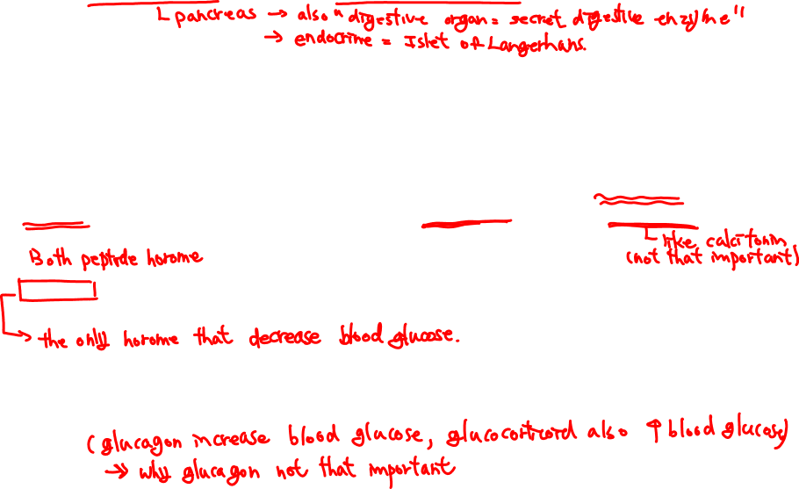
THE PANCREAS AS AN ENDOCRINE ORGAN
-located behind the stomach.
-99 % of pancreas is exocrine and secretes the digestive enzymes.
-However, scattered within the exocrine pancreas are small endocrine structures, the islets of Langerhans - compact mass of cells with good vascularization.
About 60 % of the cells of the islets of Langerhans are known as beta-cells - synthesize insulin. About 25 % of the cells of the islets are alpha-cells - synthesize glucagon.
(There are also smaller numbers of other types of cells)
Insulin and glucagon: small protein hormones and both control of glucose concentration in blood.
-insulin is more important than glucagon and insulin deficiency or absence compromises significantly the well-being of the individual and if not treated may lead to death.

Slide 4
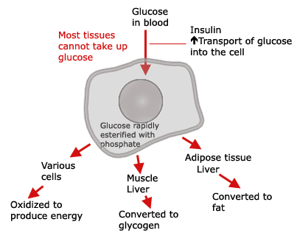
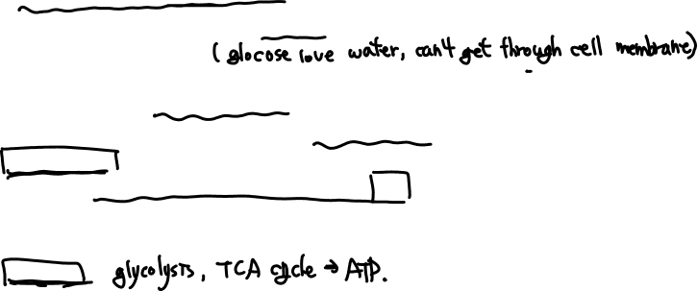
ACTIONS OF INSULIN
-Insulin: Only hormone that acts primarily to decrease blood glucose.
-Glucose always present in the blood (the fasting level is about 80mg/100ml, ~5mM). However, very little free in tissues.
-Glucose does not diffuse very readily into most cells – must be transported.
in the liver and muscle cells is converted to glycogen.
in the adipose tissue is converted to fat and stored for later use.
in many cells of the body is oxidized to produce energy.
Insulin receptor: Membrane receptor, stimulates insertion of glucose transport proteins stored in cytoplasm into plasma membrane
– increases glucose uptake.
Figure 4.3

Slide 5
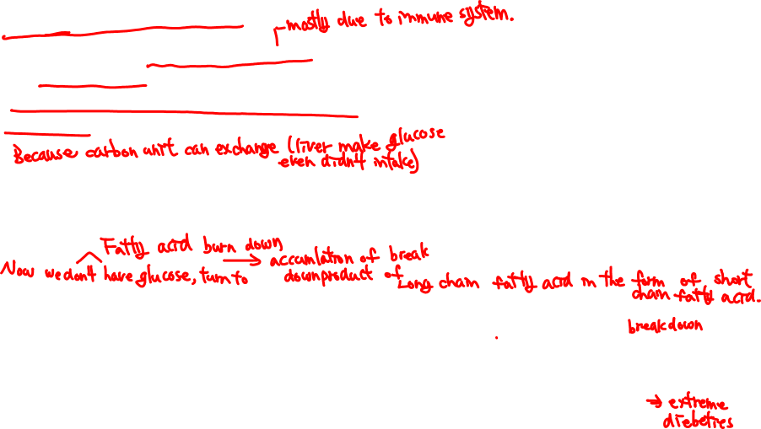
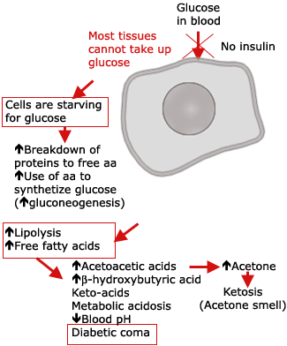

Insulin deficiency
Results when the β-cells are destroyed, will lead to Diabetes Mellitus - most tissues cannot take up glucose efficiently, glucose accumulates in circulation.
Occurs even if no glucose in diet because of increased gluconeogenesis (e.g. protein breakdown to amino acids and synthesis of glucose).
Under these conditions free fatty acids (FFA), becomes the principal source of energy – increased lipolysis.
-However, fat inefficiently used - incomplete oxidation of FFA and increased circulating acetoacetic acid and β-hydroxybutyric acid (metabolic acidosis) and acetone (ketosis - acetone smell in breath of untreated diabetics).
-leads to decreased blood pH, diabetic coma and death unless treatment is provided.
Figure 4.4

Slide 6
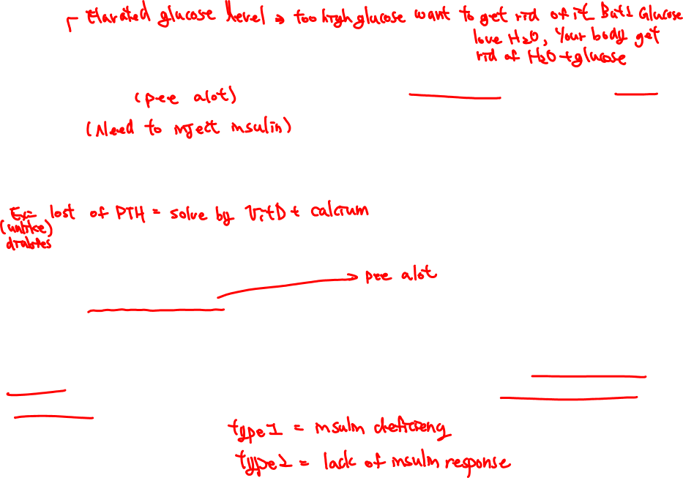
OTHER SYMPTOMS OF DIABETES MELLITUS
-At >180mg% glucose spills over into urine, causing glycosurea.
-leads to loss of water in urine, causing polyurea - dehydration and increased thirst (polydipsia). As mentioned above, untreated diabetes leads to ketosis, and metabolic acidosis.
-administration of insulin is needed to restore individual back to normal.
-in diabetic comas, acidosis and associated electrolyte imbalance must be corrected in addition to insulin administration.
CAUSES OF DIABETES MELLITUS
-Diabetes: “running through” used by Greeks 2000 years ago to describe polyurea.
-Mellitus: “sweet” distinguishes urine polyurea of produced by persons suffering from antidiuretic hormone deficiency (diabetes insipidus).
-In adults, diabetes mellitus may be due to a deficiency of insulin (type 1 insulin-dependent diabetes mellitus) or hyporesponsiveness to insulin (type 2 or insulin-independent diabetes mellitus).

Slide 7

TYPE 1 OR INSULIN-DEPENDENT DIABETES MELLITUS
(a) Destruction of the β-cells of pancreas - synthesis of insulin does not occur.
-treatment: administration of insulin is needed associated with proper diet.
(b) Defective insulin release - drugs stimulating insulin release could be administered again associated with proper diet and exercise.
When insulin administered as treatment for diabetes mellitus it is important to control the dose since too much insulin could lead to severe decrease in blood glucose content. When blood glucose reaches 20-30mg/100ml, the availability of glucose for the brain is not sufficient and the individual may fall into a coma known as insulin shock or hypoglycemic coma - individual must be treated with immediate administration of glucose, otherwise death or permanent brain damage may occur.

Slide 8
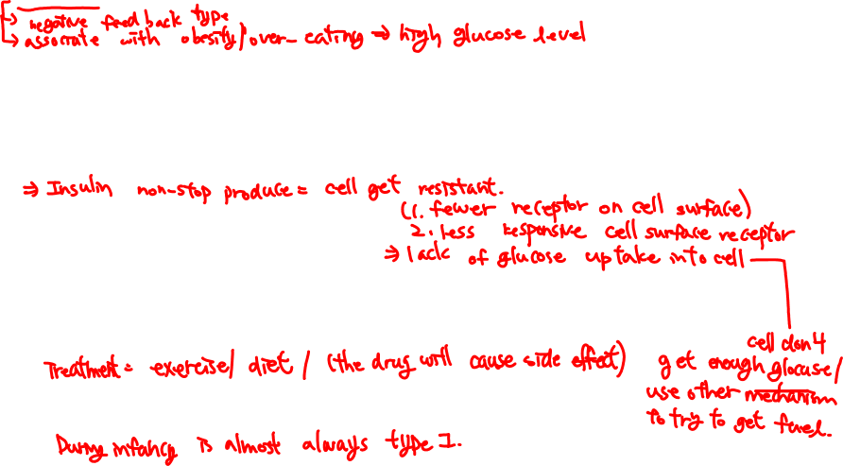
TYPE 2 OR INSULIN-INDEPENDENT DIABETES MELLITUS
-Insulin levels normal or abnormally high.
-problem is hyporesponsiveness of target cells to insulin, a.k.a. insulin resistance often due to decreased number of insulin receptors on target cells.
-associated with obesity due to overeating - prolonged high insulin levels decrease number receptors (downregulation).
Treatment:
-proper diet and exercise
decreased caloric intake, decreased insulin, upregulation of receptors.
insulin receptors increased in response to frequent endurance exercise, independent to changes in body weight.
JUVENILE DIABETES MELLITUS
Juvenile diabetes mellitus appears in childhood and is insulin dependent. The β-cells of pancreas do not produce insulin. Treatment requires administration of insulin.

Slide 9
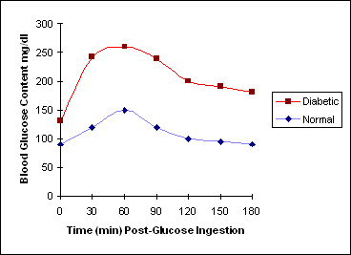


MEASUREMENT OF GLUCOSE TOLERANCE
Glucose tolerance test:
-Glucose tolerance is decreased in diabetes (low or absence of insulin) and is increased in hyperinsulinism.
-After an overnight fast, patient given 0.75 to 1.5g of glucose/kg body weight.
-Blood taken before administration and at 30-60 minute intervals thereafter for 3-4 hrs, and glucose is measured.
-Blood glucose in a normal individual increases in 1 hr from 80mg/100ml to 130mg/100 ml, and after ~2-3 hrs, returns to normal.
In a diabetic, increase in blood glucose is greater and returns to normal more slowly.
Figure 4.5. Glucose tolerance test

Slide 10
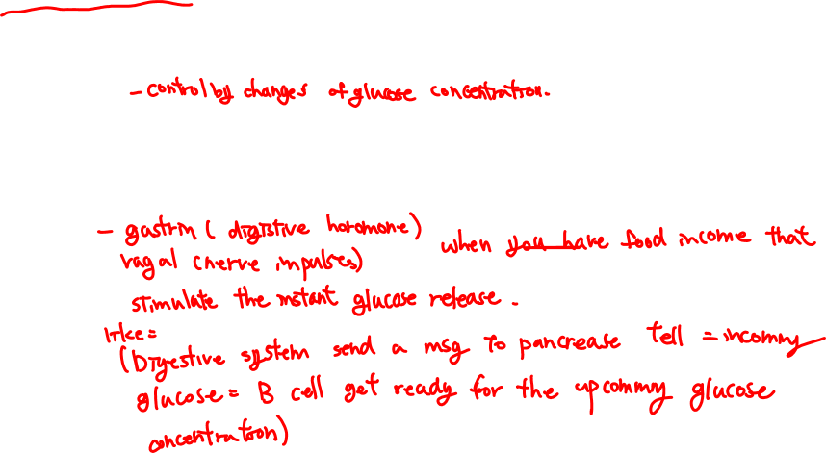
CONTROL OF INSULIN SECRETION
Several feedback mechanisms control of insulin release to avoid hypoglycemia.
-most important: beta cells respond to levels blood glucose, secreting little or no insulin when blood glucose low, secreting much more when the blood glucose is high.
-Also, release of gastrin and vagal impulses to the beta-cells induce insulin release, as a result insulin starts to leave the pancreas even before the blood glucose begins to rise during meals

Slide 11
GLUCAGON
-Peptide hormone. synthesized and released by α-cells of pancreas.
-Metabolic functions are opposite of insulin’s.
-Raises blood sugar by promoting glycogenolysis (breakdown of glycogen) and gluconeogenesis (synthesis of glucose) in the liver.
-In adipose tissue, glucagon increases rate of lipolysis leading to increased concentration of free fatty acids in circulation.
Glucagon release controlled by concentration of glucose in circulation.
-Low blood glucose stimulates pancreatic α cells to increase synthesis and release of glucagon, while high blood glucose content decreases release and synthesis.
Glucagon not as important as insulin, other hormones increase blood glucose content such as cortisol (glucocorticoids) as well as epinephrine, nor-epinephrine etc.

Slide 12

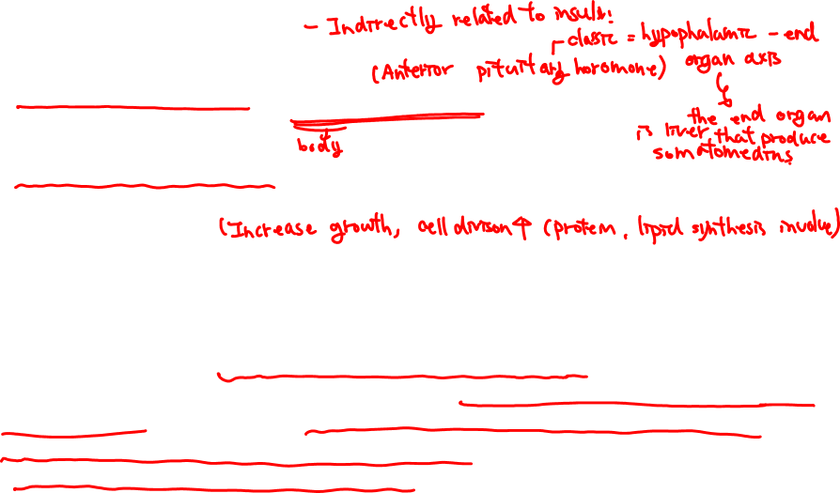
GROWTH HORMONE
-Single chain polypeptide produced by anterior lobe of the pituitary.
-Responsible for growth; a.k.a. Somatotropin (STH).
-Increases protein synthesis in many tissues such as bone, muscle, kidney, liver by enhancing amino acid uptake by cells and by accelerating the transcription and translation of mRNA.
-Also increases the rate of lipolysis and utilization of free fatty acids as a source of energy. This is a direct effect of GH not mediated by the somatomedins.
SOMATOMEDINS
-Produced by the liver under stimulation of GH – Somatomedins.
-Are structurally similar to insulin and are named insulin-like growth factors I and II (IGF-I and IGF-II). (Somatomedins may bind to insulin receptors and insulin at high concentrations may bind to somatomedin receptors).
-Increase protein synthesis and stimulate growth.

Slide 13
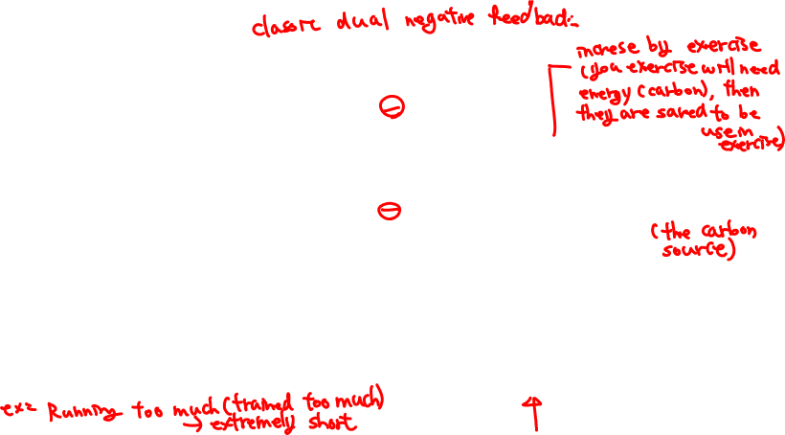
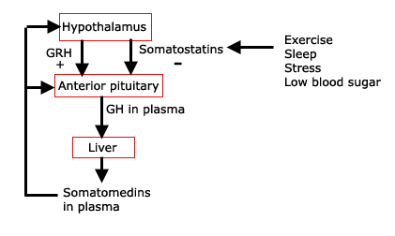
CONTROL OF GH RELEASE
Complex feedback mechanism mediated by two hypothalamic neurohormones:
growth hormone releasing hormone (GRH) also known as somatoliberin, which stimulates growth hormone release.
somatostatin (growth hormone inhibiting hormone), which inhibits growth hormone release.
GRH and somatostatin tightly regulated by an integrated system of neural, metabolic, and hormonal factors.
-
-
Figure 4.6

Slide 14
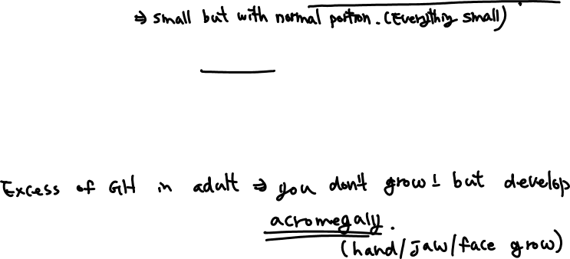
PATHOPHYSIOLOGY OF GROWTH HORMONE
GH Deficiency:
In the young, absence of growth hormone leads to decreased physical growth.
Excess of GH:
In young individual leads to gigantism.
Excess of GH in later life (adult) produces the condition of acromegaly, in which many bones (particularly at the cartilaginous regions of the bones) get longer and heavier.

Slide 15


Slide 16


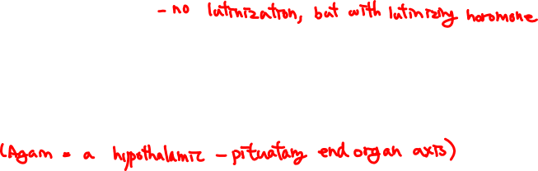
REPRODUCTION
Overview.
-primary reproductive organs: the gonads, testes in the male, ovaries in the female.
Accessory reproductive organs include system of ducts through which sperm or eggs are transported, and the glands that empty into them. In the female, breasts are also included in this category.
The gonads serve two functions:
1. Gametogenesis: the production of reproductive cells known as gametes; the spermatozoa in the male, and ova in the female.
Secretion of sex hormones (specific steroids); testosterone (androgen) in the male, and estrogen and progesterone in the female.
The differences in reproductive endocrinology in males and females is quantitative and not qualitative. Androgens not unique to males, and estrogens not unique to females. Testes produce small amounts of estrogen, and androgens can be converted into estrogens by a single enzymatic step in several non gonadal tissues (bone, for example). Androgens produced in small amounts in ovaries and in larger amounts by the adrenals.

Slide 17
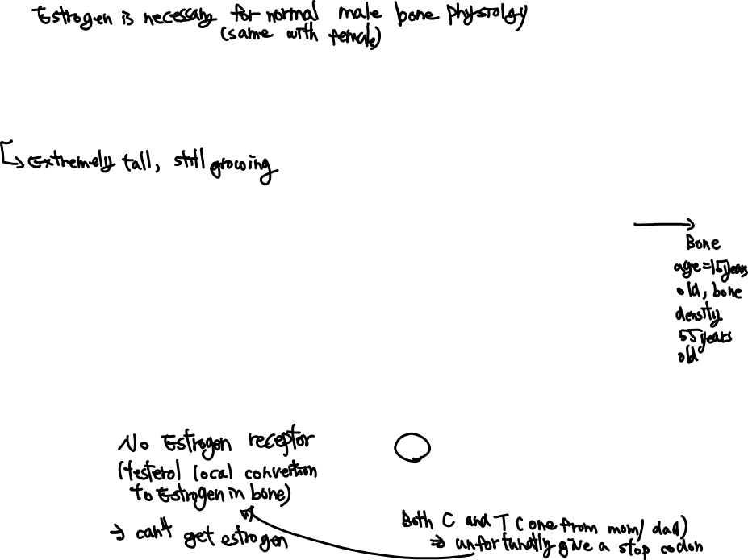
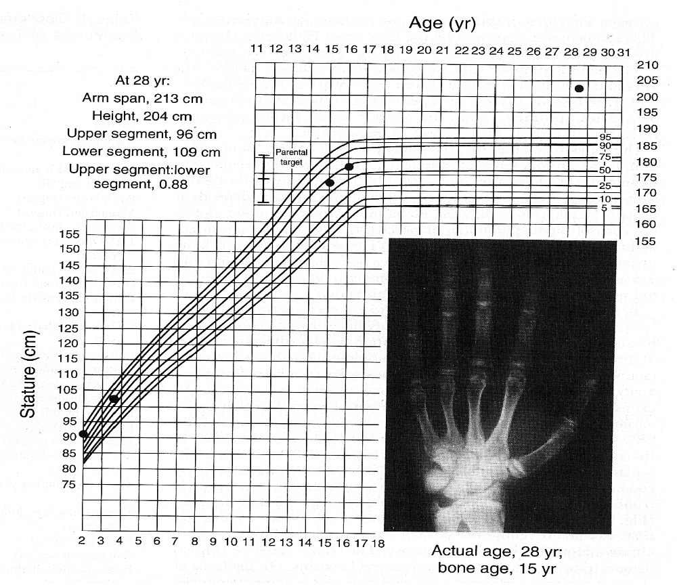
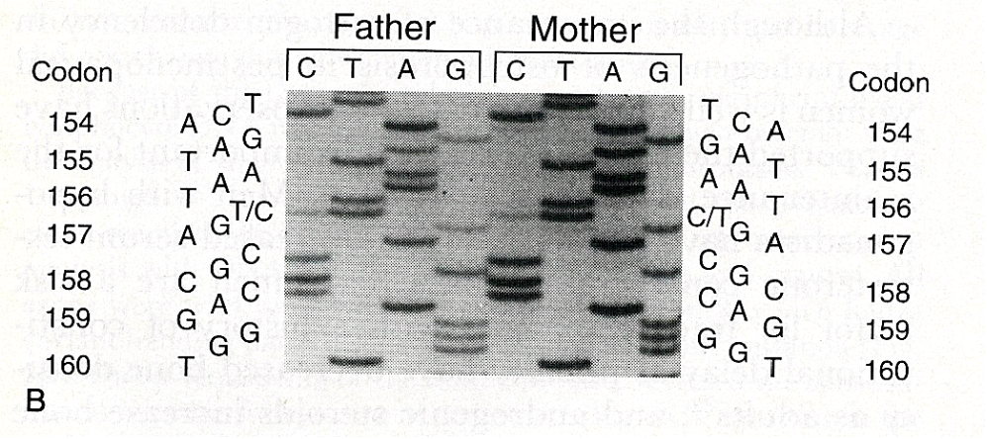

Estrogen maintains bone density in males
NEJM, 331, 1056-61, 1994
“The ER mutant patient has been lost to follow up. Unfortunately, after he got his legs and knees straightened up he didn’t want to have anything to do with us. He has apparently stopped growing”
Ken Korach, NIEHS, North Carolina
Figure 4.7

Slide 18
Estrogen in males
Estrogen in males produced locally in tissues by the conversion by aromatase of testosterone the estrogen estradiol.
Estrogen deficiency in males:
Leads to increased body fat.
Contributes to sexual desire and erectile function.

Slide 19
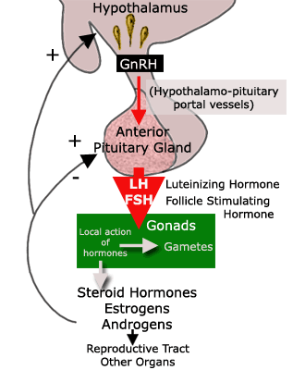

Control of reproductive function
A similar chain of signals function in males and females.
1. Gonadotropin releasing hormone (GnRH), secreted by hypothalamus, travels to anterior pituitary via hypothalmo-pituitary portal vessels.
2. Stimulates release of pituitary gonadotropins: follicle-stimulating hormone (FSH) and luteinizing hormone (LH).
(Note: FSH and LH hormones originally named for their effects in female, but function in both sexes).
3. FSH and LH stimulate development of spermatozoa or ova, and secretion of sex steroids.
4. Sex steroids exert effects in gonads, in other parts of the reproductive system, and body (e.g. estrogen maintains bone density; i.e. prevention of osteoporosis).
Gonads also produce inhibin protein which also feeds back on the anterior pituitary.
Figure 4.8

Slide 20
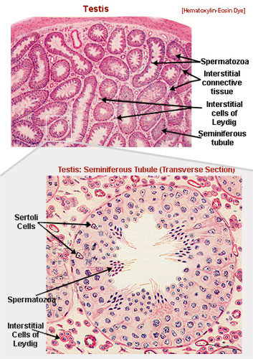

Male Reproductive System: Function of the testes
-The principal function of testes is production of mature germ cells (spermatogenesis), and steroid hormones (steroidogenesis).
-Unlike females, who at birth has her whole life’s supply of ova, the male continually renews his pool of precursor germ cells (spermatogonia) so that a relatively constant supply is available throughout life.
-The process of spermatogenesis takes place within the coiled seminiferous tubules of the testes.
-The process of maturation from immature spermatogonia to the mature spermatozoon takes approximately 60 days in humans.
Figure 4.9

Slide 21
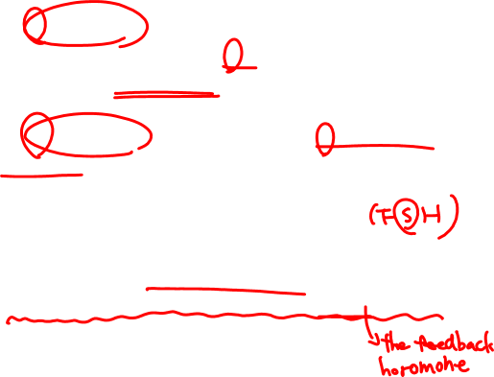
Two cell types are critical for maturation of spermatozoa
1. Leydig cells, located outside the seminiferous tubules. In response to LH, Leydig cells synthesize androgens.
2. Sertoli cells, located within the seminiferous tubules. They are intimately involved with the sperm maturation process - envelop the germ cells throughout their development.
In response to FSH Sertoli cells synthesize Androgen Binding Protein (ABP) and inhibin.
Figure 4.10

Slide 22
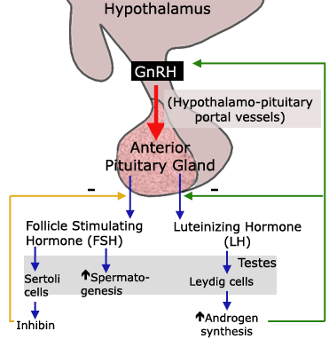

Spermatogenesis
-critically dependent on androgen concentrations within seminiferous tubules, which must be approximately 10 times higher than androgen concentration in circulation otherwise spermatogenesis ceases.
-presence of ABP synthesized by Sertoli cells ensures that high androgen concentration within seminiferous tubules.
Figure 4.11
Testicular androgen synthesis regulated by two negative feedback loops:
(a) Hypothlamic-pituitary-Leydig cell axis: GnRH stimulates release of LH and FSH - stimulate Leydig cells and Sertoli cells. Leydig cells produce androgen, which inhibit the release of GnRH , LH and FSH.
Hypothalamic-pituitary-seminiferous-tubules axis: non steroidal inhibin secreted by the sertoli cells inhbits FSH release only.
(Note: Contrary to females, no (+) feedback control in males).

Slide 23
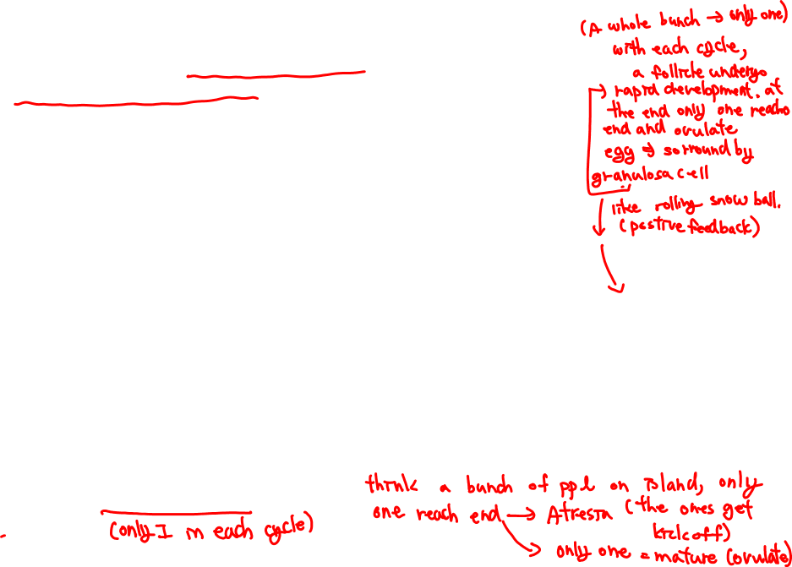
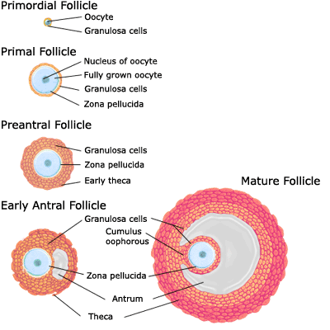
Female Reproductive System: Ovarian Function
Ovary:
-Principal functions; production of mature eggs, and steroid hormones, which regulate the reproductive tract and influence sexual behavior.
-At birth ovary contains non-proliferating pool of germ cells or oocytes (about 2 million), which are its whole life supply of ova. At puberty only ~400,000 ova left.
-The oocytes are surrounded by a single layer of granulosa cells and a basement membrane making up the structures called primordial follicles - fundamental reproductive units of the ovary.
-Growth of primordial follicles into primary follicles begins by an unknown initiating event (independent of pituitary). Once initiated, growth controlled by gonadotropins and steroid hormones until the follicles either ovulate or degenerate (atresia).
Primary Follicle
Figure 4.12

Slide 24
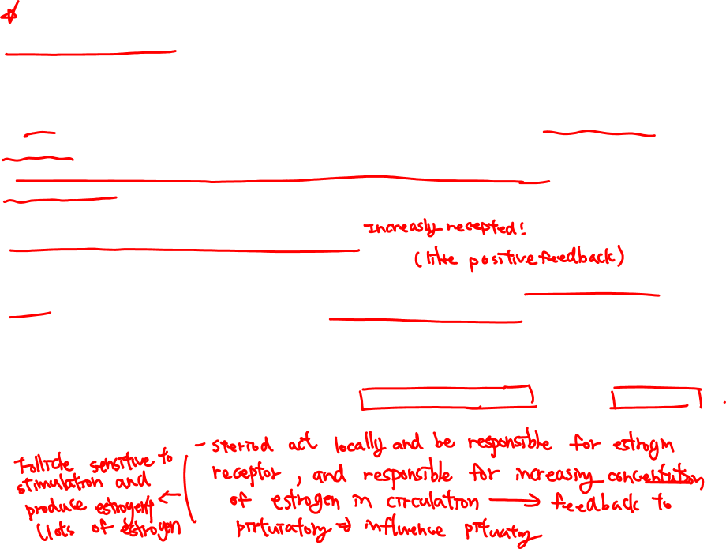
Follicular growth – development of oocytes suitable for ovulation, but also development of new endocrine organ
1. Initially, enlargement and differentiation of the oocyte, which grows & elaborates zona pellucida (an acellular layer rich in glycoproteins surrounding the oocyte).
2. Granulosa cells divide & increase to 2 or more layers - primary follicles. Influenced by FSH and estrogens. Estrogens important for expression of LH receptors on granulosa cells.
3. Under influence of FSH and LH, primary follicle develops into a secondary follicle which expresses receptors for FSH, estrogens and LH. Also, appearance of the follicular antrum which contains secretions from the granulosa cells.
4. Under the combined influence of FSH and LH the granulosa cells elaborate follicular fluid, which takes up the larger portion of the preovulatory follicle (also known as late secondary follicle or Graafian follicle or mature follicle).
Note: As follicle matures from primary to secondary follicle, cells from ovarian stroma surrounding follicle differentiate and become steroid producing cells known as theca cells (theca interna). Theca interna and the granulosa cells collaborate for synthesis of higher amounts of estrogen.

Slide 25

Follicular development leads to one of two events
1. Follicular Atresia:
Although many follicles initiate growth and development in each reproductive cycle, in humans usually only one follicle will ovulate in each reproductive cycle - remaining secondary follicles degenerate in a process known as atresia.
2. Ovulation:
Mechanism of follicular rupture poorly understood - possible that increase in intrafollicular pressure and proteolysis of ovarian wall of mature Graafian follicle lead to ovulation.

Slide 26
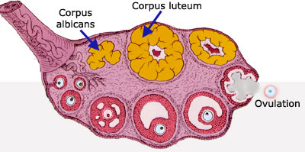
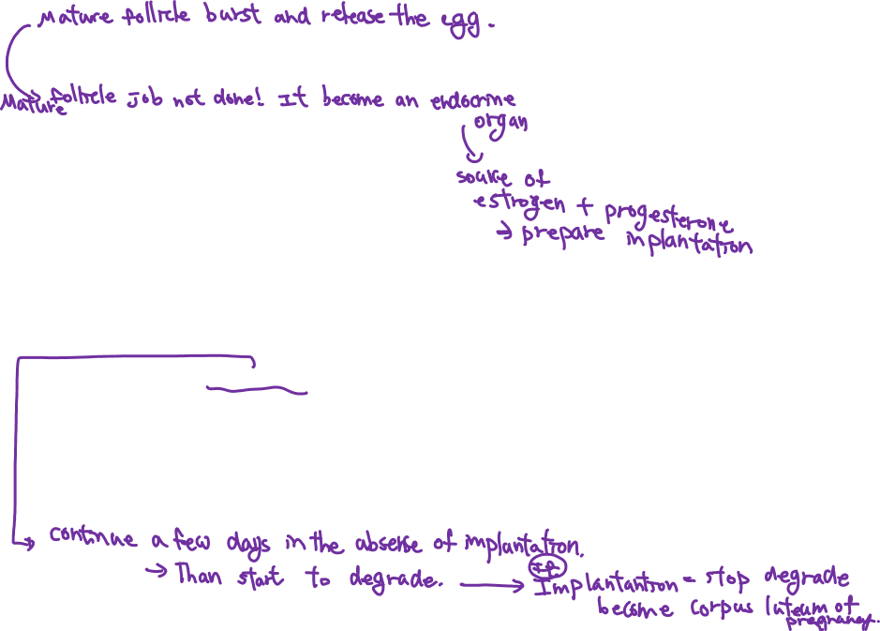
Luteinization (after ovulation)
-Ruptured follicle transformed into Corpus Luteum – secretes progesterone.
-Both theca and granulosa cells contribute to formation of the corpus luteum, a temporary endocrine structure within the ovary that synthesizes progesterone and estrogens.
Progesterone and estrogens are produced in large amounts by corpus luteum for few days following ovulation but then drop off unless implantation of the fertilized ovum occurs.
-Upon implantation, corpus luteum transformed into corpus luteum of pregnancy, responsible for synthesis of progesterone and estrogens and creation of proper endocrine environment for maintenance of pregnancy until progesterone and estrogen synthesis by placenta established.
Figure 4.13
Luteolysis:
In absence of implantation, life span of corpus luteum limited. Luteal regression may be induced by prostaglandins which decrease LH binding and thus steroidogenesis.
-Decrease of plasma progesterone and estrogen may be trigger for initiation of next reproductive cycle.

