Slide 1
RESPIRATION
A.-M. Lauzon, Ph.D.
Reference textbooks:
“Vander’s Human Physiology” by Widmaier, Raff, Strang “Respiratory Physiology- the essentials” by West "The Normal Lung" by Murray

Slide 2
TAs: marissa.aycan@mail.mcgill.ca Michael.chen5@mail.mcgill.ca
TUTORIALS:
JANUARY 24TH: 5H30 TO 6H30 PM MCMED 522 FEBRUARY 2ND: 5H30 TO 6H30 PM MCMED 522

Slide 3
Lecture 1

Slide 4
STRUCTURE OF THE LUNGS AND CHEST WALL
Function of Respiration
•The primary function of respiration is: Gas exchange.
•Inspiration: air rich in O2 is inhaled into the lungs.
•Expiration: CO2 produced during oxidative processes of the body is exhaled from the lungs.
•Both gases are transported by the blood. Thus, both the
cardiovascular system and the respiratory system are involved.

Slide 5
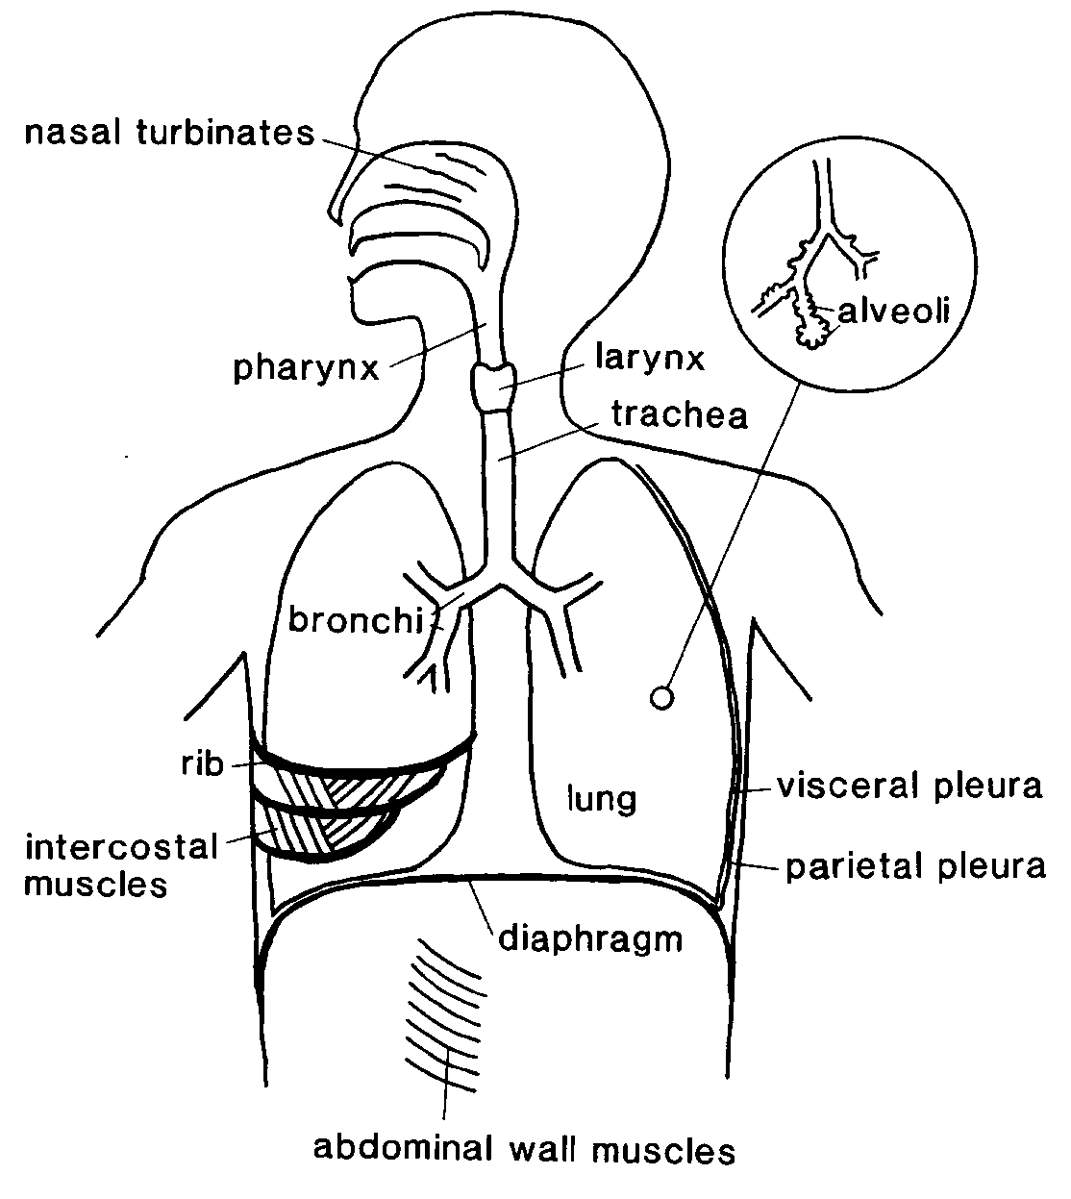
The respiratory tract

Slide 6
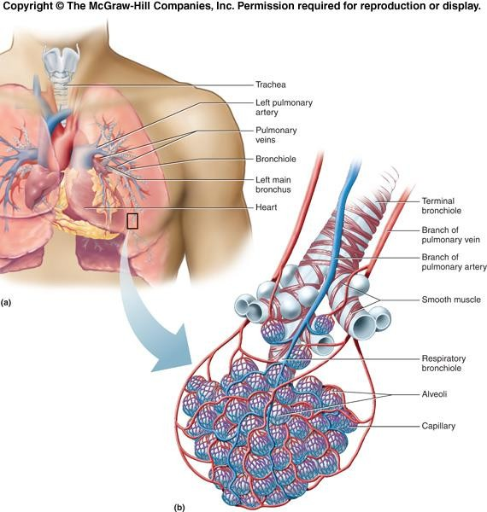
The respiratory tract

Slide 7
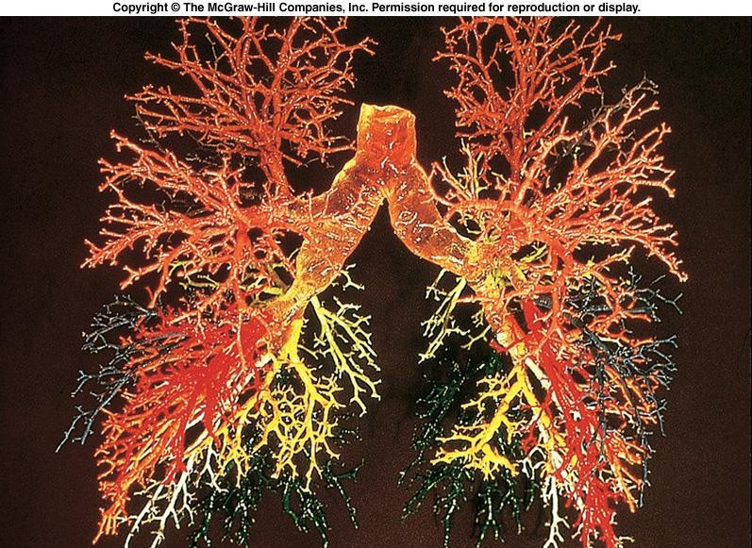
The respiratory tract

Slide 8
The respiratory tract

Slide 9
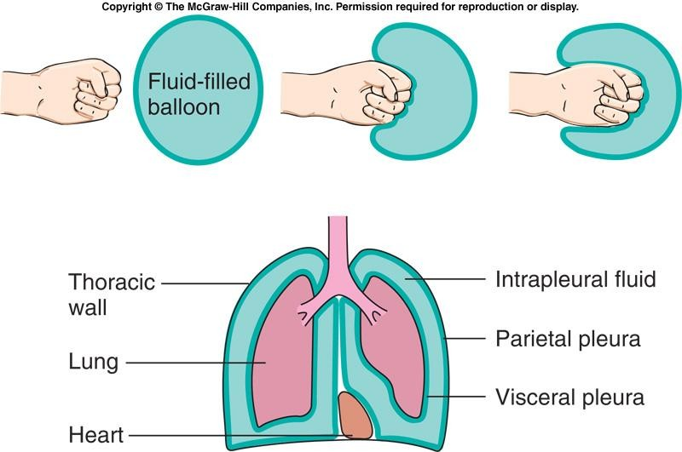
Pleural space

Slide 10
Pleural surfaces
A way to visualize the apposition of the two pleural surfaces is to put a drop of water between two glass microscope slides. The two slides can easily slide over each other but are very difficult to pull apart.
(“Human Physiology” by Widmaier, Raff, Strang)

Slide 11
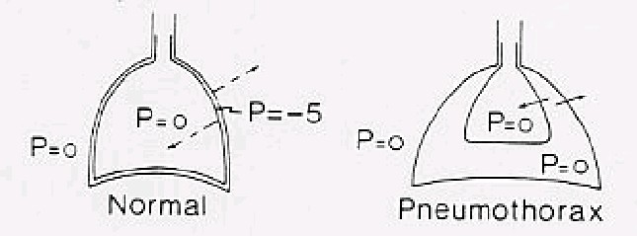
Pleural Space
Pneumothorax
Reproduced from West: Respiratory Physiology- the essentials.

Slide 12
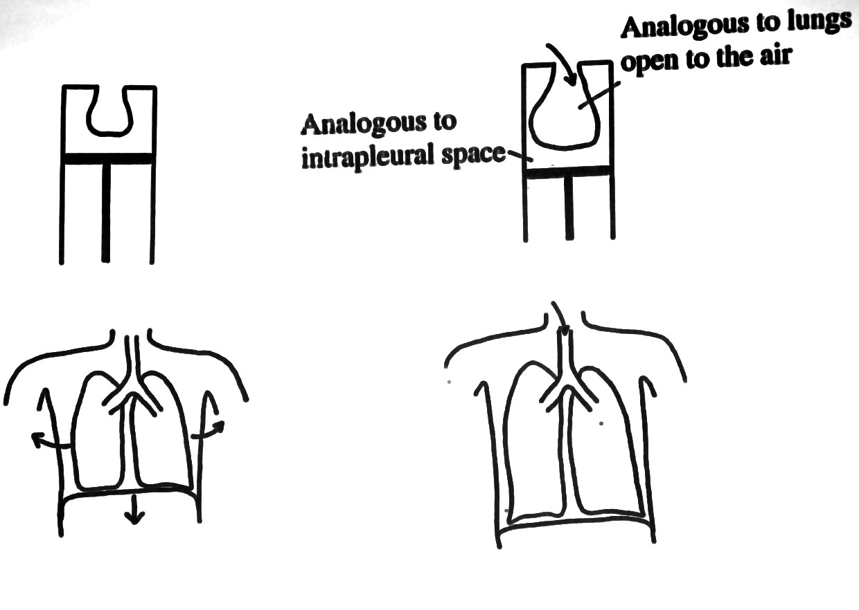
Mechanical pump

Slide 13
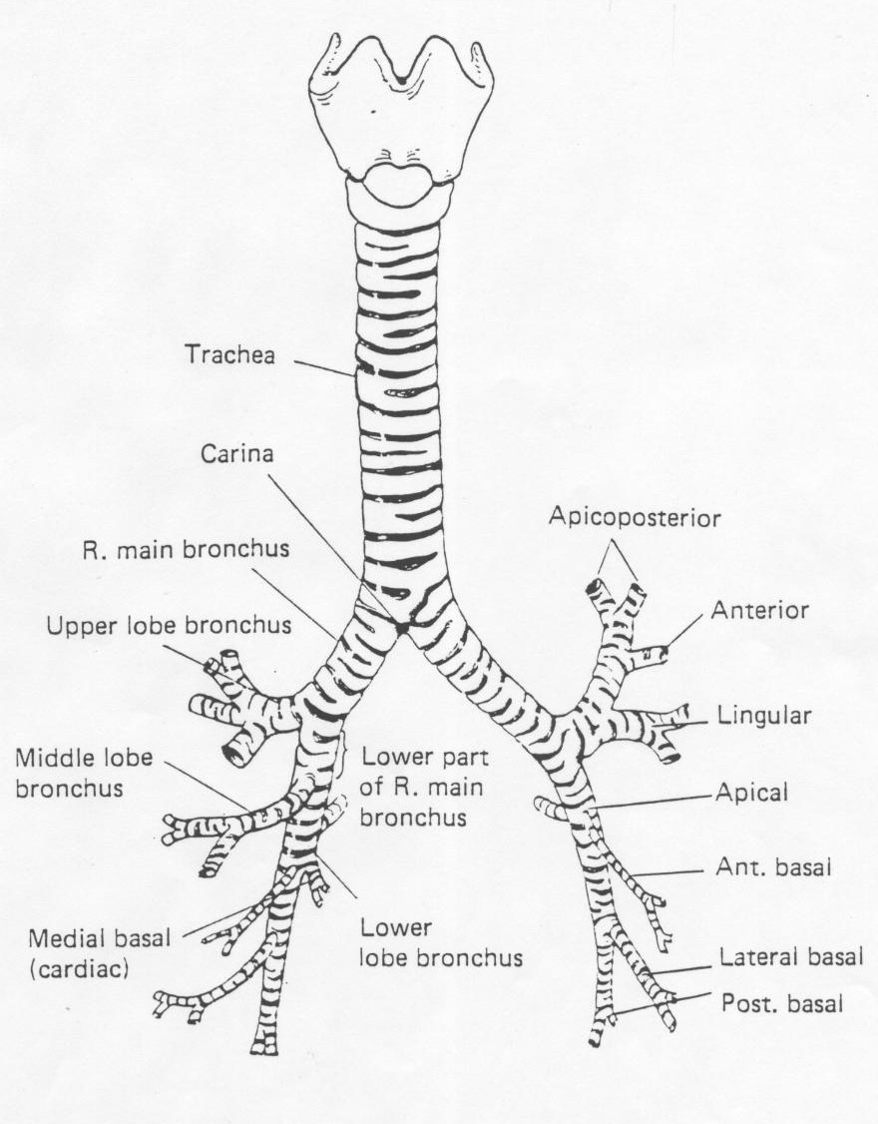

Slide 14
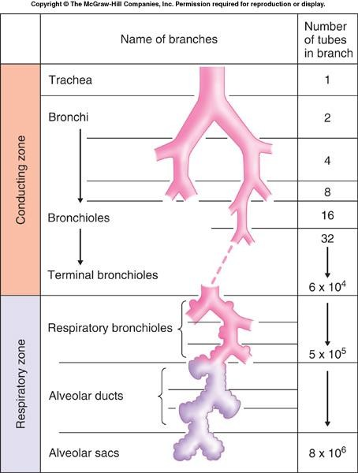
Subdivisions of the conducting airways and terminal respiratory units

Slide 15
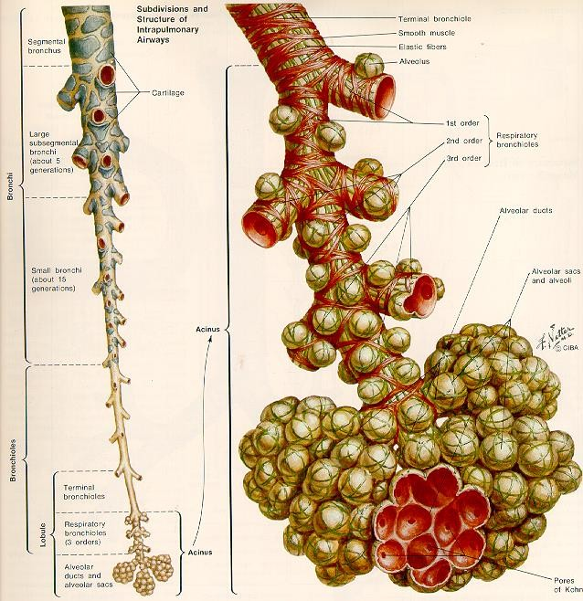
Acinus
(Reproduced from Netter, F.H.: The CIBA Collection of Medical Illustrations, vol. 7).

Slide 16
The conducting airways have 4 main functions:
Defense against bacterial infection and foreign particles:
The epithelial lining of the bronchi has hair-like projections called cilia. The epithelial glands secrete a thick substance, mucous, which lines the respiratory passages as far down as the bronchioles. Foreign particles stick to the mucous and the cilia constantly sweep the mucous up into the pharynx;
Warm and moisten inhaled air;
Sound and speech are produced by the movement of air passing over the vocal cords;
Regulation of air flow: smooth muscle around the airways may contract or relax to alter resistance to air flow.

Slide 17
Function of the Respiratory Zone
The respiratory zone is the site of gas exchange between the air in the alveoli and the blood in the pulmonary capillaries. There are roughly 300 million alveoli in the human lungs, and each alveolus may be associated with as many as 1000 capillaries.

Slide 18
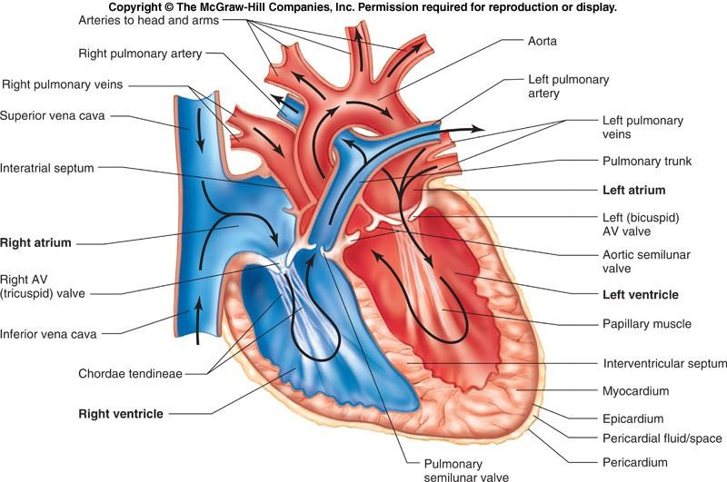

Slide 19
Blood Supply
The lungs have two circulations:
Pulmonary circulation: bringing mixed venous blood to the lungs, allowing for the blood to get oxygenated, and to then be taken back to the left heart;
Bronchial circulation: supplying oxygenated blood from the systemic circulation to the tracheobronchial tree (this circulation allows for the airways to get oxygenated).

Slide 20
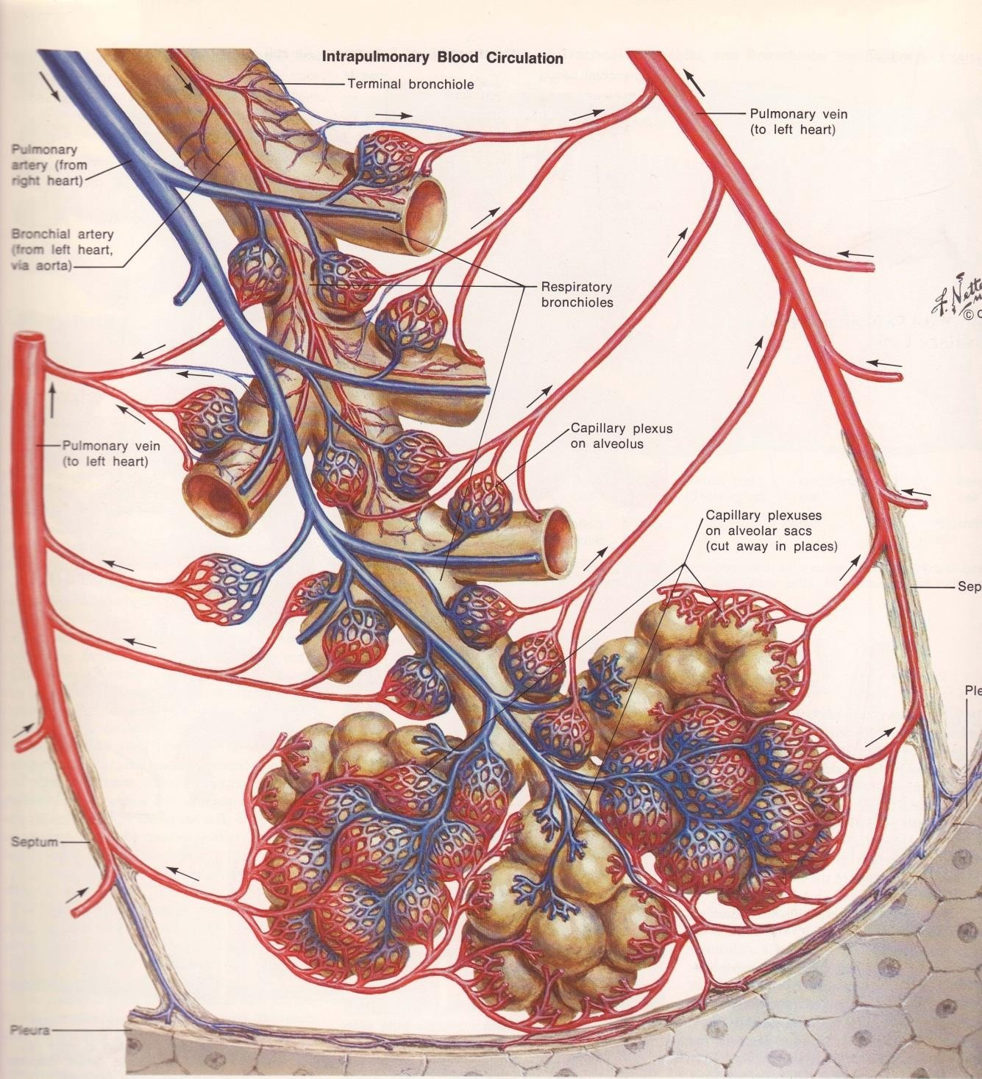
The pulmonary and bronchial circulations
Reproduced from Netter, F.H.: The CIBA Collection of Medical Illustrations, vol. 7).

Slide 21
Alveolar Cell Types
There are three alveolar cell types:
Epithelial type I and II cells:
Alveoli are lined by epithelial type I and II cells. Little is known about the specific metabolic activities of type I cells. Type II cells produce pulmonary surfactant, a substance that decreases the surface tension of the alveoli.
Endothelial cells:
Endothelial cells constitute the walls of the pulmonary capillaries. These cells may be as thin as 0.1 micron.
Alveolar macrophages:
They remove foreign particles that may have escaped the mucociliary defense system of the airways and found their way into the alveoli.

Slide 22
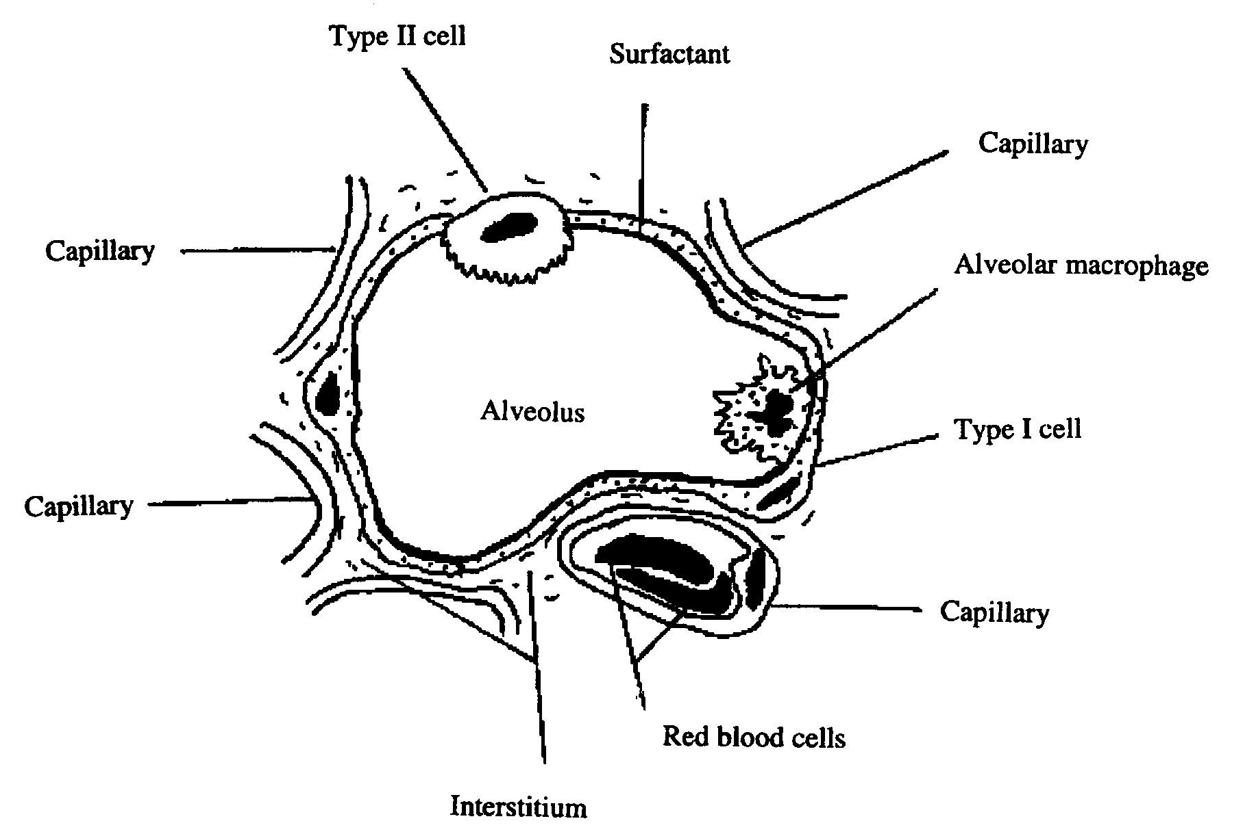
Alveolar-capillary membrane

Slide 23
Respiratory Muscles
The lung tissue is elastic, but it is unable to expand or contract by itself. Air has to be sucked into the lungs. This function is powered by the respiratory muscles of the chest wall. There are 2 types of respiratory muscles: inspiratory and expiratory.

Slide 24
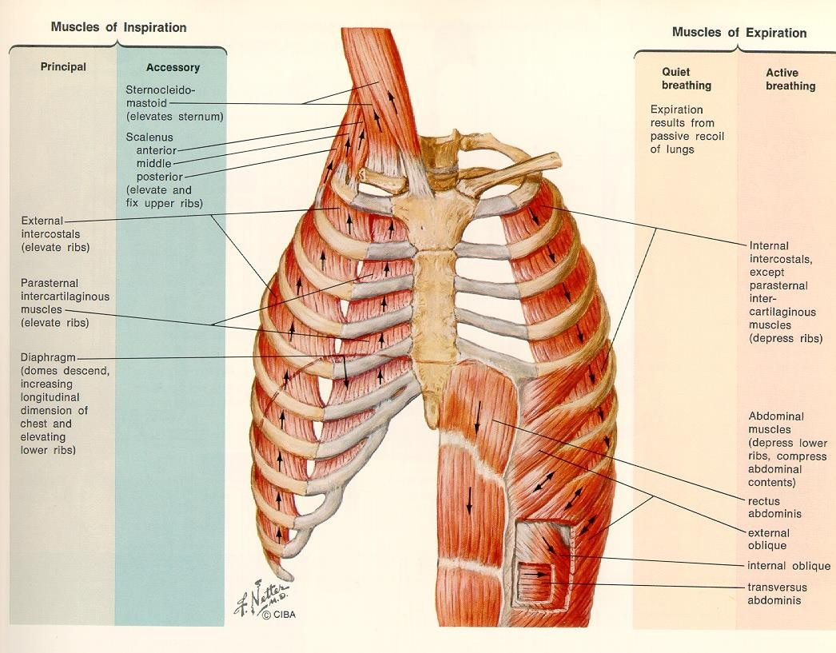
Reproduced from Netter, F.H.: The CIBA Collection of Medical Illustrations, vol. 7.

Slide 25
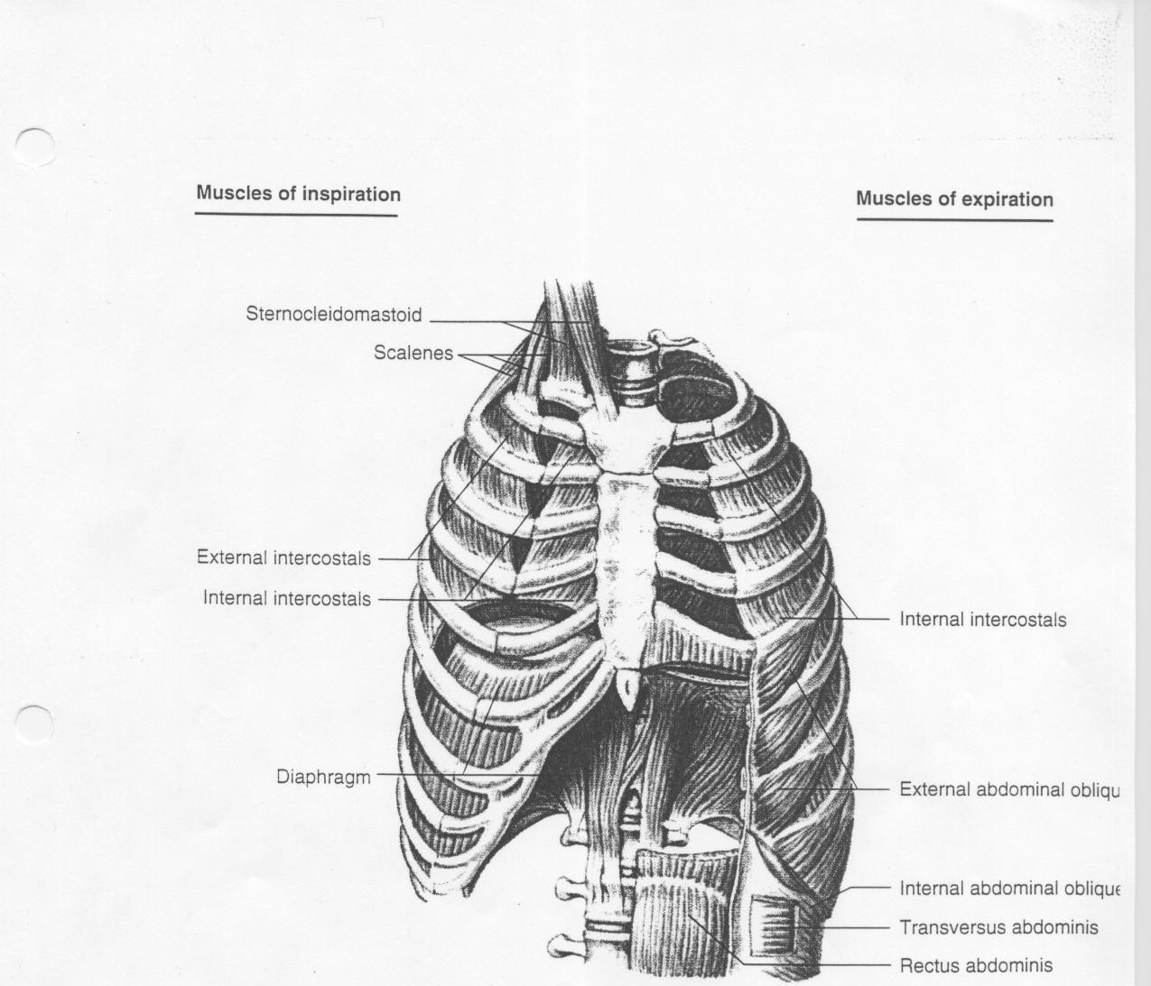
The diaphragm is innervated by the phrenic nerves from cervical
segments 3, 4 and 5.

Slide 26
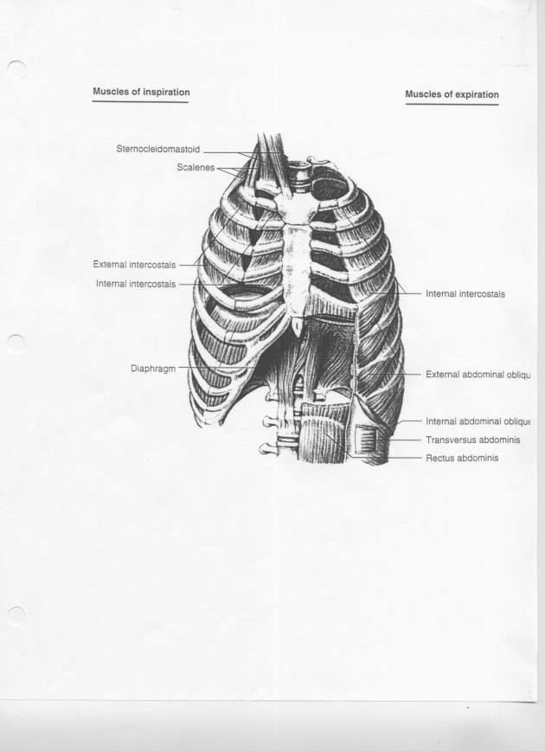
Summary of events during inspiration:
Inspiration:
Diaphragm and intercostal muscles contract
↓
Thoracic cage expands
↓
Intrapleural pressure becomes more negative
↓
Transpulmonary pressure increases
↓
Lungs expands
↓
Alveolar pressure becomes subatmospheric
↓
Air flows into alveoli

Slide 27
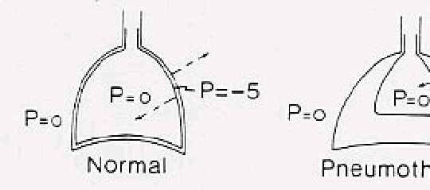
Reproduced from West: Respiratory Physiology- the essentials.

Slide 28

Summary of events during inspiration:
Inspiration:
Diaphragm and intercostal muscles contract
↓
Thoracic cage expands
↓
Intrapleural pressure becomes more negative (subatmospheric)
↓
Transpulmonary pressure increases
↓
Lungs expands
↓
Alveolar pressure becomes subatmospheric
↓
Air flows into alveoli

Slide 29
Summary of events during expiration:
Expiration:
Diaphragm and external intercostal muscles stop contracting
↓
Chest wall moves inwards
↓
Intrapleural pressure goes back towards preinspiratory value
↓
Transpulmonary pressure goes back towards preinspiratory value
↓
Lung recoil towards preinspiratory volume
↓
Air in lungs is compressed
↓
Alveolar pressure becomes greater than atmospheric pressure
↓
Air flows out of the lungs

Slide 30
Lecture 2

Slide 31
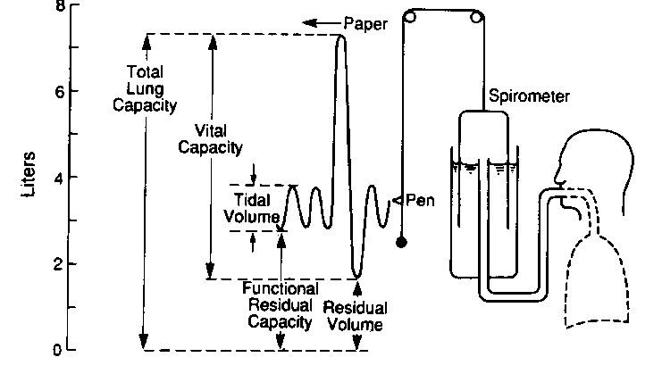
Spirometry: Measuring lung volumes
Lung volumes. (Reproduced from West, J.B.: Respiratory Physiology- the essentials).

Slide 32
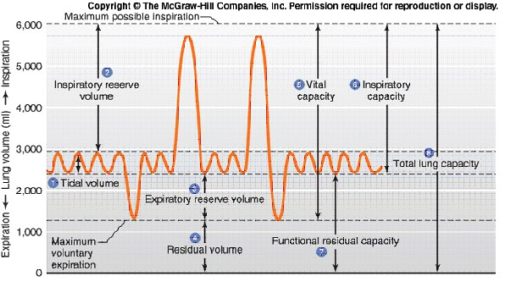

Slide 33
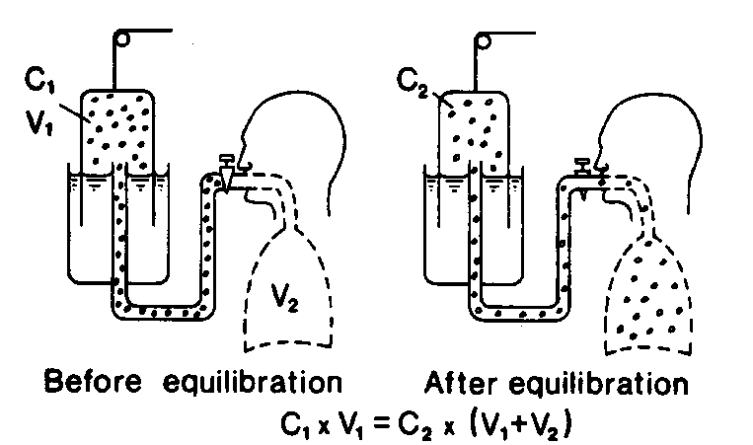
Measurement of FRC
(Reproduced from West: Respiratory Physiology- the essentials).
C1 x V1 = C2 x (V1 + FRC )
so that:
FRC = (C1 x V1 / C2) - V1
Note: Think of the lung as a balloon not as a jar.

Slide 34
VENTILATION
Minute ventilation
.
The amount of air inspired (or expired) over one minute (VE).
.
VE = VT x f
where VT is the tidal volume, and f is the number of breaths per minute.

Slide 35
Alveolar ventilation
Not all the air inhaled into the lungs reaches the gas exchanging area. Some of the air remains in the conducting airways (anatomical dead space).

Slide 36
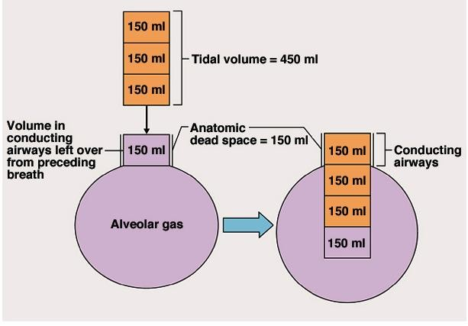
The volume of the anatomical dead space in the adult subject is about 150mL (anatomical dead space is difficult to measure, but a close approximation is a subject's weight in pounds).

Slide 37
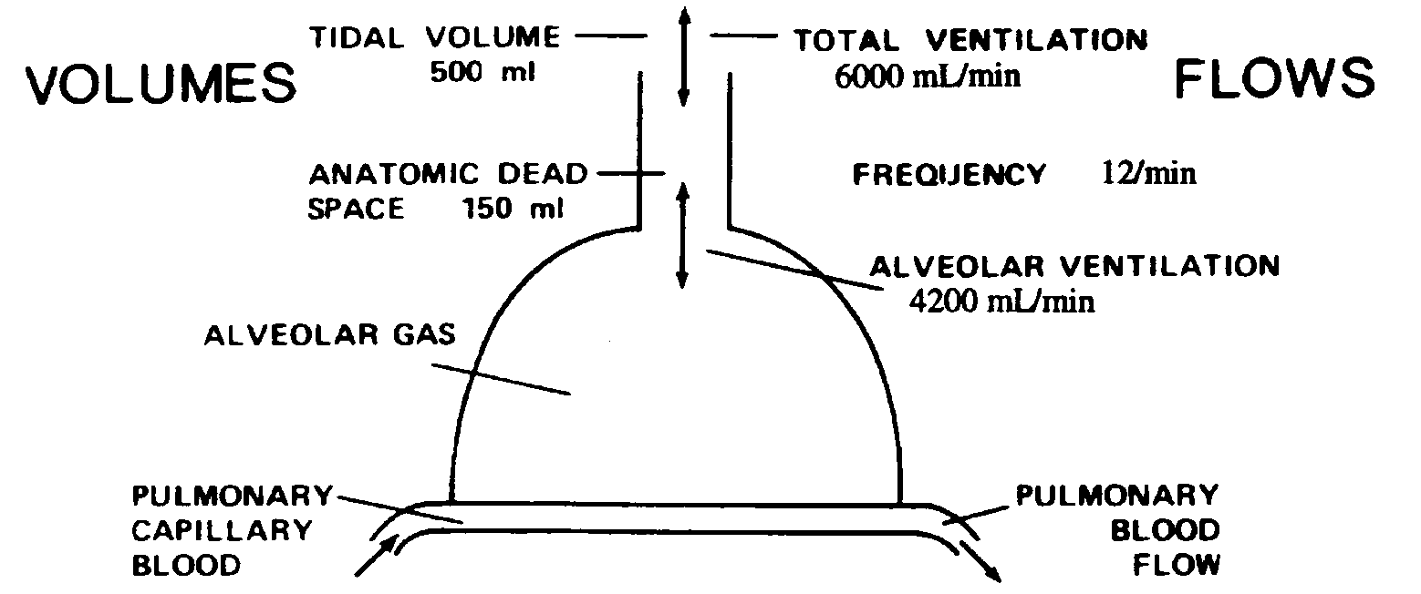
I.n a normal adult male, VT = 500ml, and f =12 breaths/minute. Therefore,
VE = 6000ml/min. The volume of the anatomical dead space in the adult subject is about 150ml. Thus, the amount of air that reaches the
respiratory z.one per minute and available for gas exchange, the alveolar
ventilation (VA), is:
.
VA= (500-150 ml) x 12= 4200 ml/min.

Slide 38
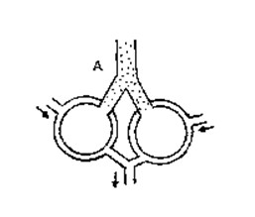
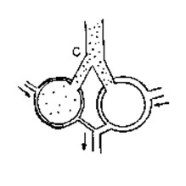
Alveolar and Physiological dead-space
Alveolar dead-space: under some pathological conditions, a certain amount of inspired air, although reaching the respiratory
zone, does not take part in gas exchange. This situation can be due to a decreased blood supply or no blood supply at all. These alveoli represent alveolar dead space.

Slide 39
Alveolar and Physiological dead-space
Physiological dead-space:
Physiological dead-space (VD): (Alveolar + Anatomical) dead-space

Slide 40
APPENDIX 1
P = total pressure
Fx = fractional concentration in dry gas Px = partial pressure of gas x
Px = P⋅Fx
Example:
Barometric P = 760mmHg FO2 = 21% *
FCO2 = 0.03% *
Px = (P-47mmHg)⋅Fx (water vapor pressure of 47mmHg) PO2 = (760mmHg – 47mmHg)⋅21/100 = 150mmHg
PCO2 = (760mmHg – 47mmHg)⋅0.03/100 = 0.2mmHg
* Fractional concentrations are generally given as the fraction of dry gas volume that is occupied by the gas in question. Because of that convention, barometric pressure has to be corrected for the contribution from water vapor.

Slide 41
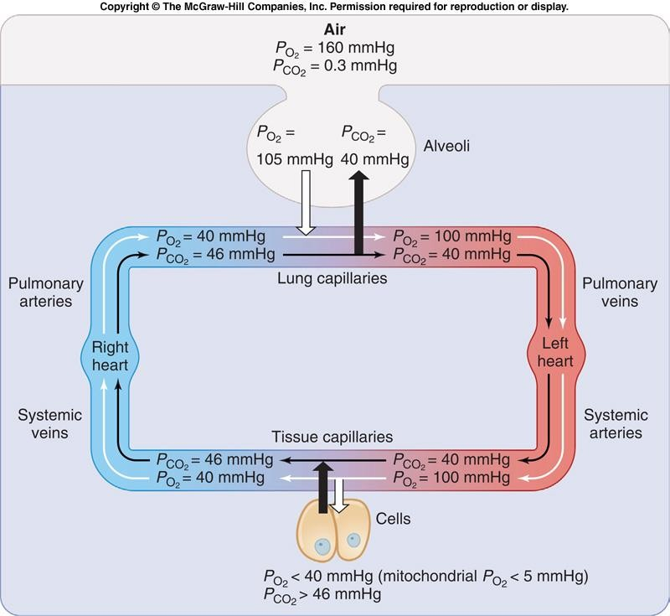
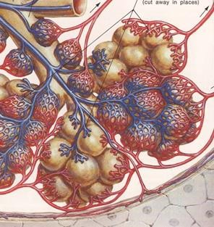
Types of Alveolar Ventilation
.
Normal Alveolar Ventilation: VA matches CO2 and keeps PaCO2
at a constant level.

Slide 42
Types of Alveolar Ventilation (Cont’ed)
Alveolar hyperventilation: This occurs when more O.2 is supplied and
more CO2 removed than the metabolic rate requires (VE exceeds the needs of the body). As a consequence, alveolar and arterial partial pressures of O2 rise and those of CO2 decrease.
Note: This is with respect to metabolism so not as during exercise.

Slide 43
Types of Alveolar Ventilation (Cont’ed)
Alveolar hypoventilation: A fall in ventilation can reduce alveolar
ventilation below that required by the metabolic activity of the body.
Under such conditions, the rate at which O2 is added to alveolar gas, and the rate at which CO2 is eliminated, is lowered, so that the alveolar partial pressure of O2 (PAO2) falls and PACO2 rises.
Therefore, PaO2 falls below normal values and PaCO2 rises above the normal value.
Alveolar hypoventilation may occur during severe disorders of the lungs (e.g. chronic obstructive lung disease), or when there is damage to the respiratory muscles. It can also occur when the chest cage is injured and the lungs collapse, or when the central nervous system is depressed.

Slide 44
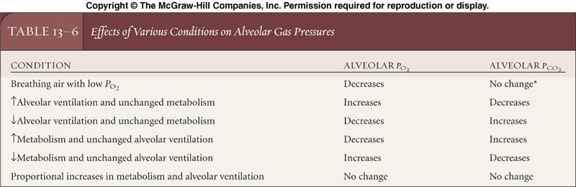

Slide 45
Types of Alveolar Ventilation

Slide 46
Lecture 3

Slide 47
GAS DIFFUSION
Diffusion Rate
The transfer of gases across the alveolar-capillary membrane occurs by passive diffusion. This diffusion is very efficient in the lungs because of the huge surface area of the membrane and its extreme thinness.
Diffusion is governed by Fick's Law: Diffusion rate is α surface area (50-100 m²)
α partial pressure gradient
α 1/thickness (~0.2 mm)

Slide 48
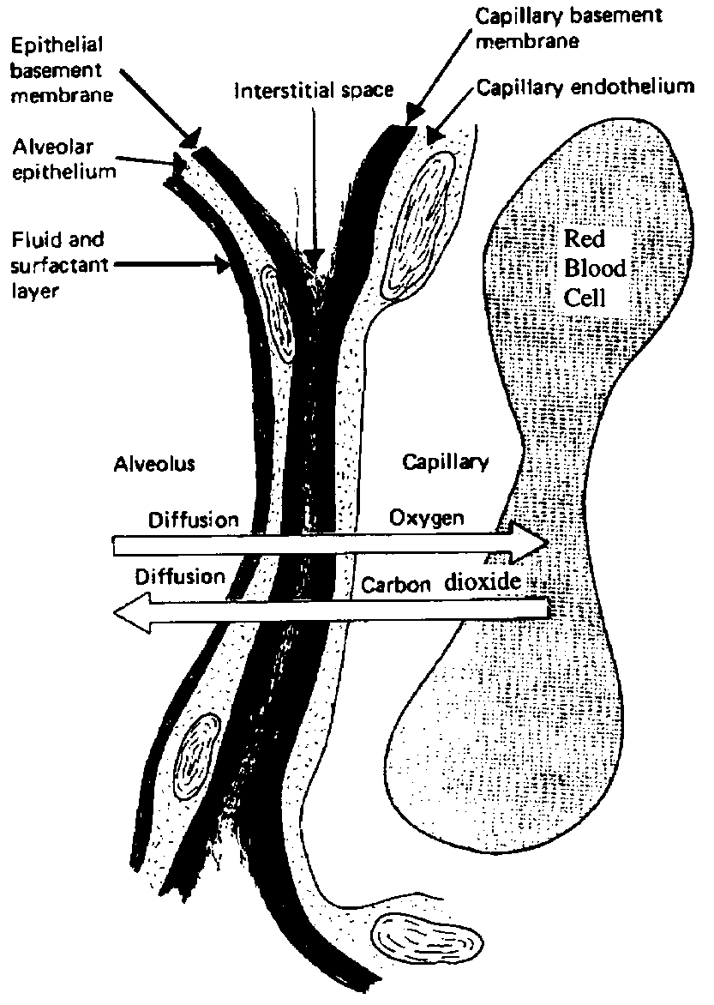
Ultrastructure of the respiratory membrane as shown in cross-section.
(Reproduced from Guyton: Textbook of Medical Physiology).

Slide 49
Diffusion Rate (Cont’ned)
•To diffuse through a liquid, a gas must be soluble in the liquid. The amount of gas dissolved is proportional to its partial pressure (Henry’s law).
Because CO2 is considerably more soluble than O2 in water, it diffuses ~20 times more rapidly than O2.
•However, the difference in PCO2 between the 2 sides of the alveolar- capillary membrane is 10 times smaller than that for PO2. Therefore, the time required for equilibrium between alveolar air and capillary blood is ~ the same for the two gases.

Slide 50
.

Slide 51
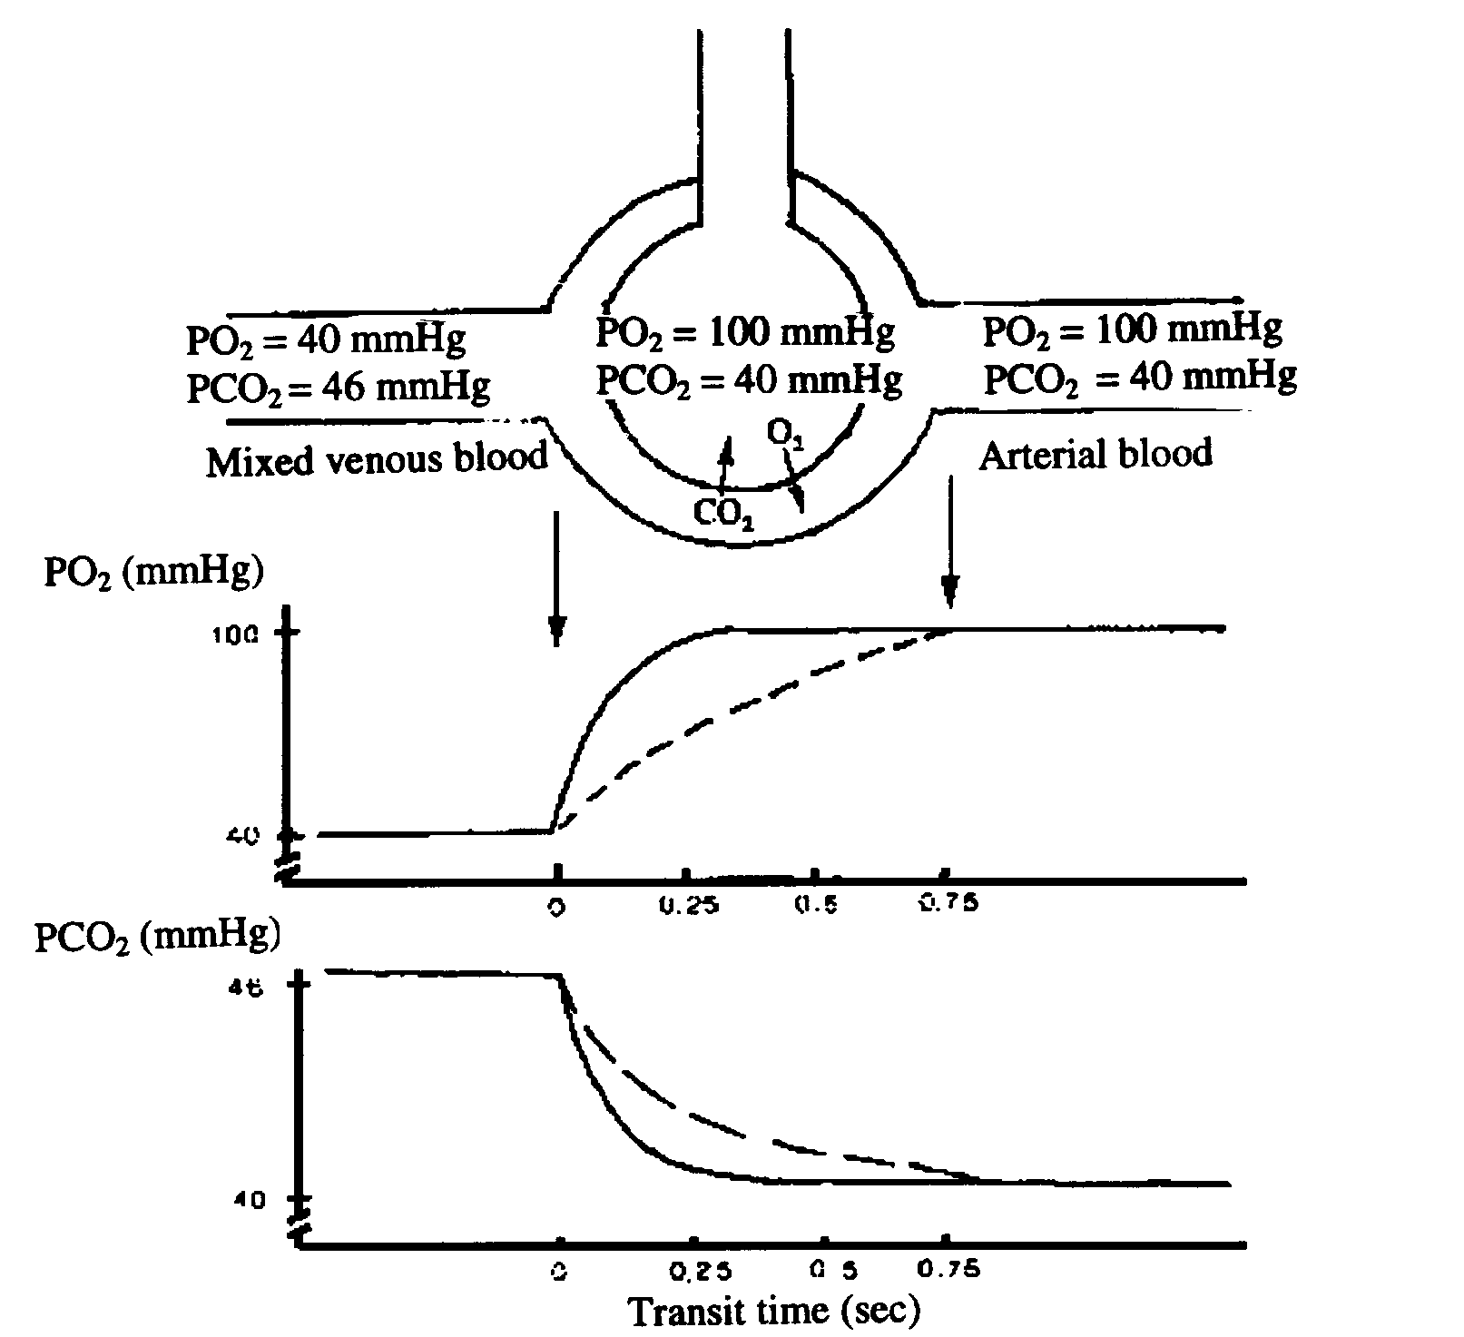
Transit Time
Pulmonary arteries
Pulmonary veins

Slide 52
IV Pulmonary blood flow
A. Pulmonary Circulation and Blood Pressure
The pulmonary circulation differs in many ways from the systemic one:
The right ventricle develops a pressure of ~25 mmHg during its systole (compared to 120mmHg in the left ventricle);
Blood pressure in the pulmonary circulation is lower than in the systemic circulation;
The pulmonary capillaries are thinner and contain less smooth muscle than comparable vessels in the systemic circulation.

Slide 53
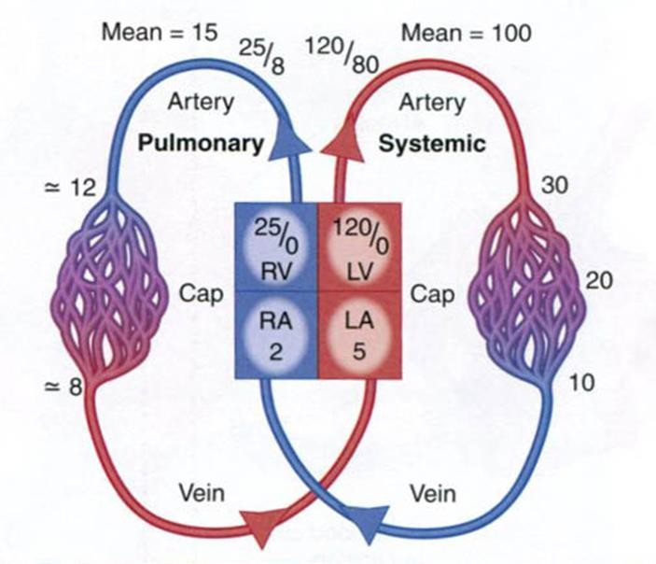
From West: Respiratory Physiology-the essentials).

Slide 54
B. Vascular Resistance
Flow = pressure / resistance
•Total pressure drop from pulmonary artery to left atrium of about 10 mm Hg.
The pulmonary resistance is ~1/10 that of the systemic circulation.
•The low vascular resistance in the pulmonary circulation relies on the thin walls of the vascular system.
•The low vascular resistance and high compliance of the pulmonary circulation allows the lung to accept the whole cardiac output at all times.

Slide 55
B. Vascular Resistance
Flow = pressure / resistance
•Total pressure drop from pulmonary artery to left atrium of about 10 mm Hg.
The pulmonary resistance is ~1/10 that of the systemic circulation.
•The low vascular resistance in the pulmonary circulation relies on the thin walls of the vascular system.
•The low vascular resistance and high compliance of the pulmonary circulation allows the lung to accept the whole cardiac output at all times.

Slide 56
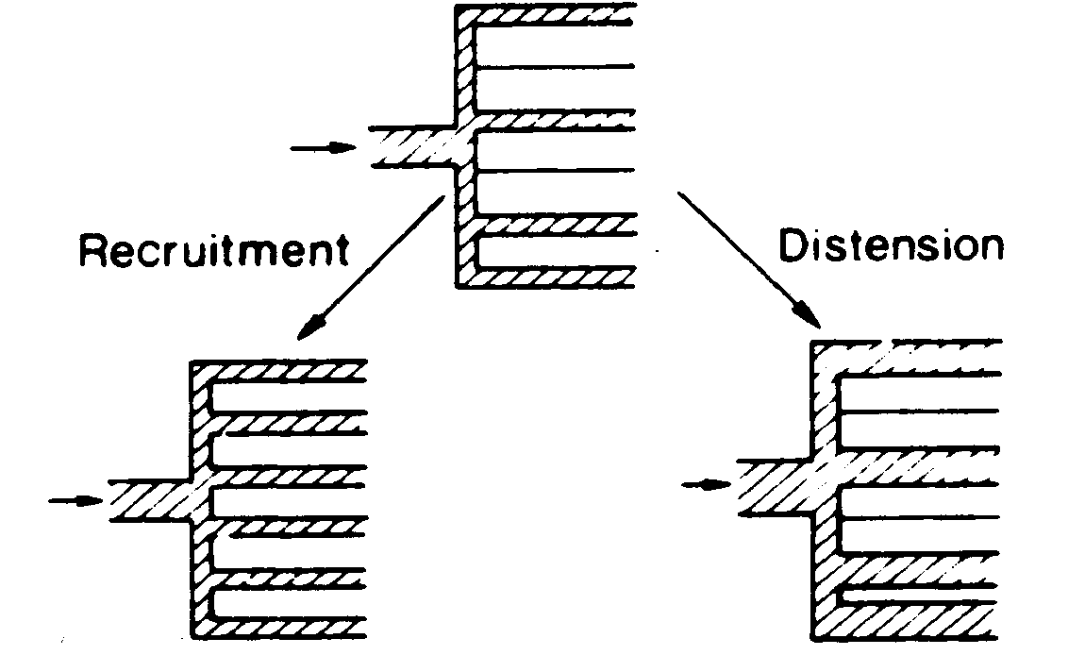
C. Accommodation of Pulmonary Blood Vessels
The pulmonary circulation has the capacity to accommodate two- to three-fold increases in cardiac output with little change in pulmonary arterial pressure.
Reproduced from West: Respiratory Physiology-the essentials.

Slide 57
C. Accommodation of Pulmonary Blood Vessels (Cont’ed)
•Drugs (serotonin, histamine, norepinephrine) which cause the contraction of smooth muscle increase pulmonary vascular resistance in the larger pulmonary arteries.
•Drugs (acetylcholine, isoproteranol) which can relax smooth
muscle may decrease pulmonary vascular resistance.
•There is a reflex vasoconstriction in regions of the lungs that are poorly oxygenated.
•Nitric oxide produced by endothelial cells relaxes vascular smooth muscle leading to vasodilation.

Slide 58
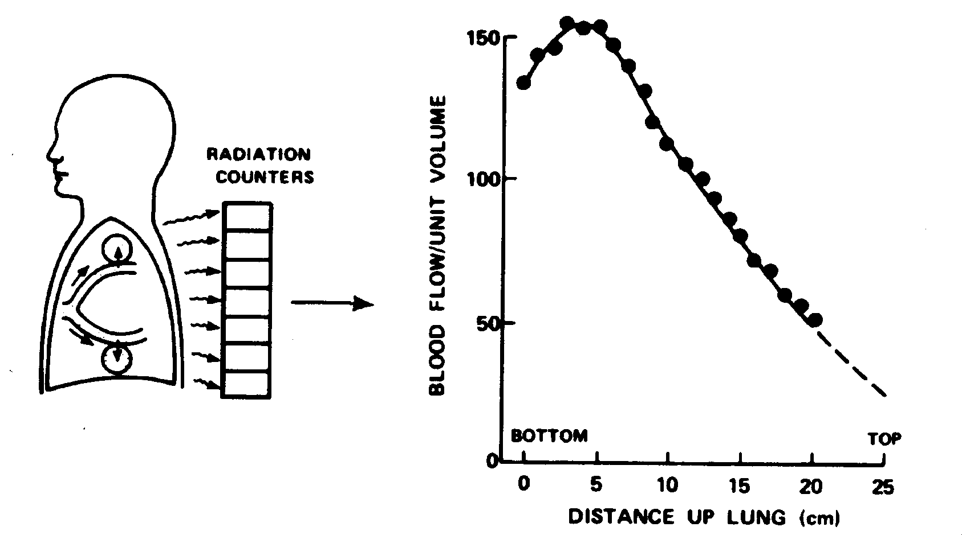
D. Effects of Gravity on pulmonary blood flow
Pulmonary blood flow is affected by gravity.
Test performed by injecting radioactive Xenon in a peripheral vein.
Note that the somewhat lower blood flow observed at the bottom of the lung is due to extra-alveolar vessels being less expanded at low lung volumes. (Reproduced from West: Respiratory Physiology-the essentials).

Slide 59
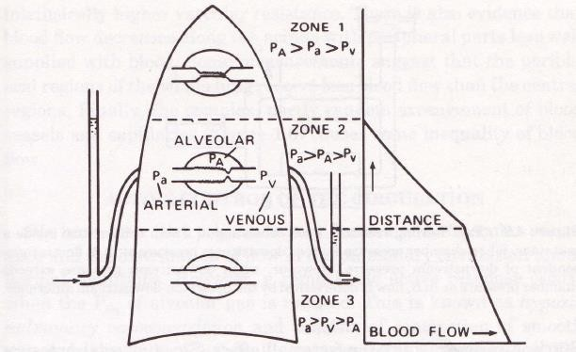
D. Effects of Gravity on pulmonary blood flow (Cont’ed)
Figure 18b: Distribution of blood flow as described as West’s zones
Reproduced from West: Respiratory Physiology-the essentials.

Slide 60
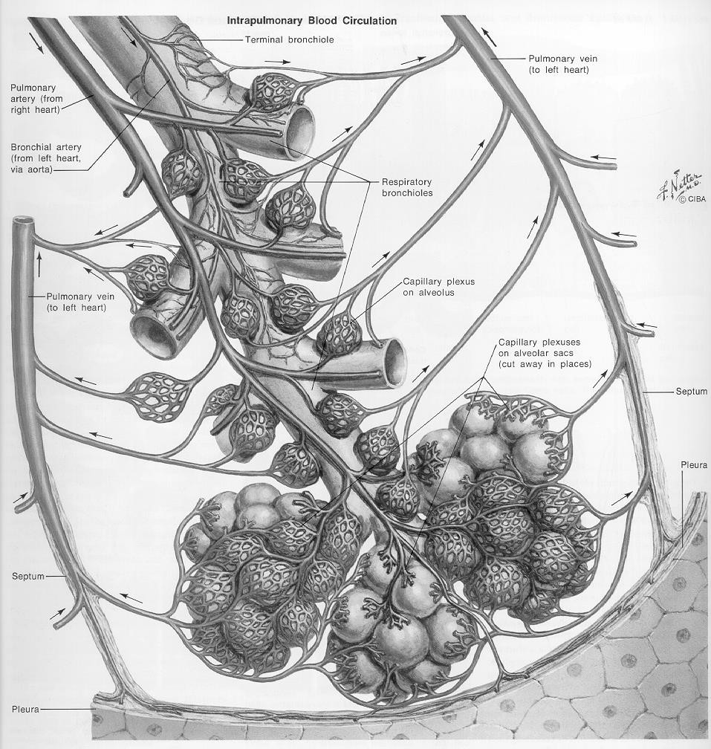

Slide 61
The Starling Resistor
Pulmonary
Circulation
Concept
(unknown source)

Slide 62
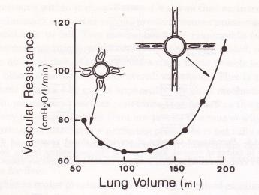
E. Effects of lung volume on pulmonary vascular resistance
Lung volume affects pulmonary vascular resistance in a complex manner depending on if the blood vessels are surrounded by alveoli (alveolar vessels) or not (extra-alveolar vessels).
FRC
Reproduced from West: Respiratory Physiology-the essentials.
Above FRC, the alveolar vessels are stretched longitudinally and thus, their diameter decrease leading to an increase in vascular resistance
Below FRC, the extra-alveolar vessels collapse because they are not stretched by the pulmonary tissues.

Slide 63
Extra-alveolar vessels
Alveolar vessels

Slide 64
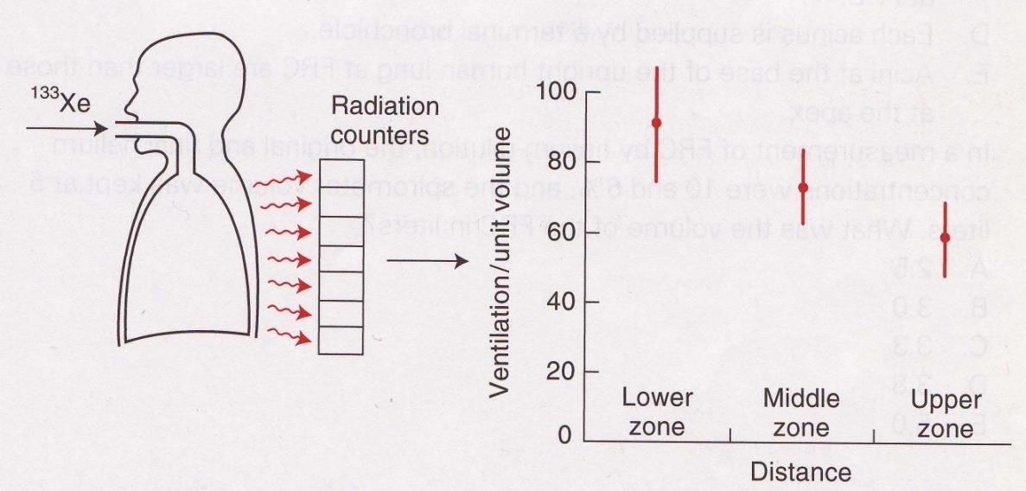
F. Effects of Gravity on Ventilation
•Gravity also affects the distribution of ventilation.
•In an upright lung at rest, in normal gravity, the alveoli at the top of the lungs are more opened than the bottom ones (think of a “Slinky” held in normal gravity).
•The distribution of ventilation can be measured in a similar way as that of perfusion but with inhaled radioactive Xenon instead of infused in the blood.
Reproduced from West: Respiratory Physiology-the essentials.

Slide 65
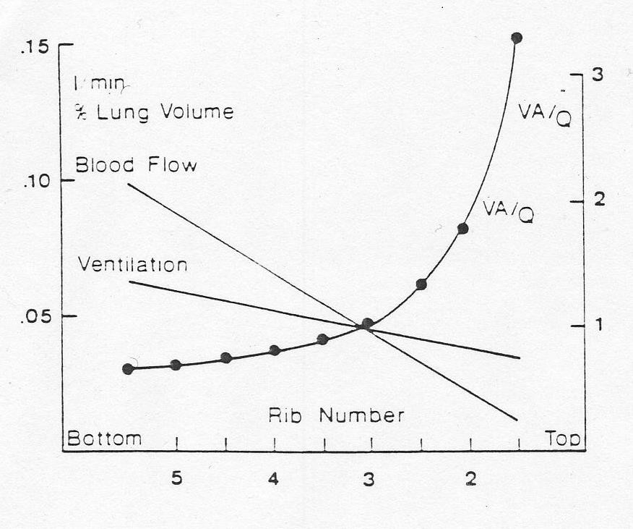
G. Distribution of ventilation perfusion ratio in the lungs in normal gravity.
Reproduced from West: Respiratory Physiology-the essentials.

