Slide 1
6.14.19

Slide 2
Strategy
Decide to do the following scenarios
1. Combine the photo and the side bar into one API request to speed up the process. That would involve changing the front end code.
Save it into another Photo-module-separate
Photo-module – combined
Problem – need to set up async/wait control so that you wait until the two table queries are compelted before send
2. Do not combine the photo and the side bar into one API request. keep them as separate API request. That means I will be running two services. The proxy would have to redirect two endpoints -- one for photo and one for side bar.
Complete all the async/wait
To speed things up
Convert your req and res into streams formatting – watching Fullstack Academy
Technical debt
React Keys
Flexible number of photos

Slide 3
Finish with whatever baseline you have before 1230.
I want both versions to be out for a comparison.

Slide 4
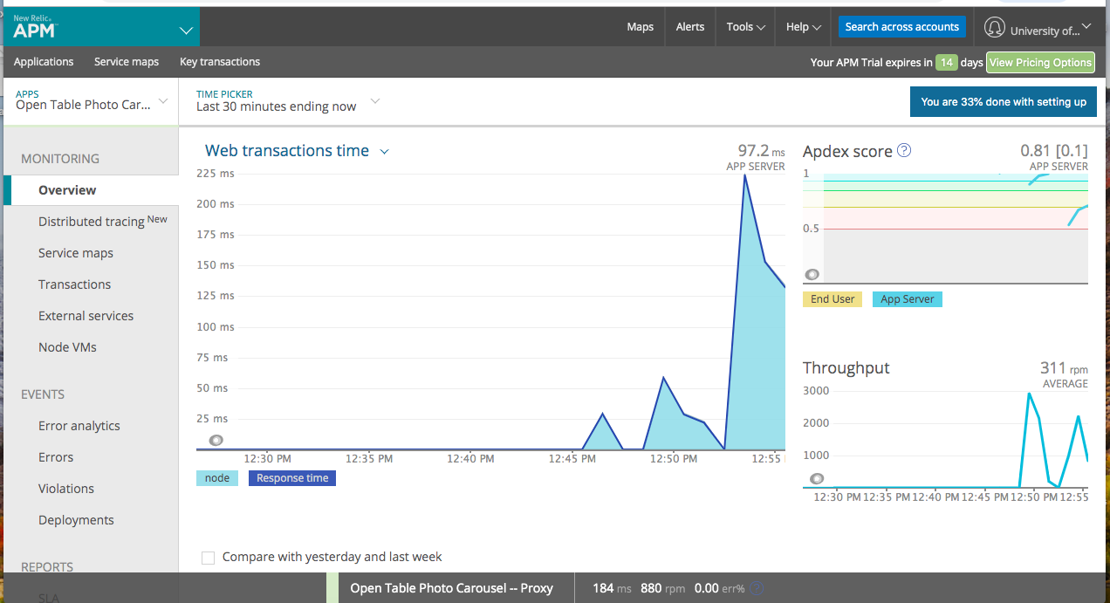
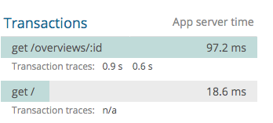
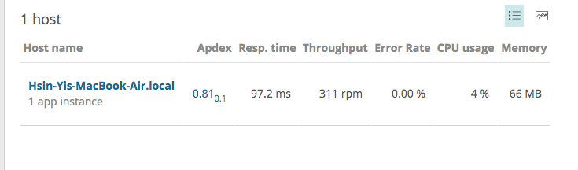
Proxy results

