Slide 1
6.14.19

Slide 2
Strategy
Decide to do the following scenarios
1. Combine the photo and the side bar into one API request to speed up the process. That would involve changing the front end code.
Save it into another Photo-module-separate
Photo-module – combined
Problem – need to set up async/wait control so that you wait until the two table queries are compelted before send
2. Do not combine the photo and the side bar into one API request. keep them as separate API request. That means I will be running two services. The proxy would have to redirect two endpoints -- one for photo and one for side bar.
Complete all the async/wait
To speed things up
Convert your req and res into streams formatting – watching Fullstack Academy
Technical debt
React Keys
Flexible number of photos

Slide 3
Finish with whatever baseline you have before 1230.
I want both versions to be out for a comparison.

Slide 4
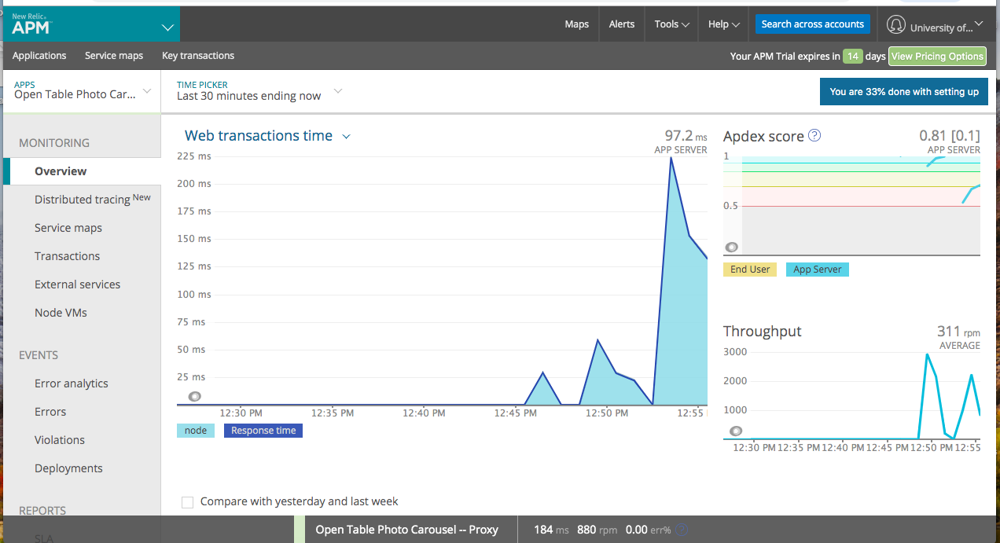
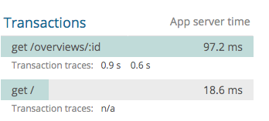
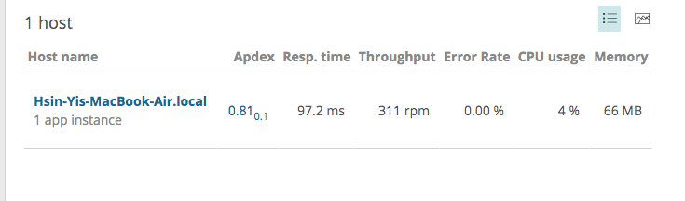
Proxy results

Slide 5
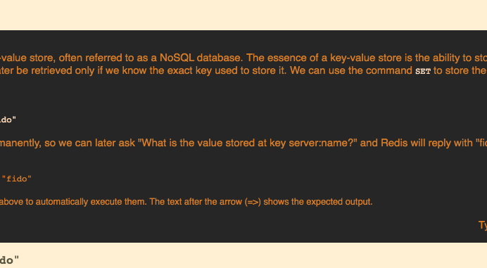
Redis command

Slide 6
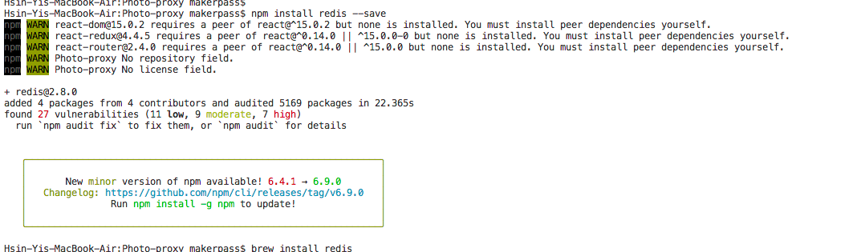
Redis
Install redis
Npm install redis

Slide 7
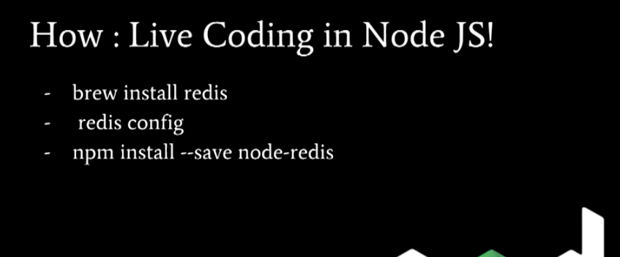
Redis install
Fullstack academy

Slide 8
Edge computing is a networking philosophy focused on bringing computing as close to the source of data as possible in order to reduce latency and bandwidth use. In simpler terms, edge computing means running fewer processes in the cloud and moving those processes to local places, such as on a user’s computer, an IoT device, or an edge server. Bringing computation to the network’s edge minimizes the amount of long-distance communication that has to happen between a client and server.
What is the network edge?
For internet devices, the network edge is where the device, or the local network containing the device, communicates with the Internet. The edge is a bit of a fuzzy term; for example a user’s computer or the processor inside of an IoT camera can be considered the network edge, but the user’s router, ISP, or local edge server are also considered the edge. The important takeaway is that the edge of the network is geographically close to the device, unlike origin servers and cloud servers, which can be very far from the devices they communicate with.

Slide 9
