Slide 2
Plans to quickly get done
Migrate over to PostgreSQL
In the next 15 minutes, finish writing your CRUD operation using PostgreSQL
How to login?
How to perform bulk insert
RDCEP – finish draft BY NOON

Slide 3
mySQL review
https://github.com/mysqljs/mysql

Slide 4
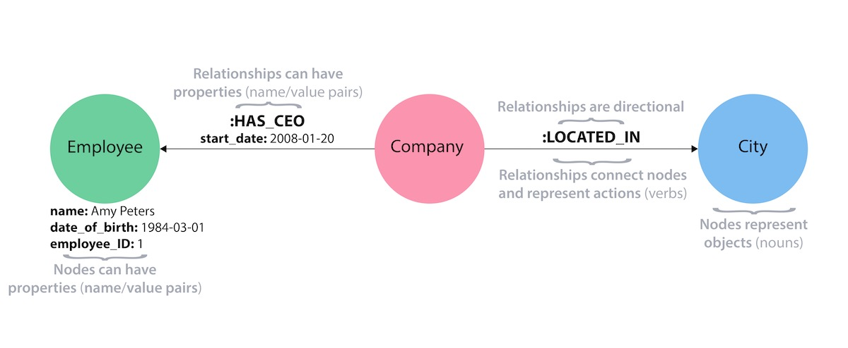
Search engine database
https://aws.amazon.com/nosql/search/
https://neo4j.com/developer/get-started/
Building blocks of the property graph model (click to zoom)
property graph elements

Slide 5
How to insert
Use pool
Breakdown the dataset by 1/10
Use 10 pools to simultaneously insert?
Just insert it once and for all
“If you're working on a web application or other software which makes frequent queries you'll want to use a connection pool. The easiest and by far most common way to use node-postgres is through a connection pool.”

Slide 6
Riak vs Cassandra
Riak uses vector clocks whereas Cassandra uses timestamps. Some Riak advocates argue that you can use a "Last-Writer-Wins" strategy to get similar behaviour to Cassandra's timestamp approach (which does not need application-specific conflict resolution). That's wrong. The Cassandra data model has the more fine-grained concept of columns, making Lost-Updates much unlikelier than in Riak. Cassandra guys claim that timestamps are just fine and vector clocks unnecessary. That's wrong, too. In his great series of posts, Aphyr [3] has shown that it leads to lost-updates on timestamp collisons that even cause dirty (intermingled) writes.
Cassandra has a richer wide-column data model allowing for interesting concepts like composite keys (which allow some scaning and ordering), projections and others [4].
https://www.quora.com/What-are-the-differences-between-Cassandra-and-Riak
Riak CS has a built-in S3 interface with S3 Access Control List (ACL) support, which means that you can both use existing S3 tools and frameworks to manage your data and also import and extract data from Amazon directly

Slide 7
Riak vs Cassandra
However, Riak and Cassandra differ in how they resolve data conflicts that occur due to eventual consistency.
Riak KV uses logical clocks, called dotted version vectors (DVVs), to ensure data accuracy. As data is updated, DVVs provide a causal history that makes it possible to determine the precise order of events. If concurrent writes cannot be resolved, DVVs ensure that all writes are stored as siblings. These sibling versions provide information that allows for conflict resolution logic when reading data. DVVs play an important role in minimizing the need for client-side conflict resolution.
Riak also provides the option to use Riak Data Types for fast, automatic server-side conflict resolution in the application. Riak Data Types are convergent replicated data types (CRDTs) and include:

Slide 8
PostgreSQL connect
PostgreSQL server can only handle 1 query at a time per conenction. That means if you have 1 global new pg.Client() connected to your backend your entire app is bottleknecked based on how fast postgres can respond to queries. It literally will line everything up, queuing each query. Yeah, it's async and so that's alright...but wouldn't you rather multiply your throughput by 10x? Use pg.connect set the pg.defaults.poolSize to something sane (we do 25-100, not sure the right number yet).
https://gist.github.com/brianc/6908287

Slide 9
Slow to load images – look down the path
https://forums.aws.amazon.com/thread.jspa?threadID=122194
Hi daviwall,
The issue here is a browser can only create one connection per domain at any point in time (so your 64 images would be downloaded one after the other and not in parallel).
To speed things up you could look at using parallel connections which would allow subsequent multiple downloads at the same time. This can be achieved by using multiple DNS CNAME records that point to the same site in your application.
I hope this helps.
Best regards,
Phil P

Slide 10
Postgresql COPY command
https://stackoverflow.com/questions/26418237/loading-images-faster-in-webpage
If you are loading a freshly created table, the fastest method is to create the table, bulk load the table's data using COPY, then create any indexes needed for the table. Creating an index on pre-existing data is quicker than updating it incrementally as each row is loaded.
https://www.postgresql.org/docs/11/sql-copy.html

Slide 11
If you segregate data, as Jasen suggests, you can even populate the
child tables in parallel, which should provide some performance improvement.

Slide 12
Google Map

Slide 13
React-server
However, when you actually try to use React for server-side rendering, you quickly run into a bunch of practical problems, such as:
How should I load data on the server for my components?
How do I ensure that the client and the server load the same data and generate the same HTML markup?
How do I write code that can be both generated server-side and be part of a single-page application (SPA)?
How should I optimize the delivery of my JavaScript and CSS?
How do I find out about and follow performance best practices?
How do I ensure that my site is streamed to the browser as quickly as humanly possible?
How can I make my app resilient when my backend has high latency spikes?
react-server is a framework designed to make universal (née isomorphic) React easier to write, providing standard answers for these questions and more. When you write your app for react-server, you concentrate on your React components, and react-server takes care of everything else that's needed to run and deploy real React server-rendered apps. Under the hood, react-server is doing a bunch of clever optimizations, many borrowed from the ideas behind Facebook's Big Pipe, to make sure that your site shows up as quickly as humanly possible for your users.
Why react-server?
One of the great things about React is its support for server-side rendering, which can make sites show up faster for users and play better with search engine bots.
https://github.com/redfin/react-server

Slide 14
Real life example from RedFin
https://www.redfin.com/blog/building-a-single-page-application-with-react-and-reflux/

Slide 15
Thoughts
onClick – client makes an HTTP request to the server with a certain parameters
Specify which marker was clicked on
The server then manipulate and talk to the Google API

Slide 16
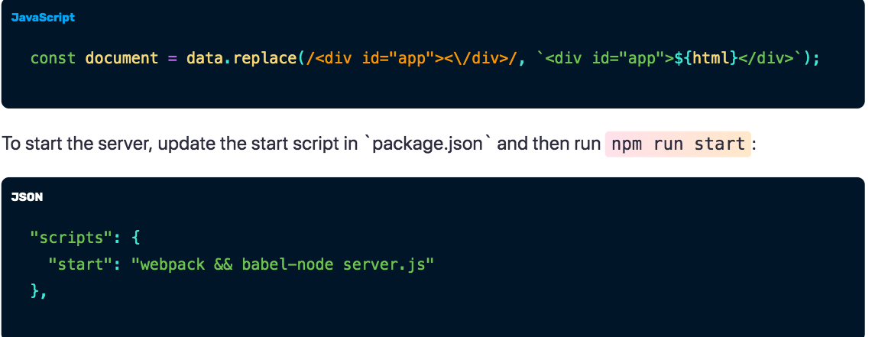
Easy tutorial on react server-side rendering
https://css-tricks.com/server-side-react-rendering/
When client click on a button, an HTTP request is sent to the server
Upon receiving the GET or POST request, the server then adjust the parsed string

Slide 17
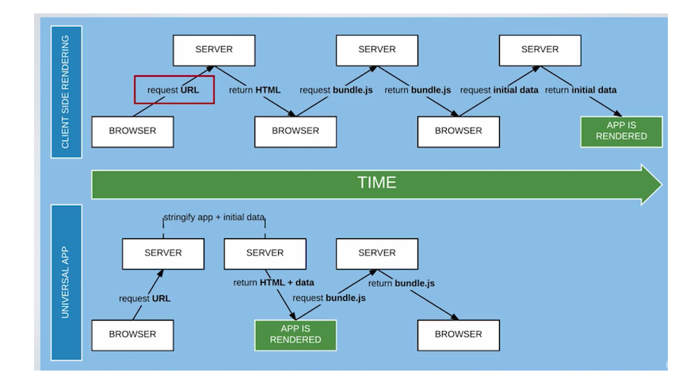
ReactJS server side rendering
http://knowledge-cess.com/category/reactjs/ unfortunately their Google Map examples do not mask the API keys

