Slide 1
6.12.19

Slide 2
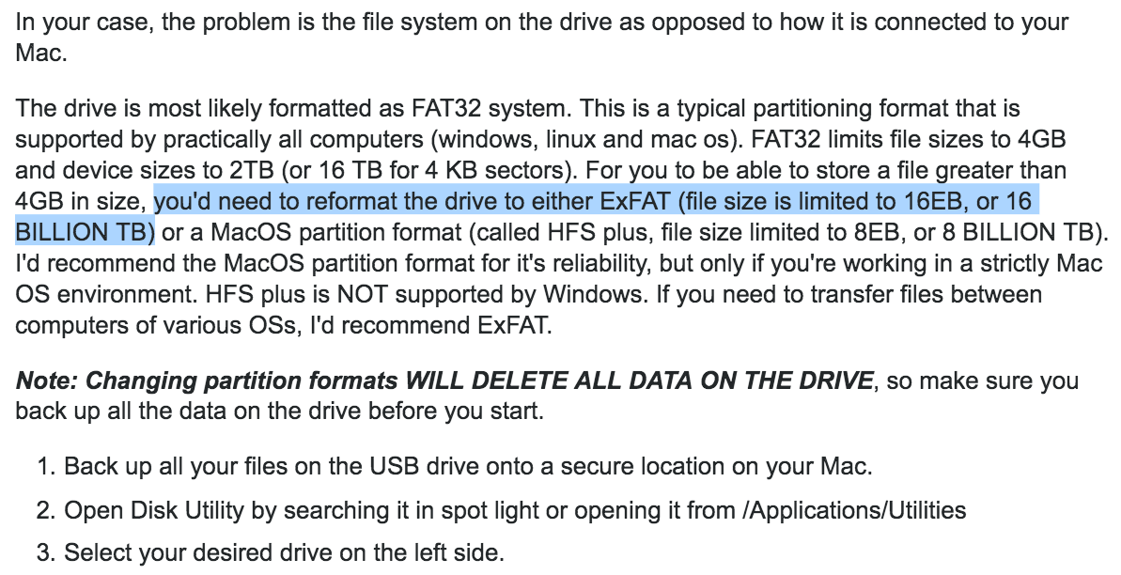
Reformat your drive to be ExFAT
https://apple.stackexchange.com/questions/77006/force-usb-to-accept-a-large-file

Slide 3
k6 is a developer-centric load testing tool designed to help you, as a developer, incorporate load testing into your workflow, and ultimately get it into your automation flow. It aims to do so by:
Being easy to get started with; open-source, well documented and with simple command line usage
Scaling with you from simple unit load tests (eg. single API endpoint) to more complex scenario load tests (eg. an application using a full API)
Allowing you to seamlessly go from local or on-premise use to the convenience of managed cloud use

