Slide 1
6.10.19

Slide 2
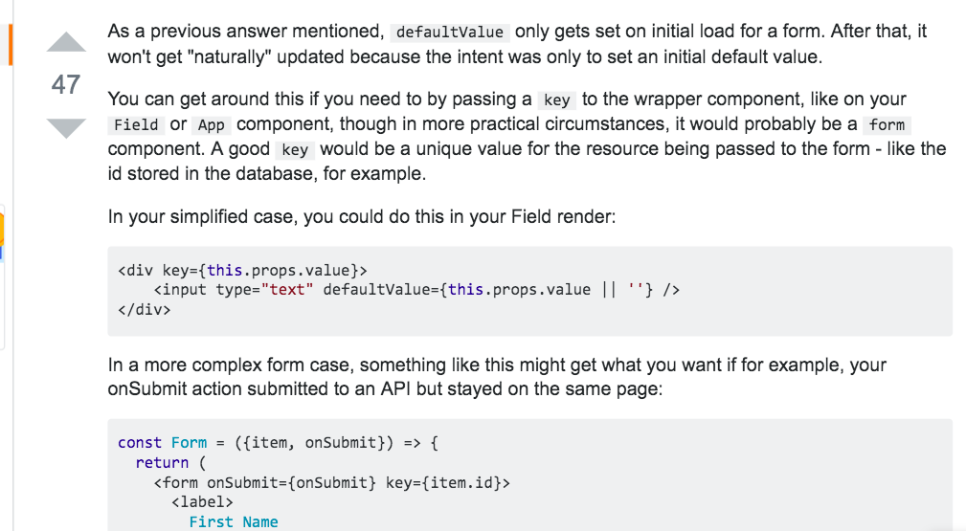
React defaultValue in <Form>
https://stackoverflow.com/questions/30727837/react-change-input-defaultvalue-by-passing-props

Slide 3
Really valuable
https://blog.j0.hn/post/80266933245/stream-all-the-things-like-data-into-postgres
I found a need for it and transform streams in order to reliably copy data from a proprietary file format straight into Postgres.

Slide 4
https://stackoverflow.com/questions/8313628/node-js-request-how-to-emitter-setmaxlisteners

Slide 5
Caching

