Slide 1
6.11.19

Slide 2
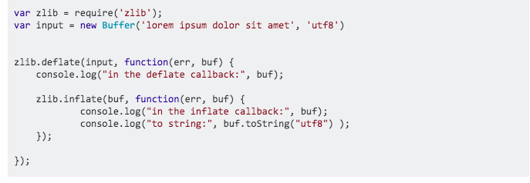
https://stackoverflow.com/questions/7625251/compression-and-decompression-of-data-using-zlib-in-nodejs
What does it really mean?
Deflate and inflate
Gzip vs Gunzip ?

Slide 3
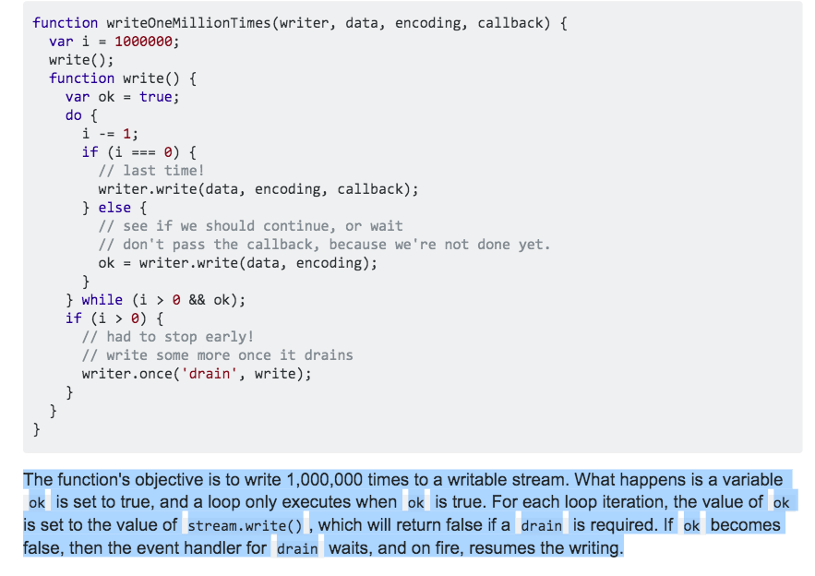
WriteOneMillionTimes
https://stackoverflow.com/questions/18932488/how-to-use-drain-event-of-stream-writable-in-node-js

Slide 4
Not working: gzipped to gunzipp
var d = ’’;
fs.createReadStream(`${craneProjectDir}/tree`) .pipe(zlib.createGunzip()) .on('data', function (data){ d += data.toString() }) .on('end', function (){ console.log(d); })
you used zlib.unzip, but the content was gzipped, so you must use one of gunzip methods.
you have used zlib.unzip which expects a buffer but you sent it a stream

Slide 5
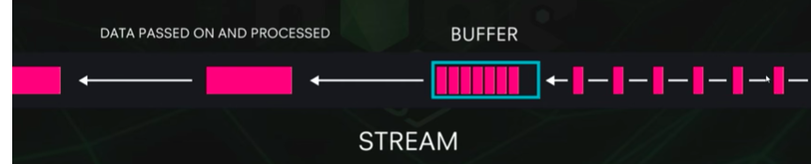
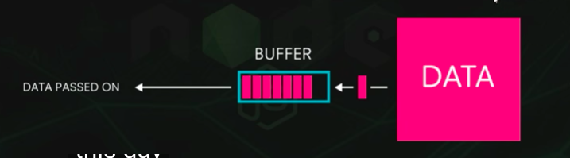
Buffer vs Stream
Buffers
Stream
Temporary storage spot for a chunck of data that is being transferred from one place to another
The buffer is filled with data and then passed along
Transfer small chunk of data at a time
Can create streams in Node.js to transfer data
Increase performance
https://www.youtube.com/watch?v=GlybFFMXXmQ

Slide 6
https://stackoverflow.com/questions/49348482/npm-install-with-error-gyp-failed-with-exit-code-1

Slide 7
Creating a readable stream TUTORIAL
https://github.com/substack/stream-handbook#creating-a-readable-stream
var Readable = require('stream').Readable; var rs = new Readable; rs.push('beep '); rs.push('boop\n'); rs.push(null); rs.pipe(process.stdout);

Slide 8
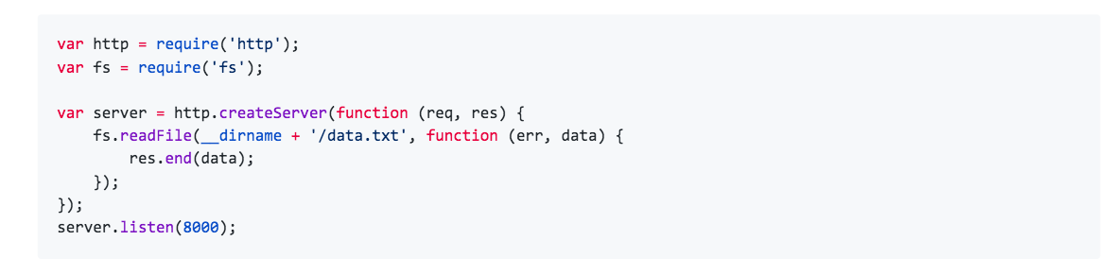
This code works but it's bulky and buffers up the entire data.txt file into memory for every request before writing the result back to clients. If data.txt is very large, your program could start eating a lot of memory as it serves lots of users concurrently, particularly for users on slow connections.

Slide 9
Luckily both of the (req, res) arguments are streams, which means we can write this in a much better way using fs.createReadStream() instead of fs.readFile():
var http = require('http’);
var fs = require('fs’);
var server = http.createServer(function (req, res) { var stream = fs.createReadStream(__dirname + '/data.txt'); stream.pipe(res); }); server.listen(8000);

Slide 10
Because backslash is not a special character in the CSV format, \., the end-of-data marker, could also appear as a data value. To avoid any misinterpretation, a \. data value appearing as a lone entry on a line is automatically quoted on output, and on input, if quoted, is not interpreted as the end-of-data marker. If you are loading a file created by another application that has a single unquoted column and might have a value of \., you might need to quote that value in the input file.

Slide 11
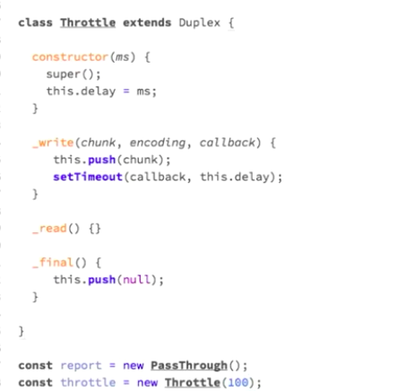
https://www.youtube.com/watch?v=-eCn0TZIodE

Slide 12
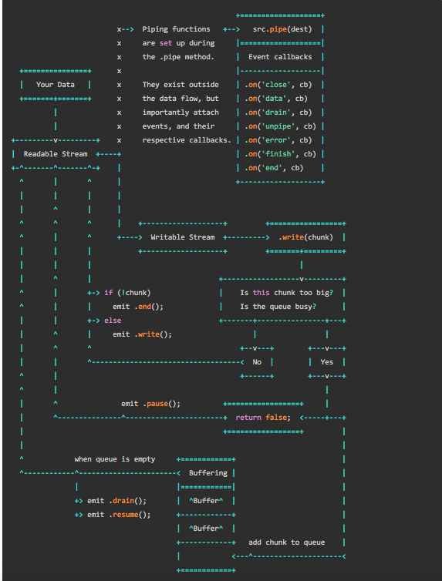

Slide 13
Data modeling best practice
https://www.ebayinc.com/stories/blogs/tech/cassandra-data-modeling-best-practices-part-2/

