Slide 2
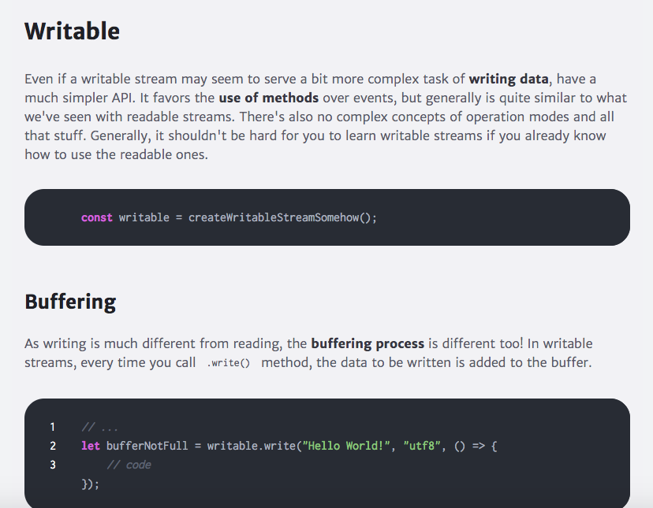
Node.js file stream explained

Slide 3
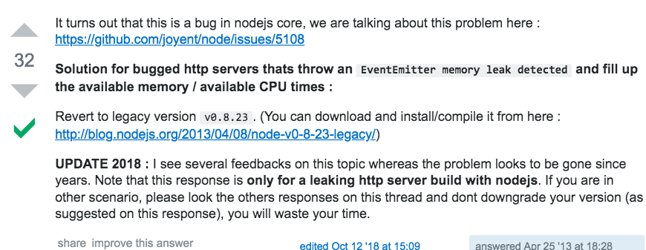
Event emitter warning
https://stackoverflow.com/questions/15581978/nodejs-how-to-debug-eventemitter-memory-leak-detected-11-listeners-added

Slide 4
NodeJS large file write
Didn’t use drain so I am suspicious of the solution quality
https://itnext.io/using-node-js-to-read-really-really-large-files-pt-1-d2057fe76b33
https://stackabuse.com/writing-to-files-in-node-js/
Read about Pipe
https://nodejs.org/en/knowledge/advanced/streams/how-to-use-stream-pipe/
http://codewinds.com/blog/2013-08-02-streams-basics.html#opening_a_write_stream_for_storing_data_in_a_file
Might be worth reading
https://medium.com/dev-bits/writing-memory-efficient-software-applications-in-node-js-5575f646b67f

Slide 5
Flow for today
Install Cassandra
How to install?
How to run?
How to make a simple table?
How to bulk insert?
Populate the database
You have written the script to COPY data from photo.csv into your schema
Install PostgreSQL
How to install?
How to run?
How to make a simple table?
How to bulk insert?
Populate the database

Slide 6
How to install Cassandra
Install Homebrew
Homebrew is a great little package manager for OS X. If you haven't already, installing it is pretty easy:
ruby -e "$(curl -fsSL https://raw.github.com/Homebrew/homebrew/go/install)"
Install Python
Mac OS X has a copy of Python preinstalled, but this makes sure you get the newest version.
brew install python
Install cql
To use cqlsh, the Cassandra query language shell, you need to install cql:
pip install cql
Install Cassandra
This installs Apache Cassandra:
brew install cassandra
Starting/Stopping Cassandra
Use this command to start Cassandra:
launchctl load ~/Library/LaunchAgents/homebrew.mxcl.cassandra.plist
Use this command to stop Cassandra:
launchctl unload ~/Library/LaunchAgents/homebrew.mxcl.cassandra.plist
On Mavericks, Homebrew failed to move the plist file into LaunchAgents, which gives this error message:
launchctl: Couldn't stat("/Users/<user>/Library/LaunchAgents/homebrew.mxcl.cassandra.plist"): No such file or directory
To fix this just issue the following command. Then, try using the launchctl load command again:
cp /usr/local/Cellar/cassandra/<version number>/homebrew.mxcl.cassandra.plist ~/Library/LaunchAgents/

Slide 7
Check if Cassandra was linked after installation
https://stackoverflow.com/questions/48614913/brew-cassandra-installation
If you don’t want/need a background service you can just run
cassandra –f
cqlsh
Don’t just use brew services start Cassandra
This will restart Cassandra EVERYTIME you restart your computer
cqlsh> show version
[cqlsh 5.0.1 | Cassandra 3.11.4 | CQL spec 3.4.4 | Native protocol v4]

Slide 8
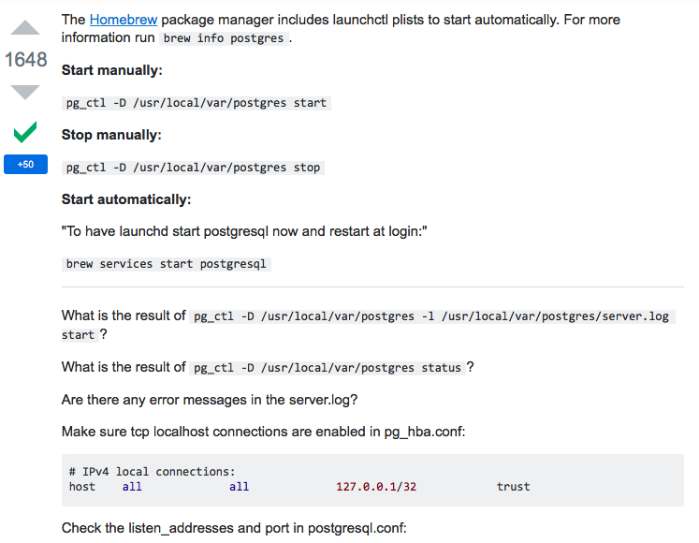
How to start Cassandra
https://stackoverflow.com/questions/7975556/how-to-start-postgresql-server-on-mac-os-x

Slide 9
For the future viewer, adding to the comment by @Apolozeus you might also want to check if Cassandra was linked after it was installed by brew.
> brew link cassandra
This will create symlinks, after this you can invoke cassandra.
> cassandra
> cqlsh

Slide 10
Cassandra
Maximize the number of writes
In Cassandra, writes are very cheap. Cassandra is optimized for high write performance. So try to maximize your writes for better read performance and data availability. There is a tradeoff between data write and data read. So, optimize you data read performance by maximizing the number of data writes.
Maximize Data Duplication
Data denormalization and data duplication are defacto of Cassandra. Disk space is not more expensive than memory, CPU processing and IOs operation. As Cassandra is a distributed database, so data duplication provides instant data availability and no single point of failure.

Slide 11
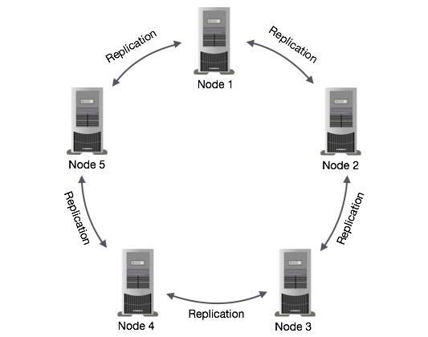
Cassandra data architecture
In Cassandra, one or more of the nodes in a cluster act as replicas for a given piece of data. If it is detected that some of the nodes responded with an out-of-date value, Cassandra will return the most recent value to the client. After returning the most recent value, Cassandra performs a read repair in the background to update the stale values.

Slide 12
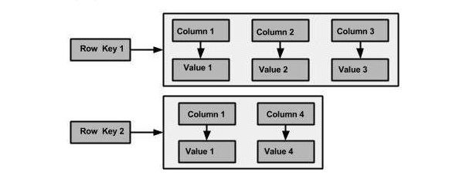
Cassandra model architecture
Node − It is the place where data is stored.
Data center − It is a collection of related nodes.
Cluster − A cluster is a component that contains one or more data centers.
Commit log − The commit log is a crash-recovery mechanism in Cassandra. Every write operation is written to the commit log.
Mem-table − A mem-table is a memory-resident data structure. After commit log, the data will be written to the mem-table. Sometimes, for a single-column family, there will be multiple mem-tables.
SSTable − It is a disk file to which the data is flushed from the mem-table when its contents reach a threshold value.
Bloom filter − These are nothing but quick, nondeterministic, algorithms for testing whether an element is a member of a set. It is a special kind of cache. Bloom filters are accessed after every query.

Slide 13
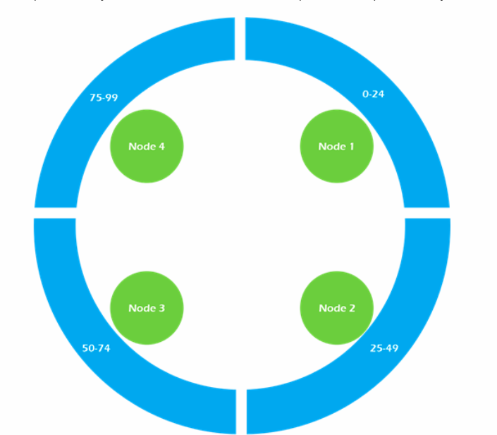
Partition keys belong to a node. Cassandra is organized into a cluster of nodes, with each node having an equal part of the partition key hashes.
What is it that you need to query the data?
Note for myself :You do need to intentionally set your partition keys in order to make the data EVENLY DISTRIBUTED

Slide 14
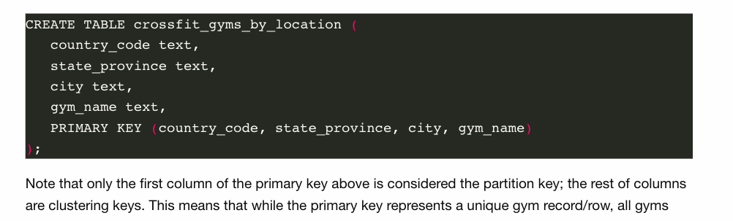


What does it mean to be the first column in your primary key set?
This means that while the primary key represents a unique gym record/row, all gyms within a country reside on the same partition. So when we query the crossfit_gyms_by_location table, we receive a result set consisting of every gym sharing a given country_code. While useful for searching gyms by country, using this table to identify gyms within a particular state or city requires iterating over all gyms within the country in which the state or city is located.
https://www.tutorialspoint.com/cassandra/cassandra_create_table.htm

Slide 15
Database Scaling (post from Catherine)
Horizontal scaling is buying more car to accommodate more people
Vertical scaling is buying a bigger car
Relational databases mostly use vertical scaling

Slide 16
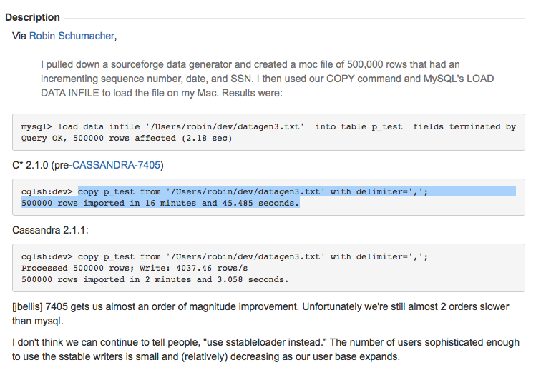
Bulk load
https://github.com/brianmhess/cassandra-loader
Use Cassandra Loader

Slide 17

How to start PostgreSQL
First you make a database and then you use PostgreSQL (psql client server connection helper) to connect to that database
Another way is to use the following
psql -p 5432 -d postgres -c

Slide 18
The importance of pooling
Connecting a new client to the PostgreSQL server requires a handshake which can take 20-30 milliseconds.
During this time passwords are negotiated, SSL may be established, and configuration information is shared with the client & server.
Incurring this cost every time we want to execute a query would substantially slow down our application.
The PostgreSQL server can only handle a limited number of clients at a time.
Depending on the available memory of your PostgreSQL server you may even crash the server if you connect an unbounded number of clients. note:
I have crashed a large production PostgreSQL server instance in RDS by opening new clients and never disconnecting them in a python application long ago. It was not fun.

Slide 19
PostgreSQL can only process one query at a time on a single connected client in a first-in first-out manner.
If your multi-tenant web application is using only a single connected client all queries among all simultaneous requests will be pipelined and executed serially, one after the other. No good!
The client pool allows you to have a reusable pool of clients you can check out, use, and return. You generally want a limited number of these in your application and usually just 1. Creating an unbounded number of pools defeats the purpose of pooling at all.

Slide 20
COPY
Note one thing: it's assumed that the number and order of columns in the table is the same as in the CSV file.
Importing a CSV file with ~1M rows now takes under 4 seconds which is blazing fast when compared to previous solutions!
https://infinum.co/the-capsized-eight/superfast-csv-imports-using-postgresqls-copy
https://www.postgresql.org/docs/11/sql-copy.html

Slide 21
How to start PostgreSQL database
initdb /usr/local/var/postgres -E utf8
postgres -D /usr/local/var/postgres
https://stackoverflow.com/questions/7975556/how-to-start-postgresql-server-on-mac-os-x
For some reason the port number 5432 is already taken
Change it to 5433

Slide 22
How to use PostgreSQL database
https://serverfault.com/questions/453580/what-is-the-difference-between-psql-and-postgres-commands
postgres is the server itself, and runs separately from all of the client connections. It is almost never run by hand. Even if you want to start and stop it, this is normally done through pg_ctl or an init script if you installed a postgres package from your distribution. I'm not sure if the OSX version of Postgresql has any special ways of starting the server, but it needs to be started before any clients can connect to it.
psql is the command-line client, that connects to the server and allows you to execute individual queries by hand. No idea why you think you needed to rm it, but not having it is just annoying since without it you'll have to write your own programs to execute commands like "CREATE TABLE" or "CREATE USER".

Slide 23
Populate PostgreSQL
Deal with posgreSQL memory
https://www.postgresql.org/docs/11/populate.html

Slide 24
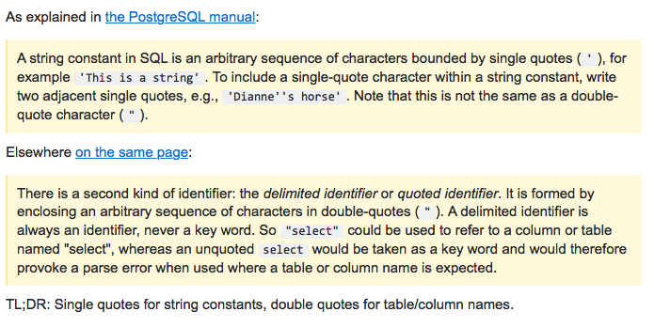
Single quote vs double quote https://stackoverflow.com/questions/41396195/what-is-the-difference-between-single-quotes-and-double-quotes-in-postgresql

Slide 25
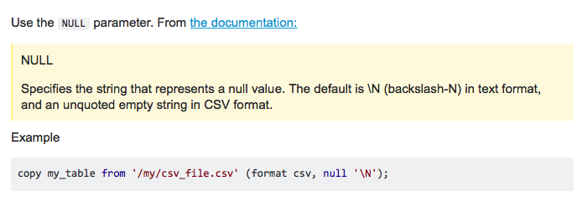
https://dba.stackexchange.com/questions/189207/copy-from-file-error-invalid-input-syntax-for-integer-n

Slide 26
Use CitrusData if it is free
https://www.citusdata.com/blog/2017/11/08/faster-bulk-loading-in-postgresql-with-copy/
Bulk ingestion with \copy is great for a lot of workloads anddoesn’t require you to load up millions of record CSVs either. You can start with micro-batches of 100, 1000, or 10000 records and still see significant performance gains.
https://info.crunchydata.com/blog/fast-csv-and-json-ingestion-in-postgresql-with-copy

Slide 27
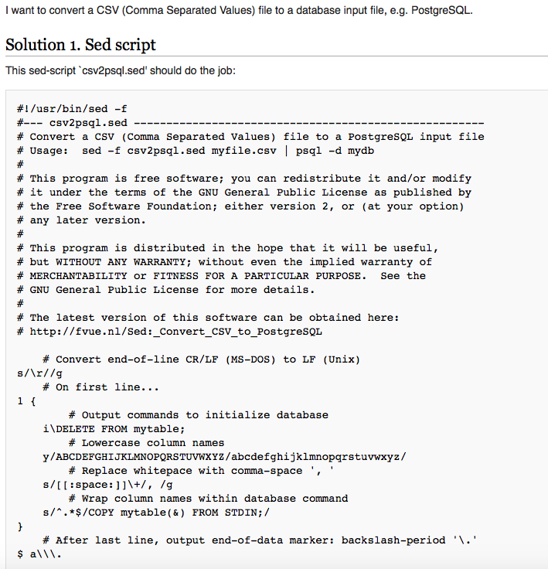
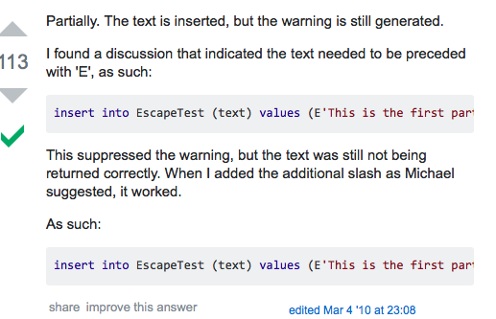
How to solve the \n issues?
Unquoted carriage return found in data - Preventing COPY FROM in PostgreSQL
https://stackoverflow.com/questions/935/string-literals-and-escape-characters-in-postgresql
https://stackoverflow.com/questions/33944437/unquoted-carriage-return-found-in-data-preventing-copy-from-in-postgresql
https://fvue.nl/wiki/Sed:_Convert_CSV_to_PostgreSQL

Slide 28
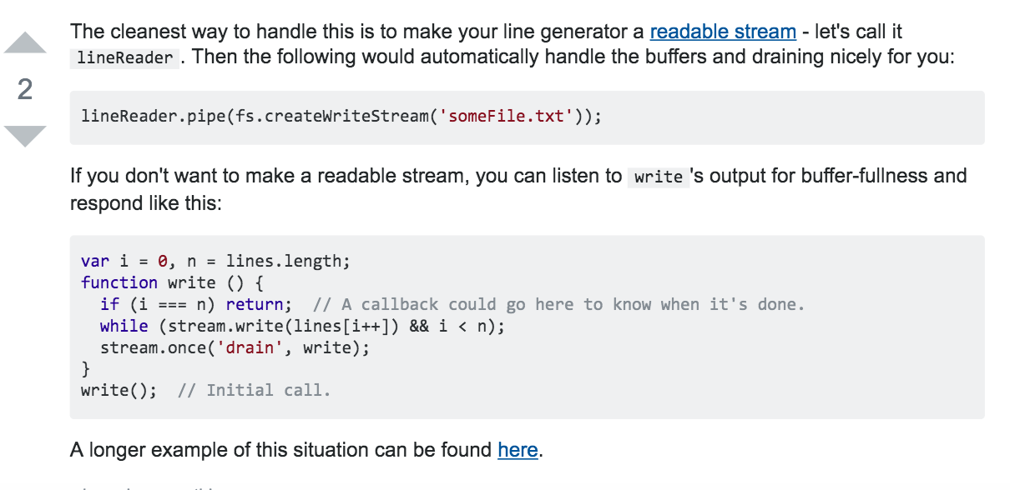
https://stackoverflow.com/questions/12755997/how-to-create-streams-from-string-in-node-js
https://stackoverflow.com/questions/9486683/writing-large-files-with-node-js

