Slide 2
Alternative Cassandra client library
https://github.com/datastax/nodejs-driver/tree/d318d2bde3248c297545704910291c0d0896ddcd

Slide 3
CREATE TABLE example ( field1 int PRIMARY KEY, field2 int, field3 int)
And insert a few example rows:
INSERT INTO example (field1, field2, field3) VALUES (1,2,3);
INSERT INTO example (field1, field2, field3) VALUES (4,5,6);
INSERT INTO example (field1, field2, field3) VALUES (7,8,9); How is the data stored?
RowKey: 1 => (column=, value=, timestamp=1374546754299000) => (column=field2, value=00000002, timestamp=1374546754299000) => (column=field3, value=00000003, timestamp=1374546754299000) -------------------
RowKey: 4 => (column=, value=, timestamp=1374546757815000) => (column=field2, value=00000005, timestamp=1374546757815000) => (column=field3, value=00000006, timestamp=1374546757815000) -------------------
RowKey: 7 => (column=, value=, timestamp=1374546761055000) => (column=field2, value=00000008, timestamp=1374546761055000) => (column=field3, value=00000009, timestamp=1374546761055000)

Slide 4
INSERT INTO example (
partitionKey1,
partitionKey2,
clusterKey1,
clusterKey2,
normalField1,
normalField2
) VALUES (
'partitionVal1',
'partitionVal2',
'clusterVal1',
'clusterVal2',
'normalVal1',
'normalVal2');

Slide 5
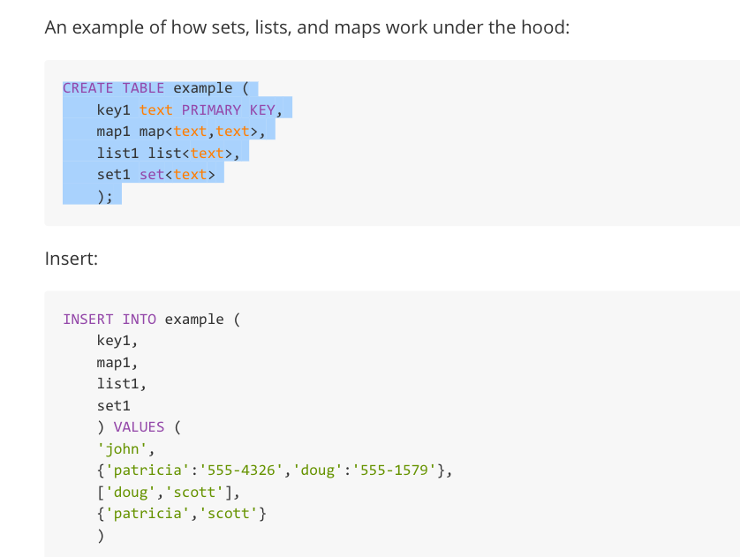

Slide 6
https://www.slideshare.net/BrianHess4/bulk-loading-into-cassandra
https://www.slideshare.net/BrianHess4/bulk-loading-into-cassandra

