Slide 1
Hauser et al (2020). Estimation of SARS-CoV-2 mortality during the early stages of an epidemic: a modelling study in Hubei, China and six locations of Europe
Presentation of the paper and the underlying model
by Daniele Francario, Hsin-Yu Ku, Chân Le, Lukas Schmid
30/05/2020

Slide 2
Contents

Slide 3
Disclaimer
We will talk about deaths and fatality ratios a lot, and for the purpose of modelling, these will both be parameters. We understand that behind those numbers lie real lives and stories of human tragedy (and recovery). However, for the sake of presentation, we will treat this numbers as mere parameters.

Slide 4
Preliminary Remarks
First preprint published on 3 March 2020, revised versions on 22 March 2020 and 8 May 2020
We refer to version three from 8 May 2020
All code and data as well as the manuscript available from https://github.com/jriou/covid_adjusted_cfr
Paper and extensive appendix
Work ongoing, likely for more changes to appear

Slide 5
Goal of the Paper
Simulate transmission dynamics of SARS-CoV-2
Provide estimates of fatality rates

Slide 6
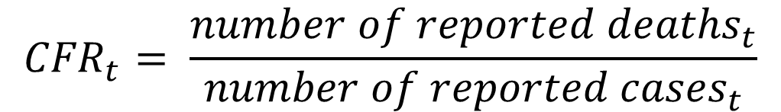
Goal of the Paper
Simulate transmission dynamics of SARS-CoV-2
Provide estimates of fatality rates
Problem one: right-censoring (“the number of confirmed and reported deaths at a certain time point does not consider the total number of deaths that will occur among already infected individuals”)
$${CFR}_{t}= \frac{{number of reported deaths}_{t}}{{number of reported cases}_{t}}$$

Slide 7


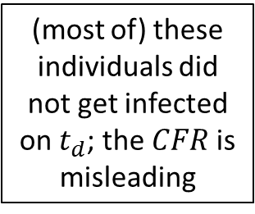

$$\# of cases$$
(most of) these individuals did not get infected on $t_{d}$; the $CFR$ is misleading
$$\# of deaths$$
$$t_{d}$$

Slide 8

$$\# of cases$$
(most of) these individuals did not get infected on $t_{d}$; the $CFR$ is misleading
$$\# of deaths$$
$$t_{d}$$

Slide 9






$$t_{d−n}$$
$$t_{d−3}$$
$$t_{d−2}$$
$$t_{d−1}$$
$$t_{d}$$

