Slide 1
Estimation of SARS-CoV-2 mortality during the early stages of an epidemic
A modelling study in Hubei, China and six locations of Europe (Hauser et al, 2020)
Daniele Francario, Hsin-Yu Ku, Chân Le, Lukas Schmid
02/06/2020

Slide 2
Contents
Preliminary Remarks
Goal of the Paper
Model Overview
Compartmental Model
Simulating Data
Deriving the Posterior
Deriving Parameters
Current State of Work

Slide 3
Foreword
We will talk about deaths and fatality ratios a lot, and for the purpose of modelling, these will both be parameters. We understand that behind those numbers lie real lives and stories of human tragedy (and recovery). However, for the sake of presentation, we will treat this numbers as mere parameters.

Slide 4
Preliminary Remarks
First preprint published on 3 March 2020, revised versions on 22 March 2020 and 8 May 2020
This presentation refers to the third version from 8 May 2020
All code and data as well as the manuscript available from https://github.com/jriou/covid_adjusted_cfr
Paper and extensive appendix
Work ongoing, likely for more changes to appear

Slide 5
Goal of the Paper
Inform healthcare planning:
Simulate transmission dynamics of SARS-CoV-2
Provide reliable estimates of fatality rates by correcting:
Right-censoring
Preferential Ascertainment

Slide 6
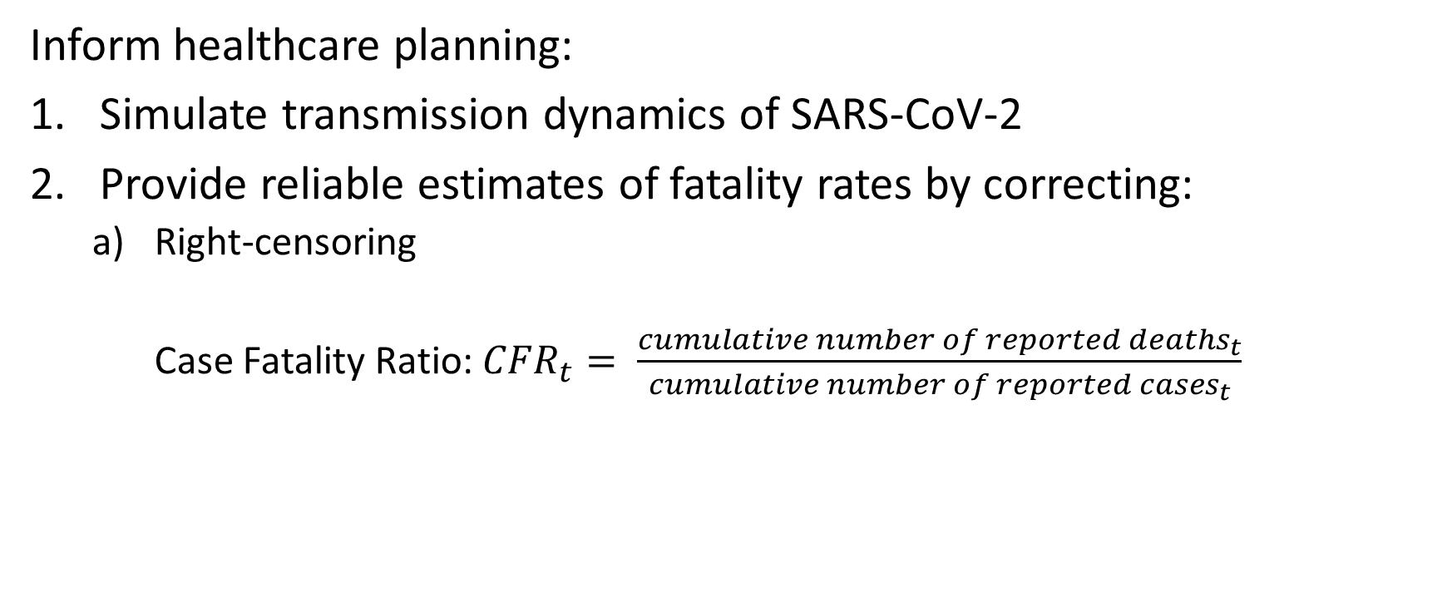
Goal of the Paper
Inform healthcare planning:
Simulate transmission dynamics of SARS-CoV-2
Provide reliable estimates of fatality rates by correcting:
Right-censoring
Case Fatality Ratio: ${CFR}_{t}= \frac{{cumulative number of reported deaths}_{t}}{{cumulative number of reported cases}_{t}}$

Slide 7



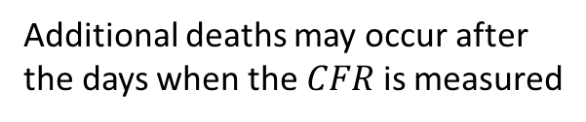





Goal of the paper
Additional deaths may occur after the days when the $CFR$ is measured
$$t_{d−1}$$
$$t_{d}$$
$$t_{d+1}$$
$$t_{d+2}$$
$$t_{d+3}$$

Slide 8
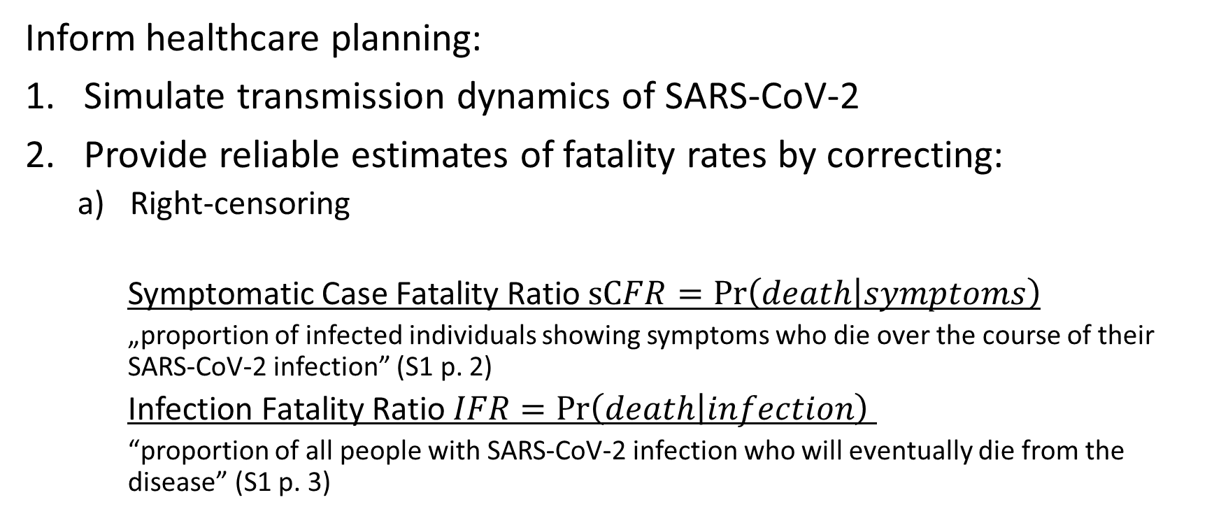
Goal of the Paper
Inform healthcare planning:
Simulate transmission dynamics of SARS-CoV-2
Provide reliable estimates of fatality rates by correcting:
Right-censoring
Symptomatic Case Fatality Ratio $sCFR=\operatorname{Pr}\left(death | symptoms\right)$
„proportion of infected individuals showing symptoms who die over the course of their SARS-CoV-2 infection” (S1 p. 2)
Infection Fatality Ratio $IFR=\operatorname{Pr}\left(death | infection\right)$
“proportion of all people with SARS-CoV-2 infection who will eventually die from the disease” (S1 p. 3)

Slide 9
Goal of the Paper
Inform healthcare planning:
Simulate transmission dynamics of SARS-CoV-2
Provide reliable estimates of fatality rates by correcting:
Right-censoring
Preferential Ascertainment: not all cases are reported
“surveillance-based case reports underestimate the total number of SARS-CoV-2-infected patients, because testing focuses on individuals with symptoms of COVID-19 and, among symptomatic cases, on patients with more severe manifestations” (S p. 2)

Slide 10
Goal of the Paper
Inform healthcare planning:
Simulate transmission dynamics of SARS-CoV-2
“Provide overall and age-stratified estimates of sCFR and IFR for SARS-CoV-2, adjusted for right-censoring and preferential ascertainment” (S p. 3)

Slide 11
Process Overview

Slide 12
Compartmental Model

Slide 13
Compartmental Model
Assign population to different compartment
Each compartment is a “disease state”
Individuals move through the compartments
Additionally: model nine different age groups 𝑘
A proportion of individuals leaving a compartment is the inverse of the stay in that compartment

Slide 14
Compartmental Model
Susceptible: not infected

Slide 15
Compartmental Model
Exposed: infected, incubating (not infectious)

Slide 16
Compartmental Model
Presymptomatic: no symptoms yet, infectious

Slide 17
Compartmental Model
Asymptomatic: no symptoms, infectious

Slide 18
Compartmental Model
Symptomatic: infected with symptoms, infectious

Slide 19
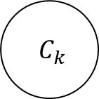
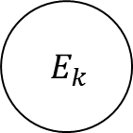
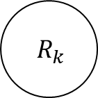
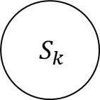
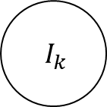
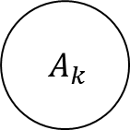
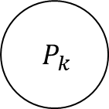
Compartmental Model
Removed: either recovered or dead; not infectious
$$A_{k}$$
$$S_{k}$$
$$E_{k}$$
$$P_{k}$$
$$R_{k}$$
$$I_{k}$$
$$C_{k}$$

Slide 20
Compartmental Model
Dummy compartment to record the cumulative number of symptomatic cases
$$A_{k}$$
$$S_{k}$$
$$E_{k}$$
$$P_{k}$$
$$R_{k}$$
$$I_{k}$$
$$C_{k}$$

Slide 21
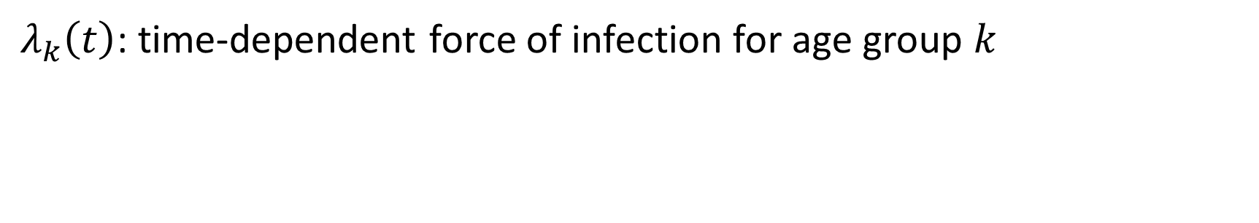
Compartmental Model
$λ_{k}\left(t\right)$: time-dependent force of infection for age group $k$
Different from other parameters: modelled seperately from a forcing function (logistic) to account for control measures and from other infectious compartments

Slide 22
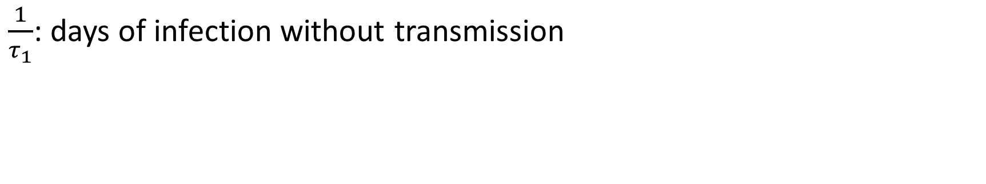
Compartmental Model
$\frac{1}{τ_{1}}$: days of infection without transmission

Slide 23
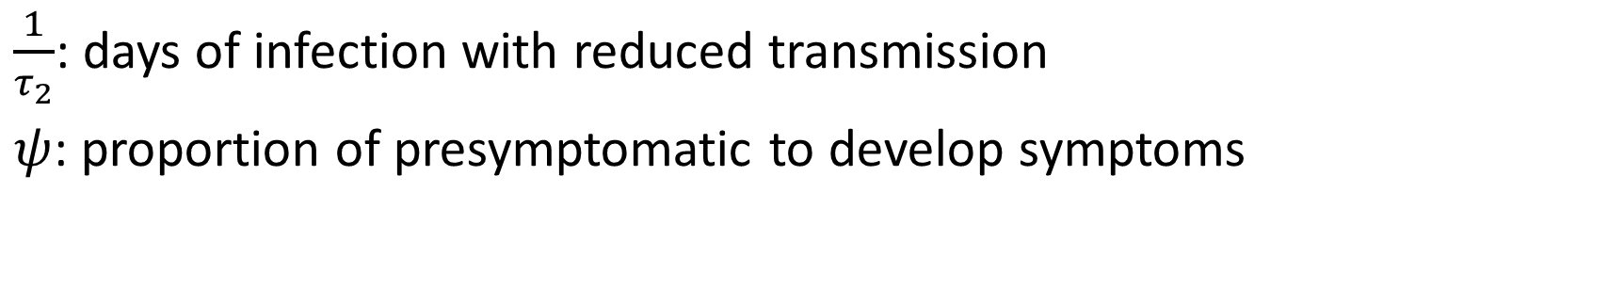
Compartmental Model
$\frac{1}{τ_{2}}$: days of infection with reduced transmission
$ψ$: proportion of presymptomatic to develop symptoms

Slide 24
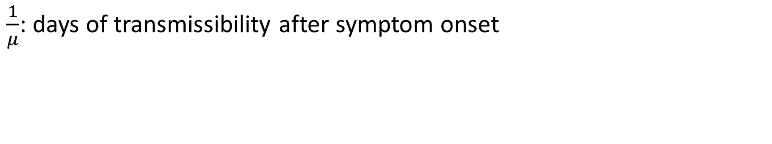
Compartmental Model
$\frac{1}{μ}$: days of transmissibility after symptom onset

Slide 25
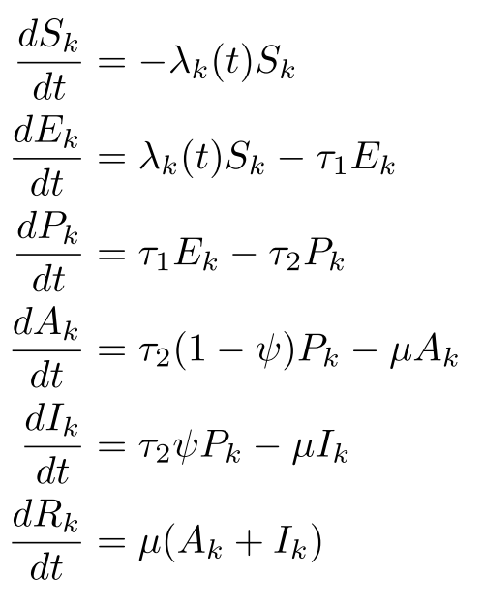
Compartmental Model
For the curious: how exactly is the movement between compartments modelled?

Slide 26
Simulating Data

Slide 27
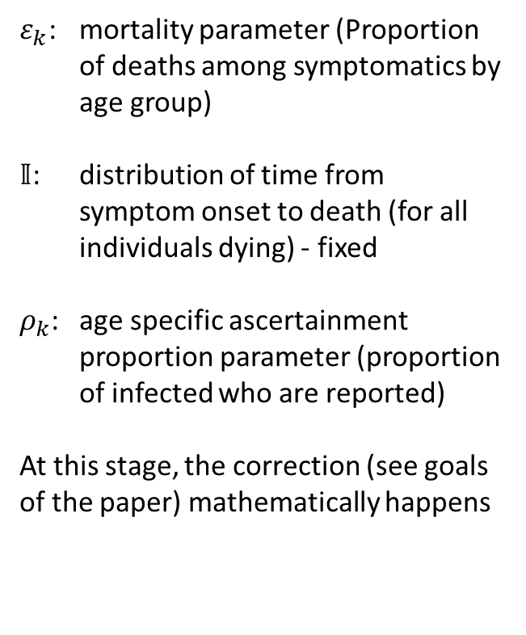
Simulating Data
$ε_{k}$: mortality parameter (Proportion of deaths among symptomatics by age group)
$𝕀$: distribution of time from symptom onset to death (for all individuals dying) - fixed
$ρ_{k}$: age specific ascertainment proportion parameter (proportion of infected who are reported)
At this stage, the correction (see goals of the paper) mathematically happens

Slide 28

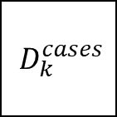

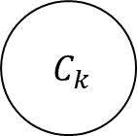
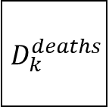
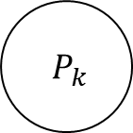
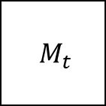

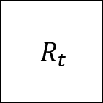
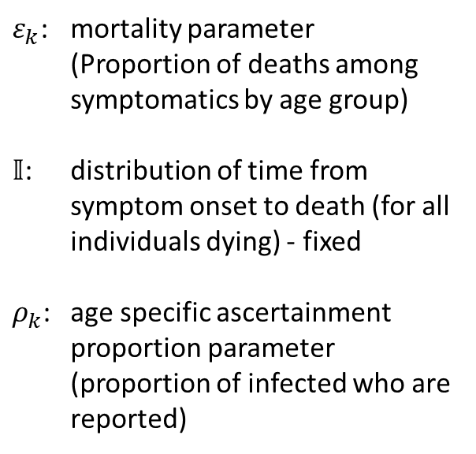
Simulating Data
$$P_{k}$$
$$D_{k}^{deaths}$$
age distribution of all deaths occurring in simulation period
$ε_{k}$: mortality parameter (Proportion of deaths among symptomatics by age group)
$𝕀$: distribution of time from symptom onset to death (for all individuals dying) - fixed
$ρ_{k}$: age specific ascertainment proportion parameter (proportion of infected who are reported)
$$τ_{2}ψ$$
$$ε_{k}, 𝕀$$
cumulative incidence of symptomatic infections by day of symp-tom onset
$$M_{t}$$
total daily number of reported deaths
$$C_{k}$$
$$R_{t}$$
total daily number of new reported infection
$$ρ_{k}$$
$$D_{k}^{cases}$$
age distribution of all reported cases occurring in simulation period

Slide 29
Simulating Data
$$D_{k}^{deaths}$$
age distribution of all deaths occurring in simulation period
$$M_{t}$$
total daily number of reported deaths
$$R_{t}$$
total daily number of new reported infection
$$D_{k}^{cases}$$
age distribution of all reported cases occurring in simulation period

Slide 30
Deriving the Posterior

Slide 31
Deriving the Posterior
$$D_{k}^{deaths}$$
age distribution of all deaths occurring in simulation period
$$M_{t}$$
total daily number of reported deaths
$$R_{t}$$
total daily number of new reported infection
$$D_{k}^{cases}$$
age distribution of all reported cases occurring in simulation period

Slide 32








Deriving the Posterior
Simulated Data
Real Data
$$D_{k}^{deaths}$$
age distribution of all deaths occurring in simulation period
Age distribution of deaths from infections
$$𝔻$$
$$M_{t}$$
total daily number of reported deaths
Deaths from infections per day
$$ℂ$$
$$R_{t}$$
total daily number of new reported infection
Confirmed cases per day
$$𝔸$$
$$D_{k}^{cases}$$
age distribution of all reported cases occurring in simulation period
Age distribution of all confirmed cases
$$𝔹$$

Slide 33
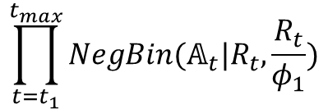
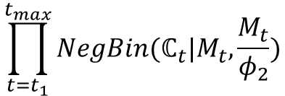


Deriving the Posterior
$$D_{k}^{deaths}$$
age distribution of all deaths occurring in simulation period
Age distribution of deaths from infections
$$Multinomial(𝔻|D_{k}^{deaths})$$
$$𝔻$$
$$M_{t}$$
total daily number of reported deaths
$$\prod_{t=t_{1}}^{t_{max}}{NegBin(ℂ_{t}|M_{t}, \frac{M_{t}}{φ_{2}})}$$
Deaths from infections per day
$$ℂ$$
$$R_{t}$$
total daily number of new reported infection
$$\prod_{t=t_{1}}^{t_{max}}{NegBin(𝔸_{t}|R_{t}, \frac{R_{t}}{φ_{1}})}$$
Confirmed cases per day
$$𝔸$$
$$D_{k}^{cases}$$
age distribution of all reported cases occurring in simulation period
Age distribution of all confirmed cases
$$Multinomial(𝔹|D_{k}^{cases})$$
$$𝔹$$

Slide 34






Deriving the Posterior
$$Likelihood$$
$$=Posterior$$
$$Multinomial(𝔻|D_{k}^{deaths})$$
$$=Pr⁡(θ|𝔻)$$
$$\prod_{t=t_{1}}^{t_{max}}{NegBin(ℂ_{t}|M_{t}, \frac{M_{t}}{φ_{2}})}$$
$$=Pr⁡(θ|ℂ)$$
Likelihood is equal to the posterior for each data
$$\prod_{t=t_{1}}^{t_{max}}{NegBin(𝔸_{t}|R_{t}, \frac{R_{t}}{φ_{1}})}$$
$$=Pr⁡(θ|𝔸)$$
$$Multinomial(𝔹|D_{k}^{cases})$$
$$=Pr⁡(θ|𝔹)$$

Slide 35
Deriving the Posterior

Slide 36


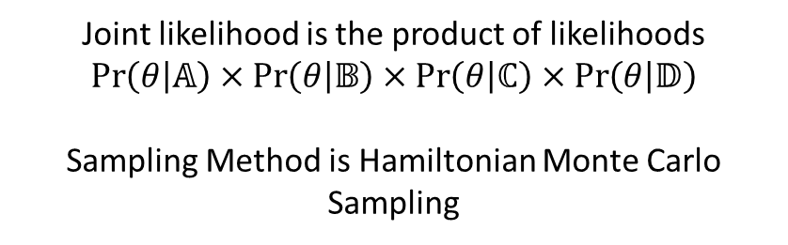


Sampling and Deriving Parameters
$$Pr⁡(θ|𝔻)$$
Joint likelihood is the product of likelihoods
$$\operatorname{Pr}\left(θ | 𝔸\right)×\operatorname{Pr}\left(θ | 𝔹\right)×\operatorname{Pr}\left(θ | ℂ\right)×\operatorname{Pr}\left(θ | 𝔻\right)$$
Sampling Method is Hamiltonian Monte Carlo Sampling
$$Pr⁡(θ|ℂ)$$
$$Pr⁡(θ|𝔸)$$
$$Pr⁡(θ|𝔹)$$

Slide 37
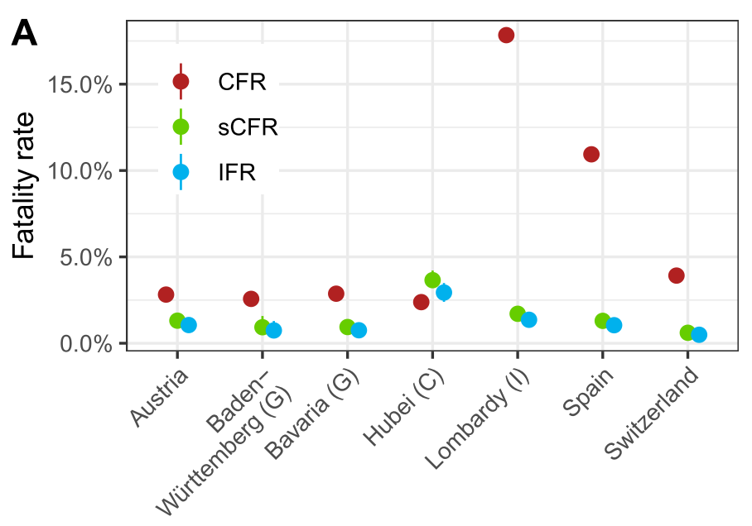
Sampling and Deriving Parameters
Source: figure S4A
From the posterior, the authors derived three fatality rates
CFR is a bad estimator for mortality
Variance in IFR reflects external factors

Slide 38
Current state of work
Open Questions:
Unclear derivation of the posterior distribution
Hamiltonian Monte Carlo Sampling
Sensitivity Analysis and Model Validation
Model Extension:
External validation for other regions

