Slide 1
Hauser et al (2020). Estimation of SARS-CoV-2 mortality during the early stages of an epidemic: a modelling study in Hubei, China and six locations of Europe
Presentation of the paper and the underlying model
by Daniele Francario, Hsin-Yu Ku, Chân Lê, Lukas Schmid
30/05/2020

Slide 2
Contents
Preliminary Remarks
Goal of the Paper
Model Overview
Compartmental Model
Simulating Data
Deriving the Posterior
Deriving Parameters
Current State of Work

Slide 3
Disclaimer
We will talk about deaths and fatality ratios a lot, and for the purpose of modelling, these will both be parameters. We understand that behind those numbers lie real lives and stories of human tragedy (and recovery). However, for the sake of presentation, we will treat this numbers as mere parameters.

Slide 4
Preliminary Remarks
First preprint published on 3 March 2020, revised versions on 22 March 2020 and 8 May 2020
We refer to version three from 8 May 2020
All code and data as well as the manuscript available from https://github.com/jriou/covid_adjusted_cfr
Paper and extensive appendix
Work ongoing, likely for more changes to appear

Slide 5
Goal of the Paper
Simulate transmission dynamics of SARS-CoV-2
Provide estimates of fatality rates

Slide 6
Goal of the Paper
Simulate transmission dynamics of SARS-CoV-2
Provide estimates of fatality rates
Correcting right-censoring
Preferential Ascertainment
Notes:
Word choice?

Slide 7
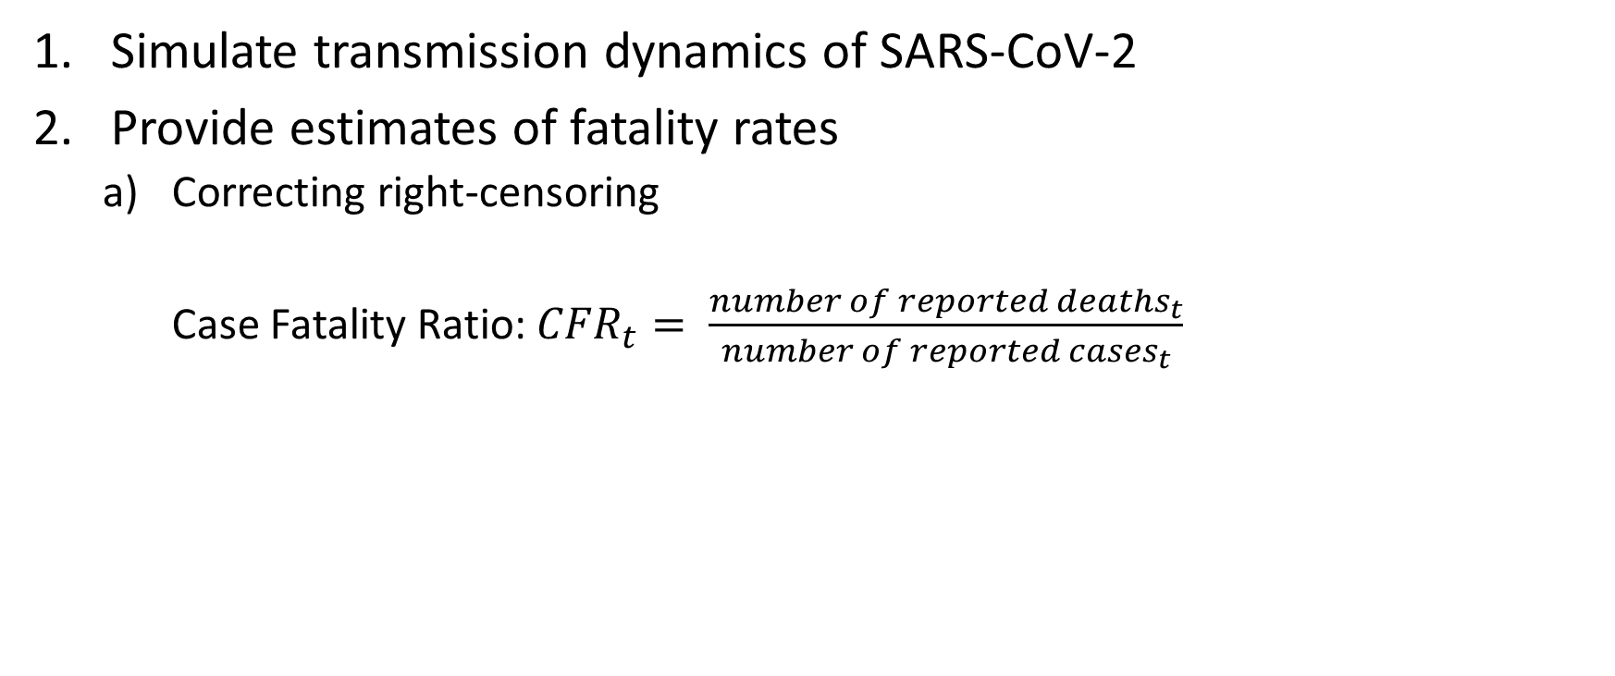
Goal of the Paper
Simulate transmission dynamics of SARS-CoV-2
Provide estimates of fatality rates
Correcting right-censoring
Case Fatality Ratio: ${CFR}_{t}= \frac{{number of reported deaths}_{t}}{{number of reported cases}_{t}}$

Slide 8

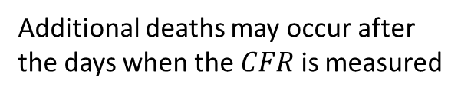




Goal of the paper
Additional deaths may occur after the days when the $CFR$ is measured
$$t_{d−1}$$
$$t_{d}$$
$$t_{d+1}$$
$$t_{d+2}$$
$$t_{d+3}$$

Slide 9
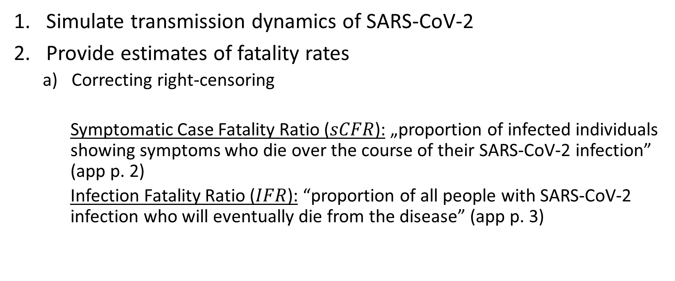
Goal of the Paper
Simulate transmission dynamics of SARS-CoV-2
Provide estimates of fatality rates
Correcting right-censoring
Symptomatic Case Fatality Ratio ($sCFR$): „proportion of infected individuals showing symptoms who die over the course of their SARS-CoV-2 infection” (app p. 2)
Infection Fatality Ratio ($IFR$): “proportion of all people with SARS-CoV-2 infection who will eventually die from the disease” (app p. 3)

Slide 10
Goal of the Paper
Simulate transmission dynamics of SARS-CoV-2
Provide estimates of fatality rates
Correcting right-censoring
Preferential Ascertainment
“surveillance-based case reports underestimate the total number of SARS-CoV-2-infected patients, because testing focuses on individuals with symptoms of COVID-19 and, among symptomatic cases, on patients with more severe manifestations” (app p. 2)
Notes:
Maybe an explanation in layman’s term instead of citing the paper.

Slide 11
Goal of the Paper
Simulate transmission dynamics of SARS-CoV-2
“Provide overall and age-stratified estimates of sCFR and IFR for SARS-CoV-2, adjusted for right-censoring and preferential ascertainment” (app p. 3)

Slide 12
Model Overview

Slide 13
Compartmental Model

Slide 14
Compartmental Model
assign population to different compartment
Each compartment is a “disease state”
Individuals move through the compartments
Additionally: model nine different age groups 𝑘
age-stratified susceptible-exposed-infected-removed (SEIR)-type compartmental mode

Slide 15
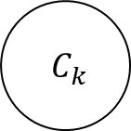
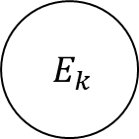
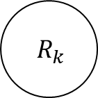
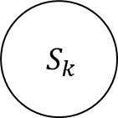
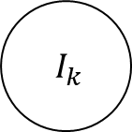
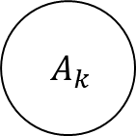
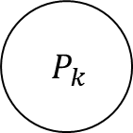
Compartmental Model
Susceptible: not infected
$$A_{k}$$
$$S_{k}$$
$$E_{k}$$
$$P_{k}$$
$$R_{k}$$
$$I_{k}$$
$$C_{k}$$

Slide 16
Compartmental Model
Exposed: infected, incubating (not infectious)
$$A_{k}$$
$$S_{k}$$
$$E_{k}$$
$$P_{k}$$
$$R_{k}$$
$$I_{k}$$
$$C_{k}$$

Slide 17
Compartmental Model
Presymptomatic: no symptoms yet, infectious
$$A_{k}$$
$$S_{k}$$
$$E_{k}$$
$$P_{k}$$
$$R_{k}$$
$$I_{k}$$
$$C_{k}$$

Slide 18
Compartmental Model
Asymptomatic: no symptoms, infectious
$$A_{k}$$
$$S_{k}$$
$$E_{k}$$
$$P_{k}$$
$$R_{k}$$
$$I_{k}$$
$$C_{k}$$

Slide 19
Compartmental Model
Infected with symptoms: infectious
$$A_{k}$$
$$S_{k}$$
$$E_{k}$$
$$P_{k}$$
$$R_{k}$$
$$I_{k}$$
$$C_{k}$$

Slide 20
Compartmental Model
Removed: either recovered or dead; not infectious
$$A_{k}$$
$$S_{k}$$
$$E_{k}$$
$$P_{k}$$
$$R_{k}$$
$$I_{k}$$
$$C_{k}$$

Slide 21
Compartmental Model
Dummy compartment to record the cumulative number of symptomatic cases
$$A_{k}$$
$$S_{k}$$
$$E_{k}$$
$$P_{k}$$
$$R_{k}$$
$$I_{k}$$
$$C_{k}$$

Slide 22
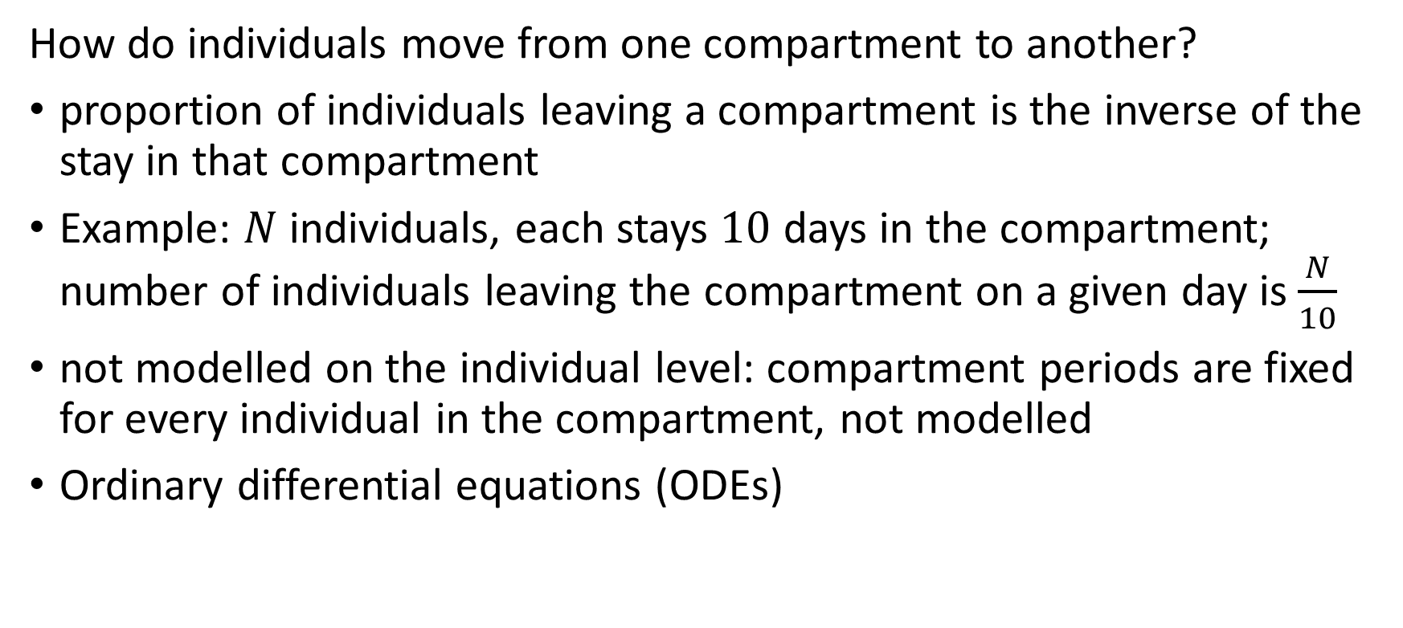
Compartmental Model
How do individuals move from one compartment to another?
proportion of individuals leaving a compartment is the inverse of the stay in that compartment
Example: $N$ individuals, each stays $10$ days in the compartment; number of individuals leaving the compartment on a given day is $\frac{N}{10}$
not modelled on the individual level: compartment periods are fixed for every individual in the compartment, not modelled
Ordinary differential equations (ODEs)

Slide 23
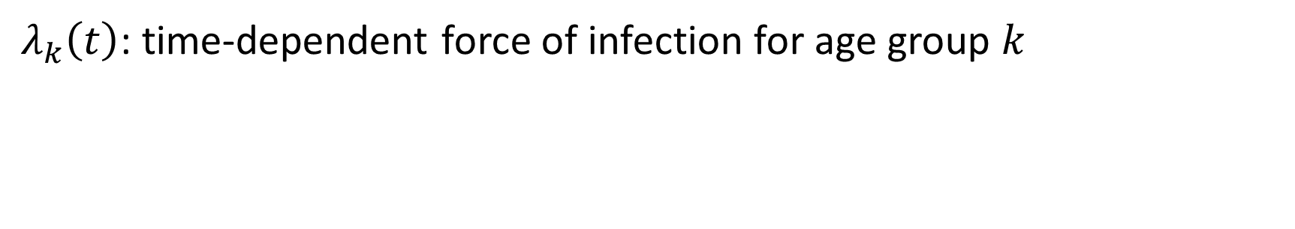
Compartmental Model
$λ_{k}\left(t\right)$: time-dependent force of infection for age group $k$
Different from other parameters: modelled seperately from a forcing function (logistic) to account for control measures and from other infectious compartments
Notes:
Lambda not just from the logistics forcing function

Slide 24
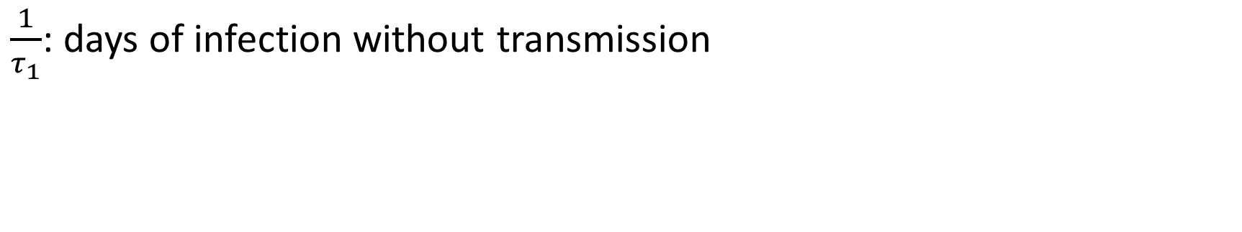
Compartmental Model
$\frac{1}{τ_{1}}$: days of infection without transmission
Notes:
Incubation period 1

Slide 25
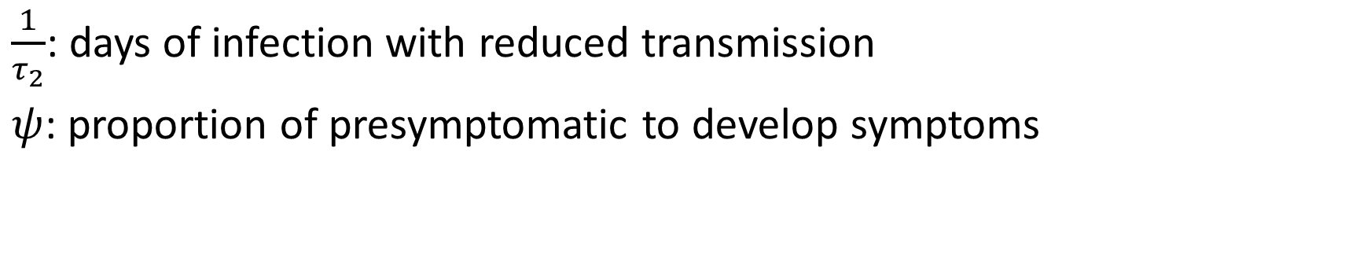
Compartmental Model
$\frac{1}{τ_{2}}$: days of infection with reduced transmission
$ψ$: proportion of presymptomatic to develop symptoms
Notes:
Incubation period 2

Slide 26
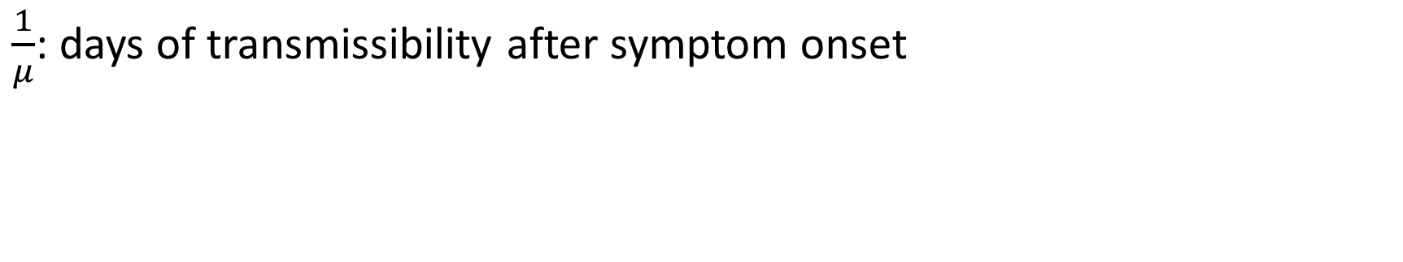
Compartmental Model
$\frac{1}{μ}$: days of transmissibility after symptom onset

Slide 27
Compartmental Model
For the curious: how exactly is the movement between compartments modelled?

Slide 28
Simulating Data

Slide 29
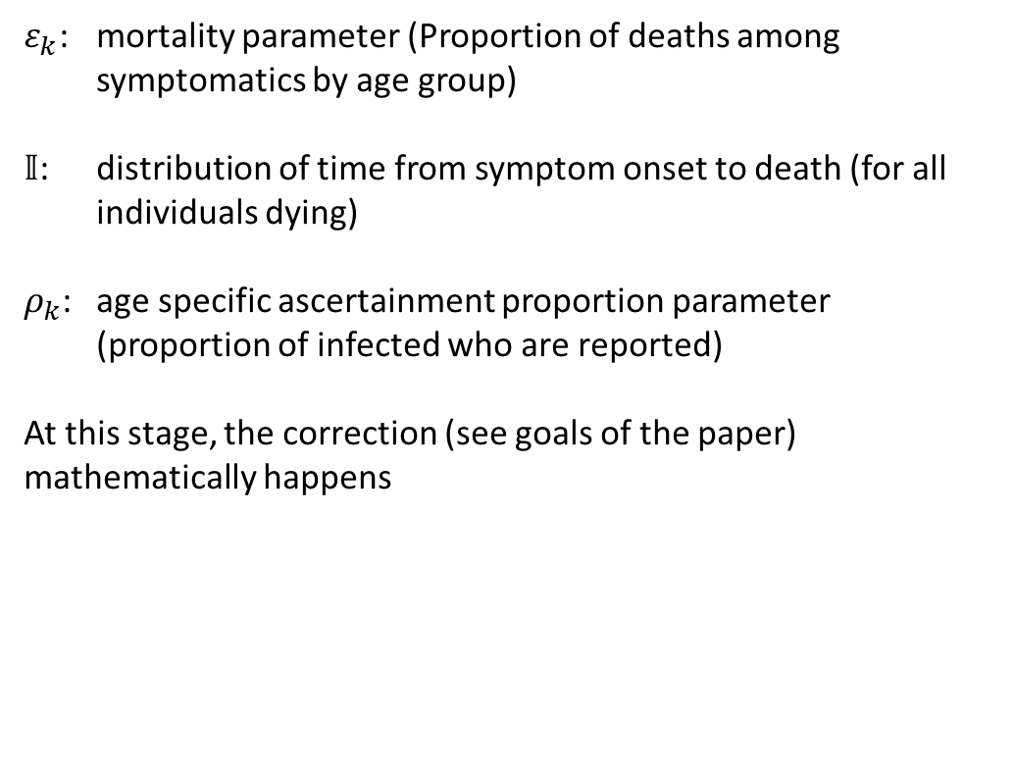
Simulating Data
$ε_{k}$: mortality parameter (Proportion of deaths among symptomatics by age group)
$𝕀$: distribution of time from symptom onset to death (for all individuals dying)
$ρ_{k}$: age specific ascertainment proportion parameter (proportion of infected who are reported)
At this stage, the correction (see goals of the paper) mathematically happens

Slide 30
Deriving the Posterior

Slide 31




Deriving the Posterior
$$𝔻$$
Age distribution of deaths from infections
$$ℂ$$
Deaths from infections per day
$$𝔸$$
Confirmed cases per day
$$𝔹$$
Age distribution of all confirmed cases

Slide 32




Deriving the Posterior
Likelihood is equal to the posterior for each data
Joint likelihood is the product of likelihoods
$$𝔻$$
$$Pr⁡(θ|𝔻)$$
$$ℂ$$
$$Pr⁡(θ|ℂ)$$
$$𝔸$$
$$Pr⁡(θ|𝔸)$$
$$𝔹$$
$$Pr⁡(θ|𝔹)$$

Slide 33
Deriving the Posterior

Slide 34

Deriving Parameters
Likelihood is equal to the posterior for each data
Joint likelihood is the product of likelihoods
$$\operatorname{Pr}\left(θ | 𝔸\right)×\operatorname{Pr}\left(θ | 𝔹\right)×\operatorname{Pr}\left(θ | ℂ\right)×\operatorname{Pr}\left(θ | 𝔻\right)$$
Hamiltonian Monte Carlo Sampling
$$Pr⁡(θ|𝔻)$$
$$Pr⁡(θ|ℂ)$$
$$Pr⁡(θ|𝔸)$$
$$Pr⁡(θ|𝔹)$$

Slide 35
Deriving Parameters
Source: figure 4A
From the posterior, the authors derived three fatality rates
CFR is a bad estimator for mortality
Variance in IFR reflects external factors

Slide 36
Current state of work
Code available online (R, Stan)
Open questions:
Unclear derivation of the posterior distribution
Unclear role of forcing function to account for control measures
Hamiltonian Monte Carlo Sampling
Sensitivity Analysis
Notes:
Why forcing function?
Model Extension:
In 2nd version of the paper: control measure only applied for China, asymptomatic cases are assumed not infectious -> originally the points for improvement
All are addressed in the latest version.
Possible: Apply model using other data

