Slide 1

Empirical Software Engineering
Establishing evidence-based practices to improve software developer productivity
Harvey Siy
Professor, Department of Computer Science
hsiy@unomaha.edu

Slide 2
Why do we need empirical evidence?
“AI makes developers more productive.”
How can we know if this is true?
“Because our favorite expert says so.”
“I have a gut feeling about that.”
“It helped me finish my last project in record time.”
What evidence could support or challenge this claim?
Notes:
Appeal to a higher power.
Appeal to our intuition.
Appeal to our experience.

Slide 3
What is empirical software engineering?
ESE is about making credible claims for improving software engineering phenomena using systematic empirical evidence.
Define the question
What can we defensibly conclude?
Design the study
Collect data
Analyze data
Answer the question
What is the phenomenon?
What method(s) work best?
What evidence can we collect?
What patterns or effects appear?

Slide 4
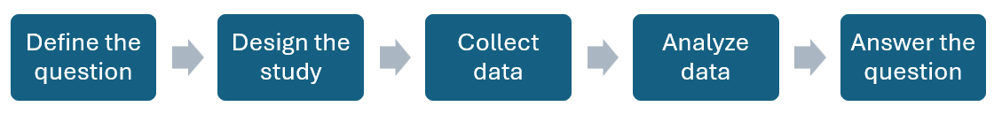
Typical software engineering phenomena
Software engineering often requires studying both technical and human dimensions.
Code maintainability
Tool evaluation
Software development practices
Testing and quality assurance
Developer collaboration
Developer satisfaction

Slide 5
Make the question researchable
Research questions should guide method selection and study design.
Purpose
Compare? Characterize? Evaluate?
Object of study
AI coding tools
Focus
Improve productivity?
Perspective
Developer or student?
Context
Doing what? What types of projects?
Basili, et al. (1994). Goal-question-metric paradigm. Encyclopedia of Software Engineering 1(6).

Slide 6
Research methods
Range of methods
Quantitative or qualitative
Comparison or observation
Human-based or artifact-based
Common types
Controlled experiments
Mining software repositories
Interviews
Surveys
Case studies

Slide 7
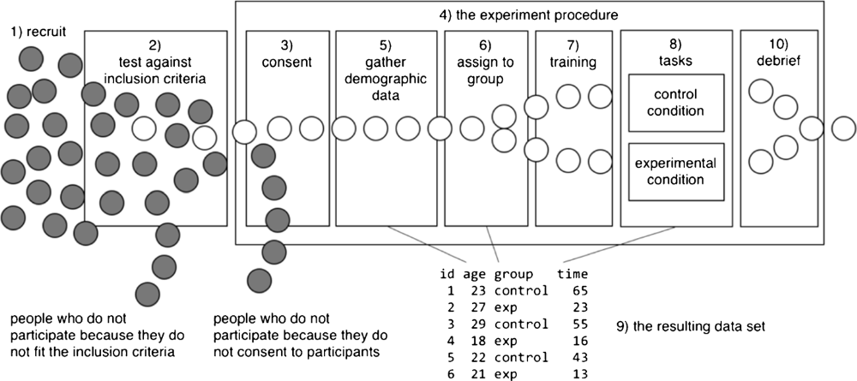
Controlled experiments
Ko, et al. (2015). A practical guide to controlled experiments of software engineering tools with human participants. Empirical Software Engineering 20(1).

Slide 8
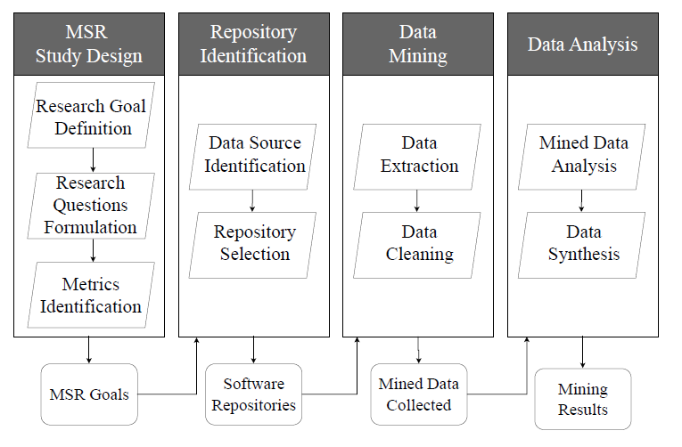
Mining software repositories
Codabux, et al. (2024). Teaching mining software repositories. Handbook on Teaching Empirical Software Engineering, Springer.

Slide 9
Choose the method to match the question
Controlled experiment
“Does AI cause faster task completion?”
Repository mining
“What patterns appear after AI adoption?”
Survey/Interview
“How do developers perceive its benefits?”
Case study
“How and why did the workflow change?”

Slide 10
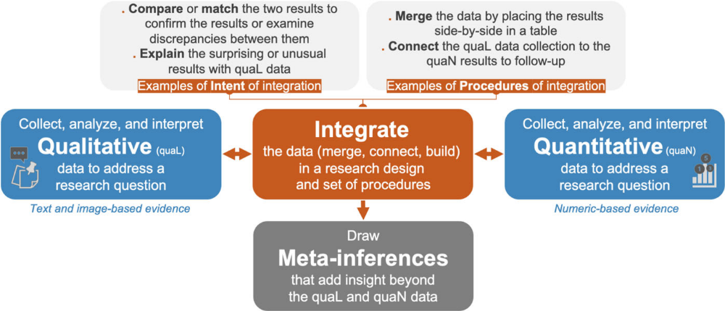
Sometimes you mix it up
Mixed methods research: multiple methods are used to collect, analyze, and integrate both qualitative and quantitative data to address a research problem and produce novel insights.
Storey, et al. (2025). Guiding principles for mixed methods research in software engineering. Empirical Software Engineering 30(5).

Slide 11
Mixed method designs
Exploratory Sequential
quaL → quaN; explore then confirm
Explanatory Sequential
complementary insights
Embedded
method 1 uses method 2 technique
Multiphase
combinations; multiple projects
Convergent Parallel
quaN → quaL; interpret findings further
Storey, et al. (2025). Guiding principles for mixed methods research in software engineering. Empirical Software Engineering 30(5).

Slide 12
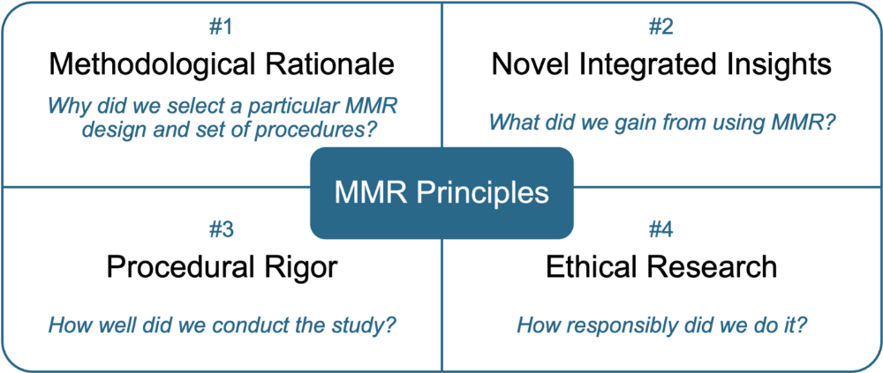
When to use mixed-methods
Storey, et al. (2025). Guiding principles for mixed methods research in software engineering. Empirical Software Engineering 30(5).

Slide 13
What data to collect?
Software artifacts
Code
Issues
Developer behavior
Demographics
Context
Task complexity
Tests
Commits
Experience
Time spent
Quality of work
Project artifacts
History
Discussions
Organizational policies
Organization type
Popularity
Releases
Code reviews

Slide 14
Measuring the outcomes
Productivity
Success on task
Time on task
Effort and cost
Quality
Defect rates
Maintainability
Security
Performance
Personal
Developer satisfaction
Cognitive load
Organizational
Return on investment
Collaboration efficiency
Process improvement
User engagement

Slide 15
Analyzing the empirical evidence
Quantitative analysis
Descriptive statistics
Distributional and validation checks (normality, reliability, …)
Model fitting (regression, time series, clustering, …)
Accuracy evaluation (precision, recall, …)
Qualitative analysis
Grounded theory
Thematic analysis
Qualitative coding
Content analysis
Narrative analysis
Hypothesis testing (t-test, ANOVA, chi-square, …)
Notes:
These are some common types of analysis. Not exhaustive.

Slide 16
Defending the findings: Threats to validity
Construct
Did the operational measures represent the concepts being studied?
Internal
Were there alternative explanations for the observed effect?
External
Will the findings generalize outside the study context?
Conclusion
Did we draw the right conclusions from the results?
Cook & Campbell. (1979). Quasi-experimentation: Design & analysis issues for field settings. Houghton Mifflin.
Lago, et al. (2024). Threats to Validity in Software Engineering – hypocritical paper section or essential analysis? ESEM 2024.

Slide 17
Takeaways for effective empirical research
Start with the software engineering question you want answered.
Identify the claims you hope to make.
Design a study to find evidence supporting the claim (or not).
Circle back to your question.

Slide 18
Some references
ACM SIGSOFT Empirical Standards: https://www2.sigsoft.org/EmpiricalStandards/
Ko, A. J., LaToza, T. D., & Burnett, M. M. (2015). A practical guide to controlled experiments of software engineering tools with human participants. Empirical Software Engineering, 20(1), 110-141.
Storey, M. A., Hoda, R., Maciel Paz Milani, A., & Baldassarre, M. T. (2025). Guiding principles for mixed methods research in software engineering. Empirical Software Engineering, 30(5), 138.
Esposito, M., Robredo, M., Sridharan, M., Travassos, G. H., Peñaloza, R., & Lenarduzzi, V. (2026). A critical reflection on the state of data analysis in empirical software engineering. ACM Transactions on Software Engineering and Methodology.

Slide 19
Empirical Software Engineering
Establishing evidence-based practices to improve software developer productivity
Harvey Siy
Professor, Department of Computer Science
hsiy@unomaha.edu

