Slide 1
Raft An Understandable Consensus Algorithm
shaojian.huang
2017-09

Slide 2
consensus problem
The consensus problem requires agreement among a number of processes (or agents) for a single data value
Termination
Every correct process decides some value.
Validity
If all correct processes propose the same value v, then all correct processes decide v.
Integrity
If a correct process decides v, then v must have been proposed by some correct process.
Agreement
Every correct process must agree on the same value.
Notes:
小的方面：出去旅游，去哪儿玩
大的：bitcoin
理解Consensus问题的关键
绝对公平，相互独立：所有参与者均可以提案，均可以参与提案的决策
正对某一件事达成完全一致：一件事，一个结论
已达成一致的结论，不可以被推翻
整个决策的过程中，么有参与者说谎（Non Byzantine Problem）

Slide 3
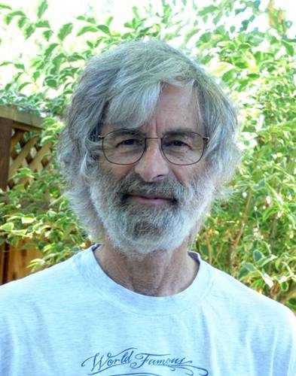
Consensus Algorithm
Paxos (1990)
Raft (2013)
图片来自http://www.lamport.org/
Notes:
Lamport 1941
LaTeX Donald E. Knuth（高德纳） The Art of Computer Programming 1974年度的图灵奖。
Time, Clocks and the Ordering of Events in a Distributed System
Dijkstra Prize (2000, 2005, and 2014) IEEE Emanuel R. Piore Award (2004) IEEE John von Neumann Medal (2008) ACM Turing Award (2013) ACM Fellow (2014)
The Part-Time Parliament 兼职 议会 1998
Paxos Made Simple 2001

Slide 4
Why Raft?
The first drawback is that Paxos is exceptionally difficult to understand
The second problem with Paxos is that it does not provide a good foundation for building practical implementations
Notes:
与zab的区别
相同点(不全,没有实现过zab): 都使用timeout来重新选择leader.
采用quorum来确定整个系统的一致性(也就是对某一个值的认可),这个quorum一般实现是集群中半数以上的服务器,zookeeper里还提供了带权重的quorum实现.
都由leader来发起写操作.
都采用心跳检测存活性.
leader election都采用先到先得的投票方式.
不同点(不全,没有实现过zab): zab用的是epoch和count的组合来唯一表示一个值, 而raft用的是term和index.
zab的follower在投票给一个leader之前必须和leader的日志达成一致,而raft的follower则简单地说是谁的term高就投票给谁.
raft协议的心跳是从leader到follower, 而zab协议则相反.
raft协议数据只有单向地从leader到follower(成为leader的条件之一就是拥有最新的log), 而zab协议在discovery阶段, 一个prospective leader需要将自己的log更新为quorum里面最新的log,然后才好在synchronization阶段将quorum里的其他机器的log都同步到一致.

Slide 5
There are significant gaps between the description of the Paxos algorithm and the needs of a real-world system. In order to build a real-world system, an expert needs to use numerous ideas scattered in the literature and make several relatively small protocol extensions. The cumulative effort will be substantial and the final system will be based on an unproven protocol.
Paxos made live
Notes:
Chubby is a fault-tolerant system at Google that provides a distributed locking mechanism and stores small files. Typically there is one Chubby instance, or “cell”, per data center. Several Google systems – such as the Google Filesystem (GFS) [4] and Bigtable [2] – use Chubby for distributed coordination and to store a small amount of metadata

Slide 6
How
Leader election: a new leader must be chosen when an existing leader fails
Log replication: the leader must accept log entries from clients and replicate them across the cluster,forcing the other logs to agree with its own
Safety: the key safety property for Raft is the State Machine Safety Property in Figure 3: if any server has applied a particular log entry to its state machine, then no other server may apply a different command for the same log index.
Notes:
近代科学的产生 1600年欧洲伽利略、开普勒、笛卡尔 牛顿
把问题拆分：第一步 第二步 第三步
如何把大象放进冰箱----赵本山、宋丹丹的小品《钟点工》
第一步：打开冰箱
第二步：把大象放入冰箱
第三步：把冰箱门关上
Given the leader approach, Raft decomposes the consensus problem into three relatively independent subproblems, which are discussed in the subsections that follow
Cluster membership changes Log compaction

Slide 7
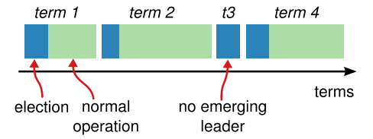
Raft(basic concepts)
Server state
Follower
Leader
Candidate
Message(RPC)
RequestVote
AppendEntries（HeartBeat）
InstallSnapshot
Terms
Term ID
Log entry
Notes:
Server state ✓ Follower： Completely Passive。 接收来自Leader或者是Candidate的message，并响应 ✓ Leader：处理所有来自客户端的请求，以及日志的复制（Log Replication） ✓ Candidate：用于选主的中间状态 ✓Message类型 ✓ RequestVote ✓ AppendEntries（HeartBeat） ✓ InstallSnapshot Terms ✓ 时间轴被划分为多个Terms ✓ Term ID：每个Term的唯一标识， 按时间轴递增 ✓ 新Term随着Leader选举而开始 ✓ 每个Term，最多只有一个Leader （可能没有Leader，split vote）

Slide 8
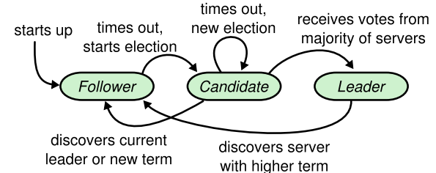
Leader election (Server states )
Notes:
Server states. Followers only respond to requests from other servers. If a follower receives no communication, it becomes a candidate and initiates an election. A candidate that receives votes from a majority of the full cluster becomes the new leader. Leaders typically operate until they fail.

Slide 9

Leader election
when
Heartbeat Message / Election Timeout
how
randomly time(avoid “live lock”)
current term++
RequestVote RPC
result
safety : only one leader or no leader
Notes:
超时驱动：Heartbeat Message / Election Timeout ✓ 随机开始：降低选举碰撞（Vote Split）导致的无主概率 ✓ 选举动作：current term++，然后发出RequestVote RPC ✓ Safty：同一Term，最多只会选出一个Leader，可以没有Leader
避免 live lock 活锁
活锁，其实和锁没有必然关系。活锁就像小猫追着自己的尾巴咬，虽然它一直在咬却一直没有咬到！活锁就是指线程一直处于运行（RUNNABLE）状态，但却是在做无用功，而这个线程本身要完成的任务却一直无法进展。活锁的一个典型例子是某些重试机制（实现地有问题）导致一个交易（请求）被不断地重试，而每次重试都是失败的（线程在最无用功），这就导致其他失败的交易无法得到重试的机会（任务无法进展）。
New Leader选取原则 ✓ 最大提交原则： During elections, choose candidate with log most likely to contain all committed entries ✓ Voting server V denies vote if its log is “more complete”: (lastTermV > lastTermC) || (lastTermV == lastTermC) && (lastIndexV > lastIndexC)

Slide 10
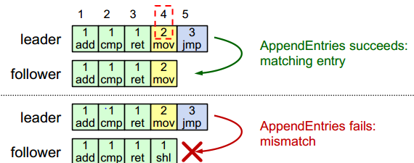
Log replication
Notes:
Logs are composed of entries, which are numbered sequentially. Each entry contains the term in which it was created (the number in each box) and a command for the state machine. An entry is considered committed if it is safe for that entry to be applied to state machines.
Raft日志格式 ✓ Raft Log（TermID， LogIndex，LogValue） ✓ TermID，LogIndex用 来标识日志的唯一性
Log Replication关键点 ✓ 连续性：Raft日志不能存在空洞 ✓ 有效性： ✓ 不同节点，拥有相同Term和LogIndex的日志 Value一定相同 ✓ Leader上的日志都是有效的 ✓ Followers日志是否有效，通过与Leader日志对 比来判断。 How？
Followers日志有效性检查 ✓ AppendEntries RPC中，除了待复制的日志之外，还带有前一个日志的唯一标识 （prevTermID，prevLogIndex） ✓ Follower在收到AppendEntries RPC之后，检查（prevTermID，prevLogIndex）与本地的 日志是否Match：Match则接受，不match则拒绝 ✓ 递归推导，证明Follower上（prevTermID，prevLogIndex）之前的所有日志，与Leader均 相同
Multi-Paxos与Raft，在日志 同步上最大的不同 ✓ Raft需要日志连续，MultiPaxos允许日志空洞存在 对于每一个没有commit的日志，需要执行basic-paxos

Slide 11
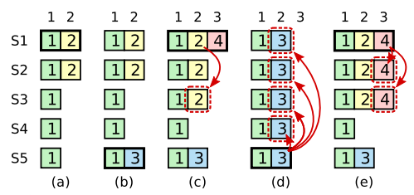
Safety
Election restriction
choose more complete
Committing entries from previous terms
Notes:
New Leader选取原则 ✓ 最大提交原则： During elections, choose candidate with log most likely to contain all committed entries ✓ Voting server V denies vote if its log is “more complete”: (lastTermV > lastTermC) || (lastTermV == lastTermC) && (lastIndexV > lastIndexC)

Slide 12
Reference
The-Part-Time-Parliament
Paxos Made Simple
In Search of an Understandable Consensus Algorithm-extend
A simple totally ordered broadcast protocol

Slide 13
@Shaojian.huang

