Slide 1


Analysis of Neuron Activity
based on the theory of Brain Modularity.
(during memory encoding and recognition)
컴퓨터 학부 201913801 장효순
2021. 12. 17

Slide 2
Purpose of analysis
It does not provide novel insights of the association between consciousness activity(i.e., memorization/recognition) and neuron activity.
In the area of neuroscience, most of the conclusions derived from the cohort study (That is inductively. not deductively.)
Therefore, we just show the results that can support existing brain theories inductively. (Another cohort, And based on the coherentism)

Slide 3
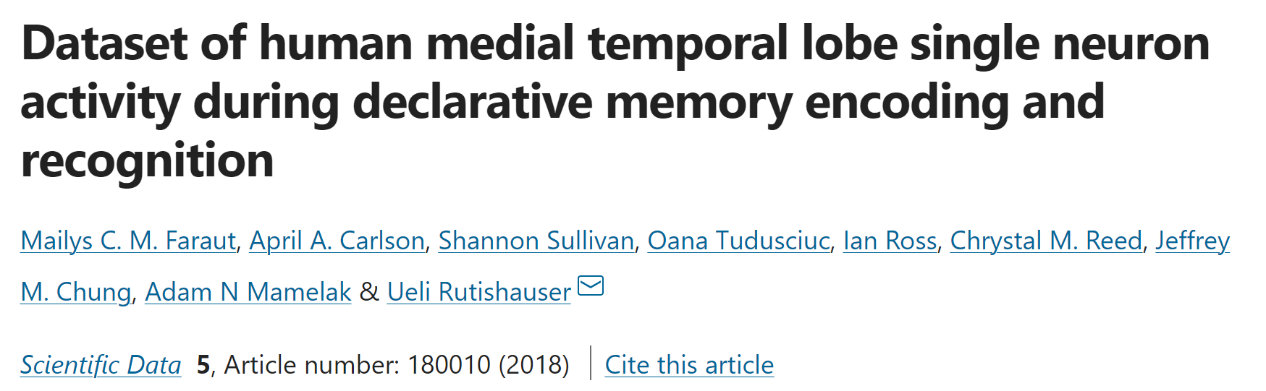
Dataset Review
1) Faraut, M., Carlson, A., Sullivan, S. et al. Dataset of human medial temporal lobe single neuron activity during declarative memory encoding and recognition. Sci Data 5, 180010 (2018). https://doi.org/10.1038/sdata.2018.10

Slide 4
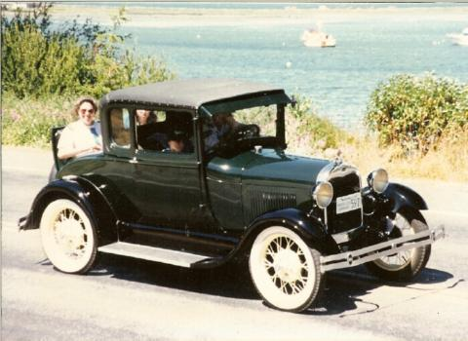
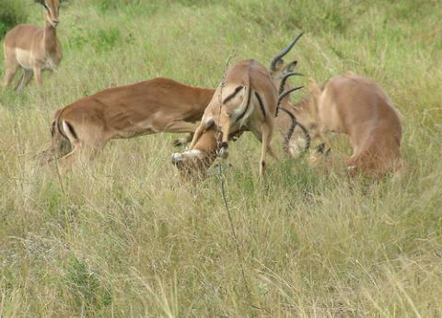

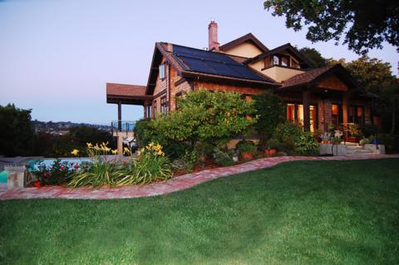
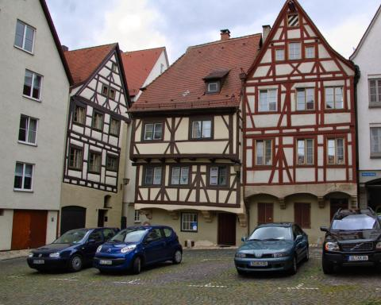
Dataset Review
Recording neuron spike
Remembering state..
Phase of learning Present various types of images. (e.g., human face, spatial, …)
Phase of memorization Present old or new image And patient distinguishes whether a given image is a ‘New’ thing or ‘Old’.
Recording neuron spike
Q: did you see this image before?
[1 – 6 Response]
New/Old, confident
New/Old, probably
New/Old, guess
Recorded locations are
Left/Right hippocampus and Left/Right amygdala.

Slide 5
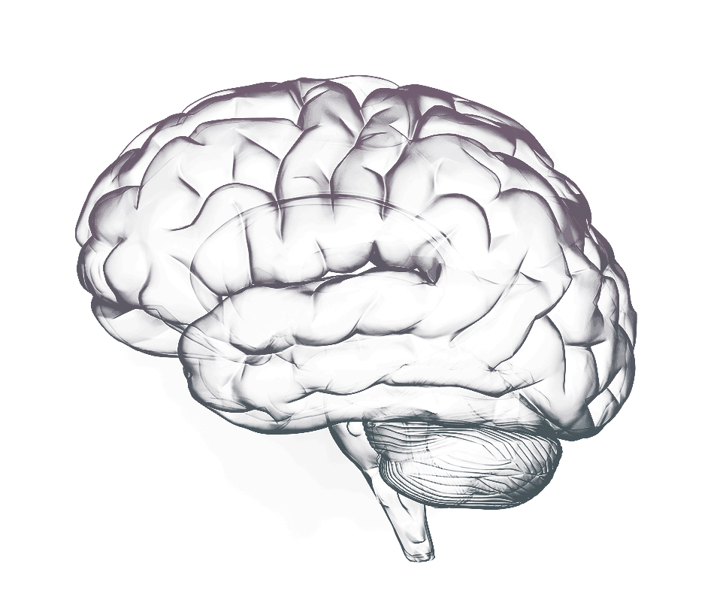
Short Review of Brain Modularity
Right Hippocampus:
Long term memory [3]
Left Hippocampus:
Short term memory [3]
More activated by
spatial stimuli
More activated by Verbal stimuli
Right Amygdala:
Processing memory,
High-level Recognition,
Negative emotion(Fearness),
Flashbulb memory[2]
Left Amygdala:
Processing memory,
High-level Recognition,
Positive/Negative emotion [2]
2) Kerstin Spanhel, Kathrin Wagner, Maximilian J. Geiger, Isabell Ofer, Andreas Schulze-Bonhage, Birgitta Metternich, Flashbulb memories: Is the amygdala central? An investigation of patients with amygdalar damage, Neuropsychologia 111, 2018
3) Hartley, Tom et al. “The hippocampus is required for short-term topographical memory in humans.” Hippocampus vol. 17,1 (2007): 34-48. doi:10.1002/hipo.20240

Slide 6
Dataset Pre-processing
uS | Situation
 | Stimulus on
 | Response (/1-6)
Neuron_id | Stimuli1 | … | Stimuli n
uS | Neuron_id
A | 42
 | 523
Firing rate
Repeat m (1, …, n):
Define the time range of a stimuli 'm'.
Get the number of the firing of a neuron 'i‘ in the time range. (repeat i (1, …, m))
Neuron ’42’ spikes when the time was A.
Neuron_id | Brain area
42 | Left Amygdala
 | …

Slide 7
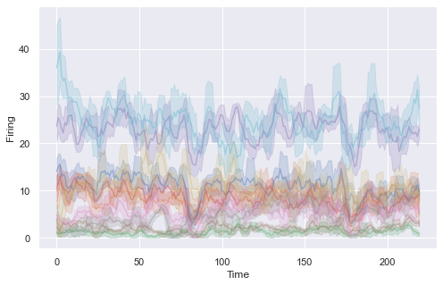
Firing rates normalization
Due to different scale of neurons firing rate,
we apply Robust-Scaling.
(+ It does not matter from the
perspective of neuron science [4].)
More easy to capture
variation of the neurons activation
Difficult to detect the variation of the neuron spike.
4) Lim, S., McKee, J., Woloszyn, L. et al. Inferring learning rules from distributions of firing rates in cortical neurons. Nature Neuroscience 18, 1804–1810 (2015). https://doi.org/10.1038/nn.4158

Slide 8
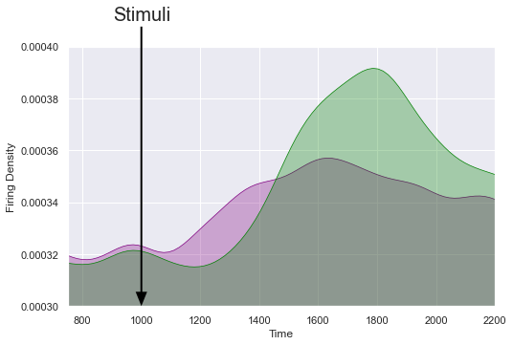
Delayed Propagation
Hippocampus
Amygdala
Difference of response time between Amygdala - hippocampus.
(Basically, Hippocampus sends
a signal to amygdala [5].)
➔ Unfairness of measuring over the same period of time.
Time period (Hippocampus)
Time period (Amygdala)
5) Kim, W.B., Cho, JH. Encoding of contextual fear memory in hippocampal–amygdala circuit. Nature Communications 11, 1382 (2020). https://doi.org/10.1038/s41467-020-15121-2

Slide 9
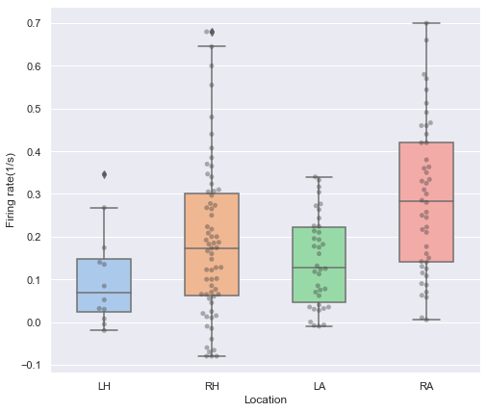
Analysis - Learning phase
 | LH | RH | LA | RA
LH | 1 | 0.12 | 0.22 | 0.0008
RH |  | 1 | 0.38 | 0.003
LA |  |  | 1 | 1e-4
RA |  |  |  | 1
We can estimate that neurons activation of RA are more frequently occurred [6, 7].
Furthermore, we compare neuron activation by a criterion of the task category (sub-task).
Mann Whiney U-test
Kruskal Result: 2e-4 (p-value)
Null hypothesis: The neuron firing rate distribution of the two modules is the same.
6) Tyng CM, Amin HU, Saad MNM and Malik AS (2017) The Influences of Emotion on Learning and Memory. Front. Psychol. 8:1454. doi: 10.3389/fpsyg.2017.01454
7) Chau, Lily S, and Roberto Galvez. “Amygdala's involvement in facilitating associative learning-induced plasticity: a promiscuous role for the amygdala in memory acquisition.” Frontiers in integrative neuroscience vol. 6 92. 10 Oct. 2012, doi:10.3389/fnint.2012.00092

Slide 10
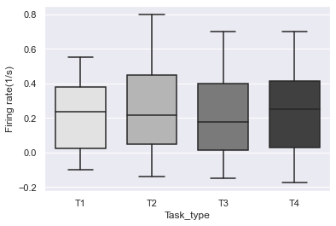
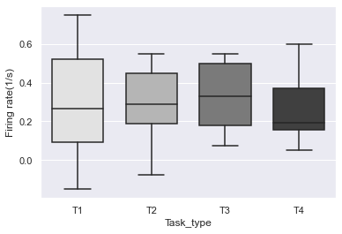
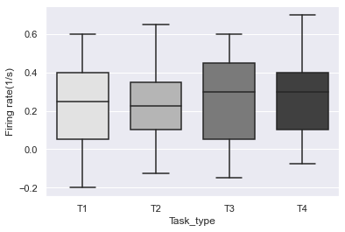
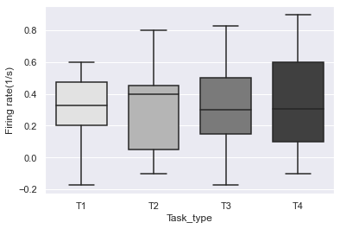
Sub-task Dependence (inter module level)
T1: recognizing inorganic object (e.g., cars)
T2: recognizing human face
T3: recognizing landscape
T4: recognizing animal
 | T1 | T2 | T3 | T4
T1 | 1 | >0.05 | >0.05 | 0.0118
T2 |  | 1 | >0.05 | >0.05
T3 |  |  | 1 | >0.05
T4 |  |  |  | 1
Right Hippocampus
(All pair reject)
Left Hippocampus
(All pair reject)
Right Amygdala
Left Hippocampus
(All pair reject)

Slide 11
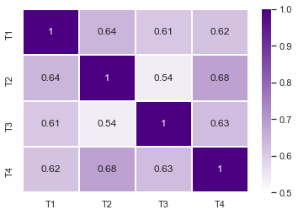
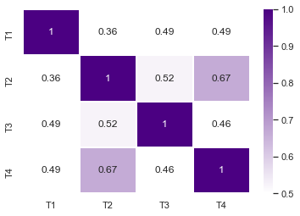
Sub-task Dependence (intra module level)
Indeed, aforementioned result can connect with the amygdala characteristic of previous research [8,9,10,11].
Emotion(Fear)
High-level recognition
Sensitivity to context.
One of the plausible explanations is viewed from the evolutionary theory.
To recognize predators and prey, it led to neural adaptation for the dedicated processing of the aforementioned type of stimulus [9].
Moreover, there are exist that the concept of categorical processing for the various type of image [8,10,11].
Right Hippocampus
Right Amygdala
8) Yang, Jiongjiong et al. “Threat, domain-specificity and the human amygdala.” Neuropsychologia vol. 50,11 (2012): 2566-72. doi:10.1016/j.neuropsychologia.2012.07.001
9) Mormann, F., Dubois, J., Kornblith, S. et al. A category-specific response to animals in the right human amygdala. Nature Neuroscience 14, 1247–1249 (2011). https://doi.org/10.1038/nn.2899
10) Fang Z, Li H, Chen G and Yang JJ (2016) Unconscious Processing of Negative Animals and Objects: Role of the Amygdala Revealed by fMRI. Front. Hum. Neuroscience. 10:146. doi: 10.3389/fnhum.2016.00146
11) Cao, Zhijun et al. “Distinct brain activity in processing negative pictures of animals and objects - the role of human contexts.” NeuroImage vol. 84 (2014):
901-10. doi:10.1016/j.neuroimage.2013.09.064

Slide 12
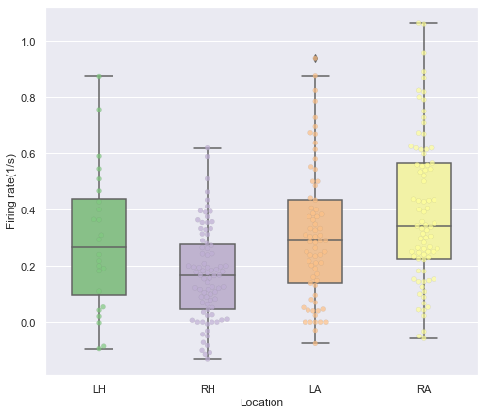
Phase of Memorization - recognize as new one.
 | LH | RH | LA | RA
LH | 1 | 0.03 | >0.05 | >0.05
RH |  | 1 | 2e-4 | 1e-8
LA |  |  | 1 | >0.05
RA |  |  |  | 1
Now, we can only estimate that neurons activation of LH, LA and RA are more frequently occurred rather than RH. (p-value < 0.05)
However, comparison of LH-LA-RA doesn't tell any information (p-value > 0.05)
Thus, we compare neuron activation by a criterion of confidence in a decision.
Mann Whiney U-test
Null hypothesis: The neuron firing rate distribution of the two modules is the same.

Slide 13
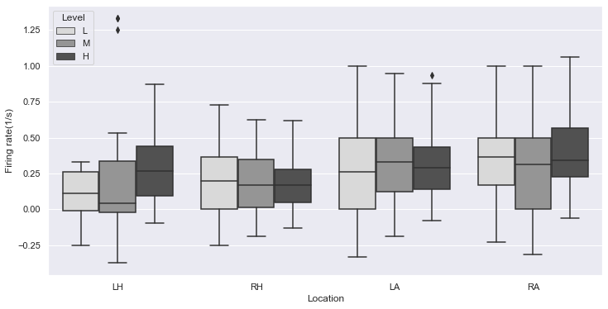
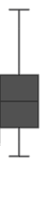
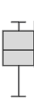
Phase of Memorization - recognize as new one.
Mann Whitney U-test
(=Wilcoxon rank-sum test, 2-groups)
and Kruskal wallis test (3-groups)
are applied to compare the firing rate of neurons for each memorization level.
 | Kruskal | Mann Whitney U-test
 | Overall | L-M | M-H | H-L
LH | 0.054240 | 0.721745 | 0.086213 | 0.039011
RH | 0.663239 | 0.696466 | 0.717544 | 0.323508
LA | 0.537404 | 0.297909 | 0.559610 | 0.508131
RA | 0.189205 | 0.204326 | 0.083717 | 0.609311
We can only infer that
Different response of Left Hippocampus
(Short term memory) [12]
Leads to a difference in decision level.
12) Cohen, Sarah J, and Robert W Stackman Jr. “Assessing rodent hippocampal involvement in the novel object recognition task. A review.” Behavioural brain research vol. 285 (2015): 105-17. doi:10.1016/j.bbr.2014.08.002

Slide 14
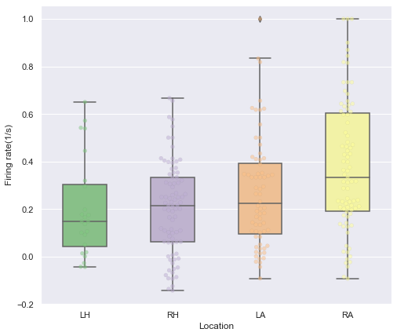
Phase of Memorization - memorize seeing it earlier.
 | LH | RH | LA | RA
LH | 1 | >0.05 | >0.05 | 0.001
RH |  | 1 | >0.05 | 6e-5
LA |  |  | 1 | 0.009
RA |  |  |  | 1
We can estimate that neurons activation of RA are more frequently occurred.
Furthermore, we compare neuron activation by a criterion of confidence in a decision.
Mann Whiney U-test
Null hypothesis: The neuron firing rate distribution of the two modules is the same.

Slide 15
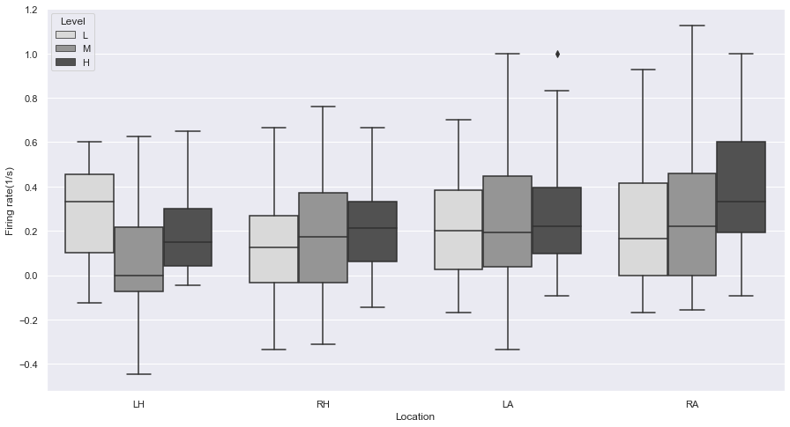
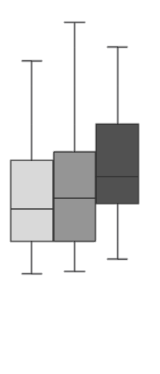

Phase of Memorization - memorize seeing it earlier.
Mann Whitney U-test
(Wilcoxon rank-sum test, 2-groups)
and Kruskal wallis test (3-groups)
are applied to compare the firing rate of neurons for each memorization level.
 | Kruskal | Mann Whitney U-test
 | Overall | L-M | M-H | H-L
LH | 0.046299 | 0.028308 | 0.068137 | 0.346379
RH | 0.101832 | 0.162111 | 0.661097 | 0.029674
LA | 0.523502 | 0.743595 | 0.502852 | 0.234541
RA | 0.001053 | 0.130493 | 0.036209 | 0.000179
We can infer that
difference response of Right Amygdala
(Flash bulb memory, Spatial memory) [2]
leads difference of decision level.
(But, it misses the relationship between L-M)
2) Kerstin Spanhel, Kathrin Wagner, Maximilian J. Geiger, Isabell Ofer, Andreas Schulze-Bonhage, Birgitta Metternich, Flashbulb memories: Is the amygdala central? An investigation of patients with amygdalar damage, Neuropsychologia 111, 2018

Slide 16
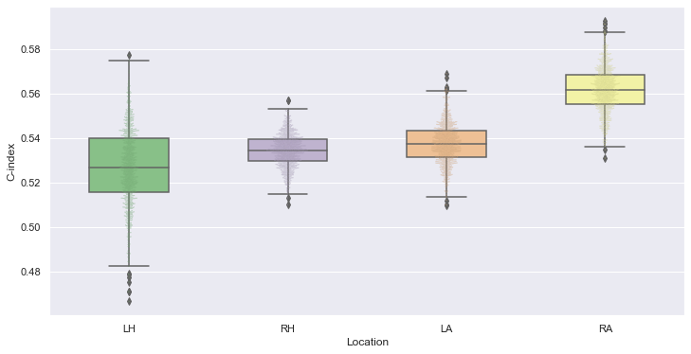
Analysis between Learning phase and Memorizing phase
Comparison of the proportional relationship between the firing rate of the learning phase
and the firing rate of the memory phase
for the same stimulus.
➔ Using Concordance-Index and bootstrap-validation
!
!
The right amygdala shows a relatively high concordance index.
Because the neuron system quickly encodes important stimuli after being exposed to strong stimuli once [13].
Learning phase
Memorization phase
Is it proportional to the neuron firing rate of the learning phase?
13) Rutishauser, Ueli et al. “Single-trial learning of novel stimuli by individual neurons of the human hippocampus-amygdala complex.” Neuron vol. 49,6 (2006): 805-13. doi:10.1016/j.neuron.2006.02.015

Slide 17
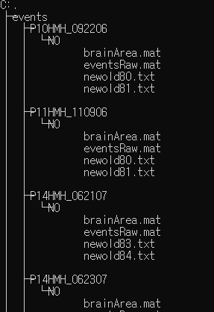
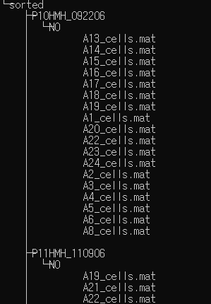
Discussion - Limitation and feature works
Intractable Format (.mat)
Intractable Dataset Architecture
Single Cohort
Highly dependent on the p-value [14].
Only analytic aspect.
Lack of domain knowledge.
Analyzing Self Organizing architecture of Neurons.
Scientific modeling of in vivo environment(mice studies) (e.g., modeling mice brain as generative cellular automata)
14) Yaddanapudi, Lakshmi Narayana. “The American Statistical Association statement on P-values explained.” Journal of anaesthesiology, clinical pharmacology vol. 32,4 (2016): 421-423. doi:10.4103/0970-9185.194772

