Slide 1
Eniac Brazil Market Expansion
An Analysis for Magist’s Suitability for Brazilian Market

Slide 2
ENIAC
High-end tech product company
High customer
satisfaction
Competitive Prices

Slide 3
TABLE OF CONTENTS
1.
2.
3.
4.
5.
ABOUT THE PROJECT
MARKET SHARE OF TECH PRODUCTS
CUSTOMER REVIEW ANALYSIS
ANALYSIS OF DELIVERY TIME
CONCLUSION

Slide 4
1
ABOUT THE PROJECT

Slide 6





BRAZIL MARKET EXPANSION
Market Share Dynamics
~ 10.02%²
Apple Product Sales
+ 21% YoY¹
Local Production Initiatives
Expanding local product manufacturing⁴
Average Delivery Time
~ 16-21 days³

Slide 7
2
MARKET SHARE OF TECH PRODUCTS

Slide 8
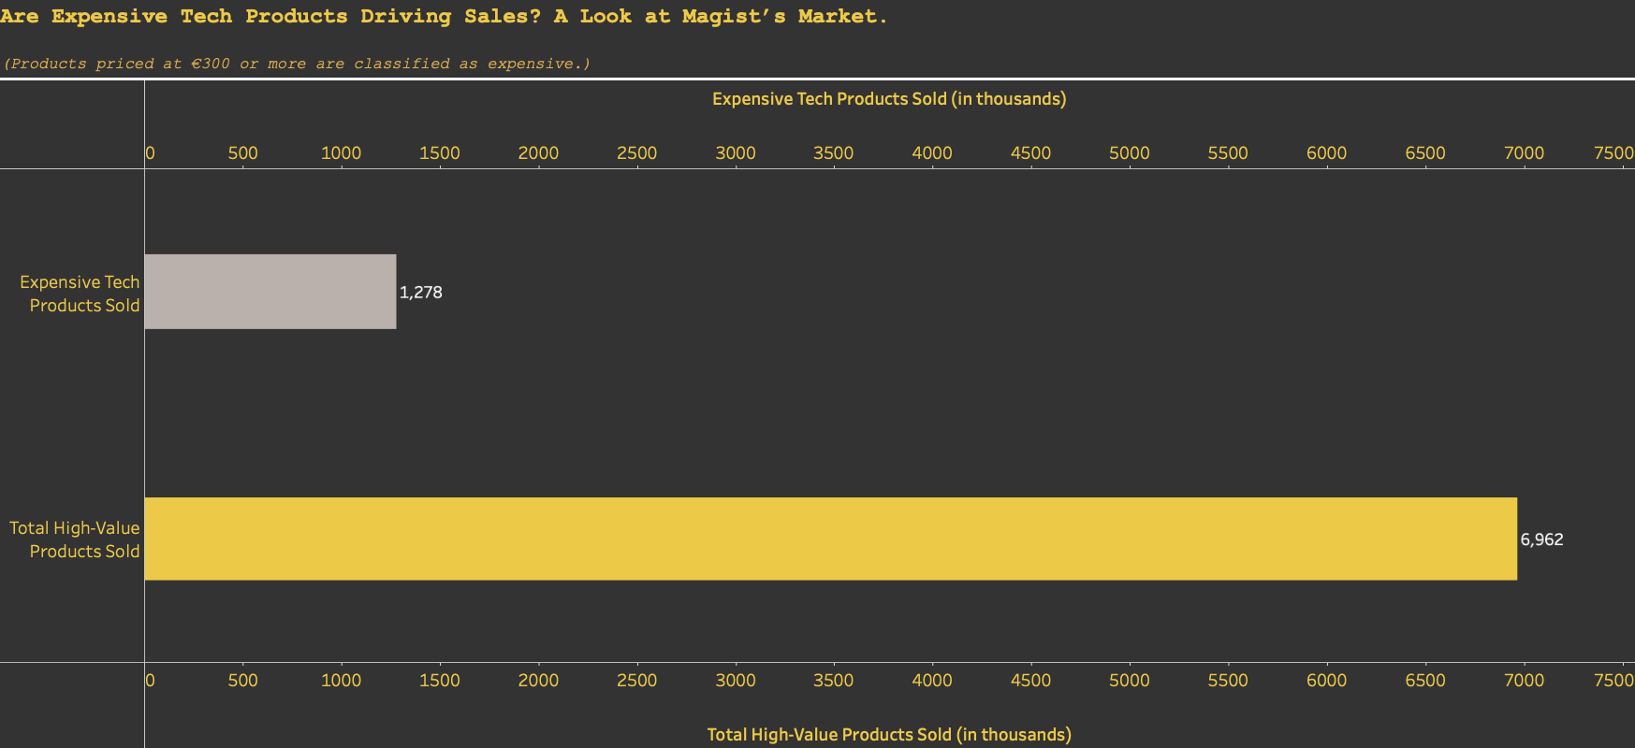
Role of Expensive Tech Product
on Sales
18.4 % share of high-value product sales

Slide 9
Customer Review Analysis
3

Slide 10
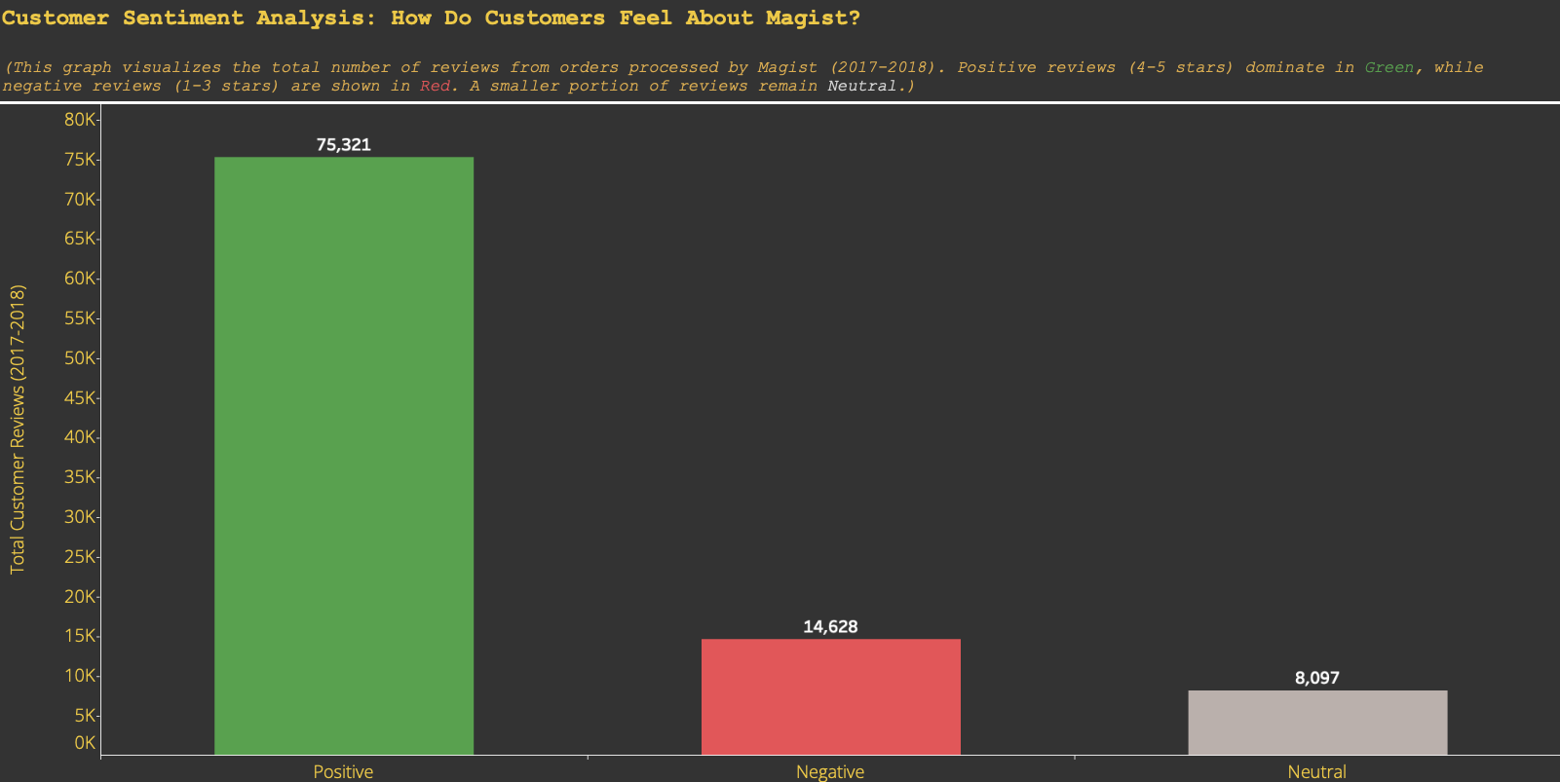

General Customer Reviews
76,8 %
Total Reviews: 98,046
14,9 %
8,3 %

Slide 11
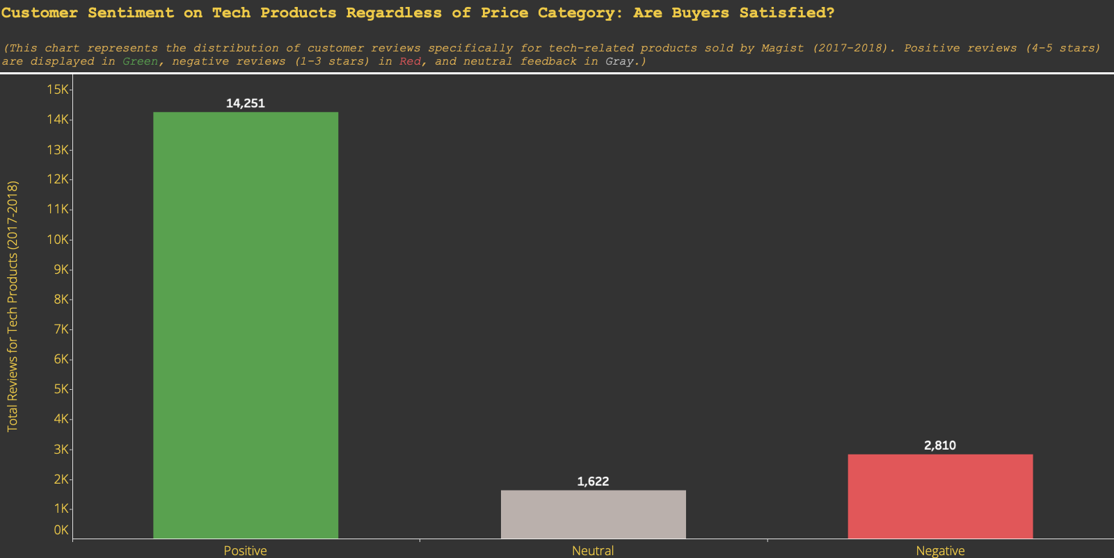

Customer Reviews for Tech-Products
76,3 %
Total Reviews: 18,683
15,0 %
8,7 %

Slide 12
4
Analysis OF DELIVERY TIME

Slide 13
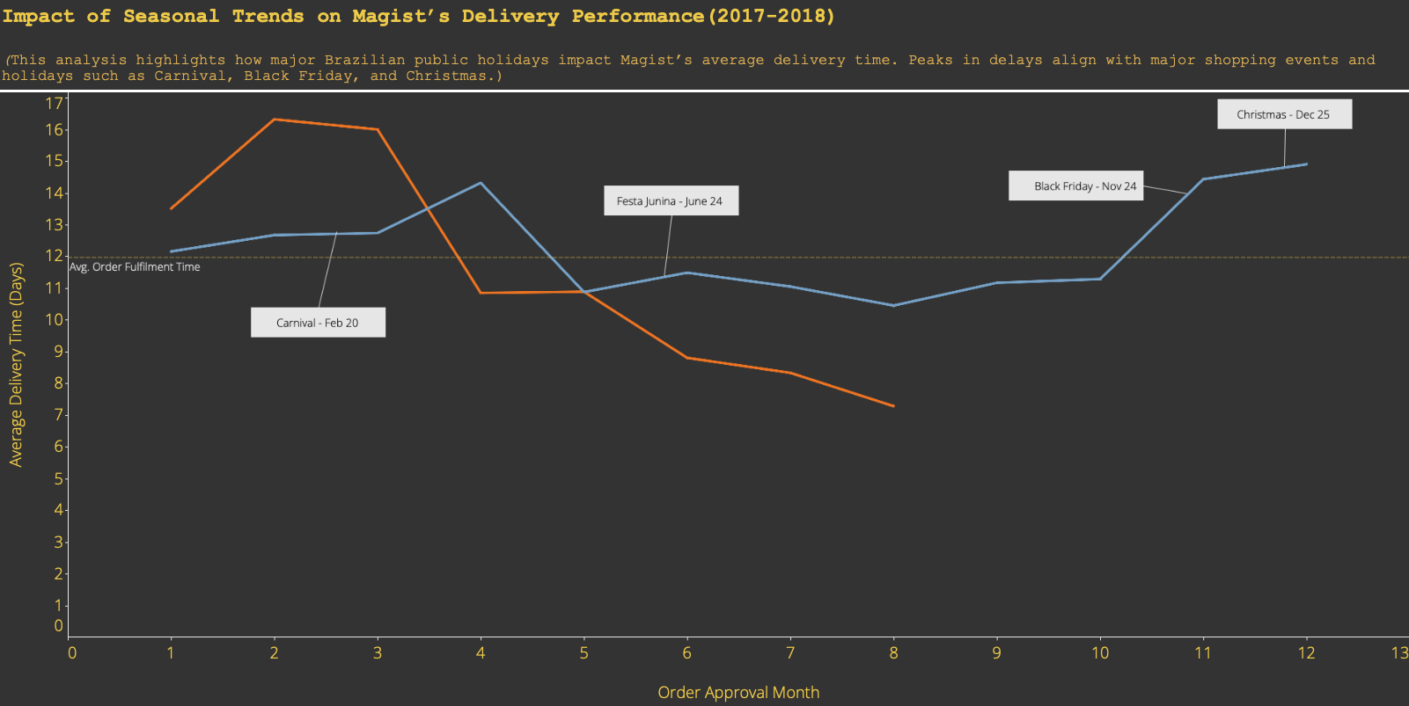
Relation between Average Delivery Time and Public Holidays
2017
2018
Magist services have improved considerably even during seasonal holidays!

Slide 14
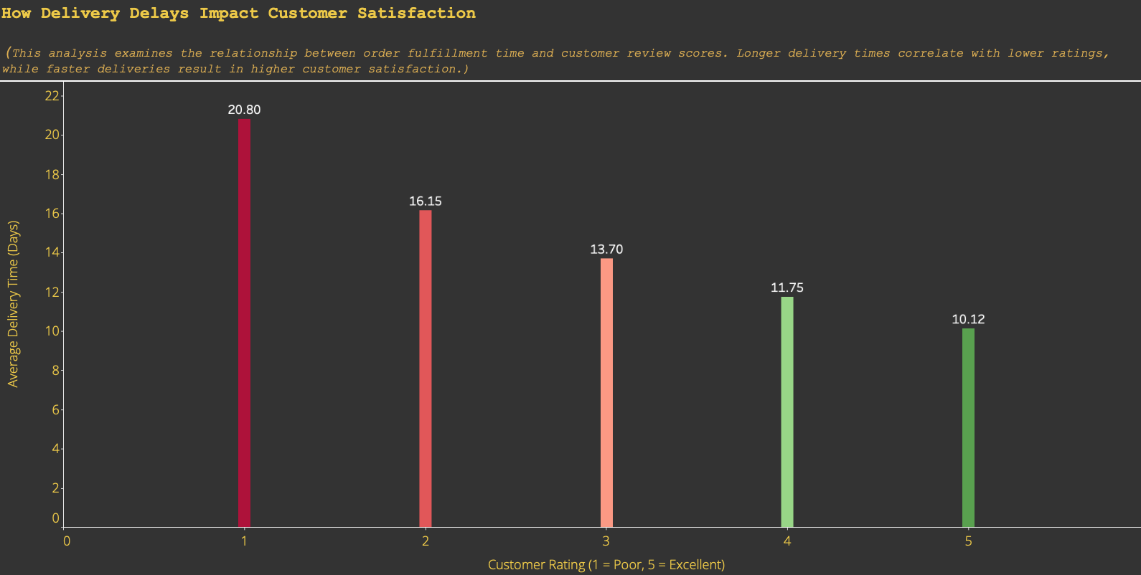
Customer Satisfaction and Delivery
Lower delivery time
🡺 higher customer satisfaction
10.12
5

Slide 15
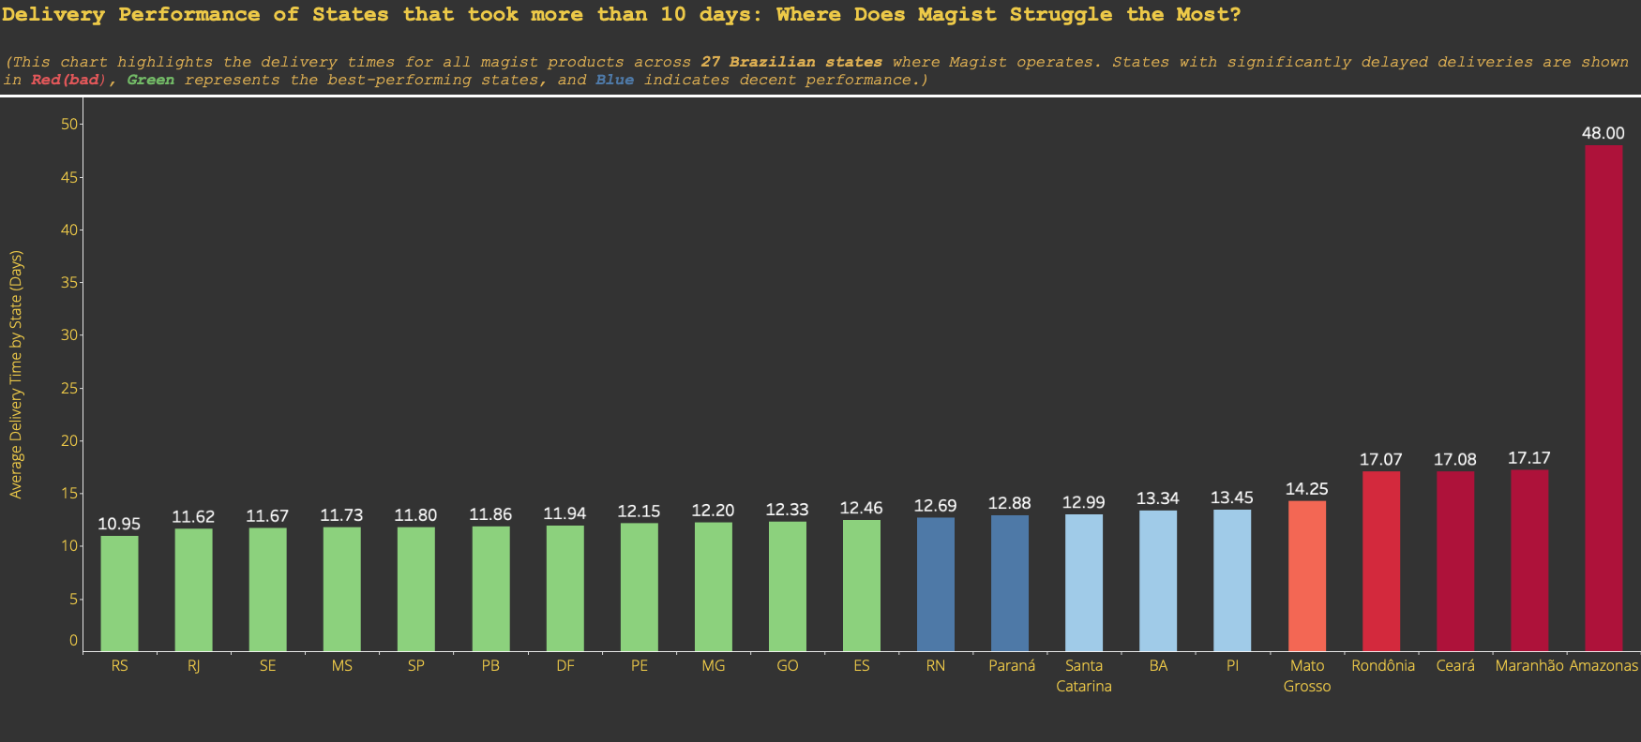
Delivery Perfomance
5 States
5 States
11 States

Slide 16
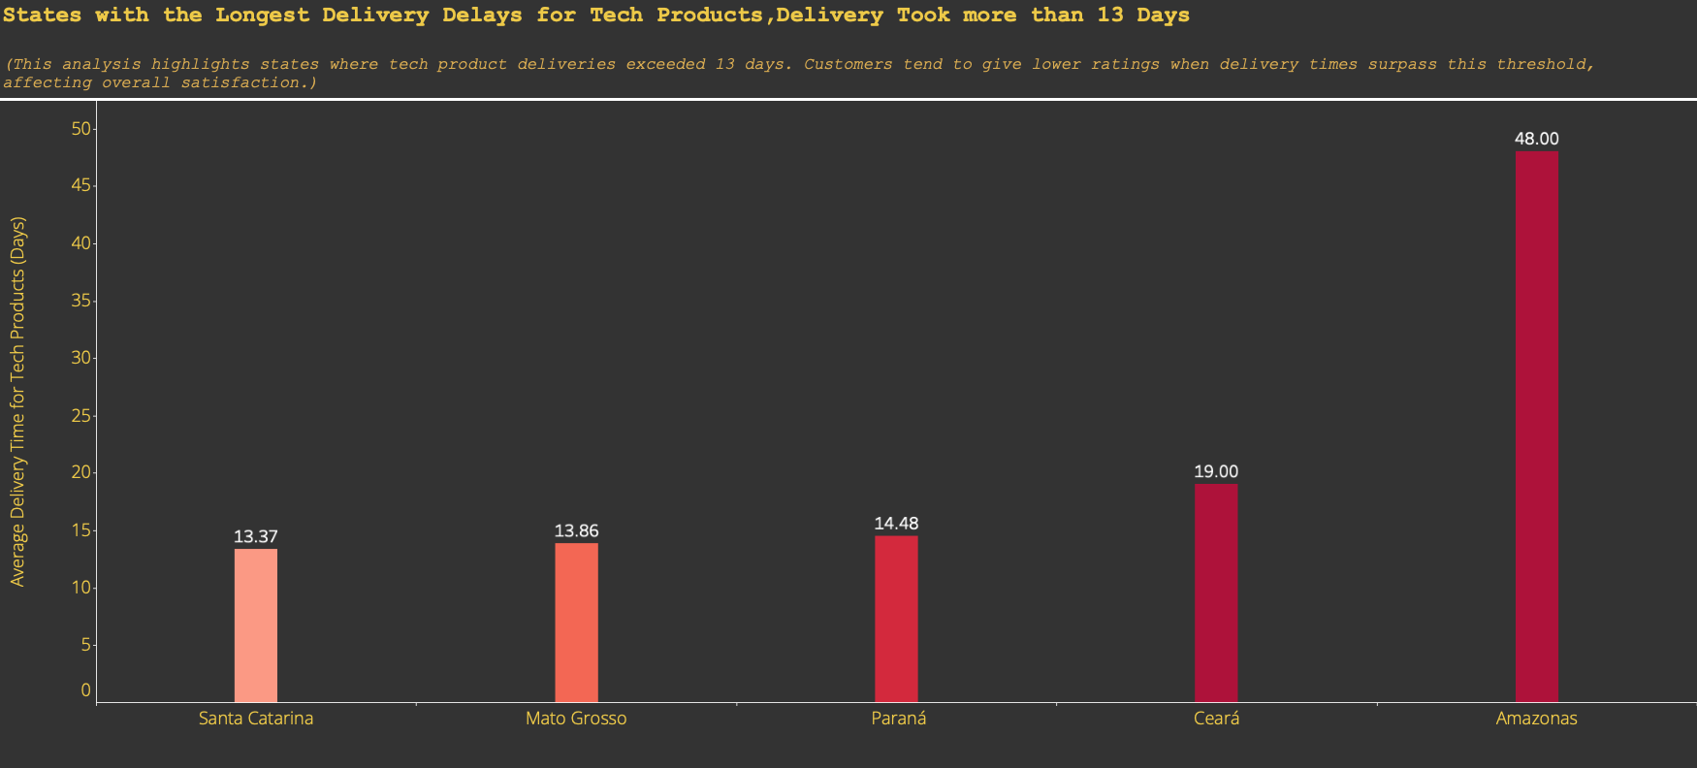
Bad Performing States

Slide 17
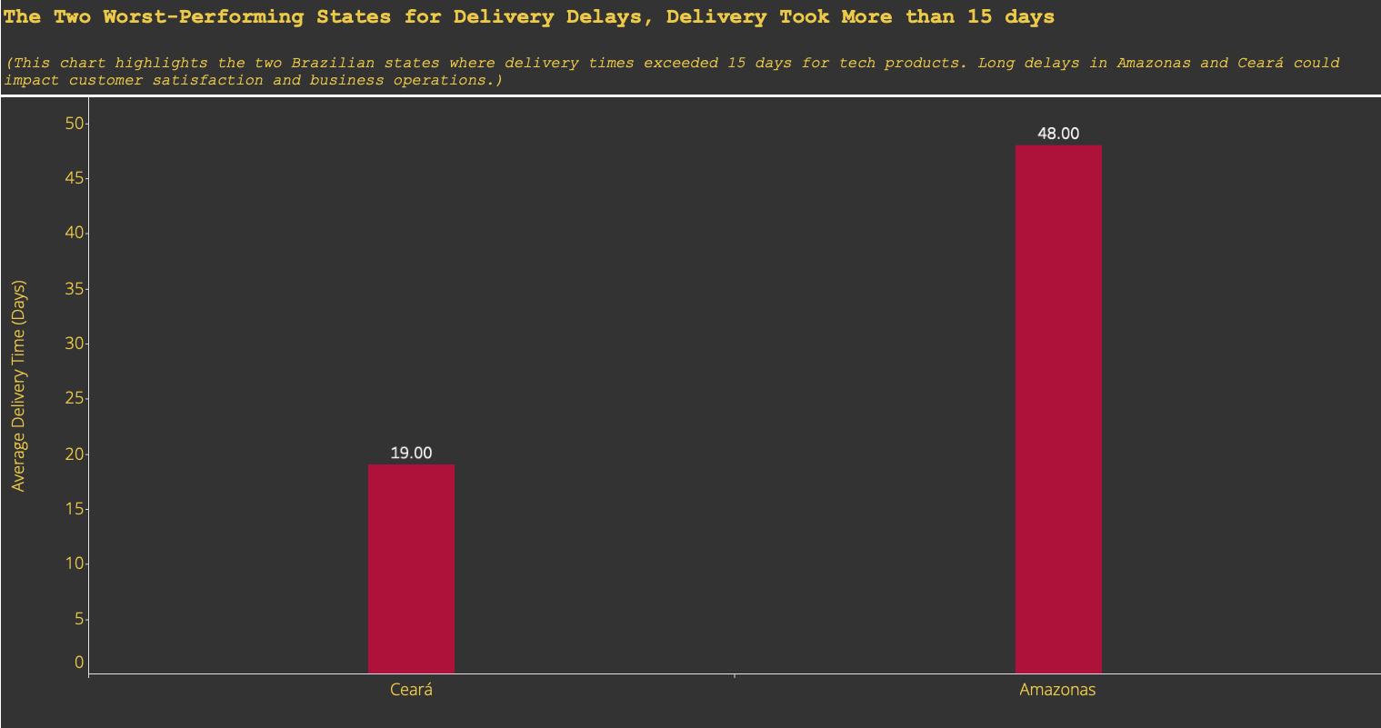
Worst Performing States

Slide 18
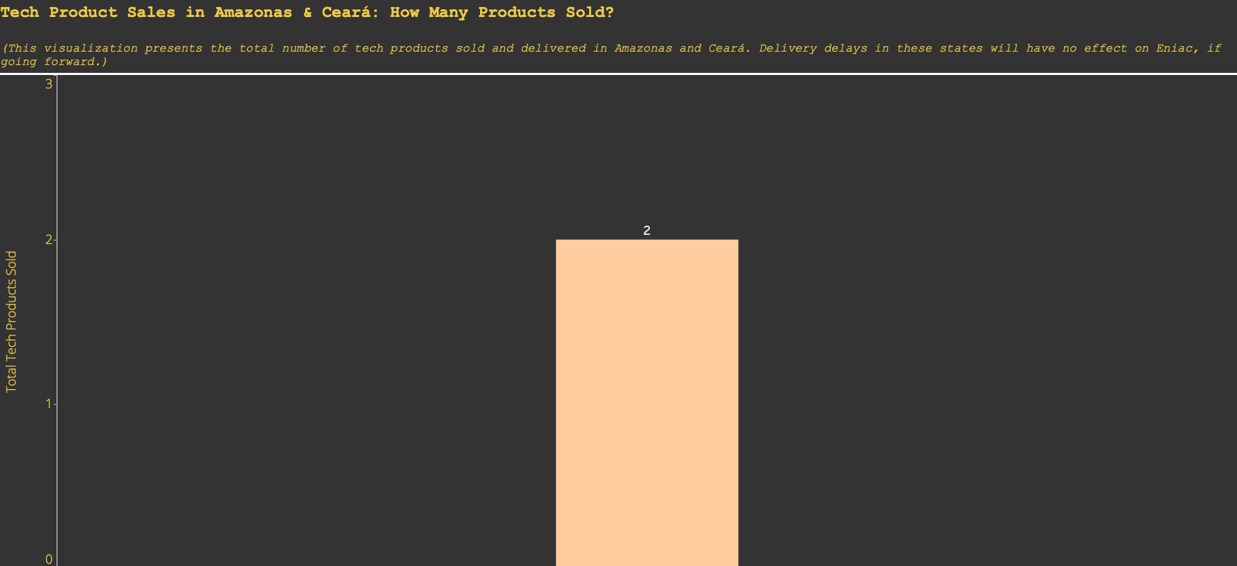

Sales Figures for Amazonas & Ceará Tech Products
2
Only 2 Tech Products Sold in These States
Less or No Effect for Eniac expansion

Slide 19
5
CONCLUSION

Slide 20



Conclusion
Business Questions
Is Magist a good fit for high-end tech products?
Are orders being delivered on time?
Sales Volume – Inconclusive
Only 1,278 high-end tech products sold.
Too low to determine scalability for premium tech.
More sales data needed before a final decision.
Customer Satisfaction – Recommended
Efficient delivery times and high customer satisfaction.
Strong logistics performance despite low sales.
Proceed with magist based on delivery efficiency.

Slide 21
THANKS!
Please keep this slide for attribution.

Slide 22
Sources
[1] Patently Apple: https://www.patentlyapple.com/2024/12/in-q3-2024-apple-took-a-solid-leap-in-smartphone-sales-in-the-latin-american-market.html?utm_source=chatgpt.com
[2] Statista: https://www.statista.com/statistics/1117196/delivery-time-e-commerce-brazil/?utm_source=chatgpt.com
[3] StatCounter: https://gs.statcounter.com/os-market-share/mobile/brazil?utm_source=chatgpt.com
[4] Digital Watch: https://dig.watch/updates/apple-expands-iphone-16-production-to-brazil?utm_source=chatgpt.com

Slide 23
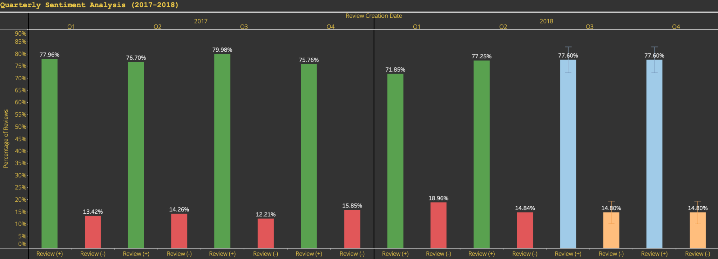
Extra

