Slide 1
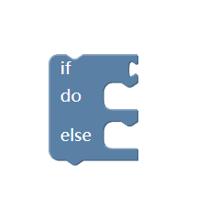

General
wireless
wireless
UI editor (JavaScript)
Arduino Code (noLib)
Fetch
Rebot (Arduino)
wired
RBAC
(PHP, JAVA or Python)
Binary Code (noLib)
Wifi interface
message
Code with lib
wired
Arduino-CLI
(Linux shell or C++)
Binary Code (noLib)
usb interface

