Slide 1
Apache SPARK
Hema Siva Krishna

Slide 2
AGENDA
What is Apache Spark?
Why Apache Spark?
Spark Components
Architecture overview
Cluster Managers and Execution modes
RDD’s
Lazy Evaluation
Spark SQL API (DataFrames/DataSets)
Spark Streaming API
Kafka brief Intro
Kafka Spark Integration

Slide 3

What is SPARK???
Apache Spark is a Unified Analytics Engine for Big Data.
It is lightning fast cluster computing tool.
It is an distributed general-purpose cluster computing system.
It can process both batch and real-time data.
Handles structured, semi-structured and unstructured data.
Notes:
Structured-> RDBMS, csv
Semi-Structured-> XML, json
Unstructured -> Logs
Spark’s Impact is such that from small startup’s to Fortune 500’s almost every single company started adopting SPARK
Industries like Banking, Media, Health Care, Finance, Telecommunications and Stock Market almost all are using SPARK

Slide 4
Why Spark?
Without Spark in order to:
Perform batch processing we used Hadoop MapReduce
Perform stream processing we used Apache Storm / S4.
Perform interactive processing we used Apache Impala / Apache Tez.
Perform graph processing we used Neo4j / Apache Giraph.
Apache Spark offers real-time stream processing, interactive processing, graph processing, in-memory processing as well as batch processing.
Notes:
Let us understand the problems that yahoo is facing. Yahoo’s properties are highly personalised to maximize relevance i.e the algorithms which it uses to
to provide personalization that are targeted advertisement and personalized content were highly sophisticated and the relevance model had to be updated frequently as the stories newsfeed kept changing with time and Yahoo also had a 150 petabytes of data which was stored on 35,000 no hadoop cluster which had to be accessed efficiently in order to avoid latency caused by the data movement and also to gain insights from data in a cost-effective manner.
So Yahoo looked SPARK to improve performance and also the machine learning algorithm that was used has 15000 lines C++ code and on the other hand the machine learning algorithm implemented with spark had just one 20 lines of Scala programming code and the algorithm was ready for production use in just 30 minutes of training on a dataset with hundred million record.
To perform batch processing, we were using Hadoop MapReduce.
Also, to perform stream processing, we were using Apache Storm / S4.
Moreover, for interactive processing, we were using Apache Impala / Apache Tez.
To perform graph processing, we were using Neo4j / Apache Giraph.
Hence there was no powerful engine in the industry, that can process the data both in real-time and batch mode. Also, there was a requirement that one engine can respond in sub-second and perform in-memory processing. Therefore, Apache Spark programming enters, it is a powerful open source engine. Since, it offers real-time stream processing, interactive processing, graph processing, in-memory processing as well as batch processing. Even with very fast speed, ease of use and standard interface. Basically, these features create the difference between Hadoop and Spark

Slide 5
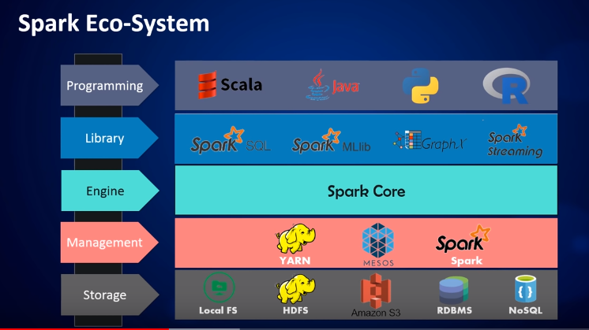
Spark Components
Spark Core component Performs IO functions, scheduling, monitoring and so on. The entire spark eco system is built on top of it.
Different Cluster Managers: Yarn, Mesos and Spark’s Standalone cluster
Different libraries like SPARK SQL, MLlib, GraphX and Spark Streaming
Spark can be implemented in Scala, R, Python and Java
Finally, we can store data over HDFS local file system and cloud (Amazon S3). It also supports SQL and NoSQL databases
Notes:
Spark Core component is the vital component of Spark eco system that is responsible for basic IO functions, scheduling, monitoring and so on. The entire spark eco system is built on top of it.
different deployment modes: Yarn, Mesos and Spark’s Standalone cluster
different libraries like SPARK SQL, Mlib, GraphX and Spark Streaming
Spark SQL which helps us to perform queries on data and also to store data using SQL-like queries.
Mllib for machine learning purpose: like summary statistics, correlation and feature extraction and many others
GraphX is the Spark API for graphs and graph-parallel computation
Spark Streaming is the component of Spark which is used to process real-time streaming data. Thus, it is a useful addition to the core Spark API. It enables high-throughput and fault-tolerant stream processing of live data streams
Spark provides real-time computation and low latency because of in-memory computation
100 times faster for large-scale data processing
Spark is also a polyglot, so we can write SPARK applications on multiple languages such as Java, Scala, Python and R
It also employes Powerful caching
It also provides multiple deployement modes. It can be deployed through Mesos, Hadoop via Yarn or on Spark’s own cluster manager

Slide 6
Architecture Overview
Spark Worker Node
Spark Driver Node
Executor
Cache
Driver
Program
Task
Task
Master Node
Cluster
Manager
Spark Context
Spark Context
Spark Worker Node
Executor
Cache
Task
Task
Notes:
The way Spark application and Spark standalone cluster manager operates is as follows. The machine where the Spark application process (the one that creates the SparkContext) is running is the "Driver" node, with process being called the Driver process. There is another machine where the Spark Standalone cluster manager is running, called the "Master" node. Along side, in each of the machines in the cluster, there is a "Worker" process running which reports the available resources in its node to the "Master". When the Driver process needs resources to run jobs/tasks, it asks the "Master" for some resources. The "Master" allocates the resources and uses the "Workers" running through out the cluster to create "Executors" for the "Driver". Then the Driver can run tasks in those "Executors"
In cluster mode, the Spark driver runs inside an application master process which is managed by YARN on the cluster
the client can go away after initiating the application. In client mode, the driver runs in the client process, and the application master is only used for requesting resources from YARN.
Cluster mode
Client mode
Local mode
Spark uses Master/Worker architecture.
Master node will have the driver program which drives your Application
Driver program is the code which we are writing or if we are using the interactive shell, the shell acts as the driver program
It runs the main function of the application and it is the place where spark context is created
Spark context is the gateway to all the functionalities
https://data-flair.training/blogs/dag-in-apache-spark/
Spark-shell
https://spark.apache.org/docs/latest/submitting-applications.html#master-urls
Standalone cluster
Go to %SPARK_HOME%\bin folder in a command prompt
Run spark-class org.apache.spark.deploy.master.Master to run the master. This will give you a URL of the form spark://ip:port
Run spark-class org.apache.spark.deploy.worker.Worker spark://10.235.14.125:7077 to run the worker. Make sure you use the URL you obtained in step 2.
Run spark-shell --master spark://10.235.14.125:7077 to connect an application to the newly created cluster.
Connect to multiple nodes
Val num = sc.parallelize(1 to 1000)
Val num2 = sc.parallelize(1001 t0 10000000)
Val v3 = v1.union(v2)
V3.collect

Slide 7
Architecture Overview – In words
Spark uses Master/Worker architecture.
Driver Node:
Driver node will have the driver program which drives Application
It runs the main function of the application and it is the place where spark context is created
Spark context is the gateway to all the functionalities
It is responsible for the translation of user code into actual spark jobs executed on the cluster
So Spark Driver and Spark Context takes care of the job execution within the cluster.
Master Node aka Cluster Manager:
Spark Context works with the cluster manager in distributing the jobs to the various nodes and the cluster manager is responsible in acquiring resources on the spark cluster and allocating them to a spark job.
Each job is partitioned to multiple tasks which are distributed over the worker nodes
Worker Nodes:
Worker nodes are actually the slave nodes whose job is to basically execute the tasks and return back the result to the spark context.
Worker Nodes will have executers which executes the tasks
Notes:
Key Points
Spark employs a cluster manager that keeps track of the resources available
The driver process is responsible for executing the driver program’s commands across the executors to complete a given task.
The executors, for the most part, will always be running Spark code. However, the driver can be “driven” from a number of different languages through Spark’s language APIs.

Slide 8
Cluster Managers and Execution Modes
Cluster Managers:
Standalone – A simple cluster manager included with Spark that makes it easy to set up a cluster.
Apache Mesos – A general cluster manager that can also run Hadoop MapReduce and service applications.
Hadoop YARN – The resource manager in Hadoop 2.
Execution Modes:
Cluster mode - This framework launches the driver inside one of the nodes of the cluster.
Client mode - The submitter launches the driver outside of the cluster in which spark job is submitted.
Local mode - All the driver and executors run on the single JVM’s
Notes:
All three cluster managers provide various scheduling capabilities but Apache Mesos provides the finest grained sharing options.
High availability is offered by all three cluster managers but Hadoop YARN doesn’t need to run a separate ZooKeeper Failover Controller.
Security is provided on all of the managers. Apache Mesos uses a pluggable architecture for its security module with the default module using Cyrus SASL. The Standalone cluster manager uses a shared secret and Hadoop YARN uses Kerberos. All three use SSL for data encryption.
Finally, the Apache Standalone Cluster Manager is the easiest to get started with and provides a fairly complete set of capabilities. The scripts are simple and straightforward to use. So, if developing a new application this is the quickest way to get started
In client mode, driver program or spark context is generated on the same machine on which spark-submit is run

Slide 9
Setting up Own play ground Env. + Various Tools
1. Command Window:
Dowload Spark from http://spark.apache.org/downloads.html
Unzip it and set the SPARK_HOME in the environment variables to <UnzippedFolder>/bin
Add this SPARK_HOME to Path in Env Variables
Execute Spark with command spark-shell. It opens up Scala Shell.
2. Spark Note Book Provided by DataBricks
Create an account in https://community.cloud.databricks.com/
Select community version which provides us with single node cluster and 6GB RAM
3. We can run spark java/scala application from IDE’s like eclipse.
4. We can even submit our own Java/Scala/Python/R applications by using maven build to generate .jar file to spark using spark-submit
Lets explore more about all these in next Slides
Notes:
show A quick demo on
1. Local mode
2. Standalone cluster with one master and two worker nodes (default client node)
https://data-flair.training/blogs/dag-in-apache-spark/
Spark-shell
https://spark.apache.org/docs/latest/submitting-applications.html#master-urls
https://jaceklaskowski.gitbooks.io/mastering-apache-spark/spark-local.html
You can run Spark in local mode. In this non-distributed single-JVM deployment mode, Spark spawns all the execution components - driver, executor, LocalSchedulerBackend, and master - in the same single JVM. The default parallelism is the number of threads as specified in the master URL. This is the only mode where a driver is used for execution.
Standalone cluster
Go to %SPARK_HOME%\bin folder in a command prompt
Run spark-class org.apache.spark.deploy.master.Master to run the master. This will give you a URL of the form spark://ip:port
Run spark-class org.apache.spark.deploy.worker.Worker spark://10.235.14.125:7077 to run the worker. Make sure you use the URL you obtained in step 2.
Run spark-shell --master spark://10.235.14.125:7077 to connect an application to the newly created cluster.

Slide 10
Data Structures of Spark RDD’s DataFrames, DataSets and SPARK SQL

Slide 11
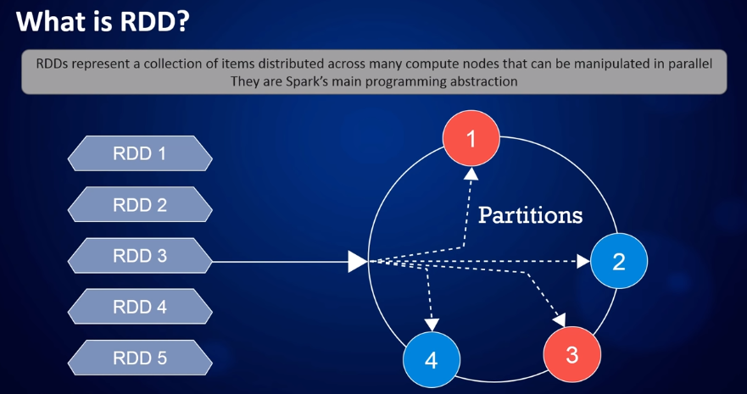
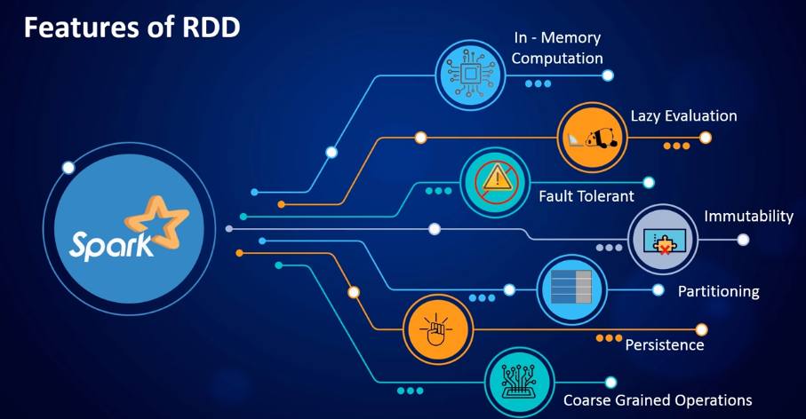
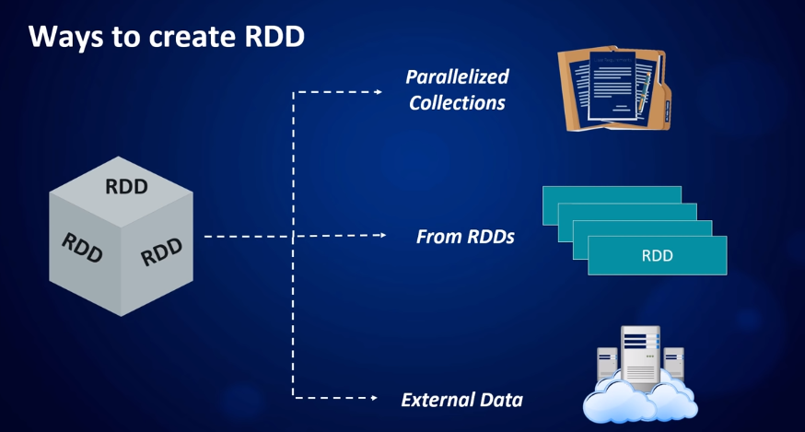
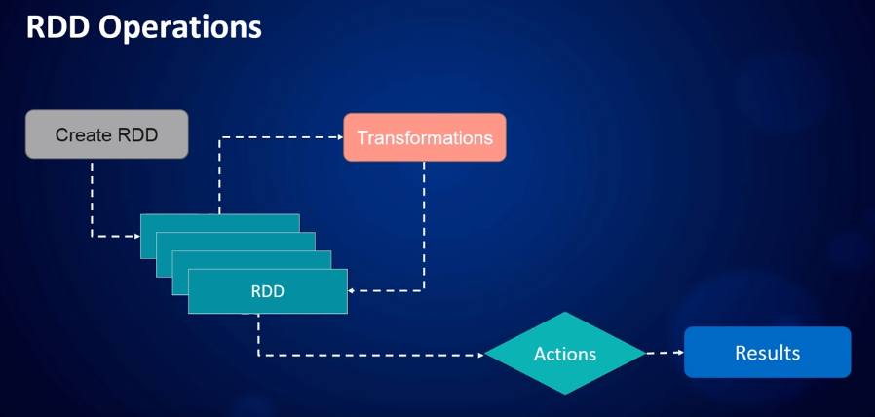
RDD :
Resilient Distributed Dataset is the fundamental data structure of Apache Spark
Notes:
Features of RDD’s
Ways to Create RDD’s
RDD Lineage
DAG
Limitations
Partitions :
By default, a partition is created for each HDFS partition, which by default is 128MB (from Spark’s Programming Guide).
RDDs get partitioned automatically without programmer intervention. However, there are times when you’d like to adjust the size and number of partitions or the partitioning scheme according to the needs of your application
To know the default number of partitions:
sc.defaultParallelism
The reason for 8 Tasks in Total is that I’m on a 8-core laptop and by default the number of partitions is the number of all available cores.
Partitioning is an important concept in apache spark as it determines how the entire hardware resources are accessed when executing any job. In apache spark, by default a partition is created for every HDFS partition of size 64MB. RDDs are automatically partitioned in spark without human intervention, however, at times the programmers would like to change the partitioning scheme by changing the size of the partitions and number of partitions based on the requirements of the application. For custom partitioning developers have to check the number of slots in the hardware and how many tasks an executor can handle to optimize performance and achieve parallelism
The read/write operation in RDD is either coarse grained or fine grained. Coarse grained meaning we can transform the whole dataset but not individual element on the dataset. While fine grained mean we can transform individual element on the dataset.
Once the action is done, data lost
ix. Coarse-grained Operation Generally, we apply coarse-grained transformations to Spark RDD. It means the operation applies to the whole dataset not on the single element in the data set of RDD in Spark
RDD’s
Features of RDD’s
RDD Operations: Transformation and Action
Ways to create RDD’s
External datasets
Parallelized collection
From an existing RDD
RDD Persistance and Caching:
The difference between cache() and persist() is that using cache() the default storage level is MEMORY_ONLY while using persist() we can use various storage levels
Persistance and caching are optimazaton techniques
To unpersist an RDD -> RDD.unpersist()
Persistance storage levels:
MEMORY_ONLY
MEMORY_AND_DISK
DISK_ONLY
MEMORY_ONLY_2
MEMORY_AND_DISK_2
This link will be helpful for checking how the data is stored if the RAM exceeds
https://spark.apache.org/docs/latest/rdd-programming-guide.html
https://stackoverflow.com/questions/20301661/what-will-spark-do-if-i-dont-have-enough-memory
https://www.quora.com/How-does-Apache-Spark-process-data-that-does-not-fit-into-the-memory
Paired RDD:
Spark Paired RDDs are nothing but RDDs containing a key-value pair. Basically, key-value pair (KVP) consists of a two linked data item in it. Here, the key is the identifier, whereas value is the data corresponding to the key value.
Limitations:
No built-in Optimization engine
Handling Structured data: Unlike Dataframe and datasets, RDDs don’t infer the schema of the ingested data and requires the user to specify it.
Performance: Being in-memory JVM objects, RDDs involve the overhead of Garbage Collection and Java Serialization which are expensive when data grows.
Storage limitation: RDDs degrade when there is not enough memory to store them. One can also store that partition of RDD on disk which does not fit in RAM. As a result, it will provide similar performance to current data-parallel systems
No Run time safety
RDD Lineage
DAG: https://data-flair.training/blogs/dag-in-apache-spark/
Differences between DAG and Lineage
The features of RDDs (decomposing the name):
Resilient, i.e. fault-tolerant with the help of RDD lineage graph(DAG) and so able to recompute missing or damaged partitions due to node failures.
Distributed, since Data resides on multiple nodes.
Dataset represents records of the data you work with. The user can load the data set externally which can be either JSON file, CSV file, text file or database via JDBC with no specific data structure.
RDD’s are immutable
https://spark.apache.org/docs/latest/rdd-programming-guide.html
https://data-flair.training/forums/topic/by-default-how-many-partitions-are-created-in-rdd-in-apache-spark/
https://stackoverflow.com/questions/40732962/spark-rdd-is-partitions-always-in-ram

Slide 12
Demo on creation of RDD
Basic Scala Syntaxes
Create Master and Worker Nodes Standalone Spark Cluster
Creating an RDD
Transformation
Action
Lineage and DAG
Notes:
Connect to multiple nodes
Val v1= sc.parallelize(1 to 1000)
Val v2= sc.parallelize(1001 t0 10000000)
Val v3 = v1.union(v2)
V3.collect
val readFile = sc.textFile("C:/Users/hepa0816/Desktop/HSK/spark/Examples/1.txt")
val mapRDD = readFile.map(HSK => HSK.toUpperCase)
val filterRDD = mapRDD.filter(HSK=>HSK.startsWith("I"))
filterRDD.collect

Slide 13
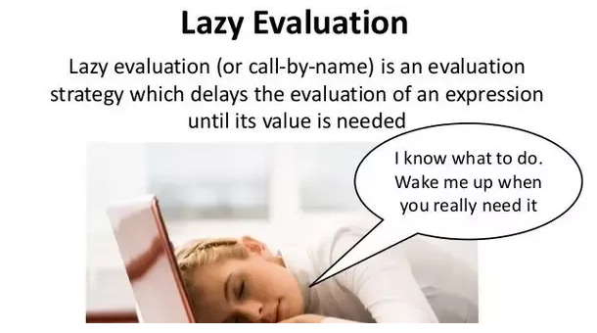

Slide 14
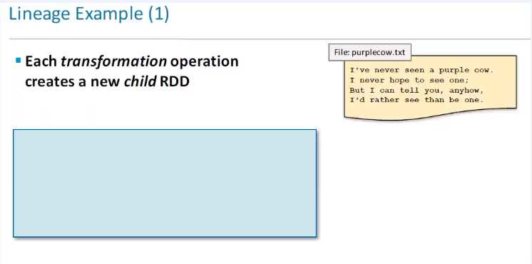
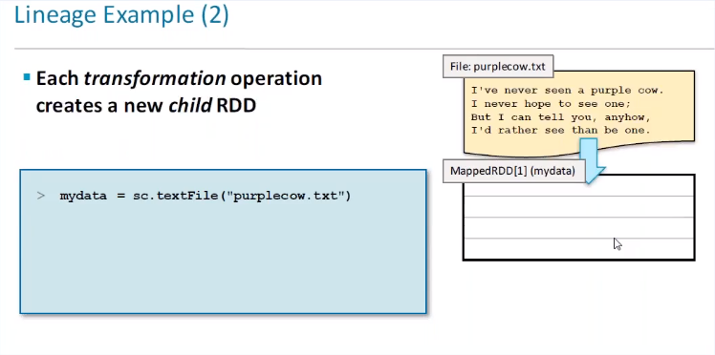
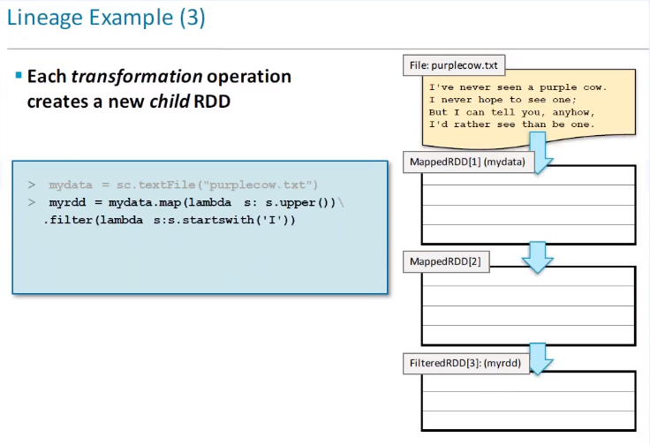
Lazy Evaluation Explained : Lineage Example(1/2)

Slide 15
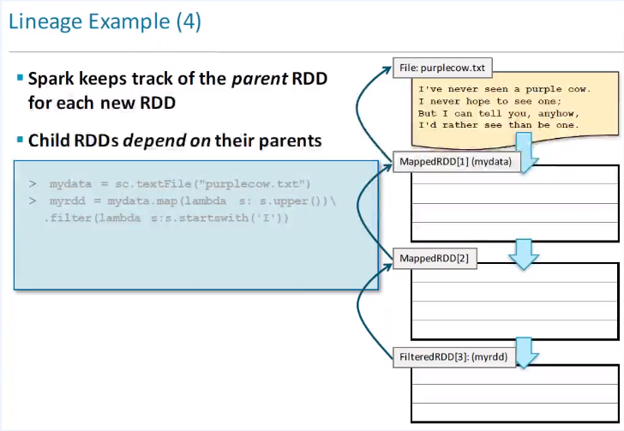
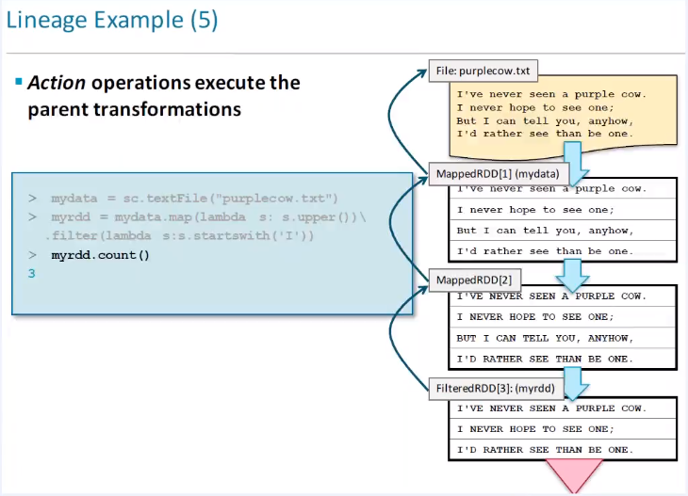
Lazy Evaluation Explained : Lineage Example(2/2)

Slide 16
Spark SQL, DataFrames and DataSets
Spark SQL:
Spark SQL is a Spark module for structured and semi structured data processing. Unlike the basic Spark RDD API, the interfaces (DataFrames/DataSets) provided by Spark SQL provide Spark with more information about the structure of both the data and the computation being performed
DataFrames:
Unlike an RDD, data organized into named columns. For example a table in a relational database. It is an immutable distributed collection of data.
DataSets:
Datasets in Apache Spark are an extension of DataFrame API which provides type-safe, object-oriented programming interface.
RDD offers low-level functionality and control. The DataFrame and Dataset allow custom view and structure. It offers high-level domain-specific operations, saves space, and executes at high speed.
All the above three can be called as High level API’s and RDD is low level API.
Notes:
DataFrames:
val df = spark.read.json("C:/Users/hepa0816/Desktop/HSK/Rakuten/CCUPP_work/InputFiles/jp-mobile-mno_monthly-comm_20160401_out.json");
val df2 = df.select("agencyCode")
DataFrame limitations:
Compile-time type safety: As discussed, Dataframe API does not support compile time safety which limits you from manipulating data when the structure is not know. The following example works during compile time. However, you will get a Runtime exception when executing this code
val dataframe = sqlContext.read.json("people.json")
dataframe.filter("salary > 10000").show
Inter-operability: Once you have transformed a domain object into dataframe, you cannot regenerate it from it. In the following example, once we have create personDF from personRDD, we won’t be recover the original RDD of Person class (RDD[Person]).
case class Person(name : String , age : Int)
val personRDD = sc.makeRDD(Seq(Person("A",10),Person("B",20)))
val personDF = sqlContext.createDataframe(personRDD)
personDF.rdd // returns RDD[Row] , does not returns RDD[Person]
Type Safety: Datasets API provides compile time safety which was not available in Dataframes. In the example below, we can see how Dataset can operate on domain objects with compile lambda functions.
case class Person(name : String , age : Int)
val personRDD = sc.makeRDD(Seq(Person("A",10),Person("B",20)))
val personDF = sqlContext.createDataframe(personRDD)
val ds:Dataset[Person] = personDF.as[Person]
ds.filter(p => p.age > 25)
ds.filter(p => p.salary > 25) // error : value salary is not a member of person
ds.rdd // returns RDD[Person]
Interoperable: Datasets allows you to easily convert your existing RDDs and Dataframes into datasets without boilerplate code
RDD’s
Paired RDD:
Spark Paired RDDs are nothing but RDDs containing a key-value pair. Basically, key-value pair (KVP) consists of a two linked data item in it. Here, the key is the identifier, whereas value is the data corresponding to the key value.

Slide 17
DataFrames vs DataSets
Compile-time type safety:
Dataframe API does not support compile time safety which limits you from manipulating data when the structure is not known.
Datasets API provides compile time safety which was not available in Dataframes.
Inter-operability:
Once you have transformed a domain object into dataframe, you cannot regenerate it from it.
Datasets allows you to easily convert your existing RDDs and Dataframes into datasets
SQL Support:
Both of them supports SQL like queries on its data

Slide 18
Spark Streaming

Slide 19
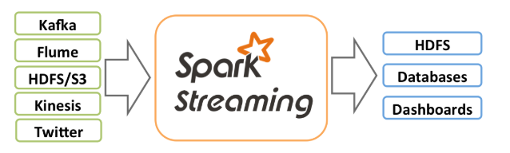
Spark Streaming (1/3)
Spark Streaming is an extension of the core Spark API
It enables scalable, high-throughput, fault-tolerant stream processing of live data streams.
Data can be ingested from many sources like Kafka, Flume, Kinesis, or TCP sockets, and can be processed using complex algorithms expressed with high-level functions like map, reduce, join and window.
Finally, processed data can be pushed out to filesystems, databases, and live dashboards.

Slide 20
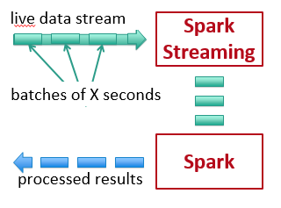
Spark Streaming (2/3)
Spark Streaming receives live input data streams and divides the data into batches, which are then processed by the Spark engine to generate the final stream of results in batches
Chop up the live stream into batches of X seconds
Spark treats each batch of data as RDDs and processes them using RDD operations
Finally, the processed results of the RDD operations are returned in batches
Notes:
Using Nc and twitter streaming

Slide 21
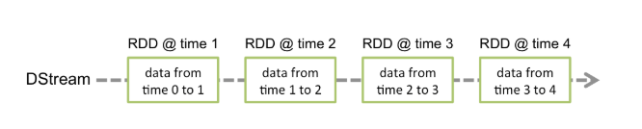
Spark Streaming (2/3)
Spark Streaming provides a high-level abstraction called discretized stream or DStream, which represents a continuous stream of data.
DStreams can be created either from input data streams from sources such as Kafka, Flume, and Kinesis, or by applying high-level operations on other DStreams.
Internally, a DStream is represented as a sequence of RDDs.
Notes:
Stateful transformation, stateless transformation, batch interval, window and sliding window
Using Nc and twitter streaming
NC command : Word_Count
execute this as spark-submit --class "WordCount" --master local[2] C:\Users\hepa0816\eclipse-workspace\Word_Count\target\Word_Count-0.0.1-SNAPSHOT.jar
from another command window, nc -l -p 9999
Twitter Streaming:
sparkStreaming-basics->TwitterStreaming.java

Slide 22
Kafka-Spark

Slide 23
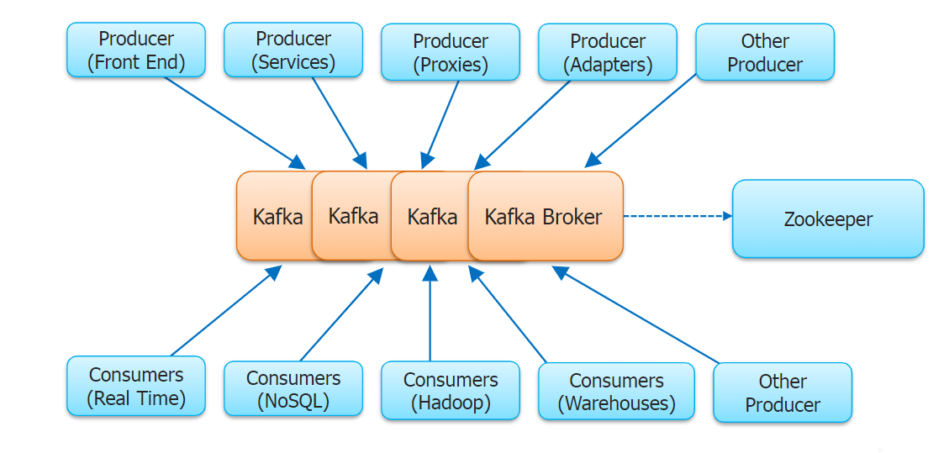
Kafka Introduction
Apache Kafka is a distributed streaming platform.
A streaming platform has three key capabilities
Publish and subscribe to streams of records
Store streams of records in a fault-tolerant durable way.
Process streams of records as they occur.
Notes:
Use this link for kafka setup https://stackoverflow.com/questions/23115013/is-there-an-easy-way-to-install-kafka-on-windows
.\bin\windows\zookeeper-server-start.bat .\config\zookeeper.properties
.\bin\windows\kafka-server-start.bat .\config\server.properties
.\bin\windows\kafka-topics.bat --create --zookeeper localhost:2181 --replication-factor 1 --partitions 1 --topic Kafka_HSK
.\bin\windows\kafka-console-producer.bat --broker-list localhost:9092 --topic Kafka_HSK
.\bin\windows\kafka-console-consumer.bat --bootstrap-server localhost:9092 --topic Kafka_HSK --from-beginning
To list available topics:
.bin\windows\kafka-topics.bat --list --zookeeper localhost:2181

Slide 24
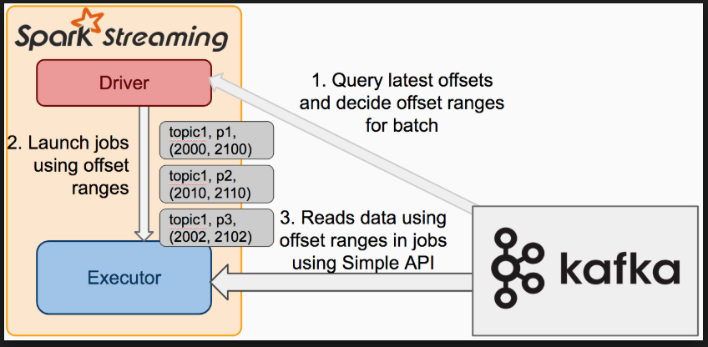
Spark Processing : With Kafka Streaming
Notes:
Links for spark kafka
https://stdatalabs.com/2016/09/spark-streaming-part-3-real-time/
https://stdatalabs.com/2016/09/spark-streaming-part-1-real-time/

Slide 25
Demos
Demo on setting your own playgroud for Spark +Tools UI
Demo on RDD
Demo to prove Lazy Evaluation
Demo on Data Frames using Json file
Demo on SQL DataFrames
Demo on DataSets proving type safe
Demo on Streaming via netcat command
Demo on Twitter Streaming
Demo on Kakfa Streaming to Spark for Processing
Demo on saving data to Cassandra via Spark
Demo on Kafka Spark and Cassandra integration

Slide 26
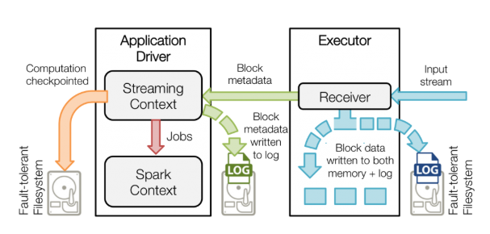
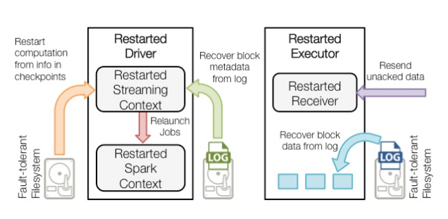
Fault Tolerance With WAL
Before Failure
After Failure
Notes:
https://databricks.com/blog/2015/01/15/improved-driver-fault-tolerance-and-zero-data-loss-in-spark-streaming.html
Real-time stream processing systems must be operational 24/7, which requires them to recover from all kinds of failures in the system.
Driver/Master Node’s Fault Tolerance:
Driver Node is the main process which co-ordinates all the workers.
When the driver process fails, all the executors running in a standalone/yarn/mesos cluster are killed as well, along with any data in their memory
However, Spark Streaming applications have an inherent structure in the computation — it runs the same Spark computation periodically on every micro-batch of data. This structure allows us to save (i.e checkpoint) the application state periodically to reliable storage and recover the state on driver restarts.
For sources like Kafka and Flume, some of the received data that was buffered in memory but not yet processed could get lost.
In case of Spark Streaming, all the data received from sources like Kafka and Flume are buffered in the memory of the executors until their processing has completed. This buffered data cannot be recovered even if the driver is restarted. To avoid this data loss, we have introduced write ahead logs in Spark Streaming in the Apache Spark 1.2 release.
Systems like Kafka can replicate data for reliability. Enabling write ahead logs effectively replicates the same data twice – once by Kafka and another time by Spark Streaming. Future versions of Spark will include native support for fault tolerance with Kafka that avoids a second log.
Failure of driver node – If there is a failure of the driver node that is running the Spark Streaming application, then SparkContent losses and all executors lose their in-memory data.
Apache Mesos helps in making the Spark master fault tolerant by maintaining the backup masters. It is open source software residing between the application layer and the operating system. It makes easier to deploy and manage applications in large-scale clustered environment. Executors are relaunched if they fail. Post failure, executors are relaunched automatically and spark streaming does parallel recovery by recomputing Spark RDD’s on input data. Receivers are restarted by the workers when they fail.

Slide 27
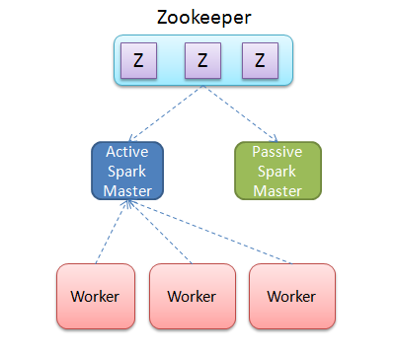
Fault Tolerance of Standby Masters with ZooKeeper
Notes:
http://spark.apache.org/docs/latest/spark-standalone.html#high-availability
http://chennaihug.org/knowledgebase/high-availability-of-apache-spark-using-apache-zookeeper-quorum/
This above link is for setting up Zookeeper
Apache Mesos (Cluster Manager) creates or maintains the backup masters in spark. Hence, that helps spark becoming the master fault tolerant
Utilizing ZooKeeper to provide leader election and some state storage, you can launch multiple Masters in your cluster connected to the same ZooKeeper instance. One will be elected “leader” and the others will remain in standby mode. If the current leader dies, another Master will be elected, recover the old Master’s state, and then resume scheduling. The entire recovery process (from the time the first leader goes down) should take between 1 and 2 minutes. Note that this delay only affects scheduling new applications – applications that were already running during Master failover are unaffected
After you have a ZooKeeper cluster set up, enabling high availability is straightforward. Simply start multiple Master processes on different nodes with the same ZooKeeper configuration (ZooKeeper URL and directory). Masters can be added and removed at any time.
In order to schedule new applications or add Workers to the cluster, they need to know the IP address of the current leader. This can be accomplished by simply passing in a list of Masters where you used to pass in a single one. For example, you might start your SparkContext pointing to spark://host1:port1,host2:port2. This would cause your SparkContext to try registering with both Masters – if host1 goes down, this configuration would still be correct as we’d find the new leader, host2.
There’s an important distinction to be made between “registering with a Master” and normal operation. When starting up, an application or Worker needs to be able to find and register with the current lead Master. Once it successfully registers, though, it is “in the system” (i.e., stored in ZooKeeper). If failover occurs, the new leader will contact all previously registered applications and Workers to inform them of the change in leadership, so they need not even have known of the existence of the new Master at startup.

Slide 28
References
Books:
Links:
https://spark.apache.org/docs/latest/quick-start.html

Slide 29
Thank You!

