Slide 1
WorkflowManager<S,P>
Implementing workflows in web applications
hasan.karahan81@gmail.com

Slide 2
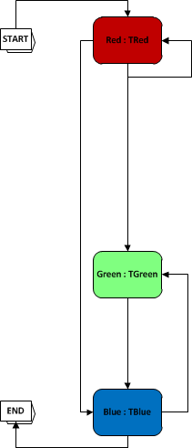
TMyWorkflow

Slide 3
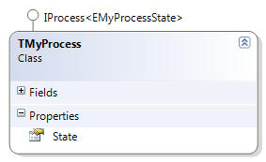
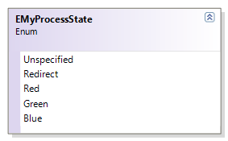
TMyWorkflow:
IWorkflow<EMyWorkflowState>

Slide 4




TMyWorkflow: IWorkflow<EMyWorkflowState>

Slide 5

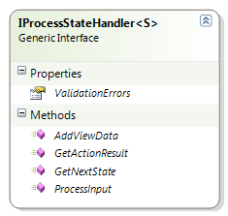
TMyWorkflow: IWorkflow<EMyWorkflowState>

Slide 6
TMyWorkflowManager

Slide 7
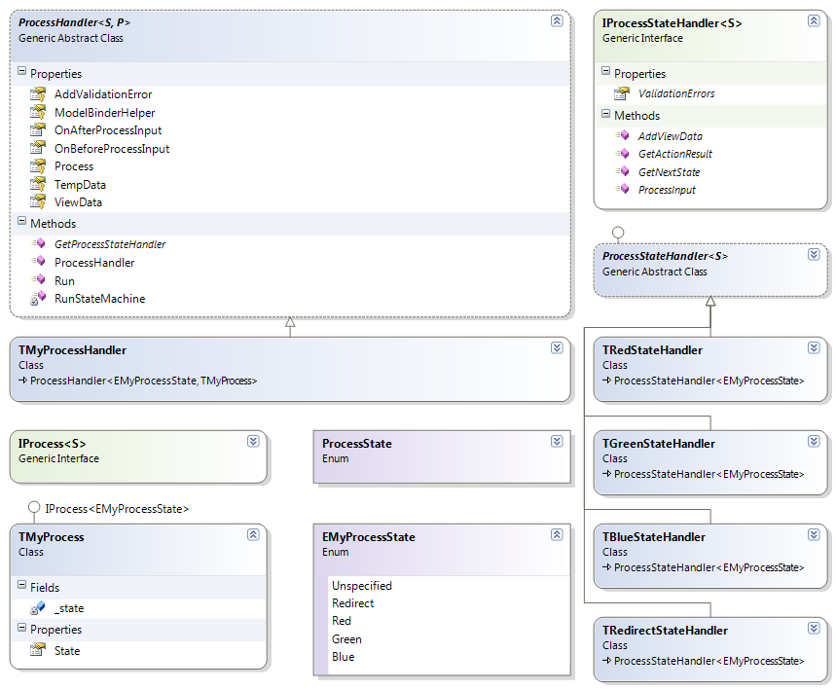

Slide 8
MyController.Default
public ActionResult Default(SavedState savedState){
var workflowManager = new TMyWorkflowManager(
this.GetMyWorkflowFrom(savedState),
this.ModelBinderHelper,
this.AddValidationError,
this.ViewData
);
var actionResult = workflowManager.Run(this.Request);
if (actionResult is RedirectResult != true){
this.SerializeMyWorkflow();
} else {
this.DeleteSavedState(savedStateId);
}
return actionResult;
}
private TMyWorkflow GetMyWorkflowFrom(SavedState savedState){..}

Slide 9
Pre- and Postconditions

Slide 10
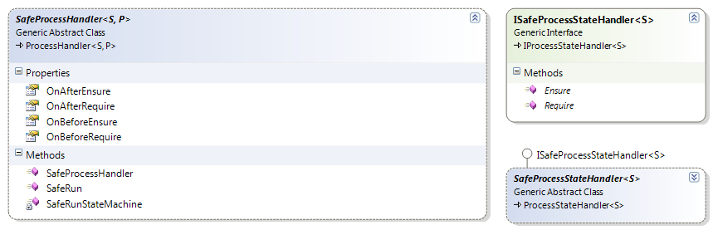
Require & Ensure

Slide 11
Require & Ensure
public override void ScanWarehouseCompartmentManager.Require(){
if (_workflow.State != StoringPalletWorkflowState.ScanWarehouseCompartment){
throw new InvalidStateException(_workflow.State.ToString());
}
if (_workflow.StoringTour == null){
throw new StorinTourIsNullException();
}
if (_workflow.WarehouseCompartment == null){
; //DONE!
}
}
public override void ScanWarehouseCompartmentManager.Ensure(){
if (_workflow.State != StoringPalletWorkflowState.ScanWarehouseCompartment){
throw new InvalidStateException(_workflow.State.ToString());
}
if (_workflow.StoringTour == null){
throw new StorinTourIsNullException();
}
if (_workflow.WarehouseCompartment == null){
throw new WarehouseCompartmentIsNullException();
}
}

Slide 12
MyController.Default
public ActionResult Default(SavedState savedState){
var workflowManager = new TMyWorkflowManager(
this.GetMyWorkflowFrom(savedState),
this.ModelBinderHelper,
this.AddValidationError,
this.ViewData
);
var actionResult = workflowManager.Run(this.Request);
if (actionResult is RedirectResult != true){
this.SerializeMyWorkflow();
} else {
this.DeleteSavedState(savedStateId);
}
return actionResult;
}
private TMyWorkflow GetMyWorkflowFrom(SavedState savedState){..}

Slide 13
?

