Slide 1
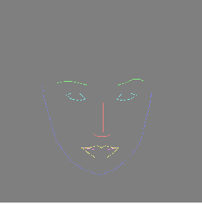
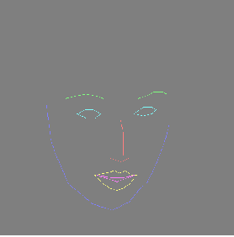
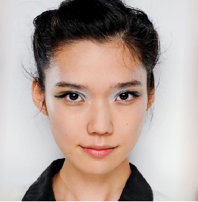
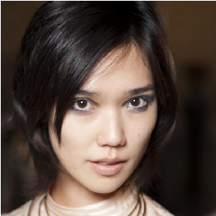
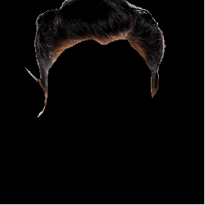
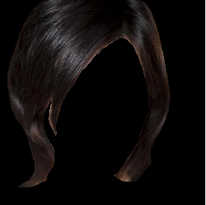
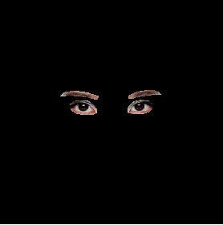
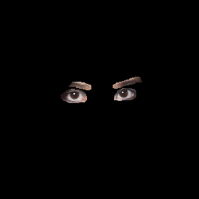

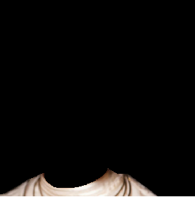
Research(Supervised)
Controllable Face Image Synthesis with Attribute-Decomposed GAN
Source
Target
GENERATOR
Face Image in the desired pose, style
Landmark
Original
Hairstyle
Eye
Alternative
STYLE EMBEDDER
Cloth

Slide 2
Research(Supervised)
Controllable Face Image Synthesis with Attribute-Decomposed GAN
Embedder
x 6
Down
sample
LRELU
CONV
CBAM
Avg Pool
LRELU
CONV
CBAM
FC
FC
AdaIN
Parameter
Avg Pool
CONV1x1
[10, 3, H, W]
[10, 512, 1, 1]

Slide 3
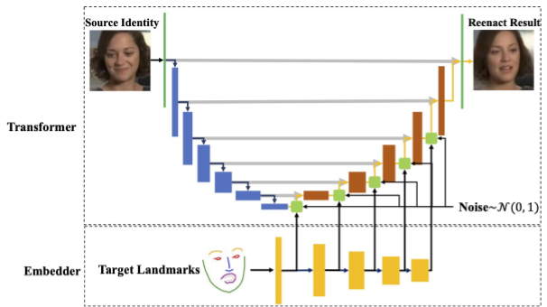
Research(Supervised)
Controllable Face Image Synthesis with Attribute-Decomposed GAN
Generator
* AdaIN is used to inject embedded style

Slide 4
Research(Supervised)
Controllable Face Image Synthesis with Attribute-Decomposed GAN
Generator
x 4
Down
sample
Up
sample
CONV
CBAM
LRELU
NOISE
AdaIN
CONV
CBAM
LRELU
NOISE
AdaIN
AdaIN Parameters from Embedder
Target Image
Target Landmark

Slide 5
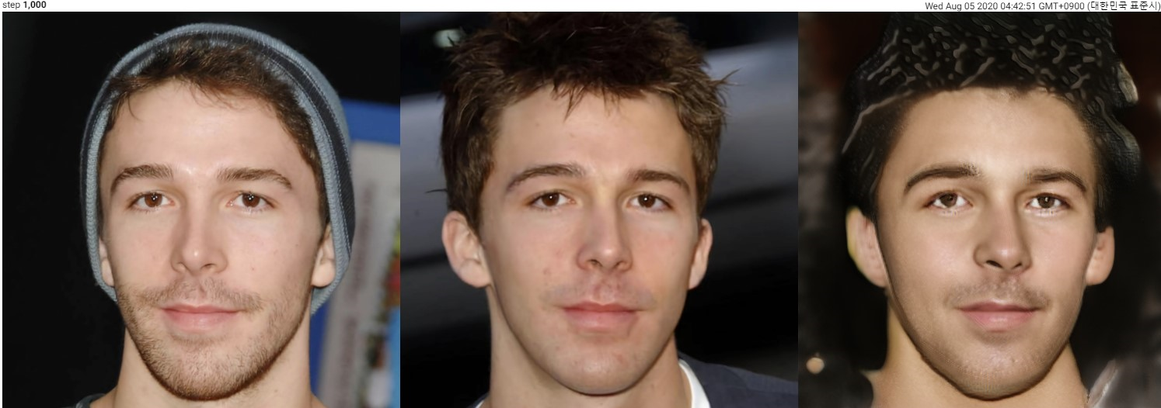
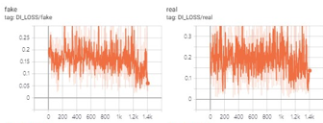
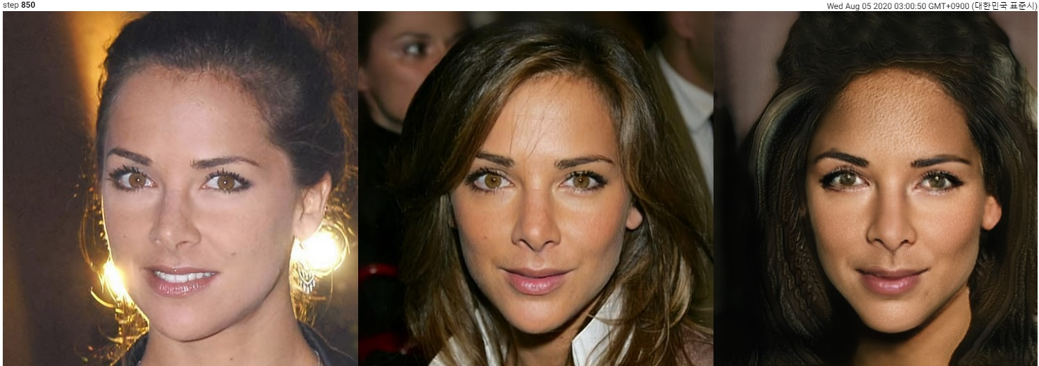
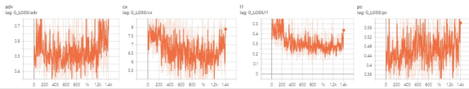
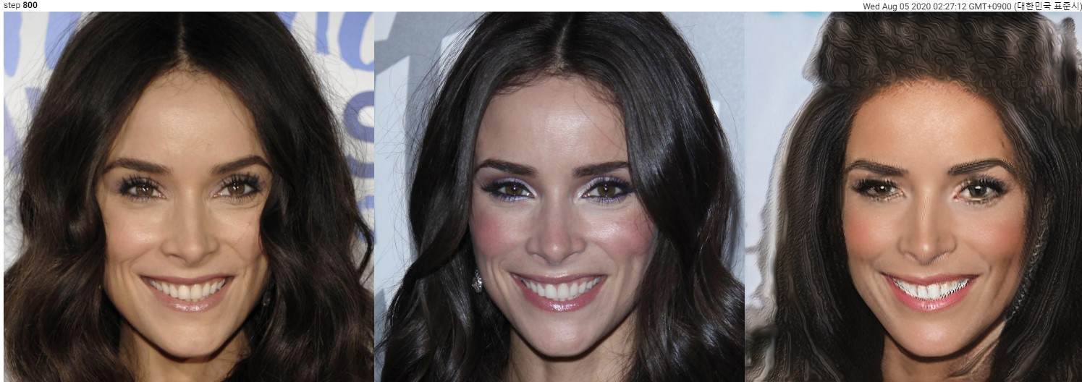
Research(Supervised)
Controllable Face Image Synthesis with Attribute-Decomposed GAN
Experiment
Discriminator Loss
Generator Loss
Source
Target
Generated

