Slide 1

Image Captioning
Attempt 1

Slide 2
Dataset
Model
Using Hugging Face coco dataset [1]
Has 5 captions per image to cover many bases
200,000 images (25GB)
Extensive coverage of everyday scenes - photographs
ViT (vision transformer model):
Transforms raw data into useful features
GPT-2:
Tokenises features
Generates captions after training on tokens
Sourced base code from [2]

Slide 3
Methodology
Initial aim: get a working code and experiment
Trained on a 1000 images – partially trained model
Sourced a model trained on the entire coco dataset – fully trained model [3]
Initially tested on coco test dataset
Tested on client images so we have clients’ model as a reference
Feature extraction using vision transformer into sequence of embeddings
GPT-2 tokenizer
Configuration – appropriate token ids for special tokens like EOS and padding tokens
Trained to minimise cross-entropy loss

Slide 4
Quick analysis of partially trained model
Training details:
Trained locally on 16GB RAM laptop
Preprocessing data took ~ 2 hours
Original dataset: 25.1GB -> Processed dataset: 370GB
Training the partially trained model took ~ 3 - 4 hours
Parameters for both ViT and GPT2 were left as default
Model Performance
Training loss: 0.3365
Evaluation loss: 0.3013
Usual range for cross entropy loss: 0.3 – 1.0 [4]
ROUGE-1 : 21.84%
Usual range is 40%-60% [6]
ROUGE-2 : 2.25%
Usual range is 20%-40% [6]

Slide 5
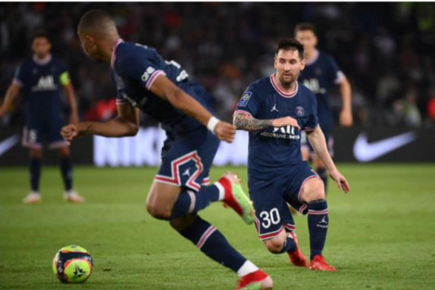
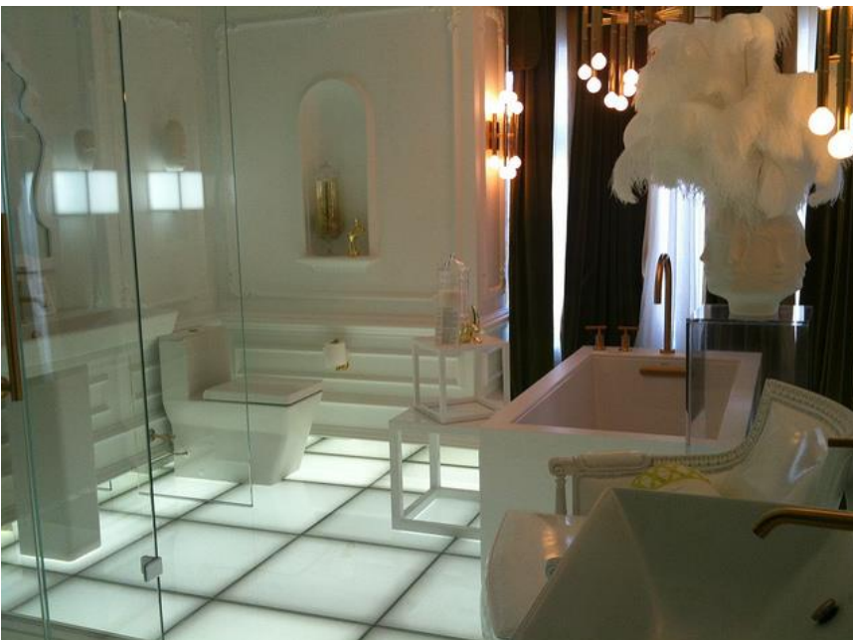
Testing with coco dataset
Fully trained model:
A bathroom with a tub, sink, and mirror
Partially trained model:
A bathroom with a shower and sink
Evaluation:
Wherever partially trained model failed, it recognised general category of the image
Partially trained model needs to be trained on a larger section of the dataset
Need a way to measure how well our fully trained model behaves
Fully trained model:
A soccer game with a player jumping to catch the ball
Partially trained model:
A man is holding a baseball bat in the air

Slide 6
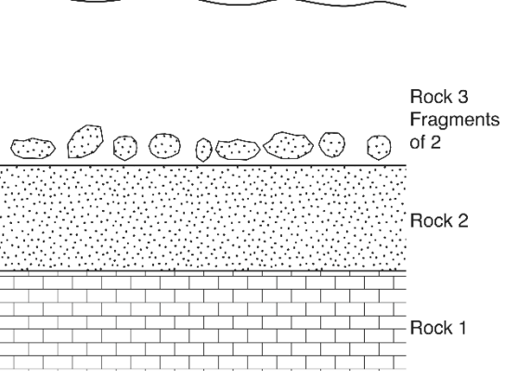
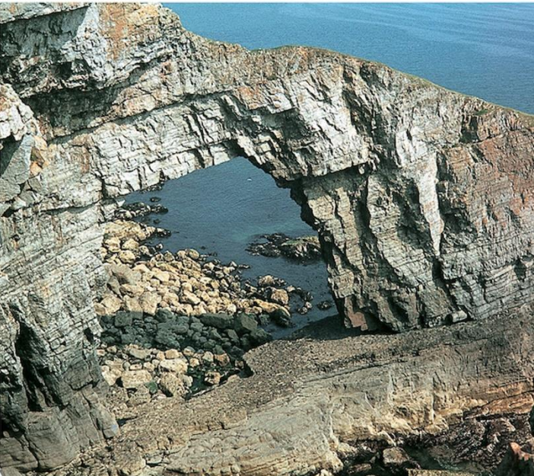
Client images in which they succeeded
Evaluation:
Fully trained model struggled on diagrams - need to train it on diagrams
Both clients and our fully trained model did very well on landscape images
Fully trained model: a series of photographs showing a series of small, white objects
Partially trained model: A man standing in front of a large mirror Client model: a diagram of a rock wall with a line of rocks on it
Fully trained model: a rocky cliff with a large rock wall
Partially trained model: A man riding a skateboard on a snowy mountain
Client model: there is a large rock formation with a hole in it

Slide 7
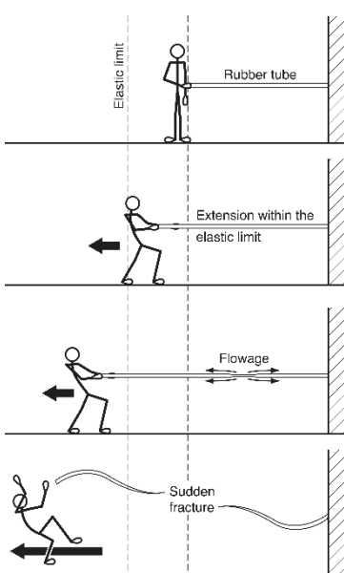
Client images in which they failed
Evaluation:
All 3 identify a man/woman but fully trained model
Skateboard and scissors are plausible readings if the resolution was lowered
Need to find a way to use the text as context - OCR (Optical Character Recognition)
Both partially and fully trained models failed to identify a tree diagram – dataset needs to include diagrams
Fully trained model: a collage of photos showing a woman cutting a pair of scissors
Partially trained model: A man standing in front of a large building with a clock
Client model: a diagram of a man doing a trick on a skateboard

Slide 8
Overall evaluation: with the aim of improving performance
Need to diversify training data to include images of a diagrams
We want data with more descriptive captions that aim to describe everything in the image, so we’ll use [5] dataset instead
Need to incorporate OCR to include context based off the text in the images
Explore any models which are more ‘powerful’ than GPT2 when it comes to learning from images

Slide 9
Next steps
Put a bigger focus on datasets – specialise datasets, explore interesting metrics etc. (currently looking into satellite images for ship detection)
Explore how Kaggle users work with visual data in terms of sorting, splitting, cleaning etc.
Need to incorporate a reinforcement learning loop
Step project down to image classification for implementation of RL and complicate as needed

Slide 10
References
[1] huggingface.co. (n.d.). nlpconnect/vit-gpt2-image-captioning · Hugging Face. [online] Available at: https://huggingface.co/nlpconnect/vit-gpt2-image-captioning
[2] Kumar, A. (2022). The Illustrated Image Captioning using transformers. [online] Ankur | NLP Enthusiast. Available at: https://ankur3107.github.io/blogs/the-illustrated-imagecaptioning-using-transformers/
[3] huggingface.co. (n.d.). nlpconnect/vit-gpt2-image-captioning · Hugging Face. [online] Available at: https://huggingface.co/nlpconnect/vit-gpt2-image-captioning.
[4] Xu, K., Ba, J., Kiros, R., Cho, K., Courville, A., Salakhutdinov, R., Zemel, R., & Bengio, Y. (2015). Show, Attend and Tell: Neural Image Caption Generation with Visual Attention. arXiv preprint arXiv:1502.03044
[5] google.github.io. (n.d.). DOCCI. [online] Available at: https://google.github.io/docci/ [Accessed 22 Jun. 2024].
[6] FreeCodeCamp. (2024). An intro to ROUGE, and how to use it to evaluate summaries. Retrieved from FreeCodeCamp

