Slide 1
Wine enthusiast analysis
Hruday Kinhikar

Slide 2
Which vineyard produces the best wine?
Best wine
Wine that is given the most points whilst simultaneously being as cheap as possible
Vineyard that produces best wine
Unoaked at the Pam’s Cuties winery
Vineyard that consistently produces highly rated wines in the top 10 wines
Organic Grapes at the Earth’s Harvest winery
Methodology
reorder wines based on points/price
weight the number of times a vineyard is featured on the top 10 list with its position on the list
Point to consider
One vineyard that produces the best wine vs a vineyard that consistently produces multiple highly rated wines

Slide 3
Three wines to recommend
Title | Pam's Cuties NV Unoaked Chardonnay (California) | ManCan NV Fizz Sparkling (California) | Earth's Harvest 2014 Organic Grapes Chardonnay (California)
Variety | Chardonnay | Sparkling Blend | Chardonnay
Description | Sweet and fruity, this canned wine feels soft and syrupy, with sugary pear as the primary flavor on the palate. It's a basic white wine in a convenient package. | This sparkling wine is the best of ManCan's three new canned offerings. It has plenty of rich fruit flavors and a buttery note. Lively bubbles settle into the smooth, creamy texture, leaving an overall impression of easygoing enjoyment. | This wine has a deep-gold color, attractive baking-spice and buttered popcorn aromas, appealing apple and pear flavors and medium body. The texture is soft and easy, and the acidity tastes low.
Points/Price | 20.75 | 17.4 | 17
Taster | Jim Gordon | Jim Gordon | Jim Gordon
Wine id | 59507 | 104412 | 37951
Winery | Pam's Cuties | ManCan | Earth’s Harvest

Slide 4
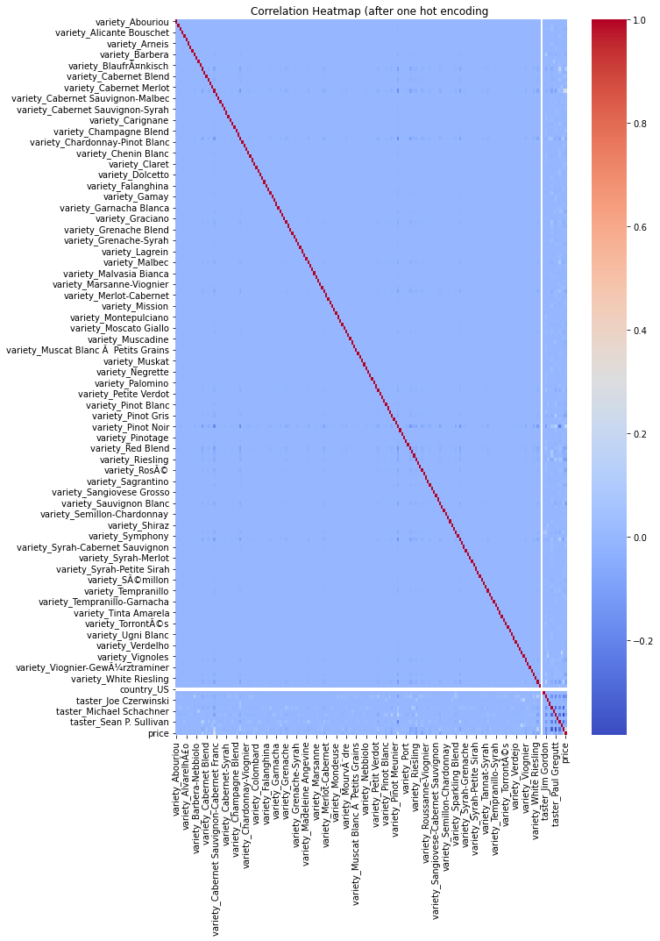
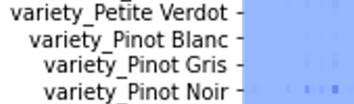
Factors important in determining the overall score of a wine
Steps to approach this problem
Step 1:
Use correlation matrix to understand correlation between different features
Step 2:
explore feature importance through Recursive Feature Elimination
Correlation Matrix
Displays the correlation coefficient between features
Implementation
One-hot encoding to convert categorical data into numerical data
Need to explore other options due to too many dimensions

Slide 5
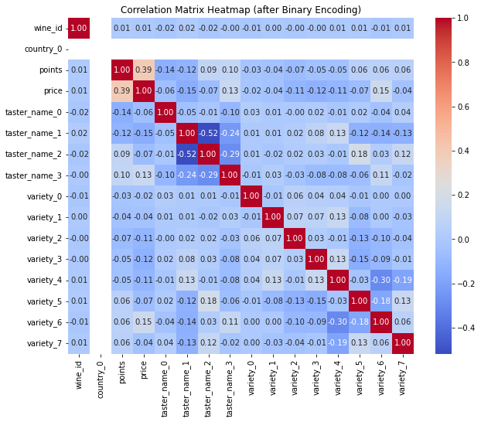
Binary encoding
Rank number k – 1 in binary
binary column does not correspond to one specific category but rather a combination of categories
each category is represented by a combination of bits across multiple columns – difficulties mapping
Insights
No correlation for country
Some tasters have preference for some varieties over others
Some varieties correlate with price
Correlation between price and points
Correlation within varieties as well as within tasters

Slide 6
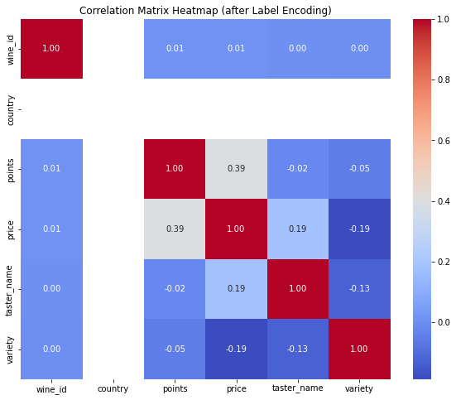
Label Encoding
replaces the categorical value with a numeric value between 0 and the number of classes minus 1
Reduces dimensionality further
generation of priority issues during model training
Correlation between:
price and points
variety and price
taster name and price
taster name and variety

Slide 7
Step 2
Recursive Feature Elimination
RFE is wrapper style feature selection algorithm
Removes the weakest feature per loop until the most important feature is left
Methodology
Pick a classifier and build a model that predicts points rated for the wine
Measure accuracy for reference
Implement RFE with a sample
Increased sample size
Extrapolate
Classifier
Support Vector Machines(SVM) as the main classifier
Works by implementing a hyperplane to separate data points
Optimises hyperplane by maximizing distance between hyperplane and nearest datapoint
Validation metric
MAE is the weighted sum of difference between predicted value and real value

Slide 8
Sample size = 20% of entire dataset
MAE = 2.0441889539432996
Feature hierarchy based on rankings:
Feature | Ranking
Taster_name | 1
Price | 2
Variety | 3
Country | 4
Sample size = 50% of entire dataset
MAE = 1.9586885164366323
Feature hierarchy based on rankings:
Feature | Ranking
Taster_name | 1
Price | 2
Variety | 3
Country | 4
Approximated order of importance for entire data set:
MAE of entire dataset:
1.9984124492243822
Feature | Ranking
Taster_name | 1
Price | 2
Variety | 3
Country | 4

Slide 9
Variety of wine for a “dry” and “citrus” flavour
Methodology
New data frame with wine that has both ‘dry’ and ‘citrus’ in its description
Ranking these wines according to points/price ratio
Same concept as question 1 - weight the number of times a variety is featured on the top 10 list with its position on the list
This gives the variety of wine which fits flavour profile whilst consistently being featured among best wines
Following table displays how the best variety for mentioned condition changes based on how many of the top wines are considered
No. of top wines considered | Recommended variety
5 | Pinot Grigio
10 | Pinot Grigio
30 | Riesling
50 | Riesling

