Slide 1


Monitoring the cold spray process through airborne acoustic emission analysis
Stratos Koufis
Notes:
Introduce myshelf

Slide 2
The cold spray process
Process parameters
Pressure
Temperature
Powder feed rate
Standoff distance
Tool path
Impact velocity
Notes:
Process explanation
Particle velocity important

Slide 3
Process monitoring
Particle velocimetry techniques
Measure velocity, particle density
Bulky equipment
Interrupt spray to measure → waste

Slide 4
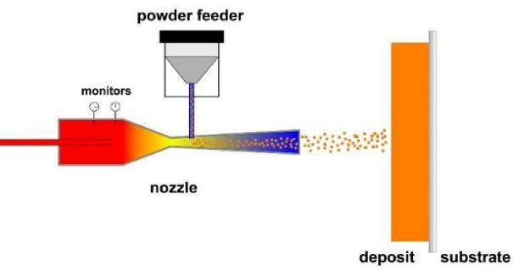

Experimental Setup
For different P,T
21 experiments @ SOD = ∞
5 experiments @ SOD = 20 mm
7 experiments @ SOD = 30 mm
4 experiments @ SOD = 40 mm
5 experiments @ SOD = 50 mm
Velocity measured for all experiments
(raw signal, .csv files)
SOD= 20, 30, 40 , 50, ∞
How to relate AAE to the particle velocity measured from the camera.
How to build a robust model that predicts velocity minimizing the amount of data required.

Slide 5
Process monitoring
Process governing parameters
Sensor selection
Data acquisition
Signal processing
Feature extraction
ML
Training/Testing

Slide 6
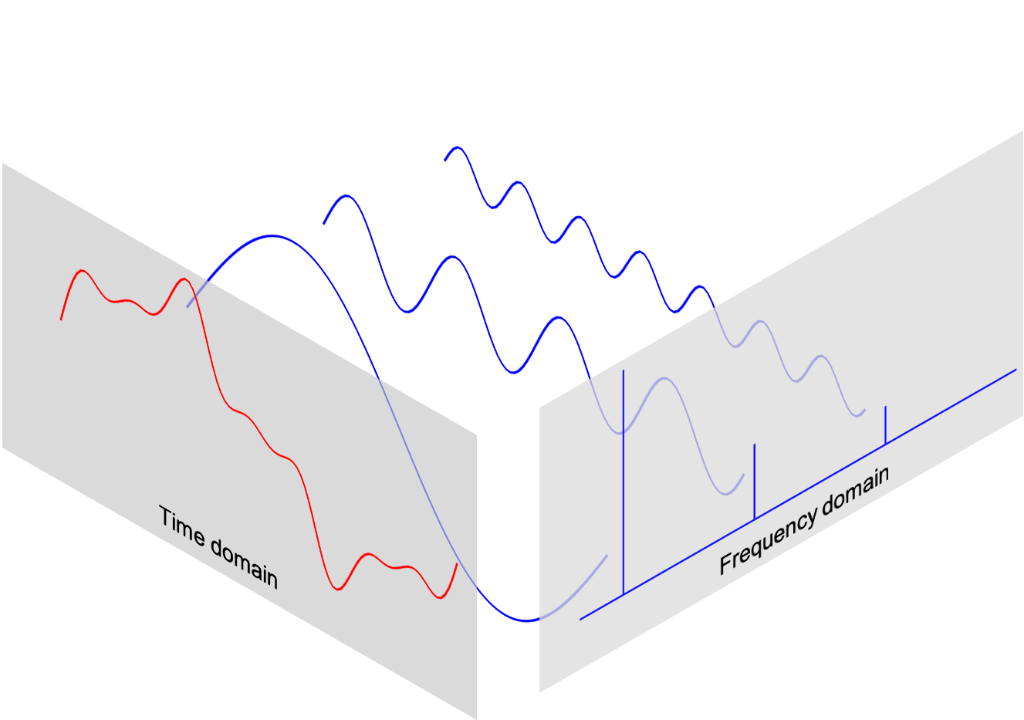
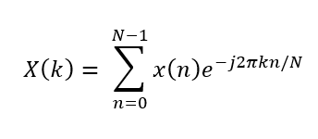
Discrete Fourier transform (DFT)
The Discrete Fourier Transform (DFT) is a mathematical technique that transforms a discrete-time signal from the time domain into the frequency domain.
STFT if windows are used.
Image source: berkley.edu

Slide 7
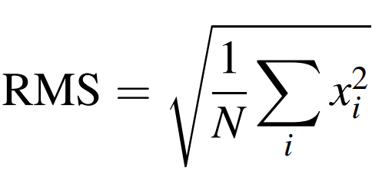
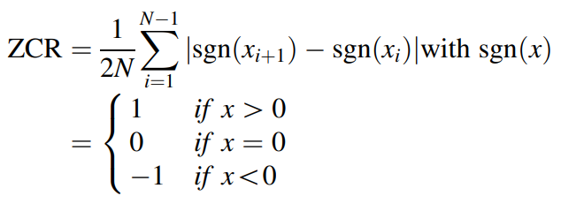
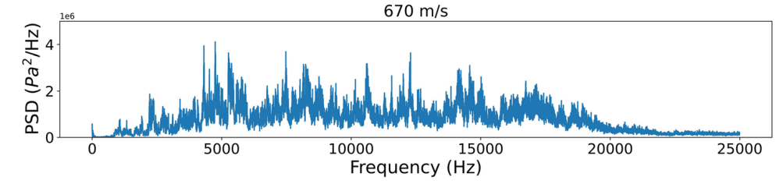
Feature extraction
Time domain (raw signal)
Frequency domain (e.g. DFT)
Time – Frequency domain
Feature extraction to reduce dimensionality and preserve the most important information:
Examples:

