Slide 2


PRISEC-III-Cryptographic-Techniques-for-Enhanced-Security
NOME APRESENTADOR:Humza Sohail
DATA: 20-02-2025

Slide 3

Summary
Objective:
Develop a multi-level encryption model (Guest, Basic, Advanced, Admin) to balance security and efficiency for resource-constrained IoT environments.
Challenges:
Limited computational power of IoT devices increases vulnerability to attacks.
Solution:
Hybrid Cryptography: Combines symmetric (AES, ChaCha20) and asymmetric (ECC, RSA) techniques.
Edge Computing: Encrypts data closer to the source to reduce latency and overhead.
Results:
Enhanced data security, efficient encryption, and scalable transmission for IoT applications.

Slide 4
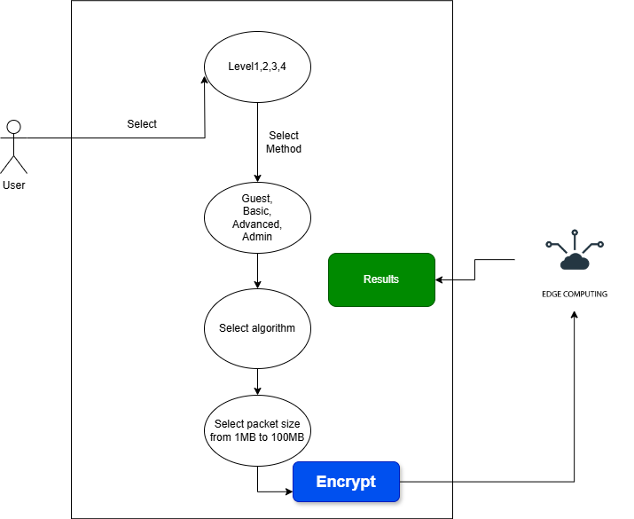

Job introduction
Context and Motivation
Key Points:
The rapid expansion of IoT and edge computing environments is transforming various industries (e.g., healthcare, smart homes, and industrial applications).
Real-time systems require robust cryptographic mechanisms to protect sensitive data without introducing performance bottlenecks.
The increasing reliance on distributed, decentralized networks presents new security challenges, such as lack of a trusted central authority and vulnerability to cyberattacks.
Visual Elements:
Diagram showing the interconnected components of an IoT system (devices, edge computing).
Emphasis on the flow of sensitive information and potential threat vectors.

Slide 5
Job introduction
Problem Statement and Objectives
Problem Statement:
Existing cryptographic frameworks often face performance and scalability issues when applied to resource-constrained devices.
Security mechanisms must strike a balance between strong encryption, efficient processing, and data integrity.
Project Objectives:
Develop PRISEC III, a cryptographic framework optimized for edge-based IoT systems.
Enhance security through multi-layer encryption techniques and dynamic, role-based access control.
Achieve efficient performance for both small and large datasets, supporting up to 100MB packet sizes.
Incorporate advanced cryptographic methods like ChaCha20, AES-256-GCM, and Curve25519 ECC.

Slide 6
state of the art slide
State of the art
Cryptographic Advancements in IoT and Edge Computing
Lightweight Algorithms:
ChaCha20 and AES-256-GCM for secure, efficient encryption; ECC (Curve25519) for energy-efficient key exchanges.
Hybrid Security Models:
Combining symmetric (AES) and asymmetric (ECC) encryption to balance performance and security, with HMAC-SHA512 for data integrity.
Emerging Research:
Peinado (2011): Trade-offs between security and performance in decentralized IoT systems.
Yang & Zhao (2023): Cryptographic models for real-time Industry 5.0 environments.
PRISEC III Innovations:
Dynamic multi-layer encryption, edge computing integration for secure, low-latency communication.

Slide 7
Cryptographic techniques implemented at each security level
 | Most Used Algorithms
Security Level
Guest Level | AES-256-GCM + RSA, ChaCha20 + ECC (Curve25519), AES-128-CCM + ChaCha20
Basic Level | AES-128-CCM + ChaCha20 + ECC (Curve25519), AES-256-GCM + ChaCha20 + RSA, AES-256-CCM + ChaCha20-Poly1305
Advanced Level | ChaCha20 + AES-256-GCM, AES-128-CCM + RSA, AES-128-CCM + AES-256-GCM + ECC (Curve25519)
Admin Level | AES-256-GCM + ChaCha20 + ECC (Curve25519), AES-128-CCM + ChaCha20 + RSA, AES-256-CTR + Blowfish + ChaCha20
Guest Level: Moderate protection with AES-256-GCM + RSA and ChaCha20 + ECC.
Basic Level: Improved security with AES, ChaCha20, and key exchange protocols like ECC and RSA.
Advanced Level: Strong encryption and authentication using AES-256-GCM and ECC.
Admin Level: Highest security with AES-256-GCM, ChaCha20, ECC, and RSA.

Slide 8
Preliminary Performance Evaluation Metrics
Encryption vs Decryption Times
Encryption Speed: The fastest encryption times are generally achieved with AES-256-GCM + RSA at the Guest level and AES-256-GCM + ChaCha20 at higher levels.
Decryption Speed: Decryption tends to be slower than encryption, with AES-256-GCM + RSA showing notable delay at higher packet sizes.
Energy Consumption: Although energy consumption varies, the most energy-efficient algorithms tend to be those with AES-128 based structures, especially for smaller packet sizes.
Security Analysis: The Admin level provides the highest security, incorporating combinations like AES-256-GCM + ChaCha20 with ECC (Curve25519).

Slide 9
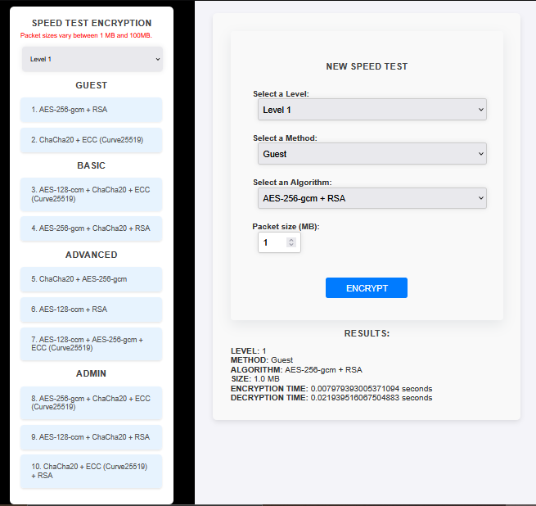
Prototype
UI & System Overview
The UI allows users to select from four security levels: Guest, Basic, Advanced, and Admin, each offering different cryptographic algorithms. Users choose a level and method (e.g., AES-256-GCM, RSA) to view the encryption and decryption results.
The system is powered by Python (Flask) for backend logic and HTML for the frontend interface, ensuring smooth user interaction.

Slide 10

Schedule of activities

Slide 11
Preliminary conclusions
The PRISEC III framework successfully integrates multiple cryptographic algorithms (AES, ChaCha20, ECC, Blowfish) across four security levels (Guest, Basic, Advanced, Admin) to provide scalable, secure communication for edge computing environments. Experimental results show that lightweight combinations like AES-128-CCM + ChaCha20 offer low-latency, high-throughput performance, while more complex ones like AES-256-GCM + ChaCha20 + ECC provide robust security for administrative operations. PRISEC III outperformed conventional models in encryption speed and efficiency, proving its effectiveness for resource-constrained devices.
Future Work: Integration with machine learning techniques to detect and respond to security anomalies dynamically in edge environments.

Slide 12
Theoretical references
Daemen, J., & Rijmen, V. (2002). *The Design of Rijndael: AES - The Advanced Encryption Standard*. Springer Science & Business Media.
Bernstein, D. J. (2008). *ChaCha, a Variant of Salsa20*. University of Illinois.
Koblitz, N. (1987). *Elliptic Curve Cryptosystems*. Mathematics of Computation, 48(177), 203-209.
Menezes, A. J., van Oorschot, P. C., & Vanstone, S. A. (1996). *Handbook of Applied Cryptography*. CRC Press.
Rivest, R. L., Shamir, A., & Adleman, L. (1978). *A Method for Obtaining Digital Signatures and Public-Key Cryptosystems*. Communications of the ACM, 21(2), 120-126.

Slide 13

Thank you for your attention!
For more details, visit: GitHub Repository

