Slide 1
Scala
HSLEE, 2016

Slide 2
Paradigm Shift (우리가 움직여야 할때, 다음 10년을 위해서..)
Side effect ??
Polyglot (Dic: 여러나라 말을 아는 사람, 말이 비슷하게 느껴져서…)
Function programming
Pattern matching (Erlang, Python….)
Lambda == Anonymous Function (func w/out name)
Higher-order function (takes a func, return a new func, learn low level func first)
Closure (don’t need to create copy for params, speed, garbage-collection)
Currying

Slide 3
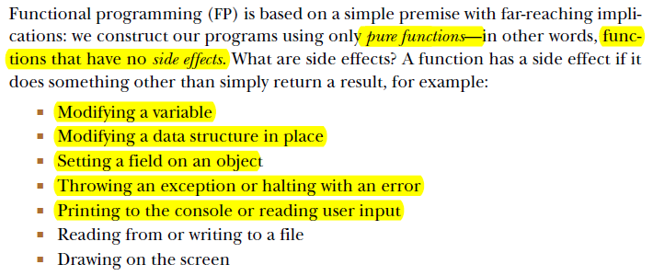
Side effect

Slide 4
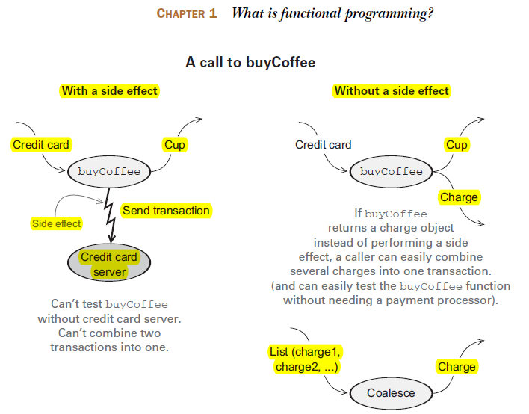
billing-log ??
billing-log ??
Port blocked??
billing-log ??
우리가 하던 코딩
debug hell
hard to test
charge many times (trx fee?)

Slide 5
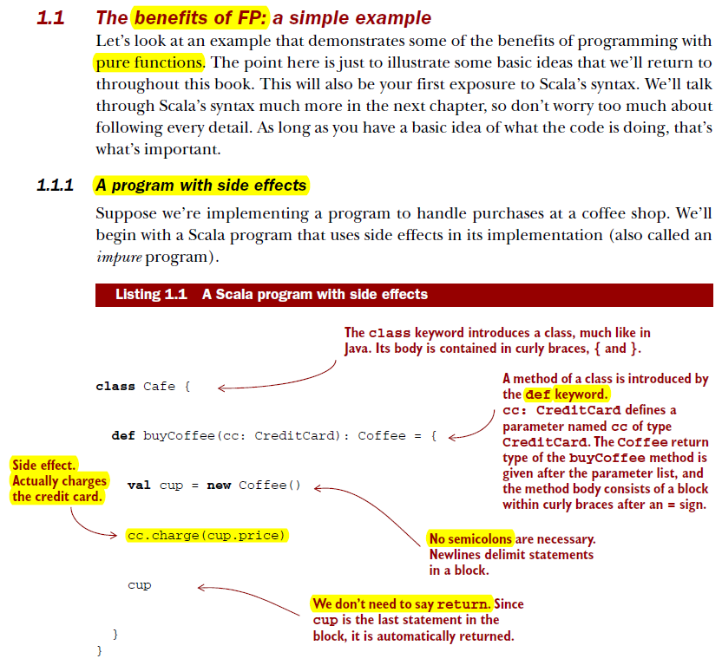

Slide 6
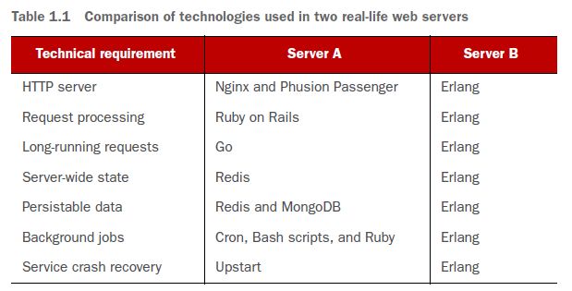
Polyglot why
example
- Make things right….
-나는 C#만 아주 잘하고 싶어....
- Elixir

Slide 7
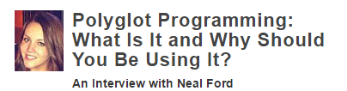
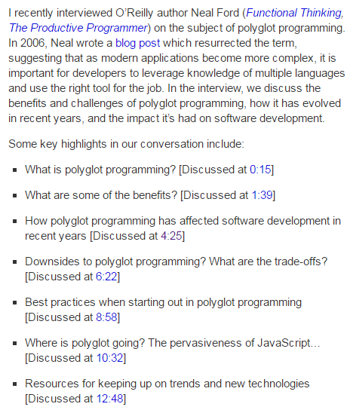
http://radar.oreilly.com/2013/11/polyglot-programming-what-is-it-and-why-should-you-be-using-it.html
Nature of
modern software dev
Javascript
Python
Scala
Golang
C++
Erlang
C
Java
https://www.youtube.com/watch?v=sBbGAzs9k-c&#t=4m25s

Slide 8
Functional Programming why?

Slide 9
Why Functional Programming
High level definition
Functional programming is the use of functions that transform values into units of abstractions, subsequently used to build software systems.
Object-oriented approach tends to break problems into grouping of “nouns”
Functional approach breaks the same problem into grouping of “verbs”

Slide 10
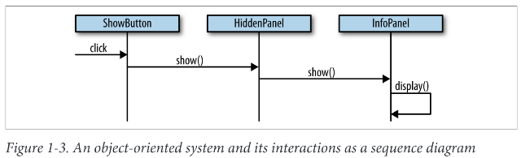
OOP
- Want to change the behavior , how?

Slide 11
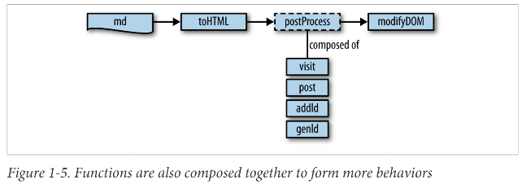
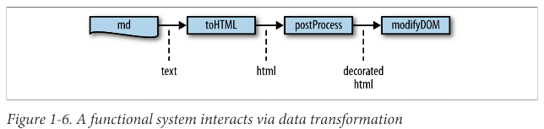
Functional
Text 를 만들고 html 만들고
Deco html 만들죠.. 점차적으로

Slide 12
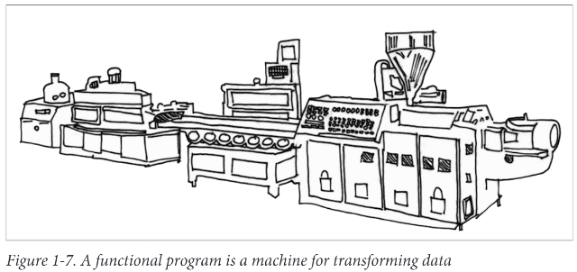
-taking a value and gradually “transforming”

Slide 13

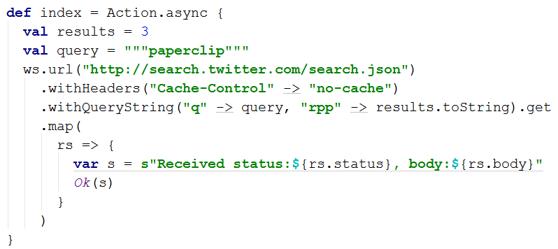
- expression-oriented programming

Slide 14
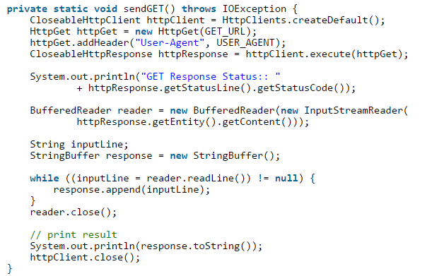

- statement
- statement
- statement

Slide 15
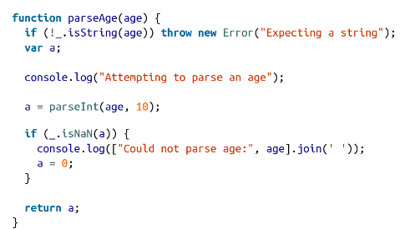
Conventional programming
- want to change error message
- side effect

Slide 16
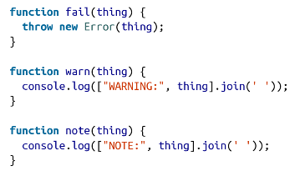

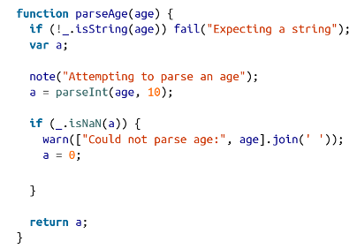
Functional Programming
-want to change behavior on the fly

Slide 17
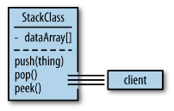
Encapsulation & Hiding in OOP

Slide 18
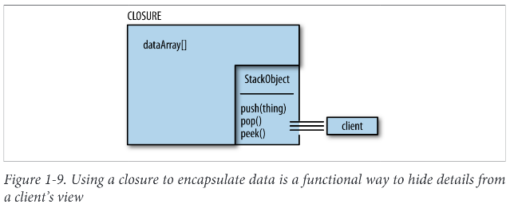
In Functional
Closure is kind of function
Achieve data hiding like OOP

Slide 19
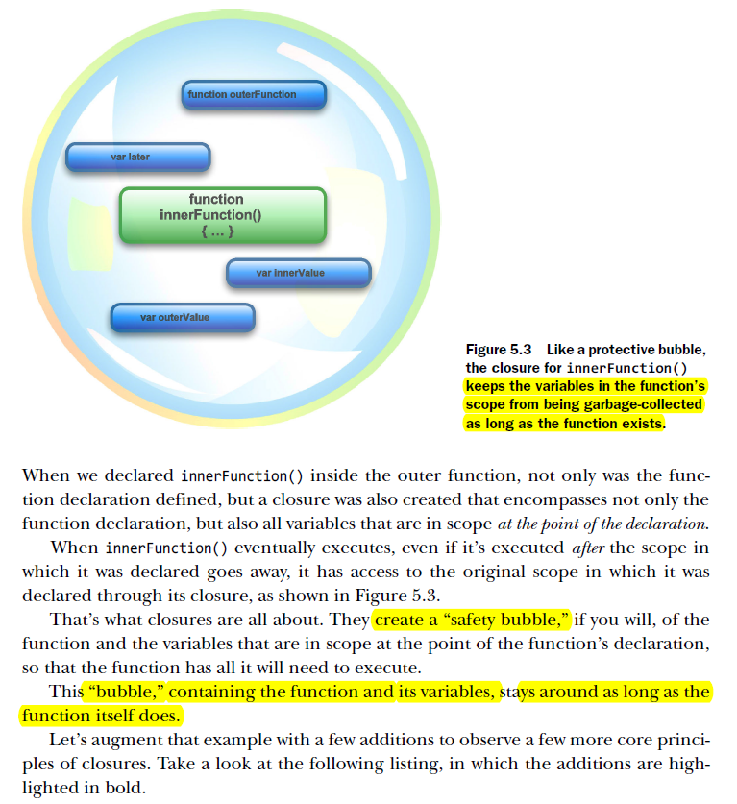
Closure

Slide 20
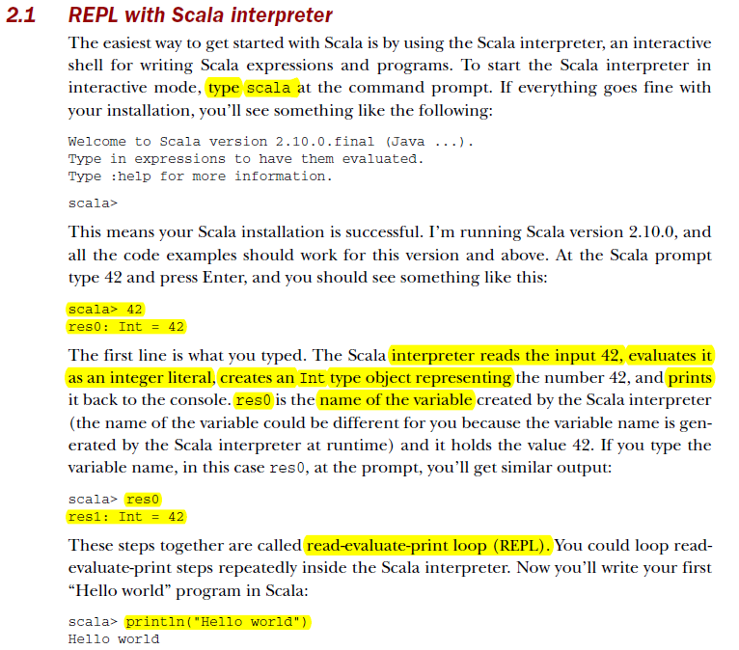

Slide 21
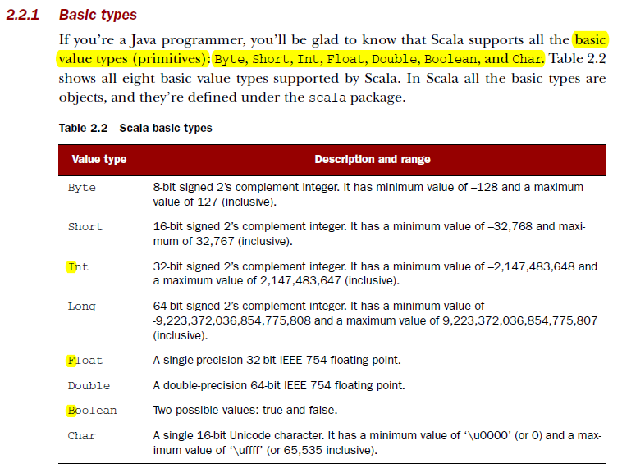

Slide 22
name : type =
Scala 말은 이렇게 생겼습니다.

Slide 23
Syntax sugar
불필요한 부분을 과감히 뺌니다. 뺄수밖에 없습니다.
그래야, 다른 중요가 코드가 보이며,
다른 중요한 코드가 더 간단하게 구현됩니다.
Reduce the size and complexity of code

Slide 24
{
var i = 5
var j = 1
}
function 에서 body 같은것
여러 문장일때 사용, 한 문장일때 생략 가능

Slide 25
First class function
first-class functions if it treats functions as first-class citizens. Specifically, this means the language supports passing functions as arguments to other functions, returning them as the values from other functions
func
{
var i = 5
var j = 1
}
object
object : 1
func (para1)
func (para1)
func (para1)

Slide 26
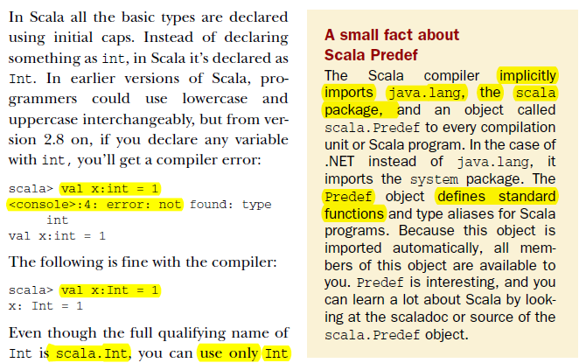
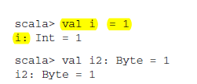

Slide 27
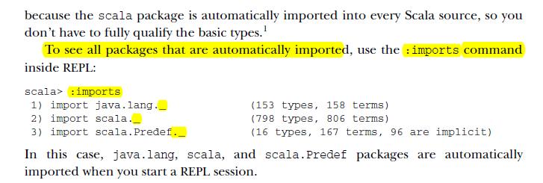

Slide 28
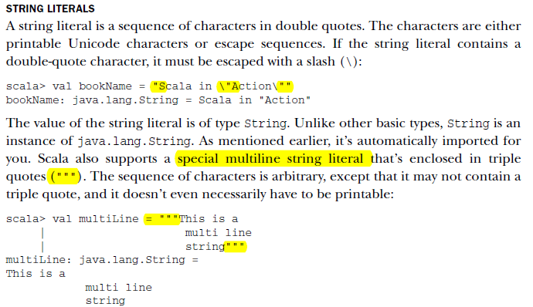
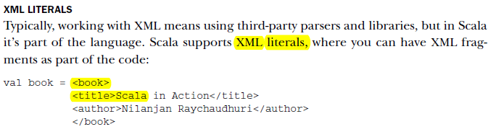

Slide 29
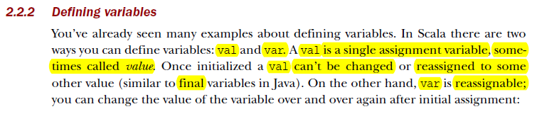
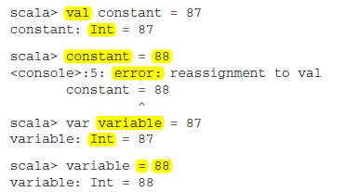

Slide 30
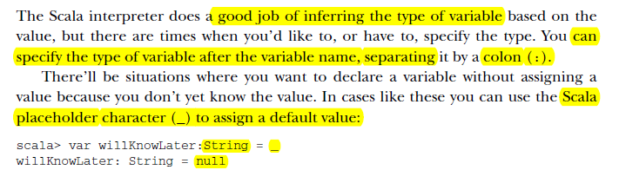
:
name : type

Slide 31
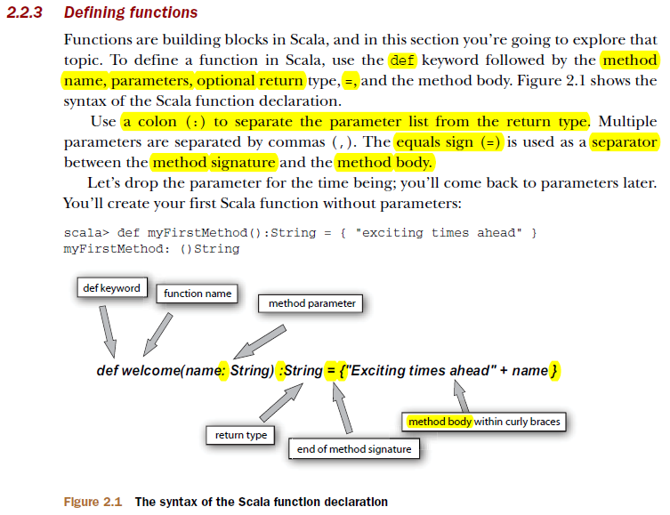

Slide 32
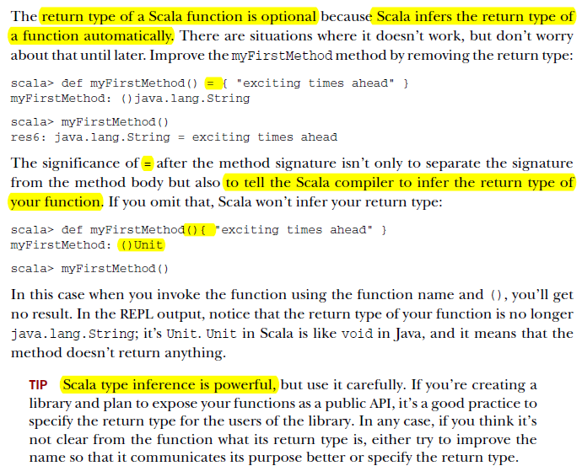

Slide 33
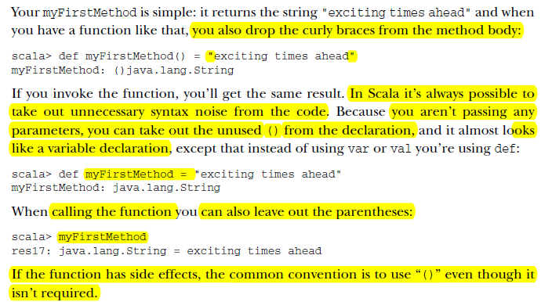

Slide 34
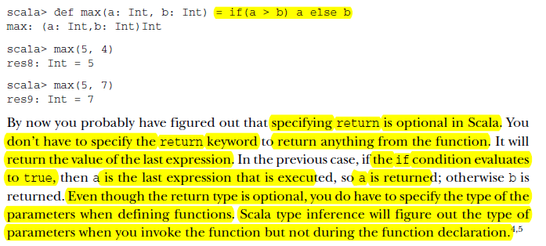

Slide 35
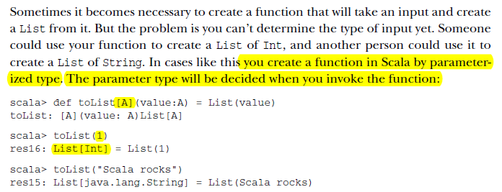
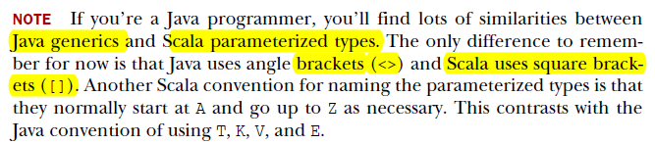

Slide 36
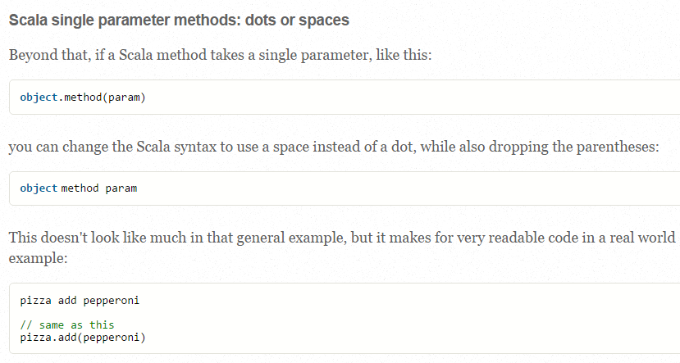

Slide 37

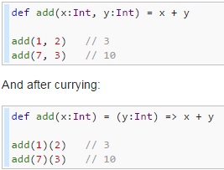
Currying

Slide 38
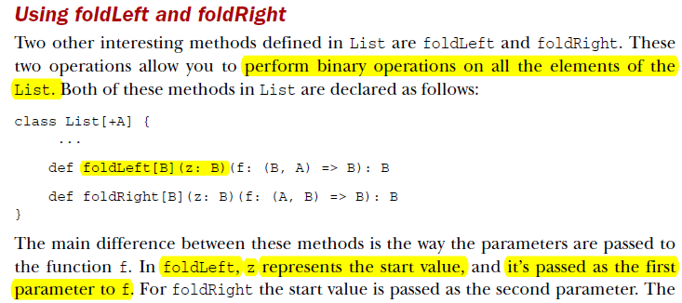
Currying

Slide 39
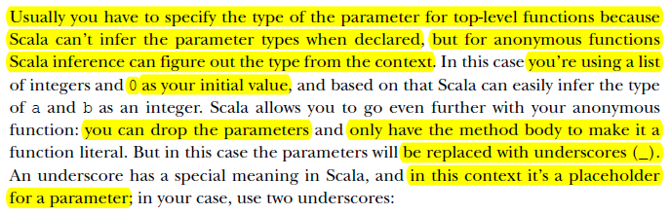


Slide 40
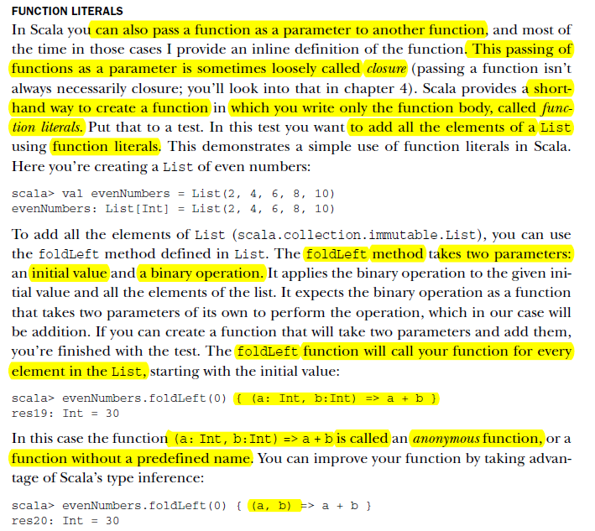

Slide 41
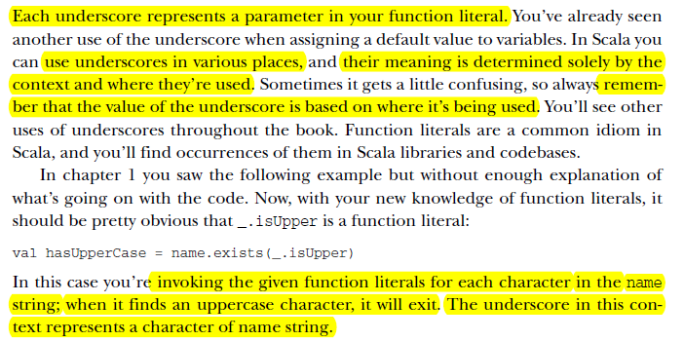

Slide 42
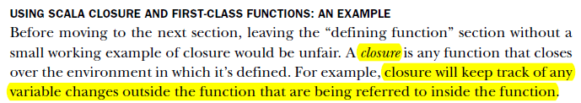

Slide 43
