Slide 1
Artificial Intelligence
Introduction to Deep Learning and Neural Networks
Mohd Shukri Hasan

Slide 2
Agenda
Components of a neural network
How to train a neural network
Practical considerations for implementing deep learning
Resources to learn more about deep learning

Slide 3
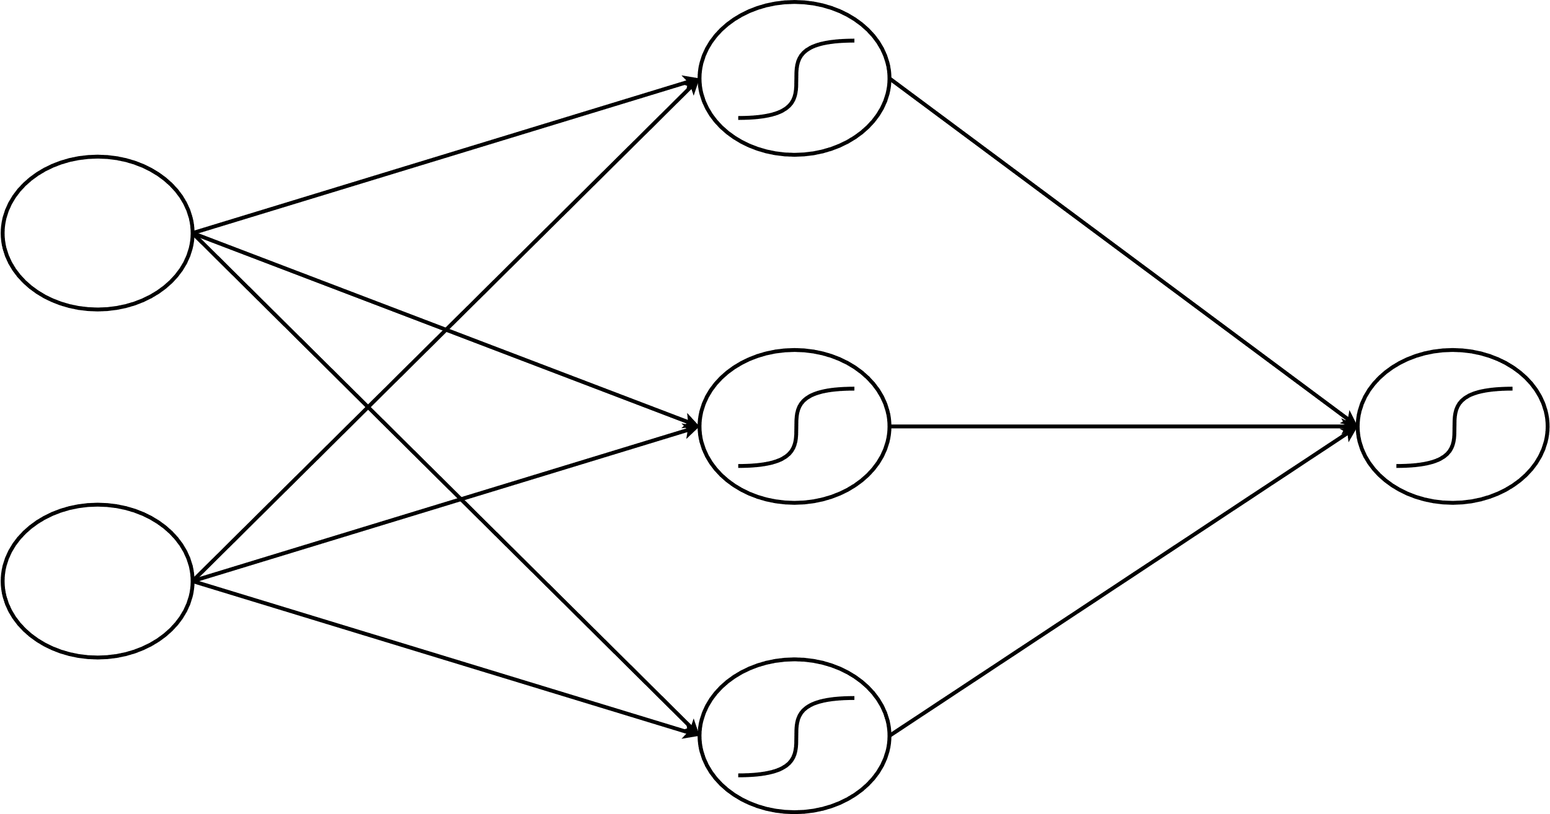



What is a neural network?
Activation Function
Hidden Layer
The w_{i}s are called parameters
Input Layer
Output Layer
w₁
w₇
w₂
w₃
$$x_{1}$$
w₈
w₄
w₅
$$\hat{y}$$
w₆
w₉
$$x_{2}$$

Slide 4
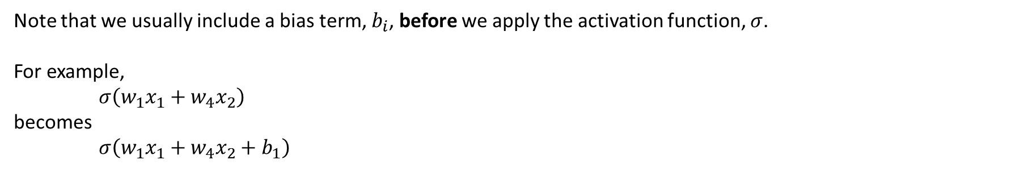

Putting everything together…
$$\hat{y}=σ\left(w_{7}σ\left(w_{1}x_{1}+w_{4}x_{2}\right)+w_{8}σ\left(w_{2}x_{1}+w_{5}x_{2}\right)+w_{9}σ\left(w_{3}x_{1}+w_{6}x_{6}\right)\right)$$
Output from node 2 in hidden layer
Note that we usually include a bias term, $b_{i}$, before we apply the activation function, $σ$.
For example,
$σ\left(w_{1}x_{1}+w_{4}x_{2}\right)$
becomes
$σ\left(w_{1}x_{1}+w_{4}x_{2}+b_{1}\right)$
Output from node 1 in hidden layer
Output from node 3 at hidden layer

Slide 5
How are neural networks trained?
Step 1
Define a loss function
Step 2
Find the parameters that will minimize the loss function

Slide 6
How are neural networks trained?
Let’s look at some code to see how this works

Slide 7
What are the challenges of implementing Deep Learning?
Reference:
How Machine Learning with TensorFlow Enabled Mobile Proof-Of-Purchase at Coca-Cola (Google Developers blog)
Challenges:
Where to get data to train the model?
How to improve the model’s accuracy over time?
How to fit the model into a production device?

Slide 8
Resources to learn more about deep learning
Deep Learning frameworks:
TensorFlow
PyTorch
CNTK
Caffe
Deeplearning4j

Slide 9
Resources to learn more about deep learning
Online courses:
Practical Deep Learning for Coders by Fast.ai
Andrew Ng’s Deep Learning Specialization on Coursera
If you encounter a concept that is difficult to understand, try https://distill.pub/

Slide 10
The End
Q & A

