Slide 1
GPGPU Computing using CUDA
Notes:
2 minutes:
Good After-noon to all of you. I am Mahesh from heterogeneous many-core computing group, corporate research and technologies, India. My presentation topic is “GPGPU Computing Using CUDA”. As we know, for last few years, HPC community has witnessed evolution of hardware in two main trajectories. One is multi-core CPU path and the other is many-core GPU path. Some of the yesterday’s key note sessions covered multi-core trajectory. In this topic, I will cover many-core GPU trajectory. GPGPU simply means using GPUs for General Purpose computing. CUDA is a GPGPU parallel programming model proposed by NVIDIA that exposes the parallel computing capabilities of the NVIDIA GPUs to application developers
The talk is divided into two parts – one hour session each. In the first session , I will discuss about the basic concept of CUDA GPGPU parallel programming model. In the second session, I briefly walk through a simple parallel algorithm implementation in CUDA programming environment including brief walk through of demo project.
Mahesha S (Siemens, CT): GPGPU Programming Using CUDA - Introduction and Tutorial
Tutorial 6: Over the last few years, graphics processing units (GPUs) have emerged as cost-effective sources of massive computing power that can be harnessed by not only graphics applications but also HPC and general purpose computations. The Compute Unified Device Architecture (CUDA) is a C-based programming model, proposed by NVIDIA, that exposes the parallel computing capabilities of the GPU to application developers in an easy to use manner. This session gives an overview of the GPU architecture and the CUDA programming model and walks you through the 4 steps of parallel program development – design, coding, compilation and debugging and performance optimization, in the CUDA context, through an example.

Slide 2
GPGPU Computing using CUDA: Goal, Scope and Pre-requisite
Goal
Introduce target audience to the world of GPGPU computing using CUDA
Scope
GPGPU Computing: What? Why? How?
Introduction to CUDA architecture and programming model
Few thumb-rules for optimizing performance
An example walkthrough of few performance optimization tips
Pre-requisite
Knowledge of C/C++ programming language basics
Notes:
4 minutes:
The main goal of this talk is to introduce the target audience to the world of GPGPU computing in general, and CUDA GPGPU programming concepts in specific.
By keeping this goal in mind, first, I will brief about what is GPGPU computing? Why GPGPU computing is important today? And, how in general, GPGPU computing is performed?
Second, I will give an introduction to CUDA GPGPU architecture.
Third, the basic rules to be followed for maximum performance gain in CUDA GPGPU environment.
Finally, I conclude with an overview of CUDA development tools.
For this talk, I assume that the taget audience have basic C/C++ programming knowledge.

Slide 3
GPGPU Computing using CUDA
GPGPU Computing: What? Why? How?
Introduction to CUDA architecture and programming model
Few thumb-rules for optimizing performance
An example walkthrough of few performance optimizations tips
Notes:
Let us move on to the first topic, that is GPGPU Computing: What? Why? How?

Slide 4

What is GPGPU Computing?
High performance parallel computing - where GPUs (Graphics Processing Units) are used as compute units - to accelerate the performance - of general purpose scientific and engineering computing tasks
An example: N-Body Simulation
Notes:
2 minutes:
What is GPGPU computing?
After 1:
Simply speaking, GPGPU computing is a high performance parallel computing - where GPUs (Graphics Processing Units) are used - to accelerate the performance - of general purpose scientific and engineering computing tasks.
In fact, GPGPU stands for General Purpose, GPU computing.
After 2:
Here is an example of GPGPU application, which shows smoke simulation using PhysX: Nvidia’s propriatory physics computation engine – which uses the power of the GPU – to perform physics simulation.
Available as a middleware. Downlodable from Nvidia site: http://developer.nvidia.com/technologies/physx

Slide 5
Why GPUs for General Purpose Computing?
Massively parallel processors – several hundreds of cores in a single chip – NVIDIA GeForce GTX 590 GPU (Fermi Architecture) has 1024 cores
Highly multithreaded – each core executes hundreds of concurent threads – each GeForce GTX 590 GPU core executes 128 concurent threads
High memory bandwidth – many times more than that of CPU
GeForce GTX 590 GPU: 320 GB/s
Intel’s Core i7-960 CPU: 26 GB/s
Attractive performance-to-price and performance-to-power ratios
GeForce GTX 590 GPU: 1024 cores, 365 watts of power consumption,
and a price of 700$
Intel’s Core i7-960 CPU: 4 cores, 130 watts of power consumption, and
price of 300$
Best suited for compute-intensive, highly data parallel computations
Notes:
4 minutes:
Now, naturally question arises, why GPUs should be used for general purpose high performance computing?
There are several reasons for it. Few important reasons are as follows.
After 1:
First, GPUs are massively parallel processors: Single GPU chip consists of several hundreds of cores. For example, Nvidia Geforce GTX 590, which is a recent release from Nvidia, consists of 1024 cores. On the other hand, in multicore CPU environment, number cores per chip are still in two digit mark.
After 2:
Second, GPUs are highly multithreaded: Each GPU core executes hundreds of concurent threads. For example, Each GeForce GTX 590 GPU core executes 128 concurent threads
After 3:
Third, GPUs have high memory bandwidth. Look at the bandwidth difference between CPU and GPU…….
After 4:
Another important reason for GPU popularity in HPC domain is their attractive performance-to-price and performance-to-power ratios. Just look the comparision of CPU and GPU in terms of their performance-to-price and performance-to-power ratios. In terms of price, GPUs are available with less than a dollor per core. On the other hand, price of cpu core is more than 30$. Similarly there is large difference in terms of power consumption by both CPU and GPU
After 5:
Moreever, GPUs are specifically designed for computationaly intensive data parallel applications like image prosessing applications, gaming applications, etc. So these data parallel, highly compute intensive applications gain better performance in GPU processing environment compare to CPU processing environment.

Slide 6
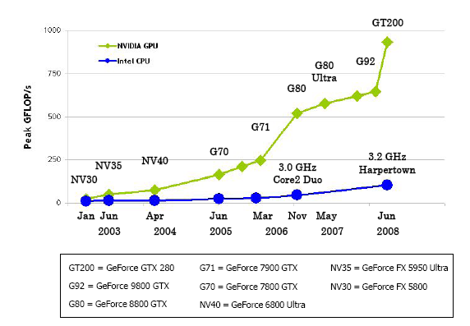
CPU vs GPU
Notes:
1 minutes
Here is the graph which shows the difference in performance of both CPU and GPU, of course, the graph is not a latest one. It shows the result till 2008. GPUs are almost 10 times faster than CPUs
From the figure above we can see that Intel’s Harpertown chips have about an 80 GFLOP rating while Nvidia’s most powerful card shipping today offers just shy of a Terra FLOP worth of computational capacity. According to this chart the GPU is 10 times faster than the CPU.
Harpertown chips: Intel’s 5400-series Xeon processor family of processors
----------------------------------------------------------------------
CPU clock speed for a single cpu has been fairly static in the last couple of years – hovering around 3.4Ghz. Of course, we shouldn’t fall completely into the Megahertz myth, but one avenue of speed increase has been blocked: Although single CPUs have been limited, due to the rise of multi-core machines, the computational power per die has still been increasing.
When we compare GPUs with CPUs over the last decade in terms of Floating point operations (FLOPs), we see that GPUs appear to be far ahead of the CPUs
here are some clock speeds of other currently available products from NVIDIA:
GTX 590: 607 MHz
GTX 580: 772 MHz
GTX 570: 732 MHz
GTX 560 Ti: 822 MHz
GTX 550 Ti: 900 MHz

Slide 7

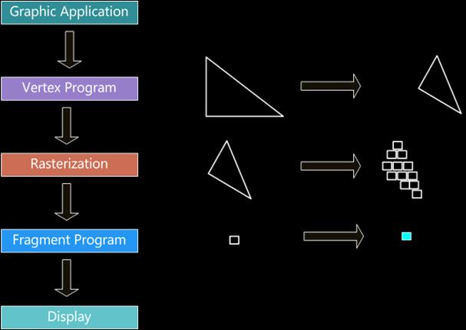


GPU Evolution: From Graphics Pipeline to Massively Parallel Processor
Graphics programming using graphics pipeline
Notes:
3 minutes:
This picture shows very high level view of the graphics pipeline used to program the graphics. I am not going to the details of graphics pipeline. However, what is important is to note that both vertex program and Fragment program stages are programmable.
------------------------------------------------------------------------------------------------------
3D graphics rendering: The process of transforming a three-dimensional image description in world co-ordinates into a two-dimensional image in screen co-ordincates.
The CPU sends instructions (compiled shading language programs) and geometry data (vertex data of the scene to be drawn) to the GPU
The Vertex Program or Vertex Shader Stage: The GPU begins by reading each selected vertex out of the vertex array and running it through the vertex shader, a program that takes a set of vertex attributes as inputs and outputs a new set of attributes, referred to as varying values, that get fed to the rasterizer. At a minimum, the vertex shader calculates the projected position of the vertex in screen space. The vertex shader can also generate other varying outputs, such as a color or texture coordinates, for the rasterizer to blend across the surface of the triangles connecting the vertex.
Triangle Assembly Stage: The GPU then connects the projected vertices to form triangles. It does this by taking the vertices in the order specified by the element array and grouping them into sets of three.
Rasterization Stage: The rasterizer takes each triangle, clips it and discards parts that are outside of the screen, and breaks the remaining visible parts into pixel-sized fragments. As mentioned above, the vertex shader's varying outputs are also interpolated across the rasterized surface of each triangle, assigning a smooth gradient of values to each fragment. For example, if the vertex shader assigns a color value to each vertex, the rasterizer will blend those colors across the pixelated surface as shown in the diagram.
The Fragment Program or Fragment Shader Stage: The generated fragments then pass through another program called the fragment shader. The fragment shader receives the varying values output by the vertex shader and interpolated by the rasterizer as inputs. It outputs color and depth values that then get drawn into the framebuffer. Common fragment shader operations include texture mapping and lighting. Since the fragment shader runs independently for every pixel drawn, it can perform the most sophisticated special effects; however, it is also the most performance-sensitive part of the graphics pipeline.

Slide 8
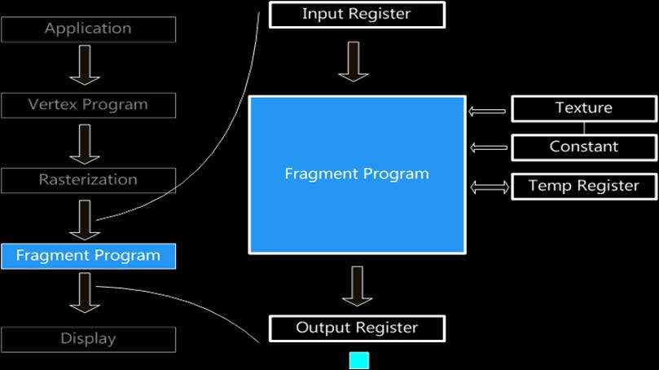
GPU Evolution: From Graphics Pipeline to Massively Parallel Processor
GPGPU programming using graphics pipeline
Basic idea: graphics pipeline is a commodity stream processor - well
suited for stream programming – For example, fragment shader stage can be modelled
as a stream processing engine
Notes:
GPGPU programming model:
Use the pixel shader stage as the computation engine
Texture as input data array
Texture lookup as memory read
Shader program as loop body
Render to framebuffer or texture as memory write
Stream processing is a computer programming paradigm, related to SIMD (single instruction, multiple data), that allows some applications to more easily exploit a limited form of parallel processing. Such applications can use multiple computational units, such as the FPUs on a GPU or field programmable gate arrays (FPGAs)^{[1]}, without explicitly managing allocation, synchronization, or communication among those units.
The stream processing paradigm simplifies parallel software and hardware by restricting the parallel computation that can be performed. Given a set of data (a stream), a series of operations (kernel functions) are applied to each element in the stream. Uniform streaming, where one kernel function is applied to all elements in the stream, is typical. Kernel functions are usually pipelined, and local on-chip memory is reused to minimize external memory bandwidth. Since the kernel and stream abstractions expose data dependencies, compiler tools can fully automate and optimize on-chip management tasks. Stream processing hardware can use scoreboarding, for example, to launch DMAs at runtime, when dependencies become known. The elimination of manual DMA management reduces software complexity, and the elimination of hardware caches reduces the amount of die area not dedicated to computational units such as ALUs.

Slide 9
GPU Evolution: From Graphics Pipeline to Massively Parallel Processor
Limitations of GPGPU programming using graphics pipeline
APIs are specific to Graphics
Limited texture size and dimension
Limited instruction set
Limited local storage
No parallel data cache or shared
memory
Notes:
Differences among directX , openGL, CUDA etc

Slide 10
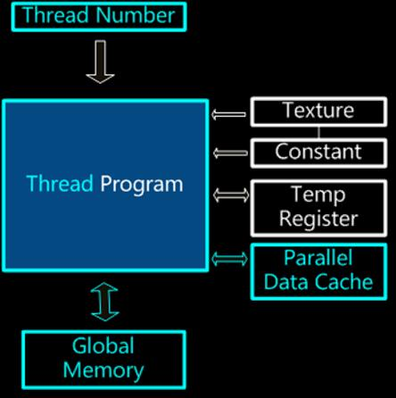
GPU Evolution: From Graphics Pipeline to Massively Parallel Processor
GPU as general purpose thread processor
Basic idea: thread, not pixel
Notes:
Differences among directX , openGL, CUDA etc

Slide 11
GPGPU Computing using CUDA
GPGPU Computing: What? Why? How?
Introduction to CUDA architecture and programming model
Few thumb-rules for optimizing performance
An example walkthrough of few performance optimizations tips
Notes:
Let us move on to the next topic: That is, Introduction to CUDA architecture and programming model

Slide 12
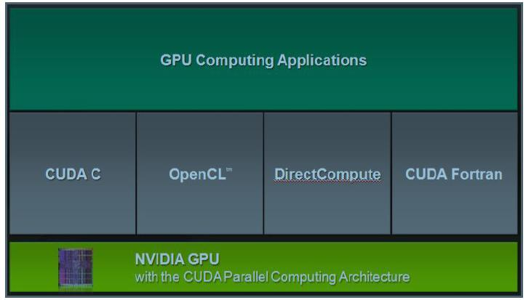
CUDA: Compute Unified Device Architecture
Notes:
1 minutes:
This is how Nvida GPU programming system looks in general. At the bottom is NVIDIA GPU hardware. GPU computing applications to be run on Nvidia GPU hardware can be programmed using different programming models like CUDA C, OpenCL, DirectCompute and CUDA Fortran. Our focus of this topic is NVIDIA GPU architecture and CUDA C programming model.
OpenGL/DirectX Compute Unified Device Architecture (CUDA)
2D, 3D computer graphics & visualization C-based parallel programming model
Algorithms to be cast as graphics APIs Natural fit for GPGPU
Slow learning curve Quick learning curve
Limited exposure to GPU hardware, inflexible Fully exposes the GPU hardware
Fast shared memory
Scattered reads/writes

Slide 13
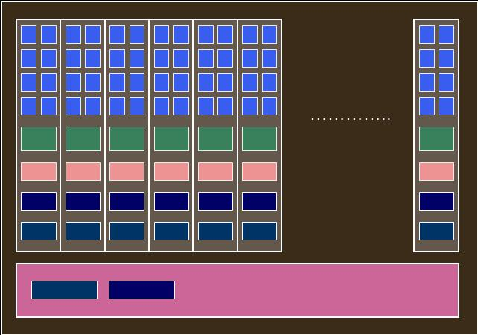
CUDA GPU Architecture
GPU device
GTX 590 graphics card (Fermi Architecture)
16 SMs in a chip
32 SIMD cores in a SM
dual chip
SIMD cores
Multi-processor
Shared memory
Register file
Constant cache
Texture cache
Device memory
Constant memory
Texture memory
Local memory
Global memory
Notes:
2 minutes

Slide 14
CUDA C Programming Model
Heterogeneous programming model:
where both CPU and GPU execution are asynchronous
Extended on C:
minimal but expressive extension
Basic concepts:
Host – CPU
Device – GPU – acts as a co-processor to host (CPU)
Kernel – C functions which run on GPU – data parallel computations are captured as kernels
Thread hierarchy – group of threads which concurrently run same kernel on different data on GPU
Memory hierarchy – different types of device memories used by GPU
Notes:
2 minutes

Slide 15
A Typical CUDA C Program
__global__ void my_kernel (/* kernel arguments */)
{
// kernel computation body
// Several threads concurrently
// read their respective input memory,
// perform computation on input data, and
// write output to their respective output memory
}
int main()
{
step1: host input memory allocation and initialization
step2: device input memory allocation
step3: memory copy from host input memory to device input memory
step4: device output memory allocation
step5: kernel launch by passing device input memory and device output memory
step6: host output memory allocation
step7: copy output from device output memory to host output memory
}
DEVICE
Asynchronous execution, but cuda api function called at step7 waits until all threads are executed
HOST
Notes:
4 minutes
Kernel launch is Asynchronous:
When the kernel is launched, the kernel immediately starts running based on the execution configuration and according to the function arguments. Meanwhile, the host continues to the next line of code after the kernel launch. At this point, both the CUDA device and host are simultaneously running their separate programs. In this particular example, the host code at step7, that is memcpy call to copy output from device memory to host memory is called asynchronously, but CUDA runtime makes sure that this function waits until all threads have finished on the device after which it pulls the output to the host memory.

Slide 16
CUDA C Program: An Example of Vector Addition
// Kernel definition
__global__ void VecAdd(float* A, float* B, float* C)
{
int i = threadIdx.x;
C[i] = A[i] + B[i];
}
DEVICE
Thread identification within a kernel
int main()
{
// The input/output matrices (A, B, C) of size ‘N’ are allocated and
// initialized
VecAdd<<<1, N>>>(A, B, C); /* Kernel invocation
with N threads, that is the size of the vector */
}
HOST
Kernel execution configuration
Notes:
1 minutes
Kernel execution configuration?
Thread ids and block ids?

Slide 17
CUDA Thread Hierarchy
threads are grouped into thread blocks
threads
thread blocks are grouped into a grid
Notes:
4 minutes

Slide 18
CUDA Thread Hierarchy
1-D grid
1-D thread blocks
3-D thread blocks
2-D thread blocks

Slide 19
CUDA Thread Hierarchy
2-D grid

Slide 20
Execution of CUDA Thread-Blocks on GPU
GPU device
SIMD cores
Multi-processor
…
Thread-blocks

Slide 21
How to Specify Thread Hierarchy? And How to Identify Threads?
__global__ void VecAdd(float* A, float* B, float* C)
{
int i = (blockId.x * blockDim.x) + threadIdx.x;
C[i] = A[i] + B[i];
}
BlockDim
GridDim
ThreadIdx
BlockIdx
int main()
{
dim3 numOfThreads(n, 1, 1);
dim3 numOfBlocks(ceil(N/n), 1);
VecAdd<<<numOfBlocks, numOfThreads>>>(A, B, C);
}
Thread hierarchy specification

Slide 22
Thread Synchronization and Scalability
Barrier sync within a thread block => __syncthreads() intrinsic function
No sync across thread blocks => to achieve trasparent scalability
GPU with 2 multi-processor units
GPU with 4 multi-processor units
Kernel grid
Kernel launch is asynchronous => heterogeneous programming
Kernel calls are implicitly synchronized

Slide 23
CUDA Memory Hierarchy
Location: On chip
Scope: Thread
Lifetime: Thread
Access: Read/Write
Speed: Fast access (8TB/s at minimum)
Size: 32K/SM (Fermi)
Location: On chip
Scope: All threads in a block
Lifetime: Block
Access: Read/Write
Speed: As fast as register in the absence of
bank conflicts
Size: Up to 48KB/SM (Fermi)
Location: Off chip (part of device memory)
Scope: Thread
Lifetime: Thread
Access: Read/Write
Cached? No
Speed: Slow access (latency of 400 to 600
clock cycles)
Size: 512KB/thread (Fermi)
Location: Off chip (part of device memory)
Scope: All threads + host
Lifetime: Host allocation
Access: Read/Write
Cached? No
Speed: Slow access (latency of 400 to 600
clock cycles)
Size: Up to 6GB (Fermi)
Location: Off chip (part of device memory)
Scope: All threads + host
Lifetime: Host allocation
Access: Read only
Cached? Yes
Spatial locality: 1D, 2D and 3D spatial locality
Speed: Slow, but cache makes it faster
Size: Depends on dimensionality of
texture and compute capability of
GPU
Cache size: Depends on GPU (from 6KB to
8KB/SM)
Location: Off chip (part of device memory)
Scope: All threads + host
Lifetime: Host allocation
Access: Read only
Cached? Yes
Speed: Slow, but cache makes it faster
Size: 64KB
Cache size: 8KB/SM
Useful for optimized accessing of static values by a group of threads
Shared memory
Register file
Constant cache
Texture cache
Constant memory
Texture memory
Local memory
Global memory
Notes:
4 minutes
Texture memory
The read-only texture memory space is cached. Therefore, a texture fetch costs one device memory read only on a cache miss; otherwise, it just costs one read from the texture cache. The texture cache is optimized for 2D spatial locality, so threads of the same warp that read texture addresses that are close together will achieve best performance. Texture memory is also designed for streaming fetches with a constant latency; that is, a cache hit reduces DRAM bandwidth demand, but not fetch latency.
In certain addressing situations, reading device memory through texture fetching can be an advantageous alternative to reading device memory from global or constant memory.
3.2.4.1 Textured Fetch vs. Global Memory Read
Device memory reads through texture fetching present several potential benefits over reads from global memory:
 They are cached, unlike global memory reads in devices of compute capability 1.x. For these devices, this results in potentially exhibit higher bandwidth if there is 2D locality in the texture fetches and can be used to avoid uncoalesced loads from global memory. (Note that the L1 cache in devices of compute capability 2.x has a higher bandwidth than the texture cache, obviating this benefit in these devices.)
 Packed data can be unpacked into separate variables in a single operation.
 8-bit and 16-bit integer input data may be optionally converted to 32-bit floating-point values in the range [0.0, 1.0] or [-1.0, 1.0].
Constant memory
There is a total of 64 KB constant memory on a device. The constant memory space is cached. As a result, a read from constant memory costs one memory read from device memory only on a cache miss; otherwise, it just costs one read from the constant cache.
For all threads of a half warp, reading from the constant cache is as fast as reading from a register as long as all threads read the same address. Accesses to different addresses by threads within a half warp are serialized, so cost scales linearly with the number of different addresses read by all threads within a half warp.
Alternatively, on devices of compute capability 2.x, programs use the LoaD Uniform (LDU) operation; see Section G.4.4 of the CUDA C Programming Guide for details.
Registers
Generally, accessing a register consumes zero extra clock cycles per instruction, but delays may occur due to register read-after-write dependencies and register memory bank conflicts.
The latency of read-after-write dependencies is approximately 24 cycles, but this latency is completely hidden on multiprocessors that have at least 192 active threads (that is, 6 warps) for devices of compute capability 1.x (8 CUDA cores per multiprocessor * 24 cycles of latency = 192 active threads to cover that latency). For devices of compute capability 2.0, which have 32 CUDA cores per multiprocessor, as many as 768 threads might be required to completely hide latency.
The compiler and hardware thread scheduler will schedule instructions as optimally as possible to avoid register memory bank conflicts. They achieve the best results when the number of threads per block is a multiple of 64. Other than following this rule, an application has no direct control over these bank conflicts. In particular, there is no register-related reason to pack data into float4 or int4 types.

Slide 24
CUDA Memory Hierarchy: An Illustration
// Kernel to compute vector sum C = A+B
__global__ void vecAdd( float* A, float* B, float* C )
{
int i = blockDim.x * blockIdx.x + threadIdx.x;
C[i] = A[i] + B[i];
}
Shared memory
Register file
…………..
Global memory
vecAdd<<< dimGrid, dimBlock >>>(d_A, d_B, d_C);

Slide 25
GPGPU Computing using CUDA
GPGPU Computing: What? Why? How?
Introduction to CUDA architecture and programming model
Few thumb-rules for optimizing performance
An example walkthrough of few performance optimizations tips

Slide 26
Thumb-rules for Impressive Speedups
Optimize computation efficiency:
to maximize execution throughput
Optimize memory usage:
to maximize memory access throughput
Optimize resource usage:
to maximize overall concurrency
Notes:
1 minute

Slide 27
Optimize Computation Efficiency
Design algorithm to achieve maximum independent data parallelism
Minimize latency:
re-computing vs off-chip data access – arithmetic latency ≈ 4 cycles
compare to off-chip memory latency ≈ 400 cycles
Maximize instruction throughput:
Use intrinsic functions like __mul24() and single precision instructions
when precision does not affect end result – __mul24() ≈ 4 cycles
compare to 32 bit int multiplication ≈ 16 cycles
Avoid warp divergence
// Dummy kernel
__global__ void dummyKernel( … )
{
if (threadId.x > 2)
{…}
else
{…}
}
Group of 32 contiguous threads within a block executing same instruction at any given time
Warp divergence. Results in two pass execution
Notes:
3 minute
Number of operations on data element
Clock cycles for single precision, fdivide(), multi24(), etc.

Slide 28
Optimize Memory Usage
Use pinned memory
Maximize coalescing
Minimize data transfers with low bandwidth and high latency
Minimize data transfers between the host and the device
Optimize access to global memory
Avoid shared memory bank conflicts
Maximize use of on-chip shared memory and caches
Avoid register spilling - as local memory access involves high latency
global memory
T0 | T1 | T2 | T3 | T4 | T5 | T6 | T7 | T8 | T9 | T10 | T11 | T12 | T13 | T14 | T15
threads in first half-warp
contiguous threads in a half-warp accessing aligned contiguous memory locations – can be coalesced into one single transaction
B1 | B2 | B3 | B4 | B5 | B6 | B7 | B8 | B9 | B10 | B11 | B12 | B13 | B14 | B15 | B16
shared memory banks
32 32-bit array elements stored in shared memory
T0 | T1 | T2 | T3 | T4 | T5 | T6 | T7 | T8 | T9 | T10 | T11 | T12 | T13 | T14 | T15
threads in first half-warp
different threads in a half-warp accessing different banks
– no conflict – simultaneous access
Threads within a half-warp accessing different addresses
in the same bank – conflict – serialized access
Notes:
A word goes to different blocks
Half-warp
Take an example
3 minutes
Pinned memory:
The runtime also provides functions to allocate and free page-locked (also known as pinned) host memory – as opposed to regular pageable host memory allocated by malloc(): cudaHostAlloc() and cudaFreeHost().
Using page-locked host memory has several benefits:
❑ Copies between page-locked host memory and device memory can be performed concurrently with kernel execution for some devices as mentioned in Section 3.2.7;
❑ On some devices, page-locked host memory can be mapped into the address space of the device, eliminating the need to copy it to or from device memory as detailed in Section 3.2.6.3;
❑ On systems with a front-side bus, bandwidth between host memory and device memory is higher if host memory is allocated as page-locked and even higher if in addition it is allocated as write-combining as described in Section 3.2.6.2.
Page-locked host memory is a scarce resource however, so allocations in page-locked memory will start failing long before allocations in pageable memory system for paging, allocating too much page-locked memory reduces overall system performance.

Slide 29
Optimize Resource Usage
Launch sufficient number of threads and thread-blocks - to keep all SMs busy
Choose block size as a multiple of warp size – to avoid padding of extra threads to last warp
Maximize occupancy – by optimizing register and shared memory usage
measure of how well the multi-processor cores are kept busy
occupancy = (# of active warps) / (maximum # of active warps)
Register usage in G80
8K/SM
768 concurent threads/SM
8K/768 = 10 registers per thread
11 registers per thread decreases no of
concurent threads/SM to (768 – block-size)
Shared memory usage in G80
16KB/SM
8 concurent thread-blocks/SM
16KB/8 = 2KB per thread-block
6KB per thread-block decreases no of
concurent thread-blocks/SM to 2
Notes:
3 minutes
Occupancy explaination more clear.

Slide 30
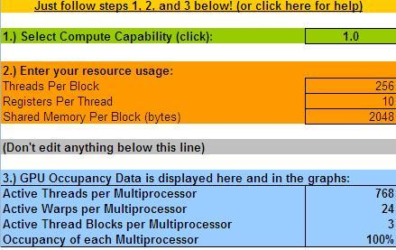
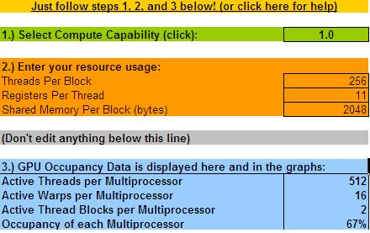
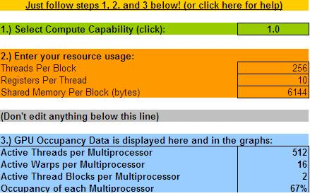
Occupancy Calculator: Determining Resource Usage
Compile with –cubin flag and open generated .cubin file in text mode
Copy register and memory usage values to occupancy calculator
code { name = my_kernel lmem = 0 smem = 2048 reg = 10 bar = 0 bincode { � } const { � } }
code { name = my_kernel lmem = 0 smem = 2048 reg = 11 bar = 0 bincode { � } const { � } }
code { name = my_kernel lmem = 0 smem = 6144 reg = 10 bar = 0 bincode { � } const { � } }
Notes:
Overview The CUDA Occupancy Calculator allows you to compute the multiprocessor occupancy of a GPU by a given CUDA kernel. The multiprocessor occupancy is the ratio of active warps to the maximum number of warps supported on a multiprocessor of the GPU. Each multiprocessor on the device has a set of N registers available for use by CUDA program threads. These registers are a shared resource that are allocated among the thread blocks executing on a multiprocessor. The CUDA compiler attempts to minimize register usage to maximize the number of thread blocks that can be active in the machine simultaneously. If a program tries to launch a kernel for which the registers used per thread times the thread block size is greater than N, the launch will fail. The size of N on GPUs with compute capability 1.0-1.1 is 8192 32-bit registers per multiprocessor. On GPUs with compute capability 1.2-1.3, N = 16384. On GPUs with compute capability 2.0, N = 32768. Maximizing the occupancy can help to cover latency during global memory loads that are followed by a __syncthreads(). The occupancy is determined by the amount of shared memory and registers used by each thread block. Because of this, programmers need to choose the size of thread blocks with care in order to maximize occupancy. This GPU Occupancy Calculator can assist in choosing thread block size based on shared memory and register requirements. Instructions Using the CUDA Occupancy Calculator is as easy as 1-2-3. Change to the calculator sheet and follow these three steps. 1.) First select your device's compute capability in the green box. Click to go there… 2.) For the kernel you are profiling, enter the number of threads per thread block, the registers used per thread, and the total shared memory used per thread block in bytes in the orange block. See below for how to find the registers used per thread. Click to go there… 3.) Examine the blue box and the graph to the right. This will tell you the occupancy, as well as the number of active threads, warps, and thread blocks per multiprocessor, and the maximum number of active blocks on the GPU. The graph will show you the occupancy for your chosen block size as a red triangle, and for all other possible block sizes as a line graph. Click to go there… You can now experiment with how different thread block sizes, register counts, and shared memory usages can affect your GPU occupancy. Determining Registers Per Thread and Shared Memory Per Thread Block To determine the number of registers used per thread in your kernel, simply compile the kernel code using the option --ptxas-options=-v to nvcc. This will output information about register, local memory, shared memory, and constant memory usage for each kernel in the .cu file. However, if your kernel declares any external shared memory that is allocated dynamically, you will need to add the (statically allocated) shared memory reported by ptxas to the amount you dynamically allocate at run time to get the correct shared memory usage. An example of the verbose ptxas output is as follows: ptxas info : Compiling entry function '_Z8my_kernelPf' for 'sm_10' ptxas info : Used 5 registers, 8+16 bytes smem Let's say "my_kernel" contains an external shared memory array which is allocated to be 2048 bytes at run time. Then our total shared memory usage per block is 2048+8+16 = 2072 bytes. We enter this into the box labeled "shared memory per block (bytes)" in this occupancy calculator, and we also enter the number of registers used by my_kernel, 5, in the box labeled registers per thread. We then enter our thread block size and the calculator will display the occupancy. Notes about Occupancy Higher occupancy does not necessarily mean higher performance. If a kernel is not bandwidth bound, then increasing occupancy will not necessarily increase performance. If a kernel invocation is already running at least one thread block per multiprocessor in the GPU, and it is bottlenecked by computation and not by global memory accesses, then increasing occupancy may have no effect. In fact, making changes just to increase occupancy can have other effects, such as additional instructions, spills to local memory (which is off chip), divergent branches, etc. As with any optimization, you should experiment to see how changes affect the *wall clock time* of the kernel execution. For bandwidth-bound applications, on the other hand, increasing occupancy can help better hide the latency of memory accesses, and therefore improve performance.

Slide 31
GPGPU Computing using CUDA
GPGPU Computing: What? Why? How?
Introduction to CUDA architecture and programming model
Few thumb-rules for optimizing performance
An example walkthrough of few performance optimizations tips

Slide 32
Reduction Algorithm
Performance Optimization
Parallel Design using CUDA
Reduction Algorithm
Parallel Coding using CUDA
CUDA Compilation
Notes:
1 minute

Slide 33
What is Reduction?
Reduction is a process of reducing multiple values into a single value using an operation
…………….....................
…….
+, max, min
reduced
value
Notes:
1 minute

Slide 34
Parallel Reduction: Sum
Binary-tree based reduction approach
1
4
8
2
3
7
6
9
+
+
+
+
5
10
10
15
+
+
15
25
+
40
Notes:
1 minute

Slide 35
Parallel design using CUDA
Reduction Algorithm

Slide 36
Parallel Sum Reduction using CUDA: A Simple Approach
Kernel Computation
Input array of integers
Thread-block
Thread-block
Thread-block
Thread-block
…
Output array of integers: Partial sums
Parallel
Host Computation
+
Sequential
Final Output
Notes:
3 minutes

Slide 37
Array Size and Kernel Configuration
Array Size (P):
power of two
1048576 (1M) elements in this example
Block Size (N):
1-dimensional
power of two
128 in this example
Grid Size (M):
1-dimensional
M = P/N
8192 (8K) in this example
Notes:
1 minutes

Slide 38
Reduction Algorithm
Reduction Algorithm
Parallel coding using CUDA

Slide 39
Simple CUDA Kernel Computation of Sum Reduction
T0 T2 T4 T6 T8 T10 …………………….. T126 Active Threads
0 1 2 3 4 5 6 7 8 9 10 11 ……………………………. …… 126 127
3 | 4 | 1 | 7 | 8 | 2 | 5 | 2 | 6 | 9 | 3 | 4 | ...................................... | 5 | 2
S0:Multiple of 2
7 | 4 | 8 | 7 | 10 | 2 | 7 | 2 | 15 | 9 | 7 | 4 | …………………………… | 7 | 2
S1: Multiple of 4
15 | 4 | 8 | 7 | 17 | 2 | 7 | 2 | 22 | 9 | 7 | 4 | …………………………… | 7 | 2
S2: Multiple of 8
32 |  |  |  |  |  |  |  | X |  |  |  | …………………………..
S3: Multiple of 16
Y |  |  |  |  |  |  |  |  |  |  |  | …………………………..
S4: Multiple of 32
Z |  |  |  |  |  |  |  |  |  |  |  | …………………………..
S5:Multiple of 64
A |  |  |  |  |  |  |  |  |  |  |  | .....................................
S6: Multiple of 128
B |  |  |  |  |  |  |  |  |  |  |  | …………………………..
Notes:
3 minutes

Slide 40
Simple CUDA Reduction Kernel
__global__ void
reduction_kernel(int *d_idata, int *d_odata)
{
//local and global thread indices
int ltid = threadIdx.x;
int gtid = (blockIdx.x * blockDim.x) + threadIdx.x;
//shared array
__shared__ int s_data [128];
//copy data from global memory to shared memory
s_data[ltid] = d_idata[gtid];
//Sync all threads within a thread-block
__syncthreads();
Notes:
5 minutes

Slide 41
Simple CUDA Reduction Kernel (Continued…)
//Perform reduction on shared memory
for (int s = 1; s < blockDim.x; s*=2)
{
if (ltid % (2*s) == 0)
{
s_data[ltid] += s_data[ltid + s];
}
//Sync threads between each stride
__syncthreads();
}
//Write partial result to global memory
if (ltid == 0)
{
d_odata[blockIdx.x] = s_data[0];
}
}

Slide 42
Host Code Snippet
int sum_reduction()
{
…..
//Allocate memory for device input array
cudaMalloc((void **)&d_idata, P*sizeof(int));
//Copy host input memory to device input memory
cudaMemcpy(d_idata, h_idata, P*sizeof(int), cudaMemcpyHostToDevice);
//Allocate memory for device output array
cudaMalloc((void **)&d_odata, M*sizeof(int));
//Launch kernel
reduction_kernel <<< M, N >>> (d_idata, d_odata);
//Copy device output memory to host output memory
cudaMemcpy(h_odata, d_odata, M*sizeof(int), cudaMemcpyDeviceToHost);

Slide 43
Host Code Snippet (Continued…)
//Compute final sum
final_sum = 0;
for(int i=0; i<M; i++)
{
final_sum += h_odata[i];
}
//return sum
return final_sum;
}

Slide 44
Reduction Algorithm
Reduction Algorithm
CUDA Compilation

Slide 45
CUDA Compilation
.cu file
NVCC Pre-Processor
host code
device code
Host Compiler
Device Compiler
target specific compilation
target independent compilation
.obj file
.ptx file
embedded
.cubin obj
run-time compilation
Jit Compiler
Notes:
2 minutes
Embedded – remove it.
Ask audience the questions ?
Speedup values – release mode. Compare with original values, and with cpu values
Configuration of hardware.
Make the animations more interactive

Slide 46
Reduction Algorithm
Performance Optimization
Reduction Algorithm

Slide 47
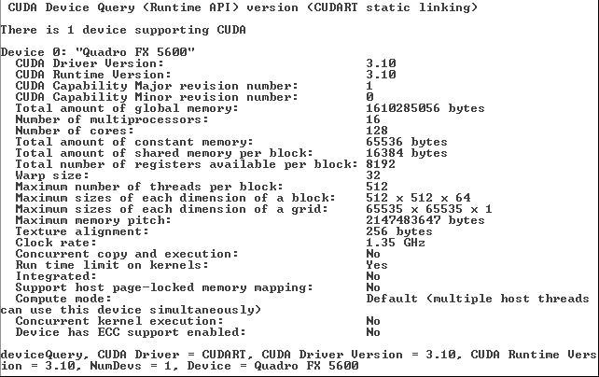
Device Information

Slide 48
Performance
Optimization | Time in ms for 1048576 (1M) elements | Step Speedup | Cummulative Speeup
Simple kernel: No optimization | 1.849457 ms | - | -
Notes:
1 minutes

Slide 49
Revisit the Simple CUDA Kernel Computation of Sum Reduction
T0 T2 T4 T6 T8 T10 …………………….. T126 Active Threads
T1 T3 T5 T7 T9 T11 T127
0 1 2 3 4 5 6 7 8 9 10 11 ……………………………. …… 126 127
3 | 4 | 1 | 7 | 8 | 2 | 5 | 2 | 6 | 9 | 3 | 4 | ...................................... | 5 | 2
S0:Multiple of 2
7 | 4 | 8 | 7 | 10 | 2 | 7 | 2 | 15 | 9 | 7 | 4 | …………………………… | 7 | 2
S1: Multiple of 4
Interleaved inactive threads within a warp
15 | 4 | 8 | 7 | 17 | 2 | 7 | 2 | 22 | 9 | 7 | 4 | …………………………… | 7 | 2
S2: Multiple of 8
Interleaved thread inactivity results in warp divergence
32 |  |  |  |  |  |  |  | X |  |  |  | …………………………..
S3: Multiple of 16
Y |  |  |  |  |  |  |  |  |  |  |  | …………………………..
S4: Multiple of 32
Also uses expensive % operator to compute active threads
Z |  |  |  |  |  |  |  |  |  |  |  | …………………………..
S5:Multiple of 64
A |  |  |  |  |  |  |  |  |  |  |  | .....................................
S6: Multiple of 128
B |  |  |  |  |  |  |  |  |  |  |  | …………………………..
Notes:
3 minutes

Slide 50
Optimization 1: Minimize Warp Divergence
T0 T1 T2 T3 T4 T5 …………………….. T63 Active Threads
0 1 2 3 4 5 6 7 8 9 10 11 ……………………………. …… 126 127
3 | 4 | 1 | 7 | 8 | 2 | 5 | 2 | 6 | 9 | 3 | 4 | ...................................... | 5 | 2
S0: First 64
7 | 4 | 8 | 7 | 10 | 2 | 7 | 2 | 15 | 9 | 7 | 4 | …………………………… | 7 | 2
S1: First 32
15 | 4 | 8 | 7 | 17 | 2 | 7 | 2 | 22 | 9 | 7 | 4 | …………………………… | 7 | 2
S2: First 16
32 |  |  |  |  |  |  |  | X |  |  |  | …………………………..
S3: First 8
Y |  |  |  |  |  |  |  |  |  |  |  | …………………………..
S4: First 4
Z |  |  |  |  |  |  |  |  |  |  |  | …………………………..
S5: First 2
A |  |  |  |  |  |  |  |  |  |  |  | .....................................
S6: 0th thread
B |  |  |  |  |  |  |  |  |  |  |  | …………………………..
Notes:
3 minutes

Slide 51
Modified Kernel to Minimize Warp Divergence
//Perform reduction on shared memory
for (int s = 1; s < blockDim.x; s*=2)
{
if (ltid % (2*s) == 0)
{
s_data[ltid] += s_data[ltid + s];
}
//Sync threads between each stride
__syncthreads();
}
//Write partial result to global memory
if (ltid == 0)
{
d_odata[blockIdx.x] = s_data[0];
}
}
{
int index = 2*s*ltid;
if (index < blockDim.x)
{
sdata[index] += sdata[index + s];
}
//Sync threads between each stride
__syncthreads();
}
First 64 threads execute IF block, and remaining 64 are inactive
Notes:
2 minutes

Slide 52
Is Warp Divergence Completely Removed?
T0 T1 T2 T3 T4 T5 …………………….. T63 Active Threads
0 1 2 3 4 5 6 7 8 9 10 11 ……………………………. …… 126 127
3 | 4 | 1 | 7 | 8 | 2 | 5 | 2 | 6 | 9 | 3 | 4 | ...................................... | 5 | 2
S0: First 64
7 | 4 | 8 | 7 | 10 | 2 | 7 | 2 | 15 | 9 | 7 | 4 | …………………………… | 7 | 2
S1: First 32
Technically not
15 | 4 | 8 | 7 | 17 | 2 | 7 | 2 | 22 | 9 | 7 | 4 | …………………………… | 7 | 2
S2: First 16
32 |  |  |  |  |  |  |  | X |  |  |  | …………………………..
S3: First 8
Warp divergence still exists!
Y |  |  |  |  |  |  |  |  |  |  |  | …………………………..
S4: First 4
But, performance is not much affected
Z |  |  |  |  |  |  |  |  |  |  |  | …………………………..
S5: First 2
A |  |  |  |  |  |  |  |  |  |  |  | .....................................
S6: 0th thread
B |  |  |  |  |  |  |  |  |  |  |  | …………………………..
Notes:
1 minute

Slide 53
Performance
Optimization | Time in ms for 1048576 (1M) elements | Step Speedup | Cummulative Speeup
Simple kernel: No optimization | 1.849457 ms | - | -
Optimization 1: Minimize warp divergence | 0.882953 ms | 2.09x | 2.09x
Notes:
1 minutes

Slide 54
Revisit the Previous Modified Kernel with Optimization 1
T0 T1 T2 T3 T4 T5 ……….. T8………. . T63 Active Threads
0 1 2 3 4 5 6 7 8 9 10 11 ……………………………. …… 126 127
3 | 4 | 1 | 7 | 8 | 2 | 5 | 2 | 6 | 9 | 3 | 4 | ...................................... | 5 | 2
S0: First 64
B1 B2 B3 B4 B5 B6 B7 B8 B9 B10 B11 B12……B16 B1…….
7 | 4 | 8 | 7 | 10 | 2 | 7 | 2 | 15 | 9 | 7 | 4 | …………………………… | 7 | 2
S1: First 32
15 | 4 | 8 | 7 | 17 | 2 | 7 | 2 | 22 | 9 | 7 | 4 | …………………………… | 7 | 2
S2: First 16
32 |  |  |  |  |  |  |  | X |  |  |  | …………………………..
S3: First 8
Threads T0 and T8 belong to same half-warp, but try to simultaneously access same bank B1
Y |  |  |  |  |  |  |  |  |  |  |  | …………………………..
S4: First 4
Z |  |  |  |  |  |  |  |  |  |  |  | …………………………..
S5: First 2
Results in shared memory bank conflict, and memory access of T0 and T8 has to be serialized
A |  |  |  |  |  |  |  |  |  |  |  | .....................................
S6: 0th thread
B |  |  |  |  |  |  |  |  |  |  |  | …………………………..
Notes:
3 minutes
Each bank has a bandwidth of 32 bits per clock cycle
Successive 32-bit words are assigned to successive banks
G80 has 16 banks
So bank = address % 16
Same as the size of a half-warp
No bank conflicts between different half-warps, only within a single half-warp

Slide 55
Optimization 2: Minimize Shared Memory Conflicts
T0 T1 T2 T3 T4 T5 ……………………..T63 Active Threads
0 1 2 3 4 5 …………………………. 63 64 65 66 127
3 | 4 | 1 | 7 | 8 | 2 | …………………………. | 4 | 7 | 1 | 3 | …………………… | 2
S0: First 64
10 | 5 | 4 |  |  |  | …………………………. | 6 |  |  |  | ……………………
S1: First 32
X | Y | Z |  |  |  | …………………………. |  |  |  |  | ……………………
S2: First 16
A | B | C |  |  |  | …………………………. |  |  |  |  | ……………………
S3: First 8
D | E | F |  |  |  | …………………………. |  |  |  |  | ……………………
S4: First 4
G | H | I |  |  |  | …………………………. |  |  |  |  | ……………………
S5: First 2
J | K |  |  |  |  | …………………………. |  |  |  |  | ……………………
S6: 0th thread
L |  |  |  |  |  | …………………………. |  |  |  |  | ……………………
Notes:
3 minutes
Re-capture of bank conflicts as picturial representation

Slide 56
Modified Kernel to Minimize Shared Memory Conflicts
//Perform reduction on shared memory
for (int s = 1; s < blockDim.x; s*=2)
{
if (ltid % (2*s) == 0)
{
s_data[ltid] += s_data[ltid + s];
}
//Sync threads between each stride
__syncthreads();
}
//Write partial result to global memory
if (ltid == 0)
{
d_odata[blockIdx.x] = s_data[0];
}
}
for (int s = blockDim.x/2; s > 0; s>>=1)
{
if (ltid < s)
{
sdataltid] += sdata[ltid + s];
}
//Sync threads between each stride
__syncthreads();
}
{
int index = 2*s*ltid;
if (index < blockDim.x)
{
sdata[index] += sdata[index + s];
}
//Sync threads between each stride
__syncthreads();
}
Index is initialized to half of the block-size and reduced by half in every iteration

Slide 57
Is Shared Memory Conflicts Completely Removed?
T0 T1 T2 T3 T4 T5 ……………………..T63 Active Threads
0 1 2 3 4 5 …………………………. 63 64 65 66 127
3 | 4 | 1 | 7 | 8 | 2 | …………………………. | 4 | 7 | 1 | 3 | …………………… | 2
S0: First 64
10 | 5 | 4 |  |  |  | …………………………. | 6 |  |  |  | ……………………
S1: First 32
Indeed Yes!
X | Y | Z |  |  |  | …………………………. |  |  |  |  | ……………………
S2: First 16
A | B | C |  |  |  | …………………………. |  |  |  |  | ……………………
S3: First 8
D | E | F |  |  |  | …………………………. |  |  |  |  | ……………………
S4: First 4
G | H | I |  |  |  | …………………………. |  |  |  |  | ……………………
S5: First 2
J | K |  |  |  |  | …………………………. |  |  |  |  | ……………………
S6: 0th thread
L |  |  |  |  |  | …………………………. |  |  |  |  | ……………………

Slide 58
Performance
Optimization | Time in ms for 1048576 (1M) elements | Step Speedup | Cummulative Speeup
Simple kernel: No optimization | 1.849457 ms | - | -
Optimization 1: Minimize warp divergence | 0.882953 ms | 2.09x | 2.09x
Optimization 2: Minimize shared memory conflicts | 0.460922ms | 1.91x | 4.01x
Notes:
1 minutes

Slide 59
Revisit the Previous Modified Kernel with Optimization 2
T0 T1 T2 T3 T4 T5 ……………………..T63 Active Threads
0 1 2 3 4 5 …………………………. 63 64 65 66 127
3 | 4 | 1 | 7 | 8 | 2 | …………………………. | 4 | 7 | 1 | 3 | …………………… | 2
S0: First 64
Is synchronization required?
10 | 5 | 4 |  |  |  | …………………………. | 6 |  |  |  | ……………………
S1: First 32
X | Y | Z |  |  |  | …………………………. |  |  |  |  | ……………………
S2: First 16
Actually not!
A | B | C |  |  |  | …………………………. |  |  |  |  | ……………………
S3: First 8
Because, only one last warp is active
D | E | F |  |  |  | …………………………. |  |  |  |  | ……………………
S4: First 4
How can we optimize it?
G | H | I |  |  |  | …………………………. |  |  |  |  | ……………………
S5: First 2
J | K |  |  |  |  | …………………………. |  |  |  |  | ……………………
S6: 0th thread
Unroll the last warp
L |  |  |  |  |  | …………………………. |  |  |  |  | ……………………
Notes:
3 minutes

Slide 60
Modified Kernel with Last Warp Unrolled
//Perform reduction on shared memory
for (int s = 1; s < blockDim.x; s*=2)
{
if (ltid % (2*s) == 0)
{
s_data[ltid] += s_data[ltid + s];
}
//Sync threads between each stride
__syncthreads();
}
//Write partial result to global memory
if (ltid == 0)
{
d_odata[blockIdx.x] = s_data[0];
}
}
for (int s = blockDim.x/2; s > 0; s>>=1)
{
if (ltid < s)
{
sdataltid] += sdata[ltid + s];
}
//Sync threads between each stride
__syncthreads();
}
for (int s = blockDim.x/2; s >32; s>>=1)
{
if (ltid < s)
{
sdataltid] += sdata[ltid + s];
}
__syncthreads();
}
if (ltid < 32)
{
sdata[ltid] += sdata[ltid + 32];
sdata[ltid] += sdata[ltid + 16];
…
sdata[ltid] += sdata[ltid + 1];
}
{
int index = 2*s*ltid;
if (index < blockDim.x)
{
sdata[index] += sdata[index + s];
}
//Sync threads between each stride
__syncthreads();
}
Loop is executed till last warp is reached
Last warp is unrolled
Notes:
2 minutes

Slide 61
Performance
Optimization | Time in ms for 1048576 (1M) elements | Step Speedup | Cummulative Speeup
Simple kernel: No optimization | 1.849457 ms | - | -
Optimization 1: Minimize warp divergence | 0.882953 ms | 2.09x | 2.09x
Optimization 2: Minimize shared memory conflicts | 0.460922ms | 1.91x | 4.01x
Optimization 3: Unroll last warp | 0.254793 ms | 1.80x | 7.25x
Notes:
1 minutes

Slide 62
Questions?

Slide 63
THANKS

