Slide 1
How GPUs Work?

Slide 2
OUTLINE
An overview of graphics rendering pipeline
An overview of graphics programming
An overview of GPU architecture - three main ideas behind GPU architecture

Slide 3
Part - 1
An overview of graphics rendering pipeline

Slide 4
The Graphics Rendering Pipeline
Rendering
Process to convert high level description to a specific instance
Graphics Rendering
Process to convert raw 3D scene description (set of vertices) to a 2D pixel image
Graphics Rendering Pipeline
Sequence of stages followed during graphics rendering process

Slide 5
Main Stages In Graphics Rendering Pipeline
Vertex Processing
transform input vertices from world space to screen space
apply texture to vertices
convert set of vertices to set of primitives (usually triangles)
remove (part of) primitives which lie outside the screen space
3D to 2D coordinate mapping of all primitive units
find all the fragments (pixels) which belong to each primitive unit
Primitive Processing
Fragment Processing
apply different attributes like color, lighting, texture, etc to fragments

Slide 6
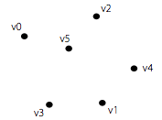
Graphics Rendering Pipeline - An Illustration
Vertex Processing
Set of Vertices

Slide 7

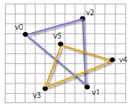
Graphics Rendering Pipeline - An Illustration
Primitive Processing
Primitives
Fragments

Slide 8


Graphics Rendering Pipeline - An Illustration
Fragment Processing
Shaded Fragments
Pixels

Slide 9
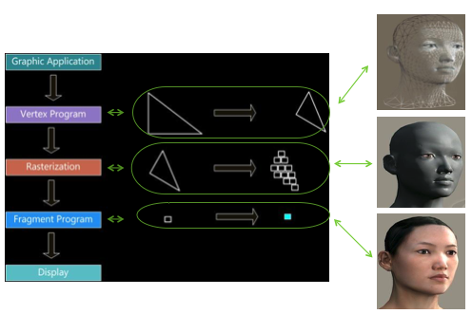

Slide 10
Part - 2
An Overview of Graphics Programming

Slide 11
Graphics Programming - Key Observations
Vertex Processing
Each vertex can be programmed independently, and same sequence of vertex operations is applied to each vertex
Primitive Processing
Each primitive can be programmed independently, and same sequence of primitive operations is applied to each primitive
Fragment Processing
Each fragment can be programmed independently, and same sequence of fragment operations is applied to each fragment
Scope for massive parallelism
SPMD (Single Program Multiple Data) parallelism
Hardware can be designed by keeping this massive parallelism in mind, and programmable GPUs were initially born this way
Corresponding programming model is called shader programming model

Slide 12
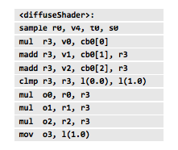
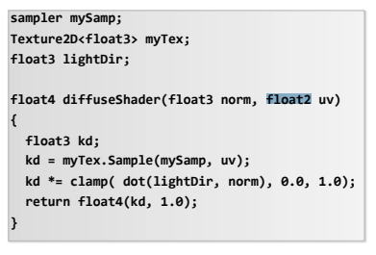
How Shader Programming Works? Shader Compilation
Shader Compiler
A fragment shader
Compiled fragment shader

Slide 13
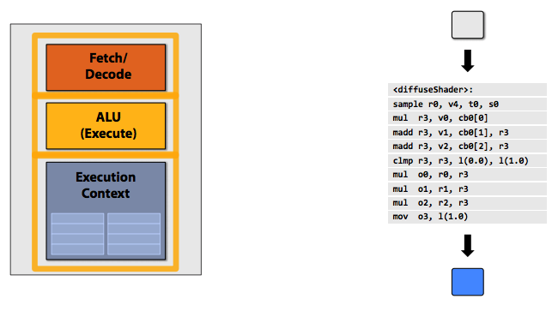
How Shader Programming Works? Shader Execution
Shader execution

Slide 14
Part - 3
An Overview of GPU Architecture
How GPUs Can Be Designed To Take Advantage Of Massive Parallelism?

Slide 15
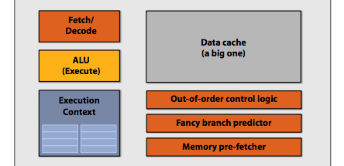
CPU-Style Cores
Makes sequential program execution faster
CPU-style cores

Slide 16
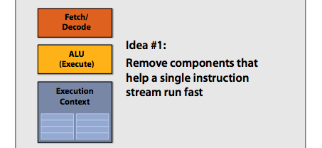
Idea #1: Slim Down The Core And Pack Multiple Simple Cores

Slide 17
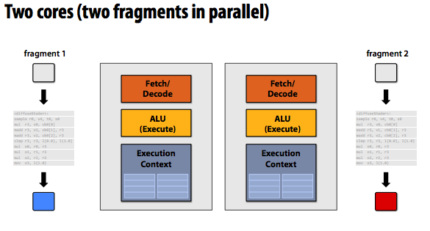

Slide 18
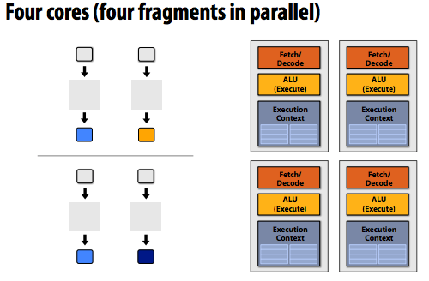

Slide 19
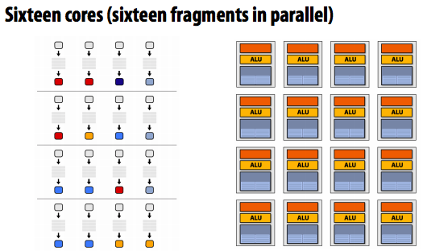
16 cores = 16 copies of same simultaneous instruction streams,
but, each work on 16 different fragment data to produce corresponding output fragment

Slide 20
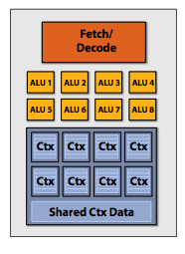
Idea #2: Pack More ALUs Within The Core (SIMD Processing)
SIMD Processing
Single Instruction Multiple Data

Slide 21
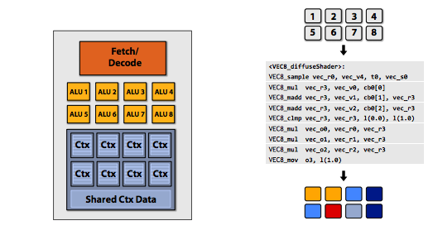
vector instructions
New Modified Shader

Slide 22
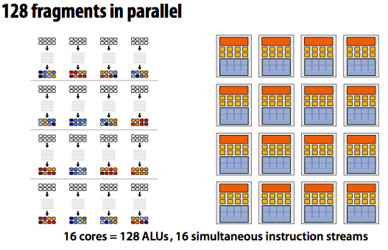
Type to enter a caption.

Slide 23
So Far So Good!
But, what about Stalls which occurs because of instruction dependency?
We have removed fancy Caches and Logic which avoid stalls to a greater extent in CPU-style cores.

Slide 24
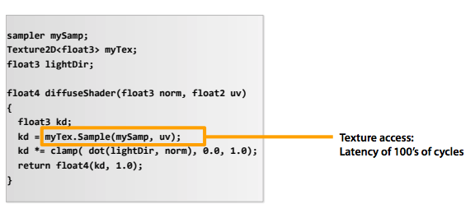

Slide 25
Idea #3: Hide Latency To Achieve Maximum Throughput
We have LOTS of independent fragments.
(way more fragments to process than ALUs)
Interleave processing of many fragments on a single core to avoid stalls caused by high latency operations.
In Layman words, keep the cores always busy, and it is possible to a greater extent in graphics programming.

Slide 26
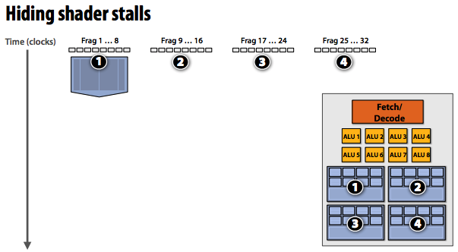

Slide 27
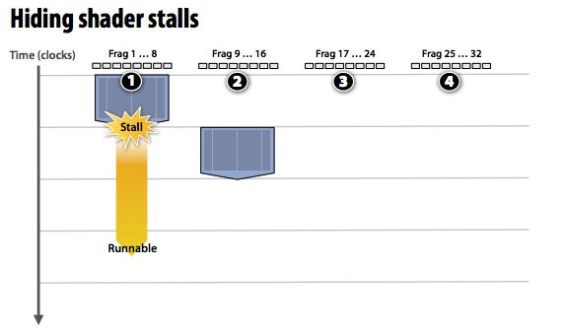

Slide 28
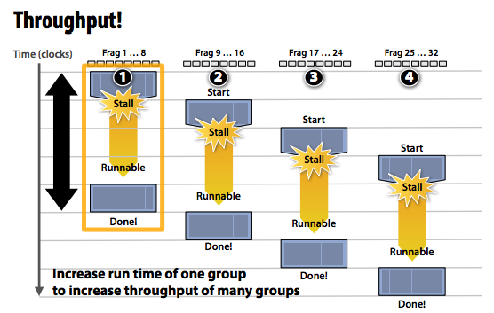

Slide 29
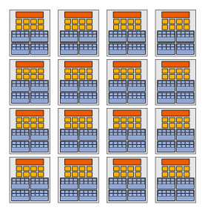
Idea #1: 16 cores per chip (SPMD at chip level)
Idea #2: 8 ALUs per core (SIMD at core level)
Idea #3: 4 execution contexts per core (in order to
hide latency)
So, at any given point of time, processing of 512 concurrent fragments are in flight!
Todays modern GPUs are a way more powerful than this illustrated example GPU!
Our Example GPU

Slide 30
Questions?

