Slide 1
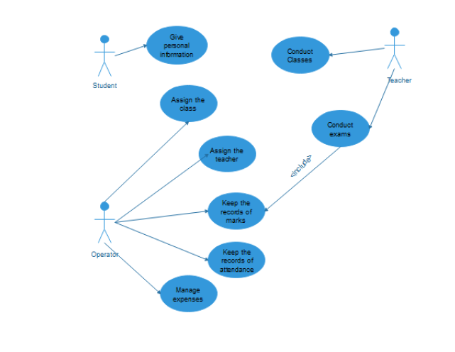
This software is for A/l Commerce tutuion class. For subjects,
Business studies Econ Accountancy General English GIT
Classes are conducted on All 7 days of the week
The Manager and a one of another person can be log
In to the software and manage the recordings

Slide 2
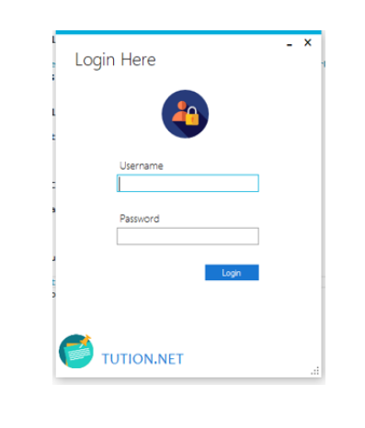
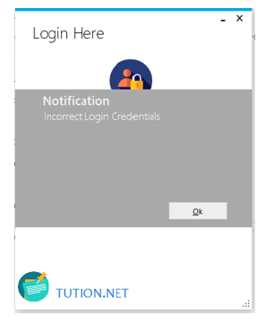
Login Page for the invalid user login

Slide 3
Home Page
TEACHER
STUDENT
ATTENDANCE
PAYMENT
REPORTS

Slide 4
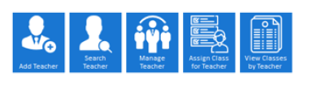
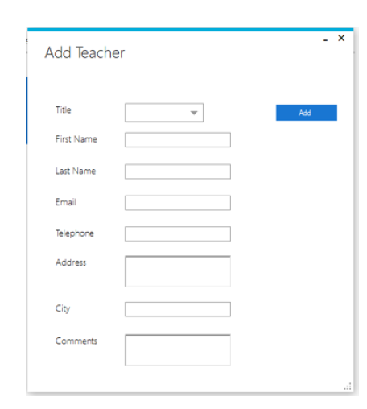
1.When click the Teacher Tab
Manage teacher icon Should be replaced by
“All teachers”
1.1 Add teacher

Slide 5
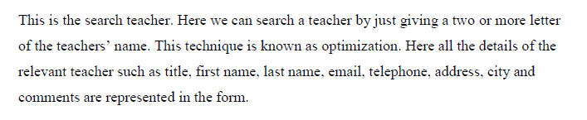
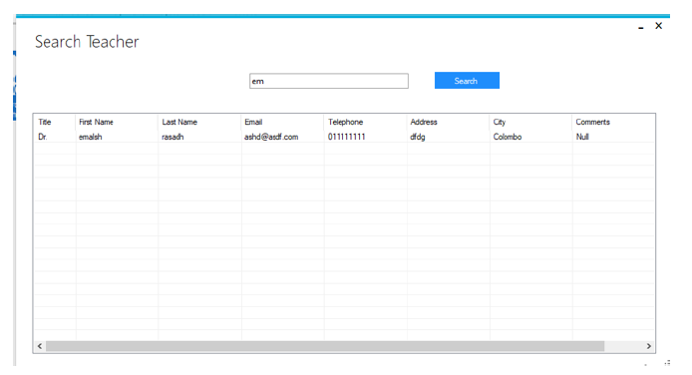
1.2 Search Teacher Information

Slide 6
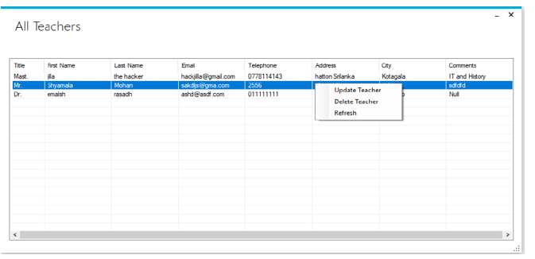
1.3 View All Teachers 1.3.1 update Teacher
1.3.2 delete Teacher

Slide 7
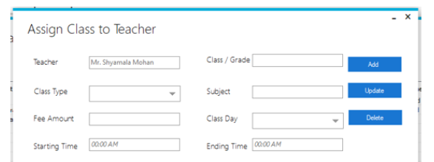
1.4 Assign classes to the teacher 1.5 View classes by teacher
By Entering the teacher name
the assigned classes should be displayed

Slide 8
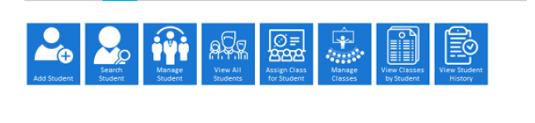
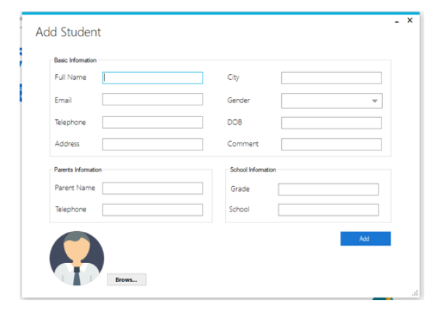
2. When click the Student Tab
3RD, 6TH,7TH ICONS ARE NOT NEEDED
2.1 Add student

Slide 9
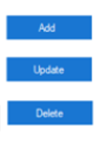
2.2 Search Student
2.3 view all students
2.3.1 view student 2.2 and 2.3 are same as Teachers
2.3.2 delete student
2.4 Assign class to the student 2.5 View Classes by Student
By Entering the student name
the assigned classes should be displayed
Assign Class to Student
Student
Teacher
Class/ Grade

Slide 10
3. Attendence
Generate QR code
Scan
Attendances
(from Students)
Attendances
(from Class wise and day wise)

Slide 11
3.1 Generate QR code > Print
3.2 Scan > Attendence should be marked
QR code
PRINT

Slide 12
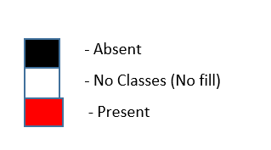
3.3 Attendence (from student)
Month
Year
Student
Class
Teacher
Export to CVV

Slide 13

3.4 Attendence (from class wise and day wise)
Class
Teacher
80
Number of the student present
Export to CVV

Slide 14
4. Payments
Pay Feez
Payments paid (from class wise)

Slide 15
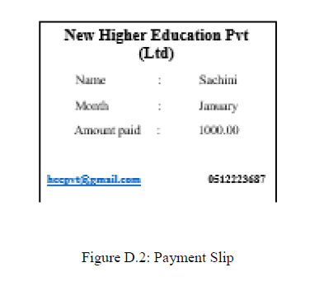
4.1. Pay Fees
Index Number :
Class :
Year :
Month :
Amount :
Class : Econ
PRINT

Slide 16


4.2 Payments paid from class wise
Rs. 200, 000.00
Total Amount for the month

Slide 17
5. Reports
Attendance
Report
Payment
Report

Slide 18
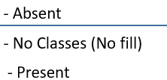
-
Month
 | 1 | 2 | 3 | 4 | 5 | 6 | 7 | 8 | 9 |  |  |  |  |  |  |  |  |  |  |  |  |  |  |  |  |  |  |  |  |  | 31
Ashan
Nimal
Export to CVV

Slide 19

5.2 Payment Report
Year
 | Jan | Feb | Mar | Apr | May | Jun | Jul | Aug | Sep | Pct | Nov | Dec
Ashan
Nimmi
Kasun
Export to CVV
- Paid

