Slide 1
QTL Cartographer
A Program Package for mapping Quantitative Trait Loci
C. J. Basten
Z.-B. Zeng and B. S. Weir

Slide 2
Experimental Design
Inbred Lines
P
P
1
2
F
1
B
B
1
2
F
2

Slide 3
Crosses
Backcross to either parental line (B1, B2)
Repeated backcrosses (B1i, B2i)
Intercrosses, either selfed (SFi) or randomly mated (RFi)
Testcross of SFi or RFi to either parental line
Testcross of SFi for j more generations
Recombinant inbreds from selfing (RI1) or sib mating (RI2) and doubled haploids (RI0)

Slide 4
Three Phases
Phase I: Simulate or Reformat Data
Phase II: Analyze Data
Phase III: Visualize Results

Slide 5
Data Preparation
Simulate a genetic linkage map, genetic model and data set of marker and trait values
Reformat a MAPMAKER data set
Reformat your own data set
Perform a bootstrap resampling

Slide 6
Reformat MAPMAKER Data
MAPMAKER *.raw file
Create *.maps file with MAPMAKER
Rmap reformats *.maps file
Rcross reformats *.raw file
*.maps
*.raw
Rmap
Rcross
Rmap.out
Rcross.out

Slide 7
Simulate Data
Rmap creates a linkage map
Rqtl creates a genetic model
Rcross creates a data set of marker and trait values
Rmap
Rqtl
Rcross
Rmap.out
Rqtl.out
Rcross.out

Slide 8
Resample Data
Prune allows resampling of data
Permute traits on genotypes
Bootstrap
Simulate missing or dominant markers
Simulate selective genotyping
Rmap.out
Rcross.out
Prune
Rcross2.out

Slide 9
Transition to Analysis
At this point, we have a genetic linkage map and a data file of the proper format
All analyses will depend on these two files
Call them Rmap.out and Rcross.out

Slide 10
Analysis Modules
Qstats for basic statistics
LRmapqtl, SRmapqtl and MultiRegress for linear regression
Zmapqtl, JZmapqtl for interval and composite interval mapping
MImapqtl for multiple interval mapping
In general, input a map (Rmap.out) and data (Rcross.out)
Some can also input a putative model

Slide 11
Qstats
Calculate basic statistics on each trait
Produce histogram of each trait
Summarize missing data for each marker and each individual
Perform tests for marker segregation
Often will find that problems with other programs due to missing data

Slide 12
LRmapqtl
Do simple linear regression of trait on each marker in turn
Trait = Mean + Marker + Error
Estimate model parameters
F statistic for Hypothesis of a Linked QTL

Slide 13
SRmapqtl
Forward stepwise regression to rank markers
Backward elimination to rank markers
Forward addition with a final backward elimination step: Rank markers, but only add or delete subject to criteria

Slide 14
MultiRegress
Requires a specially formatted input file produced by JZmapqtl
Does stepwise regression of trait on QTL expected values
Least-squares based analysis is fast
Can produce a putative model for input into multiple interval mapping

Slide 15
Zmapqtl
Do interval or composite interval mapping (IM or CIM)
Specify genome walk rate
Choose cofactors for CIM
Perform tests using the bootstrap, jacknife or permutation

Slide 16
CIM Model 6
Test Site
Blocked Region
LFM
RFM
Top markers (as determined by stepwise regression) not in blocked regions used as cofactors
Markers

Slide 17
CIM Model 8
Use Zmapqtl and Eqtl to identify a set of markers closest to likelihood peaks
These markers used as cofactors in next round of CIM
Can repeat until a stable set of cofactors obtain

Slide 18
Missing Data
Jiang and Zeng method using Markov chain to infer missing markers
Dominant markers can also be used
Same algorithms for genotype at test site in IM and CIM
Many experimental designs available

Slide 19
JZmapqtl
Map multiple traits using IM or CIM
Simultaneous estimation of additive and dominance effects
Joint and single trait likelihood ratios
G x E interactions
Still a work in progress: not yet integrated into Preplot

Slide 20
MImapqtl
Implements Kao and Zeng’s multiple interval mapping
Allows for estimation of epistatic interactions
Calculates variance/covariance matrix, residuals and breeding values for a model

Slide 21
MImapqtl
Analyze a single trait in a single environment with multiple interval mapping
Additive, dominance and epistatic interactions
Breeding values for MAS
Variance/covariance matrix for parameters

Slide 22
Model evaluation
Information criterion that employs a penalty function for added parameters
Compare these functions for k and k+1 parameter models to decide whether to keep a new parameter
Six possibilities in MImapqtl

Slide 23
Initial Model
Could be true model from simulation (Rqtl output)
Could be estimated model from other method (Zmapqtl, then Eqtl output or MultiRegress)
Could be from prior run of MImapqtl
Can also calculate residuals from model and use them as new trait

Slide 24
Given Initial Model
Read in model
Re-estimate parameters
Refine position estimates within intervals
Test significance of all QTL
Search for new QTL
Search for interactions

Slide 25
De novo Analysis
Can start without an initial model
Search for QTL main effects
Search for interactions

Slide 26
Once a Model is Found
Calculate breeding values of individuals for MAS
Calculate variance/covariance matrix
Calculate r squared values for each parameter
Format model so that it may be used in simulations or further analyses

Slide 27
Visualization Schematic
Rqtl.out
Rmap.out
c#t#.?
Preplot
GNUPLOT
Eqtl
(pictures)
Zmapqtl.out
LRmapqtl.out

Slide 28
Visualization
Use Zmapqtl.out, LRmapqtl.out and Rmap.out
Summarize QTL positions and effects with Eqtl
Display graphs with Preplot and GNUPLOT

Slide 29
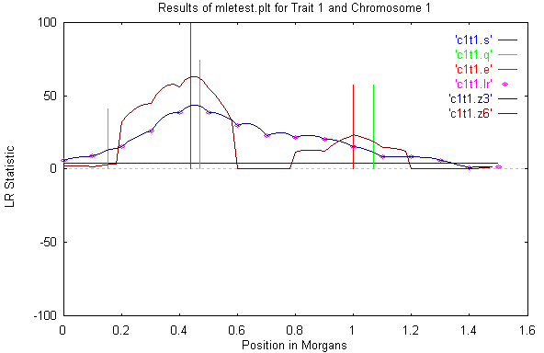

Slide 30
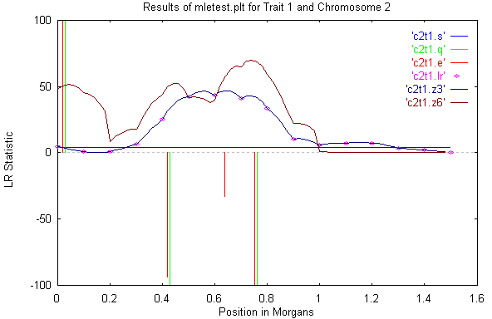

Slide 31
Scripting
QTL Cartographer modules can be scripted in csh or Perl
Perl scripts include Bootstrap.pl, Permute.pl, Model8.pl among others
Perl scripts tested under MacOSX and Solaris 8

Slide 32
Computing Environment
Programs written in C language
UNIX, MS-Windows and Macintosh versions are available
Command line and menu driven interfaces
Same look and feel over all platforms

Slide 33
Availability
Free. Source code with UNIX version, binaries for Windows and Macintosh
Anonymous ftp: in /pub/qtlcart on statgen.ncsu.edu
See also: http://statgen.ncsu.edu/qtlcart
Manual in pdf and html

