Slide 1
Exact Acceleration of K-Means++ and K-Means||
Paper by: Edward Raff Group 15: Mohammad Mahmoudi, Hesam Mousavi

Slide 2
Abstract
Selecting the initial seeds of K-means
Considering the limited opportunities within seed selection to perform pruning
Triangle inequality pruning strategies
Dynamic priority queue

Slide 3
Introduction
Seed selection step is critical to obtaining high quality results with the K-means algorithm.
K-means++ algorithm are log-optimal for solving the -means problem [Arthur and Vassilvitskii, 2007] requires O(nK) distance computations.
If Parallel processors are available P-means++ can be done in O(nK/P)
Communication overhead -> Bahmani et al. [2012] introduced K-means||

Slide 4
Introduction[cont.]
The cost of K-means++ has long been recognized as being an expensive but necessary step for better results
…

Slide 5
Accelerating K-Means++
Parameters:
K: number of cluster
X, W: each data point and associated weight
Variables:
Alpha: cache the distance between each point and it’s closest mean
Gamma: Distance of previous means to the last mean
m: store means
Q: priority queue
Method of improving:
Applying the Triangle Inequality
Let x be a point and let b and c be centers. If d(x,c) >= 2d(x,b) then d(x,c) >= d(x,b)
Create dynamic priority queue with binary heap tree
How to update?

Slide 6
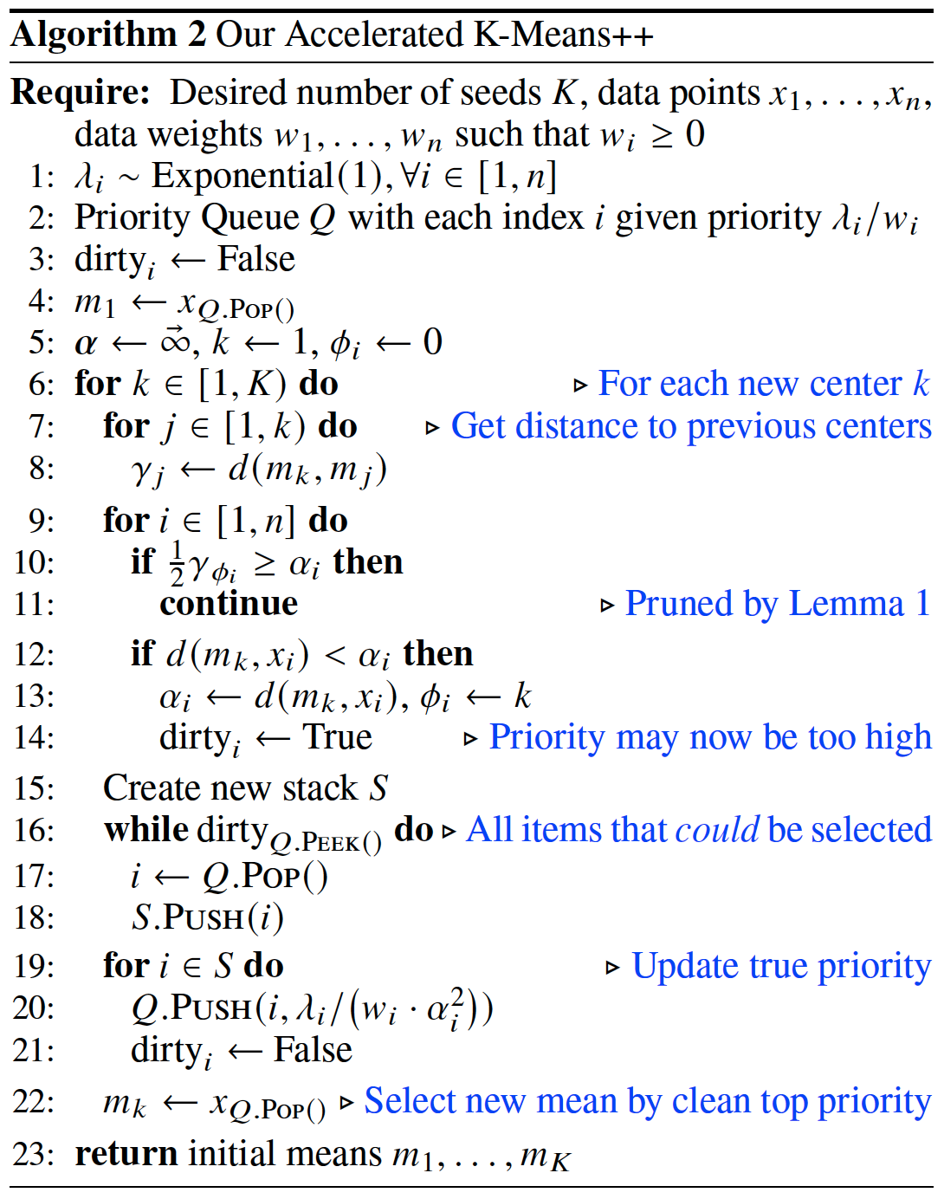

Slide 7
Accelerating K–Means||
Parameters:
K: number of cluster
X, W: each data point and associated weight
R: number of rounds (5 in our implementation)
L: over sampling factor (2xK in our implementation)
Variables:
Alpha: cache the distance between each point and it’s closest mean
Gamma: Distance of previous means to the last mean
c: our means
C: VPtree
Method of improving:
Use the Vantage Point tree (VP) algorithm (instead of triangle inequality)
Find nearest mean in O(log K)

Slide 8
Nearest In Range Queries
Parameters:
q: query point
r: search within a radius of r to the query
Variables:
tau: to keep track of the distance to the nearest neighbor found.
near_{low} , near_{high}: the shortest and farthest distance to the points in the left child
far_{ow} , far_{high}: the shortest and farthest distance to the points in the right child
Method of improving:
Set initial tau = alpha[q]

Slide 9
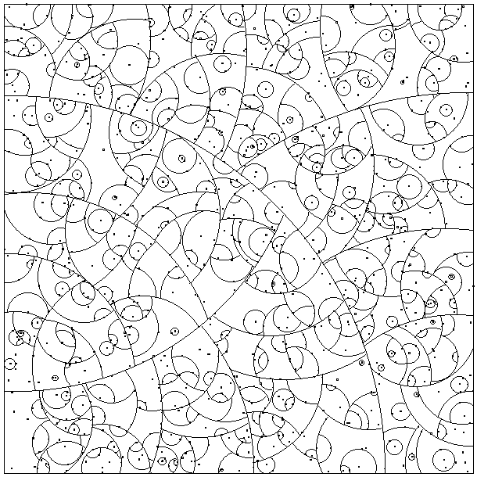
Vantage Point tree (VP)

Slide 10
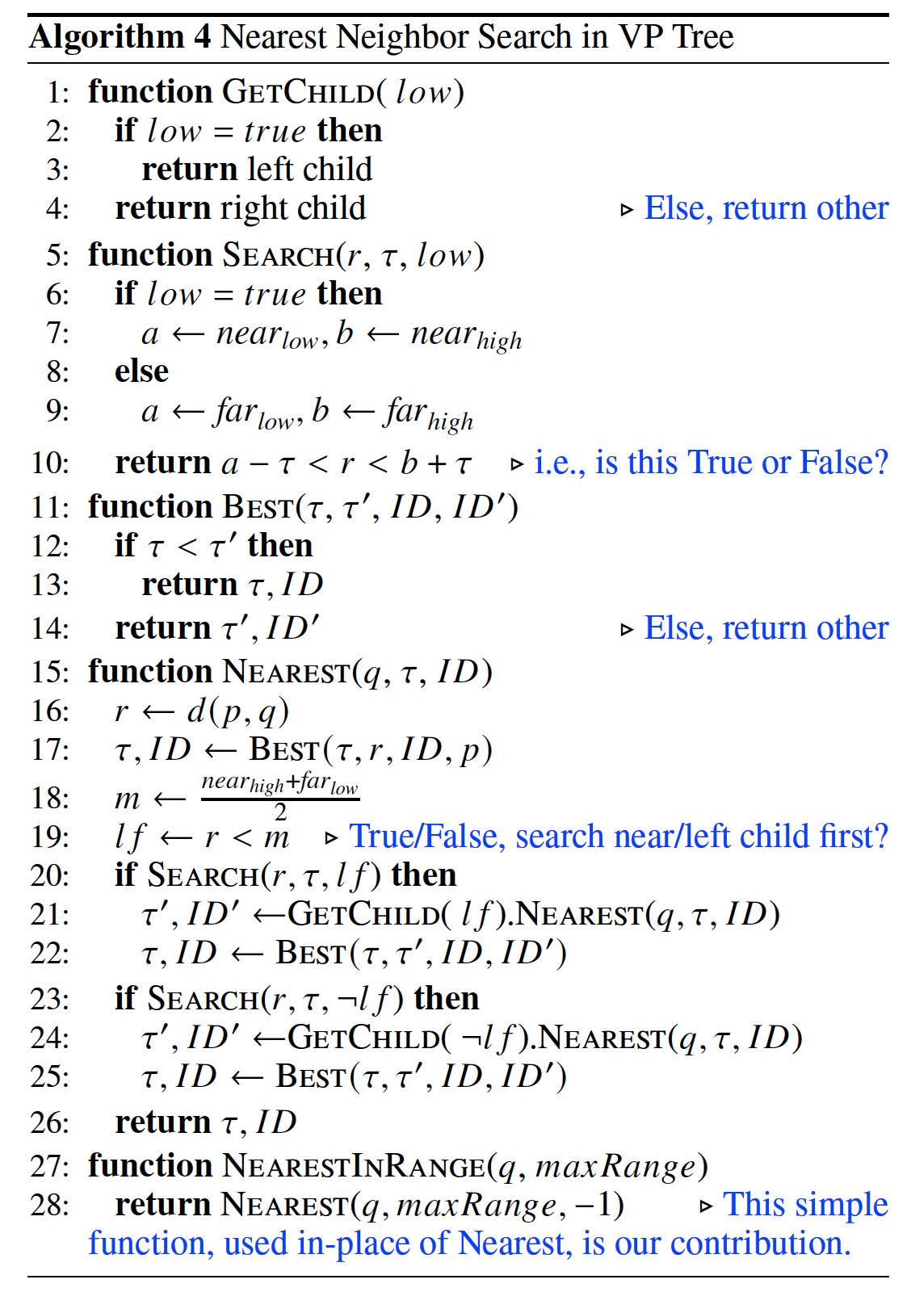

Slide 11
