Slide 1
Exact Acceleration of K-Means++ and K-Means||
Paper by: Edward Raff Group 15: Mohammad Mahmoudi, Hesam Mousavi

Slide 2
Abstract
Selecting the initial seeds of K-means
Considering the limited opportunities within seed selection to perform pruning
Triangle inequality pruning strategies
Dynamic priority queue

Slide 3
Introduction
Seed selection step is critical to obtaining high quality results with the K-means algorithm.
K-means++ algorithm are log-optimal for solving the -means problem [Arthur and Vassilvitskii, 2007] requires O(nK) distance computations.
If Parallel processors are available P-means++ can be done in O(nK/P)
Communication overhead -> Bahmani et al. [2012] introduced K-means||

Slide 4
Introduction[cont.]
The cost of K-means++ has long been recognized as being an expensive but necessary step for better results.
Modern accelerated versions of K-means clustering perform as few as 1.2 total iterations of the dataset [Ryšavý and Hamerly, 2016].
making K-means++ seed selection take up to 44% of all distance computations.
Faster seed selection is useful many application such as:
Corset construction [Bachem et al., 2015]
Change detection [Raff et al., 2020]
Tensor algorithms [Jegelka et al., 2009]
…

Slide 5
Introduction[cont.]
Accelerating K-means++
Triangle inequality
Dynamic priority queue
Accelerating K-means ||
NearestInRange query
Empirical evaluation
Large dataset
K in range [32, 4096]

Slide 6
Accelerating K-Means++
Parameters:
K: number of cluster
X, W: each data point and associated weight
Variables:
Alpha: cache the distance between each point and it’s closest mean
Gamma: Distance of previous means to the last mean
m: store means
Q: priority queue
Method of improving:
Applying the Triangle Inequality
Let x be a point and let b and c be centers. If d(x,c) >= 2d(x,b) then d(x,c) >= d(x,b)
Create dynamic priority queue with binary heap tree
How to update?

Slide 7
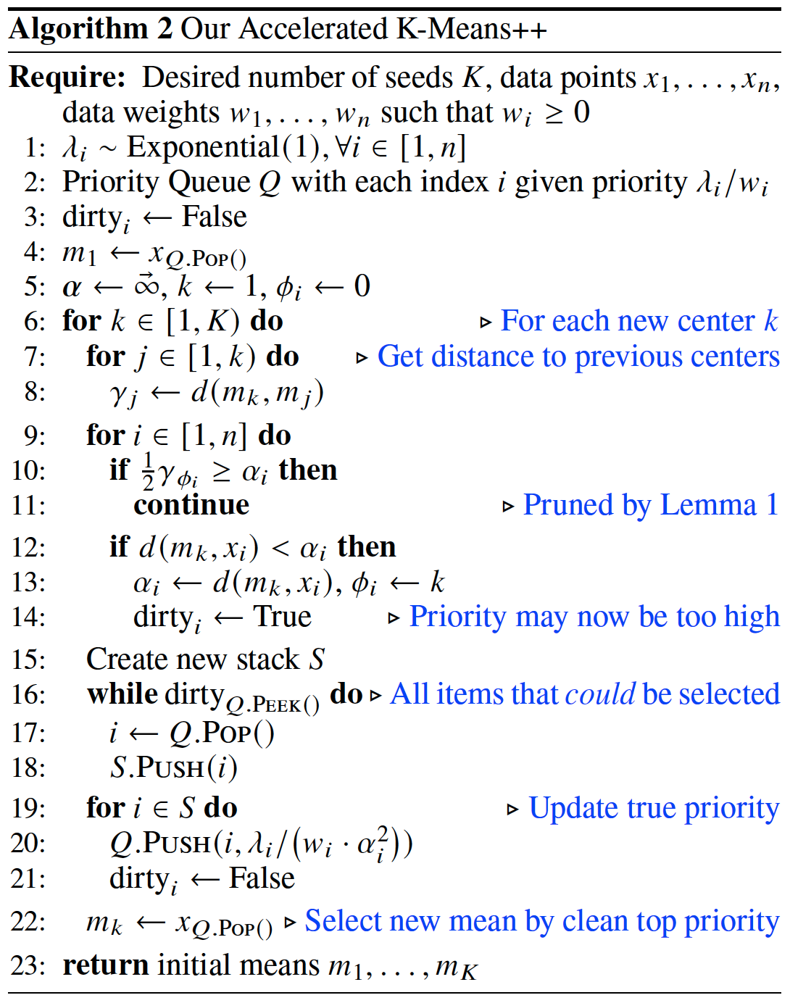

Slide 8
Accelerating K–Means||
Parameters:
K: number of cluster
X, W: each data point and associated weight
R: number of rounds (5 in our implementation)
L: over sampling factor (2xK in our implementation)
Variables:
Alpha: cache the distance between each point and it’s closest mean
Gamma: Distance of previous means to the last mean
c: our means
C: VPtree
Method of improving:
Use the Vantage Point tree (VP) algorithm (instead of triangle inequality)
Find nearest mean in O(log L)

Slide 9
Nearest In Range Queries
Parameters:
q: query point
r: search within a radius of r to the query
Variables:
tau: to keep track of the distance to the nearest neighbor found.
near_{low} , near_{high}: the shortest and farthest distance to the points in the left child
far_{ow} , far_{high}: the shortest and farthest distance to the points in the right child
Method of improving:
Set initial tau = alpha[q]

Slide 10
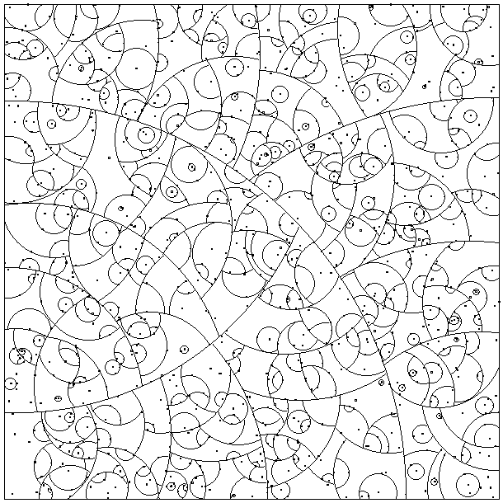
Vantage Point tree (VP)

Slide 11
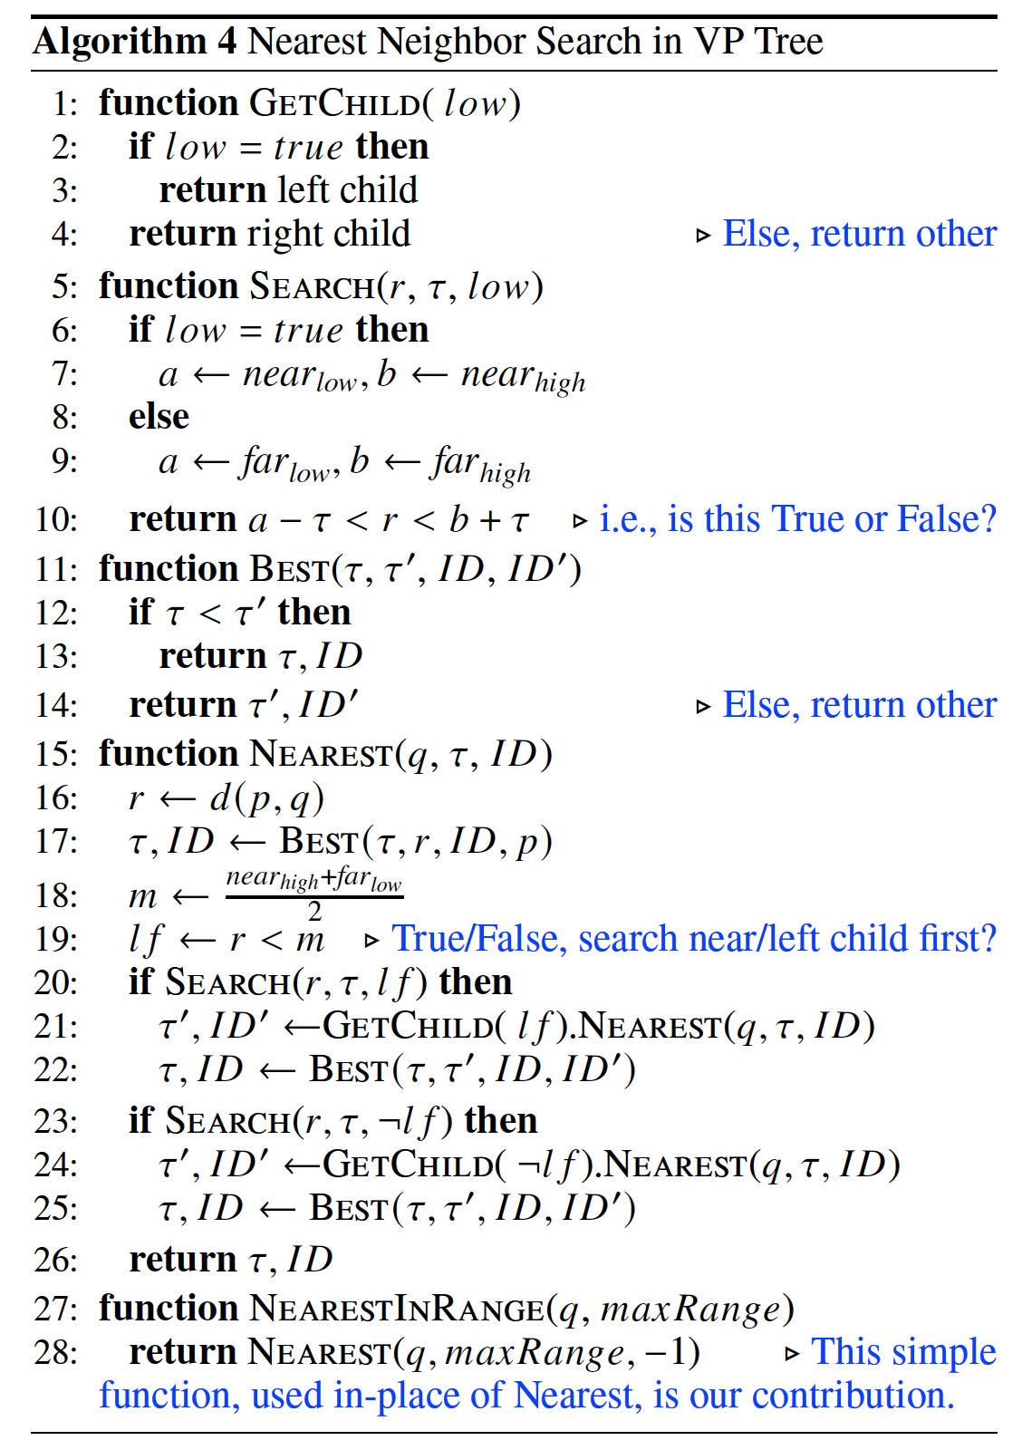

Slide 12
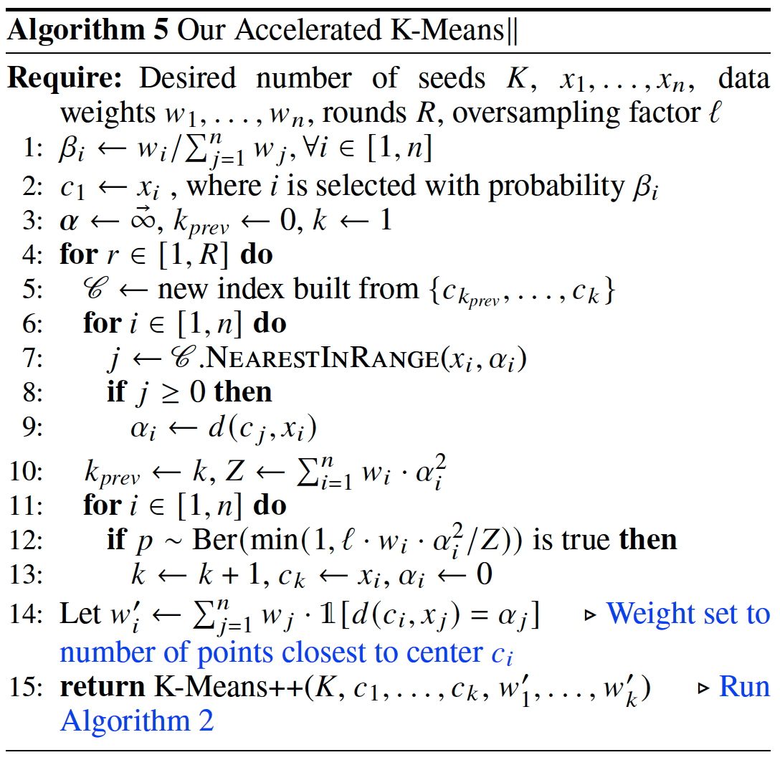

Slide 13
An overview of the work done

Slide 14
Modules
tools
binary_heap
kpp
kll
result-kmeans-plusplus
dataset
nearest_neighbor_search
akpp
akpp
result-kmeans-parallel

Slide 15
Functions in tools
[function]
[detail]

Slide 16
Functions in dataset
[function]
[detail]

Slide 17
Functions in binary_heap
[function]
[detail]

Slide 18
Functions in nearest_neighbor_search
[function]
[detail]

Slide 19
Functions in kpp
[function]
[detail]

Slide 20
Functions in akpp
[function]
[detail]

Slide 21
Functions in kll
[function]
[detail]

Slide 22
Functions in akll
[function]
[detail]

Slide 23
Functions in [module]
[function]
[detail]

Slide 24
Functions in result-kmeans-parallel
[function]
[detail]

