Slide 1
Exact Acceleration of K-Means++ and K-Means||
Paper by: Edward Raff Group 15: Hesam Mousavi, Mohammad Mahmoudi

Slide 2
Abstract
Selecting the initial seeds of K-means
Considering the limited opportunities within seed selection to perform pruning
Triangle inequality pruning strategies
Dynamic priority queue

Slide 3
Introduction
Seed selection step is critical to obtaining high quality results with the K-means algorithm.
K-means++ algorithm are log-optimal for solving the -means problem [Arthur and Vassilvitskii, 2007] requires O(nK) distance computations.
If Parallel processors are available P-means++ can be done in O(nK/P)
Communication overhead -> Bahmani et al. [2012] introduced K-means||

Slide 4
Introduction[cont.]
The cost of K-means++ has long been recognized as being an expensive but necessary step for better results
Modern accelerated versions of K-means clustering perform as few as 1.2 total iterations of the dataset [Ryšavý and Hamerly, 2016].
making K-means++ seed selection take up to 44% of all distance computations.
Faster seed selection is useful many application such as:
Corset construction [Bachem et al., 2015]
Change detection [Raff et al., 2020]
Tensor algorithms [Jegelka et al., 2009]
…

Slide 5
Introduction[cont.]
Accelerating K-means++
Triangle inequality
Dynamic priority queue
Accelerating K-means ||
NearestInRange query
Empirical evaluation
Large dataset
K in range [32, 4096]

Slide 6
K-Means++
Parameters:
K: number of cluster
X, W: each data point and associated weight
Variables:
Alpha: cache the distance between each point and it’s closest mean
Beta: new weight based on the squared distance of X to the closest existing seed
m: store means ( initial center )

Slide 7
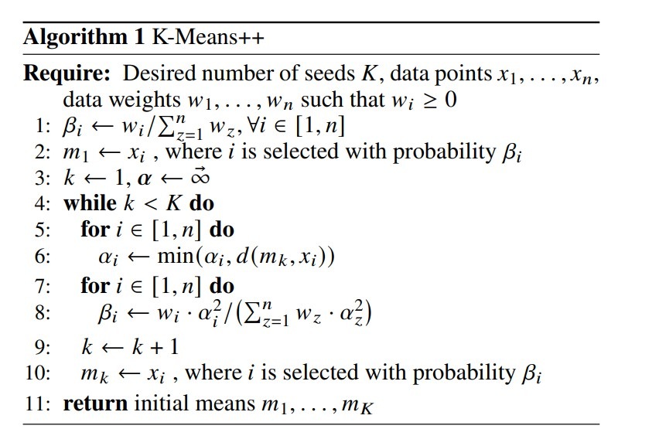

Slide 8
Accelerating K-Means++
Parameters:
K: number of cluster
X, W: each data point and associated weight
Variables:
Alpha: cache the distance between each point and it’s closest mean
Gamma: Distance of previous means to the last mean
m: store means
Q: priority queue
Method of improving:
Applying the Triangle Inequality
Let x be a point and let b and c be centers. If d(x,c) >= 2d(x,b) then d(x,c) >= d(x,b)
Create dynamic priority queue with binary heap tree
How to update?

Slide 9
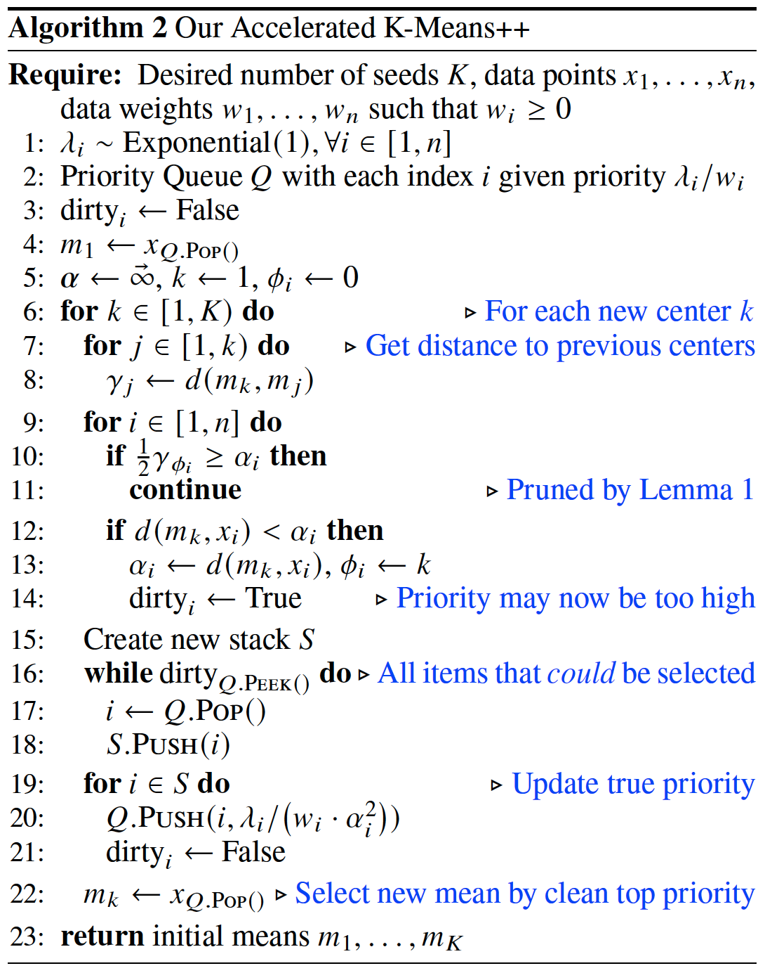

Slide 10
K–Means||
Parameters:
K: number of cluster
X, W: each data point and associated weight
R: number of rounds (5 in our implementation)
L: over sampling factor (2xK in our implementation)
Variables:
Alpha: cache the distance between each point and it’s closest mean
Beta: new weight based on the squared distance of X to the closest existing seed
c: our means

Slide 11
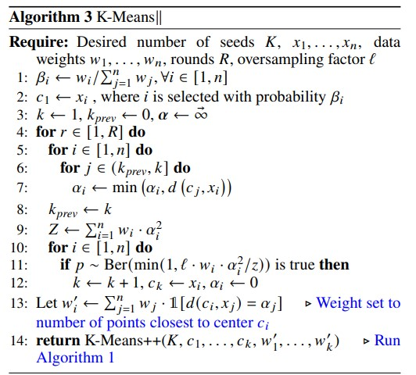

Slide 12
Accelerating K–Means||
Parameters:
K: number of cluster
X, W: each data point and associated weight
R: number of rounds (5 in our implementation)
L: over sampling factor (2xK in our implementation)
Variables:
Alpha: cache the distance between each point and it’s closest mean
Gamma: Distance of previous means to the last mean
c: our means
C: VPtree
Method of improving:
Use the Vantage Point tree (VP) algorithm (instead of triangle inequality)
Find nearest mean in O(log K)

Slide 13
Nearest In Range Queries
Parameters:
q: query point
r: search within a radius of r to the query
Variables:
tau: to keep track of the distance to the nearest neighbor found.
near_{low} , near_{high}: the shortest and farthest distance to the points in the left child
far_{ow} , far_{high}: the shortest and farthest distance to the points in the right child
Method of improving:
Set initial tau = alpha[q]

Slide 14
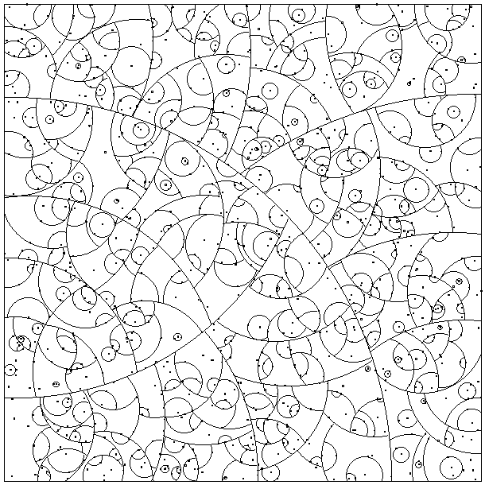
Vantage Point tree (VP)

Slide 15
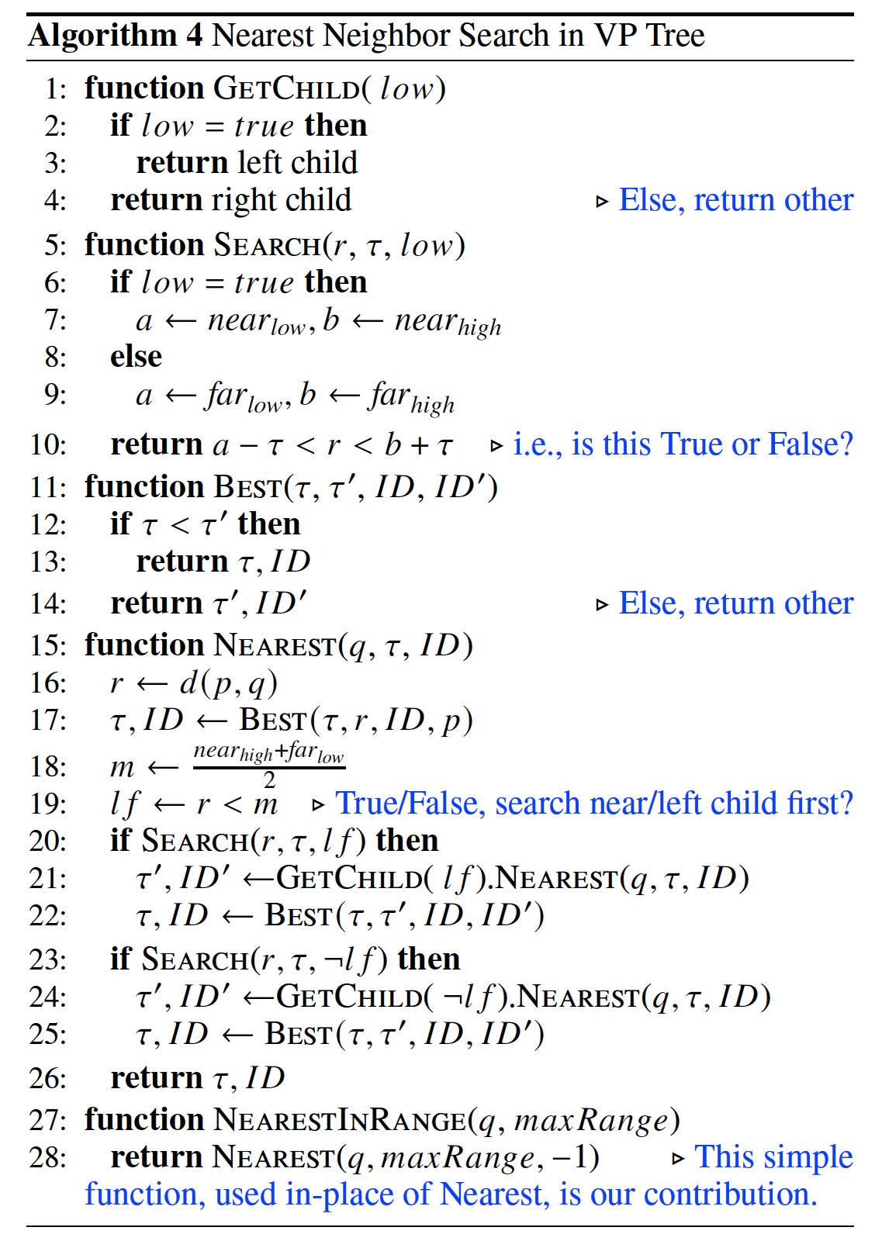

Slide 16
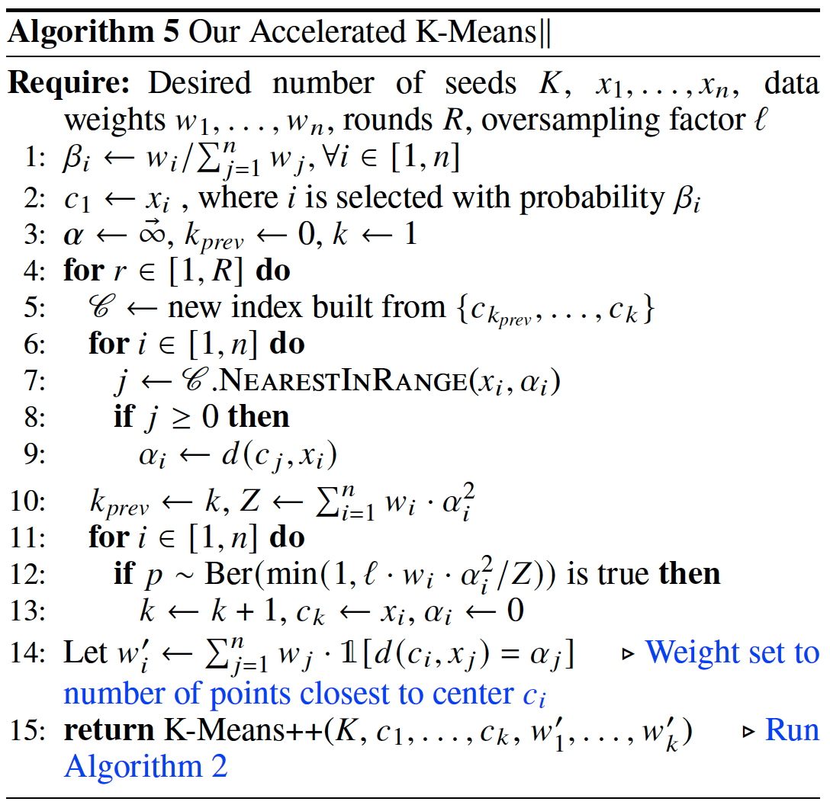

Slide 17
Experimental Result
The two measures we are concerned with are the following:
reducing the total number of distance computations .
the total run-time spent.
We use phishing dataset with :
11055 samples
68 features

Slide 18
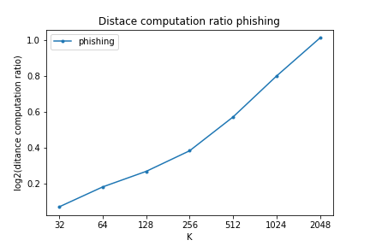
K-means ++ VS Accelerated K-means ++
Distance ratio
Total distance computed K-means ++ / Total distance computed Accelerated K-means

Slide 19
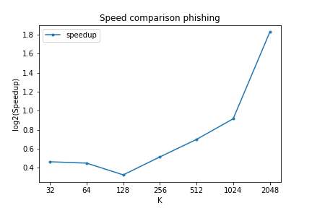
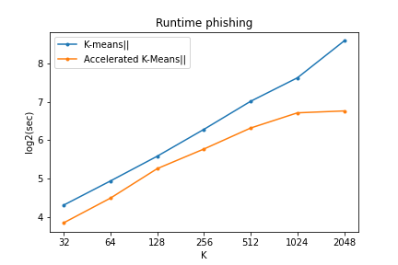
K-means ++ VS Accelerated K-means ++

Slide 20
An overview of the work done

Slide 21
Modules
tools
binary_heap
kpp
kll
result-kmeans-plusplus
dataset
nearest_neighbor_search
akpp
akpp
result-kmeans-parallel

Slide 22
Functions in tools
distance
Using SciPy to find Euclidean distance of each pair (x, y)
new_seed
Select L new seed(s) with our probability from X
tlogger
Decorator for Store total computated distance
execution_time
Decorator for compute runtime of function

Slide 23
Functions in dataset
__init__
Get file path or ndarray and initialize all the needed variables
read_dataset
With this function you can read dataset with file path or as ndarray

Slide 24
Functions in binary_heap
Class BinaryHeap:
__init__
Get points and create binary heap tree each node is (point, id)
push
Get new point and it’s id and add to the tree in O(log n)
pop
Pop the node with minimum value(root) from tree and remove the node O(log n)
Return minimum value in tree
peek
Peek the node with minimum value(root) from tree but node still is in tree O(1)
Return minimum value in tree

Slide 25
Functions in nearest_neighbor_search
euclidean
Get’s two points and return Euclidean distance between them
Class NNS:
__init__
Get points and their id and build Vantage Point-tree each node is (point, id)
Get vptree and set as it self vptree
get_child
Get a Boolean
Return NNS object contain left child if bool be true, otherwise return right child

Slide 26
Functions in nearest_neighbor_search[cont.]
search
Gets r, tau, low
Return true if we should search in low child
best
Gets tau, tau_p, id, id_p
Return tau, id of the closer point
nearest
Gets q, tau
Return tau, id: distance of closest point to q in range tau and it’s id
nearest_in_range
Gets q, max_range
Call nearest function with query(q, -1), max_range
Return nearest point in tree to q in range max_range if be non return -1

Slide 27
Functions in kpp
Class KPP
__init__
Gets object Dataset and store in self.X and set other infotmation
fit
Gets
K (int): number of cluseter
w (ndarray): nx1 ndarray for weights of n sample (default 1)
Run K-Means++ method to find initial seeds for K-means
Returns initial K seed(s)

Slide 28
Functions in akpp
Class AKPP
__init__
Gets object Dataset and store in self.X and set other infotmation
fit
Gets
K (int): number of cluseter
w (ndarray): nx1 ndarray for weights of n sample (default 1)
Run accelerated K-Means++ method to find initial seeds for K-means
Returns initial K seed(s)

Slide 29
Functions in kll
Class KLL:
__init__
Gets object Dataset and store in self.X and set other infotmation
fit
Gets
K (int): number of cluseter
R (int): number of round(s) (default = 5)
L (int): size of oversampling (default = 2xK)
w (ndarray): nx1 ndarray for weights of n sample (default 1)
Run K-Mean|| method to find initial seeds for K-means
Returns initial K seed(s)

Slide 30
Functions in akll
Class AKLL:
__init__
Gets object Dataset and store in self.X and set other infotmation
fit
Gets
K (int): number of cluseter
R (int): number of round(s) (default = 5)
L (int): size of oversampling (default = 2xK)
w (ndarray): nx1 ndarray for weights of n sample (default 1)
Run accelerated K-Mean|| method to find initial seeds for K-means
Returns initial K seed(s)

Slide 31
Functions in result-kmeans-plusplus
In this module we load phishing dataset and run both K-means++ and accelerated K-means ++ and compare them with total distance computed by each of them for different K in range [32, 2048] and get plot with we show the ratio of total distance computed in K-means++ divided by total distance computed in accelerated K-means++ (plot axis are in log2 scale)

Slide 32
Functions in result-kmeans-parallel
In this module we load phishing dataset and run both K-means|| and accelerated K-means||and compare them with runtime of each one for different K in range [32, 2048] and get plot two plot that in first one we plot the runtime of two algorithm and in second one with we show the ratio of runtime of K-means|| divided by runtime of accelerated K-means || (Both plots axis are in log2 scale)

Slide 33
Algorithm 2 Accelerating K-Means++
We'll find seed with accelerated K-Means++ method first using landa for randomness then create priority queue using a standard binary heap which highest priority has smallest value build in O(log n) and create Boolean array to know if priority changes to update it at the end of each iteration, we store mean in m and select them from highest priority in tree
In each iteration to find new seed we compute distance of previous centers to last center (k-1)x1 and using triangle inequality if x be a point and b and c be centers if d(b, c) >= 2d(x, b) then d(x, c) >= d(x, b) so we continue otherwise we check if distance of last point is closer than previous centers to our point and if it was we update alpha[i] which is distance of point[i] to nearest center and set gamma[i] to id of last center(k) and make priority of point i dirty to update it at the end
Now before selecting new center we should update our priority queue and to do this we only need reprioritize dirty nodes until we get clean code because in each update as alpha[i] decrease it’s priority decrease to so it’s not going to be our next center

Slide 34
Algorithm 5 Accelerating K-Means||
We'll find seed with accelerated K-Means|| method, first we set beta as probability that first center select with probability w[i]/sum(w) and after selecting first center in each round (r in range R) we will oversampling L new center, for doing this first we should update our alpha which we use as probability parameter and to doing this we only need to check if created centers in our previous round are now closer to each node or not and to doing this we use VPTree that contains our centers that created in previous round and then for each sample we will find that if is there any center that be closer than alpha[i] in O(#new centers) and if we find a center we’ll update alpha[i]
Now we have around LxR which R is 5 and L is 2xK equal to 10xK centers and we should select K of them, for this we use k-means++ with initial weights for each center is the sum of weights of each point that assign to that center to choose better centers

Slide 35
Thank you …
Any Question ?

